Slide 1

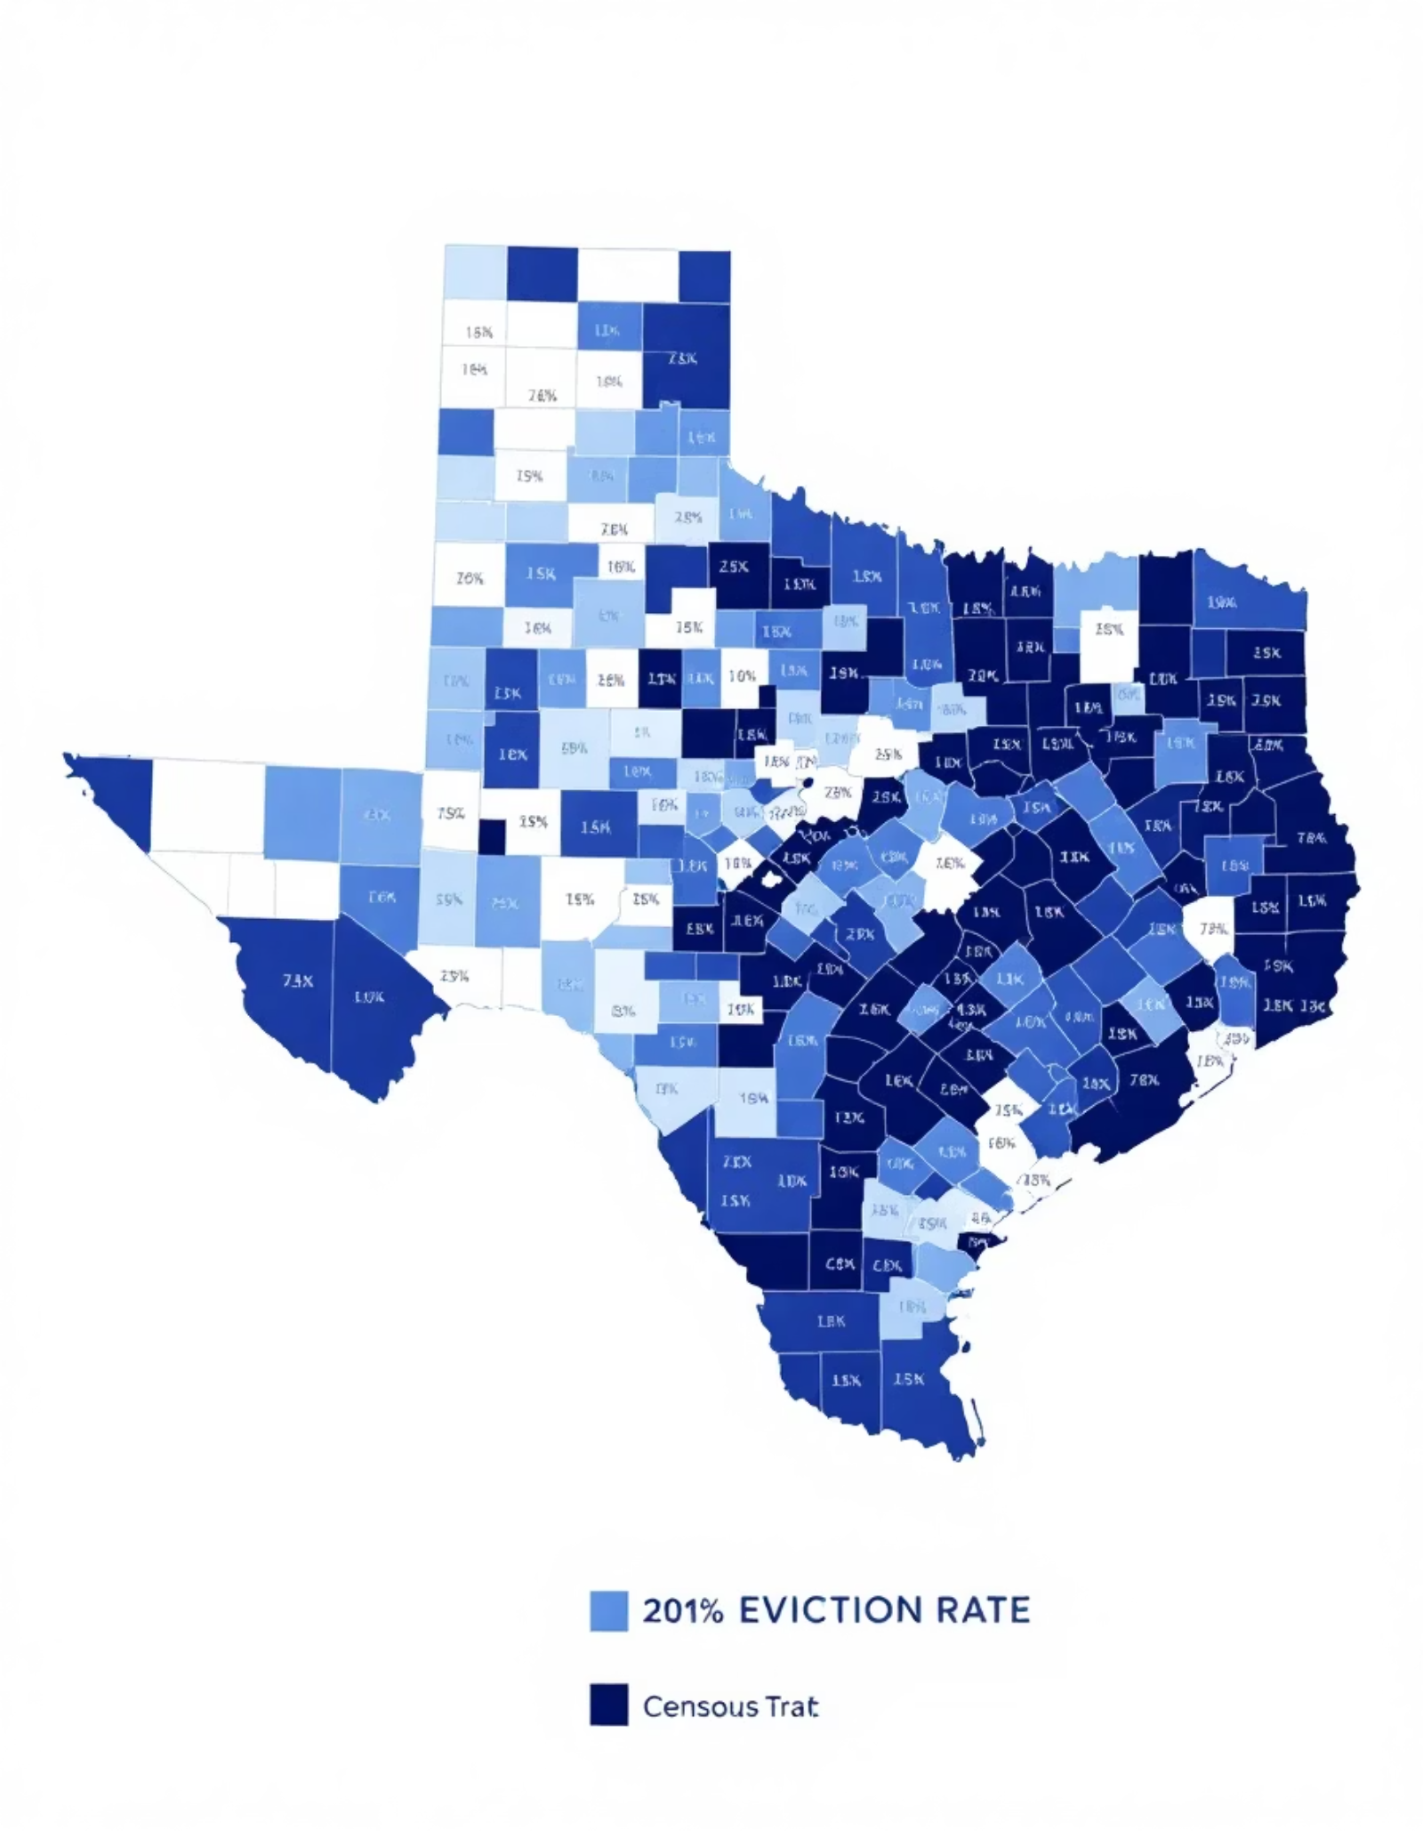
Executive Report: Eviction and Census Data Analysis in Texas (2020-2023)
Objective
Key Findings
Analyze eviction filings in Texas census tracts and assess potential socioeconomic and racial disparities using U.S. Census data (2017-2023) and monthly eviction filings data (2020-2023).
Eviction risk is disproportionately high in Black-majority tracts (3.59 per 1k) compared to Hispanic (1.09) and White (0.86) tracts. Vulnerability indicators are elevated in Black and Hispanic communities.
Top Predictors
Youth Burden, High Renter status, Uninsured × HS or Less, and Renter × Poverty were identified as generalizable, structural markers of vulnerability.
The analysis included feature engineering to assess structural inequities, creating indicators such as Eviction Rate per 1k Residents, Poverty to Education Ratio, and High Renter Flag. Temporal trends showed eviction rates peaked in 2022 across all racial groups, with disparities persisting year-over-year.
Fairness evaluation metrics revealed the model underestimates eviction risk for White and Hispanic tracts but consistently underperforms for Black-majority areas. Recommended next steps include expanding to predictive modeling, integrating intervention data, and applying similar methodology to other states.

