Slide 1


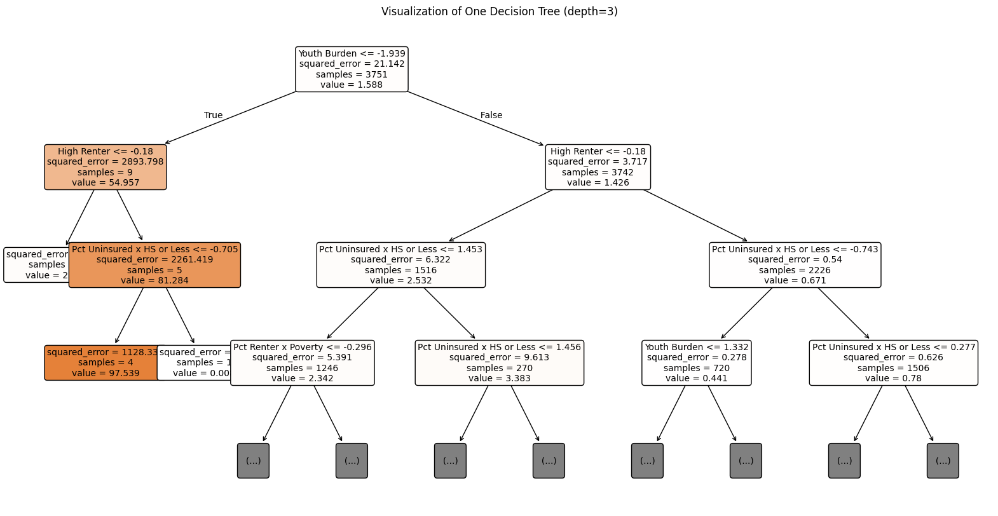
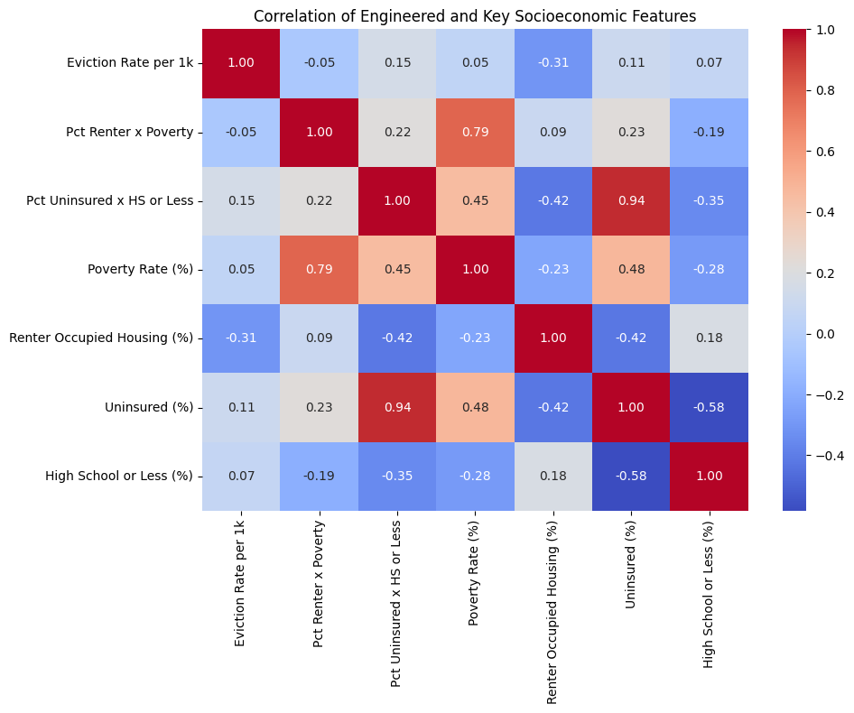
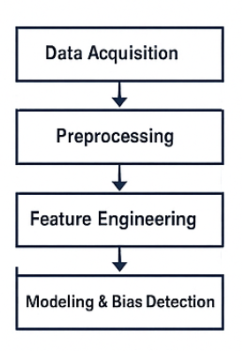
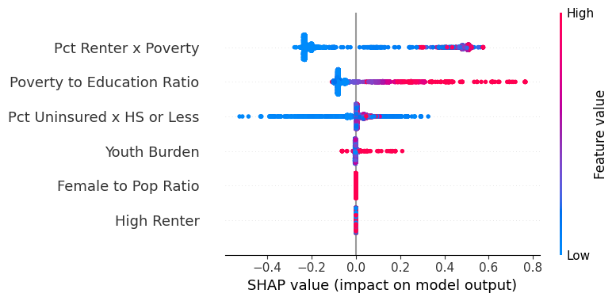
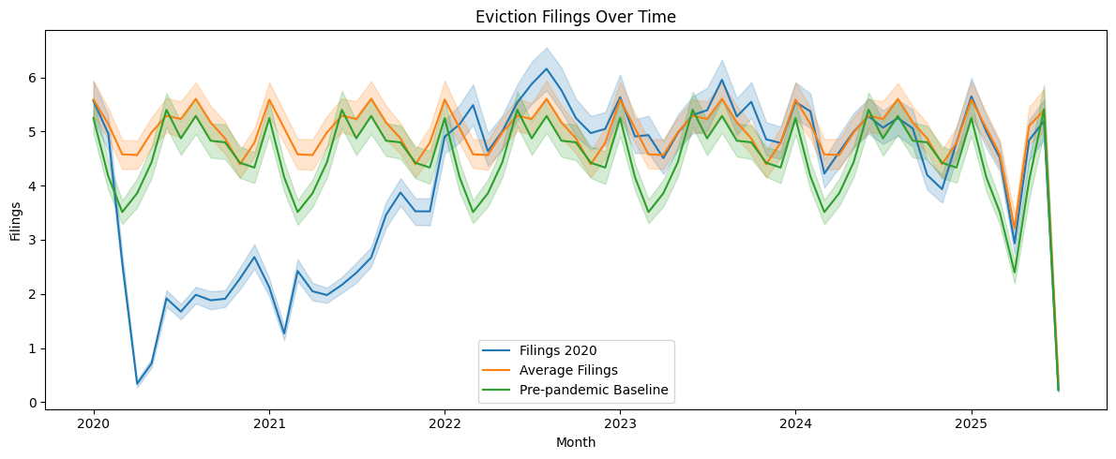
Eviction Disparities in Texas (2020–2023): A Socioeconomic and Racial Lens
Insert Program Logo
Some conferences require email and phone number.
Israel Vargas and Dr. Maryam Tabar
israelagustin.vargasmonroy@my.utsa.edu
a01796556@tec.mx
+52 557 111 3652
Abstract
Methods
Results
In this study, we explore socioeconomic and racial disparities in eviction filings across Texas from 2020 to 2023. Using tract-level data from the Eviction Lab and the U.S. Census Bureau (2017–2023), we identify key factors associated with higher eviction risks.
Our analysis includes data merging, feature engineering, and visualization to assess patterns over time and space.
Results suggest that communities with higher percentages of Black and Hispanic residents, elevated poverty and uninsured rates, and low homeownership are disproportionately affected by evictions. We also discuss model performance and potential biases. This work emphasizes the importance of ethical modeling and data justice in housing policy research.
We combined two main data sources:
Eviction Lab's eviction filings from 2020 to 2023, and
American Community Survey (ACS) data from 2017 to 2023.
We engineered tract-level features such as:
Percent Black, Hispanic, uninsured, below poverty line, and renter-occupied households.
We then joined and cleaned the datasets for alignment by tract and time.
We visualized spatial patterns, assessed correlations, and trained simple decision tree classifiers to identify key predictors of eviction risk. Finally, we applied SHAP values to evaluate potential bias in model explanations.
Correlation Matrix for our F.E. metrics
Introduction (Background)
Figure 1. Data Pipeline. Image created to illustrated the data processing for this work.
Data Sources:
Eviction Lab: Monthly eviction filings (2020–2023)
US Census ACS 5-Year Estimates: Socioeconomic indicators (2017–2023)
Preprocessing:
Standardized tract-level, missing data and harmonized column names
Feature Engineering:
% uninsured,
% poverty,
% Black/Hispanic
% renters
Bias Assessment:
Explored correlation of demographic attributes with eviction rates
Figure 3. This plot explains which features most influence the eviction risk classifier’s predictions, using SHAP values. Engineered features that capture intersections of social disadvantage (e.g., poverty & education) are strong predictors of eviction risk. But care must be taken—some of these features are proxies for race or inequality, which raises fairness concerns.
Housing instability, particularly eviction, disproportionately affects marginalized populations. Studies have shown strong links between racial and socioeconomic inequality and eviction risk. This research aims to deepen understanding of such disparities in Texas by integrating eviction records with census tract-level demographics.
Our objective is to identify correlational patterns, visualize geographic disparities, and evaluate risks of model bias. By uncovering patterns and proposing bias-aware modeling strategies, we seek to contribute to equitable policy recommendations.
Eviction is a key driver of housing insecurity and long-term social inequality. It is associated with poor health, job instability, educational disruption, and increased homelessness1.
Black and Hispanic renters face eviction at disproportionately high rates, even after controlling for income and family status23.
Figure 2. This heatmap visualizes pairwise Pearson correlations. Poster Insight: Many social vulnerabilities are intertwined—poverty, low education, and lack of insurance tend to co-occur and shape eviction risk indirectly.
Conclusions (Disc. or Summary)
SHAP values – impact model
Socioeconomic and racial disparities significantly correlate with eviction risk.
Even simple models can perpetuate bias if sensitive attributes are used.
Transparent model interpretation is key to fair housing analytics.
Geospatial visualization is a powerful tool to guide policy and intervention.
Communities of color and economically vulnerable areas face the greatest eviction risks—ethical AI must mitigate, not amplify, these patterns.
Results
Background/Literature Review
Our analysis uncovered consistent socioeconomic and racial disparities in eviction filings across Texas census tracts from 2020 to 2023.
Correlations: Strongest predictors include poverty rate, % Black and Hispanic population, and % renters.
Modeling: Decision Trees and Logistic Regression used to classify risk.
Bias Detection: SHAP analysis revealed model sensitivity to race-related features.
Geospatial Analysis: Certain tracts in Houston, Dallas, and San Antonio show significantly higher eviction filings.
Matthew Desmond’s work has highlighted eviction as a systemic racial and economic injustice, not merely a result of individual financial hardship2.
The Eviction Lab has enabled national-level tracking of eviction trends, yet localized studies at the census tract level remain limited, especially in Texas, a state with rapid urban growth and deep structural disparities4.
There is growing concern that predictive models in housing risk assessment can encode and amplify racial bias if socio-demographic features are used without transparency and fairness checks5.
This study addresses that gap by integrating geospatial data, socioeconomic indicators, and ethical modeling to assess eviction disparities in Texas communities.
Figure 3. This plot explains which features most influence the eviction risk classifier’s predictions, using SHAP values. Engineered features that capture intersections of social disadvantage (e.g., poverty & education) are strong predictors of eviction risk. But care must be taken—some of these features are proxies for race or inequality, which raises fairness concerns.
References
ReferencesDesmond, M. (2012). Eviction and the Reproduction of Urban Poverty. American Journal of Sociology, 118(1), 88–133
Desmond, M. (2016). Evicted: Poverty and Profit in the American City. Crown Publishing Group.
Hepburn, P., Louis, R., & Desmond, M. (2020). Racial and Gender Disparities among Evicted Americans. Sociological Science, 7, 649–662.
The Eviction Lab. (2023). Eviction Tracking System for Texas. https://evictionlab.org/
Barocas, S., Hardt, M., & Narayanan, A. (2019). Fairness and Machine Learning: Limitations and Opportunities. fairmlbook.org
Acknowledgements
This research was partially funded by the Department of Education Ronald E. McNair Scholars Grant at the University of Texas at San Antonio. We thank the Eviction Lab and U.S. Census Bureau for making the data available.

