Slide 1
Nursing Foundations

Slide 2
O b j e c t i v e s
On completion of this chapter, the audience should be able to:
Find the nursing origins.
Identify Nightingale’s Contributions.
Identify nursing definitions mainly Virginia Henderson.
Determine the nursing theory concepts.
Identify the educational ladder.
Determining the Nursing roles.
Ability to define the delegation needs.
Define the unique nursing skills

Slide 3
ORIGINS OF NURSING
Nursing is one of the youngest professions but one of the oldest arts.
It evolved from the familial roles of nurturing and caretaking.
Early responsibilities included assisting women during childbirth, suckling healthy newborns, and
ministering to the ill, aged, and helpless within households and surrounding communities.
Its hallmark was caring more than curing.

Slide 4
Nightingale’s Contributions
Nightingale changed the negative image of nursing to a positive one.
She is credited with the following:
Training women for future work
Selecting only those with upstanding characters as potential nurses
Improving sanitary conditions for the sick and injured
Significantly reducing the death rate of British soldiers
Providing classroom education and clinical teaching
Advocating that nursing education should be lifelong

Slide 5
Nursing Definitions
Nursing is; an Art, Science & Spirit
Art ; At first, the training of nurses consisted of learning the art (ability to perform an act skillfully) of nursing.
Science ; A science (body of knowledge unique to a particular subject)
Spirit ; the fine sense in side nurse as human (patient is as me, my mom, my dad, my brother …)
The combination of art, science and spirit make Super Nurse

Slide 6
Nursing Definitions
Virginia Henderson (1897 to 1996).
Her definition, adopted by the International Council of Nurses, broadened the description of
nursing to include health promotion, not just illness care. As stated in 1966,

Slide 7
Virginia Henderson Definition
As stated in 1966,
The unique function of the nurse is to assist the individual, sick or well, in the performance of those
activities contributing to health or its recovery (or to a peaceful death) that he could perform unaided if
he had the necessary strength, will or knowledge. And to do this in such a way as to help him gain
independence as rapidly as possible.

Slide 8
Virginia Henderson Definition
As stated in 1966,
إن وظيفة التمريض الأساسية هي مساعدة الفرد إن كان مريضا أو سليما، ومساعدته على أساس القيام بالنشاطات الصحية التي تؤدي إلى تعزيز الصحة أو الوصول إلى الشفاء (أو حتى الوصول إلى الموت بأمان). وتلك النشاطات التي كان يقوم بهال الفرد دون مساعدة من أحد إن كان يمتلك العلم والقدرة والرغبة، ونساعد الانسان بالطريقة المثلى للوصول بالإنسان للقيام بتلك النشاطات باستقلالية بأسرع وقت ممكن.
النشاطات هي:
الأكل والشرب، الحمام، الحركة ... ونسميها النشاطات الصحية اليومية
Activities of daily livings (ADLs)

Slide 9
Integrating Nursing Theory
The word theory (opinion, belief, or view) comes from a Greek word that means vision.
Nursing has undergone a similar scientific review. Florence Nightingale and others have examined the relationships among
humans,
health,
the environment, and
nursing.
The outcome of such analysis becomes the basis for nursing theory (proposed ideas about what is involved in the process called nursing).

Slide 10
THE EDUCATIONAL LADDER
Years | Degree | #
6 – 8 months training | Aid Nurse | 0
2 Academic years | Practical Nurse (LPN) | 1
3 Academic years | Registered Staff Nurse (RN) | 2
4 Academic years | Bachelor Degree in Nursing (BSN) | 3
4 Academic years + 2 Academic years | Master Degree in Nursing (MSN) | 4
4 Academic years + 2 + 3 – 5 Academic years | Philosophy of Doctorate (Ph.D.) | 5
Ph.D. + | Post Doctorate Level Scientist | 6
Not bounded and my begin in any stage from BSN | Scientist | 7
Unlicensed assistive personnel (UAP) like family memebers

Slide 11
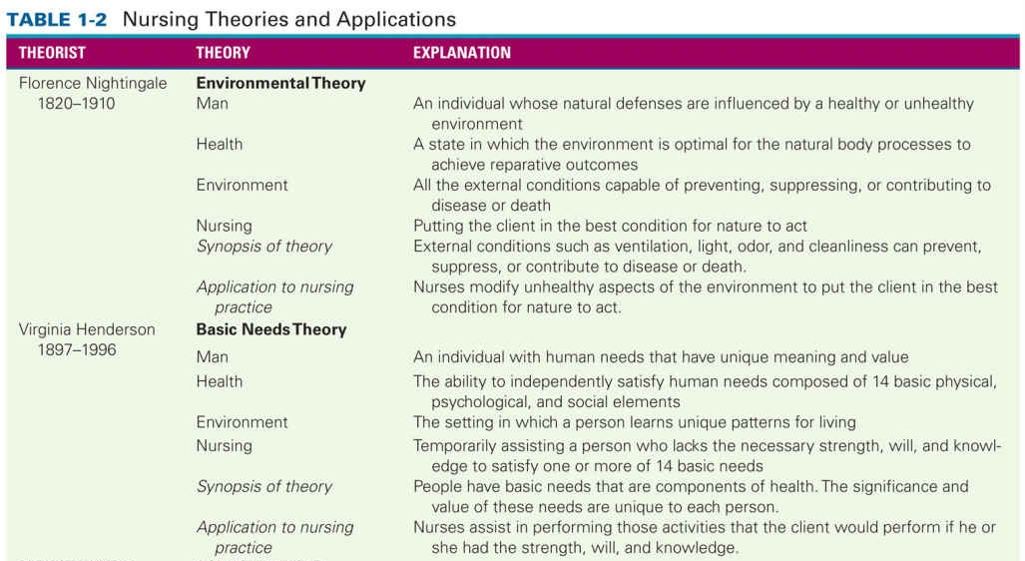
Integrating Nursing Theory cont.

Slide 12
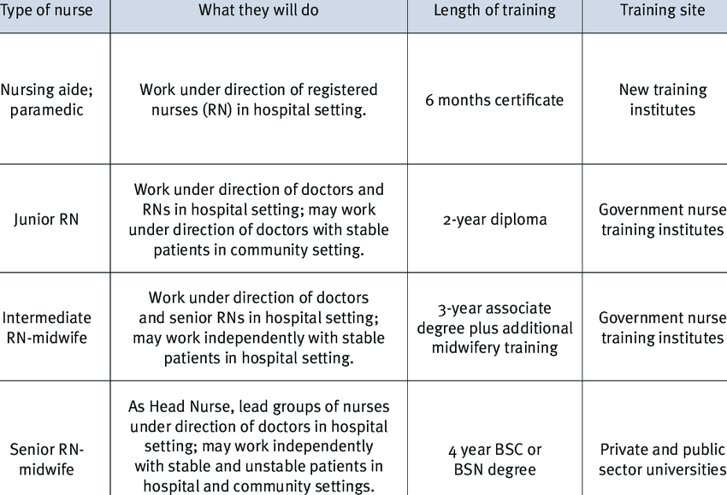

Slide 13
Delegating Nursing Work
Regardless of whether it is an RN delegating to an LPN or a UAP or an LPN delegating to an UAP, delegation requires adhering to the following five guidelines:
Right task: matching the client’s needs with the caregiver’s skills
Right circumstance: ensuring that the situation is appropriate
Right person: knowing the unique competencies of the caregiver
Right directions and communication: providing sufficient information
Right supervision and evaluation: being available for assistance; validating

Slide 14
Roles of a Nurse
Coordinator
Communicator
Teacher
Counselor
Manager
Leader
Team player
Motivator
Delegator
Critical thinker
Innovator
Researcher
Advocate

Slide 15
UNIQUE NURSING SKILLS
Assessment Skills
Caring Skills
Counseling Skills
Comforting Skills

Slide 16
Assessment Skills
Before the nurse can determine what care a person requires, he or she must determine the client’s needs and problems.
This requires the use of assessment skills (acts that involve collecting data), which include interviewing, observing, and examining the client, and in some cases, the client’s family

Slide 17
Caring Skills
Caring skills (nursing interventions that restore or maintain a person’s health) may involve actions as simple as assisting with activities of daily living (ADLs).
(ADLs), the acts that people normally do every day, for example, bathing, grooming, dressing, toileting, and eating.

Slide 18
Counseling Skills
Counseling Skills
Nurses implement counseling skills (interventions that include:
communicating with clients,
actively listening during exchanges of information,
offering pertinent health teaching,
and providing emotional support)
Because clients do not always communicate their feelings to strangers, nurses use empathy (intuitive awareness of what the client is experiencing) to perceive the client’s emotional state and need for support. This skill differs from sympathy (feeling as emotionally distraught as the client).
Empathy helps the nurse become effective at providing for the client’s needs while remaining compassionately detached.

Slide 19
Comforting Skills
Nightingale’s presence and the light from her lamp communicated comfort to the frightened British soldiers in the 19th century.
The nurse uses comforting skills (interventions that provide stability and security during a health-related crisis)

Slide 20



