Slide 1
Data Analysis - Restaurant Analysis

Slide 2
Data Cleaning Using Python
Fill Missing Values
Remove Rows or Columns With Missing Values
Naming Conventions
Replace missing numerical values with the mean, median, or mode of the column.
Drop rows with few or crucial missing data, and drop non-essential columns with many missing values.
standardize names for variables, columns, and files to ensure consistency, readability, and easier collaboration. Use clear, descriptive, and uniform formats
Remove Duplicates
Numeric Outliers
Remove Spaces In Character
eliminate duplicate rows or entries to ensure data accuracy and avoid redundancy in analysis.
identify and handle extreme values that can skew analysis, either by removing them or adjusting based on their relevance.
eliminate unnecessary leading, trailing, or extra spaces in text data to ensure uniformity and avoid processing issues.

Slide 3
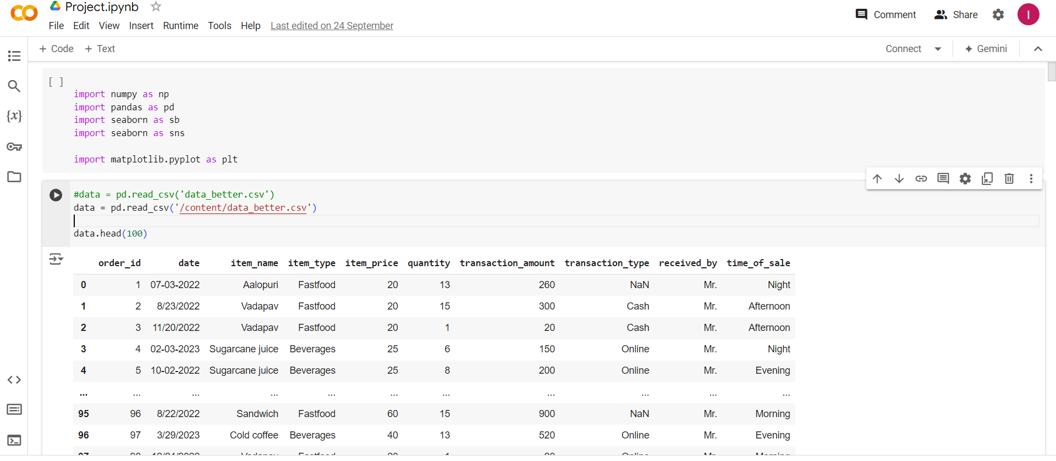
First Read Data

Slide 4
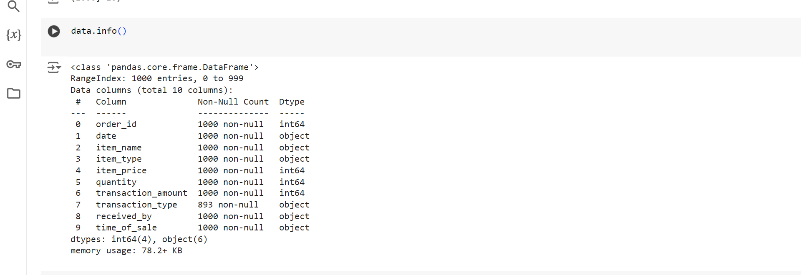
Check data information

Slide 5
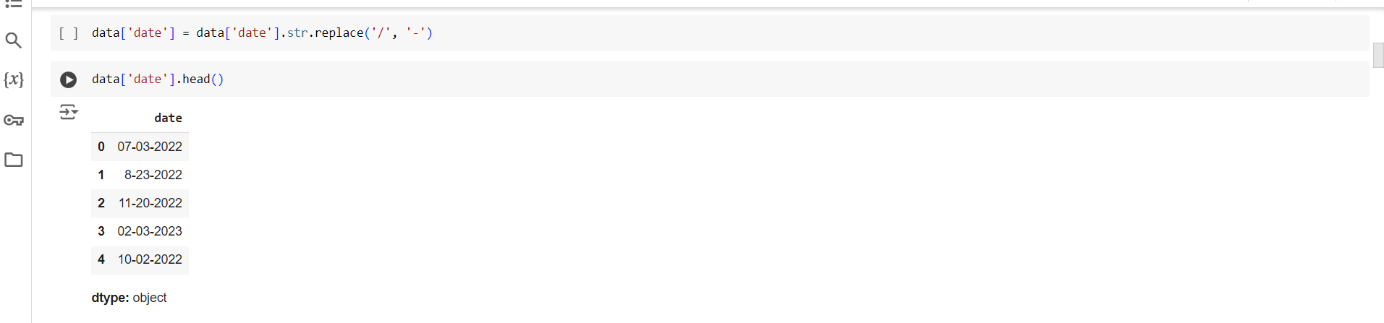
Naming Conventions

Slide 6
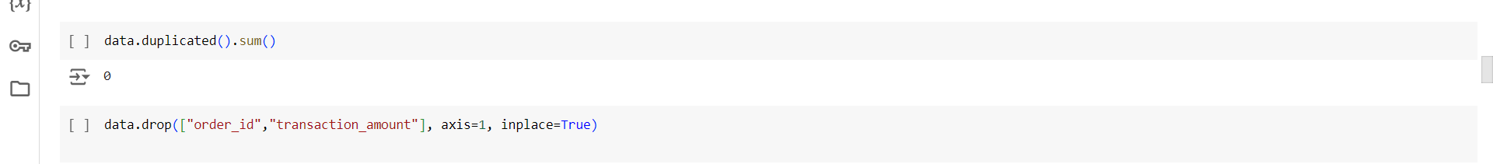
Drop Columns and check Duplicate

Slide 7
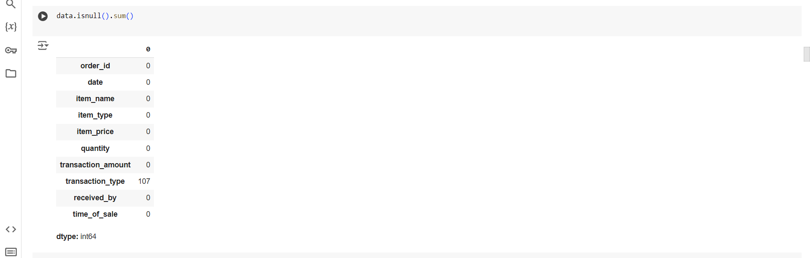
Check Nulls in Columns

Slide 8
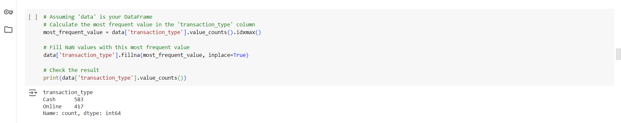
Fill Missing Value

Slide 9
Objectives
01
03
02
04
Calculate New Column
“Total Cost”
Calculate Daily Cost Over Time
Calculate Distribution of Total Cost
Calculate Total Cost by Item Name

Slide 10
01
Calculate New Column “Total Cost”

Slide 11
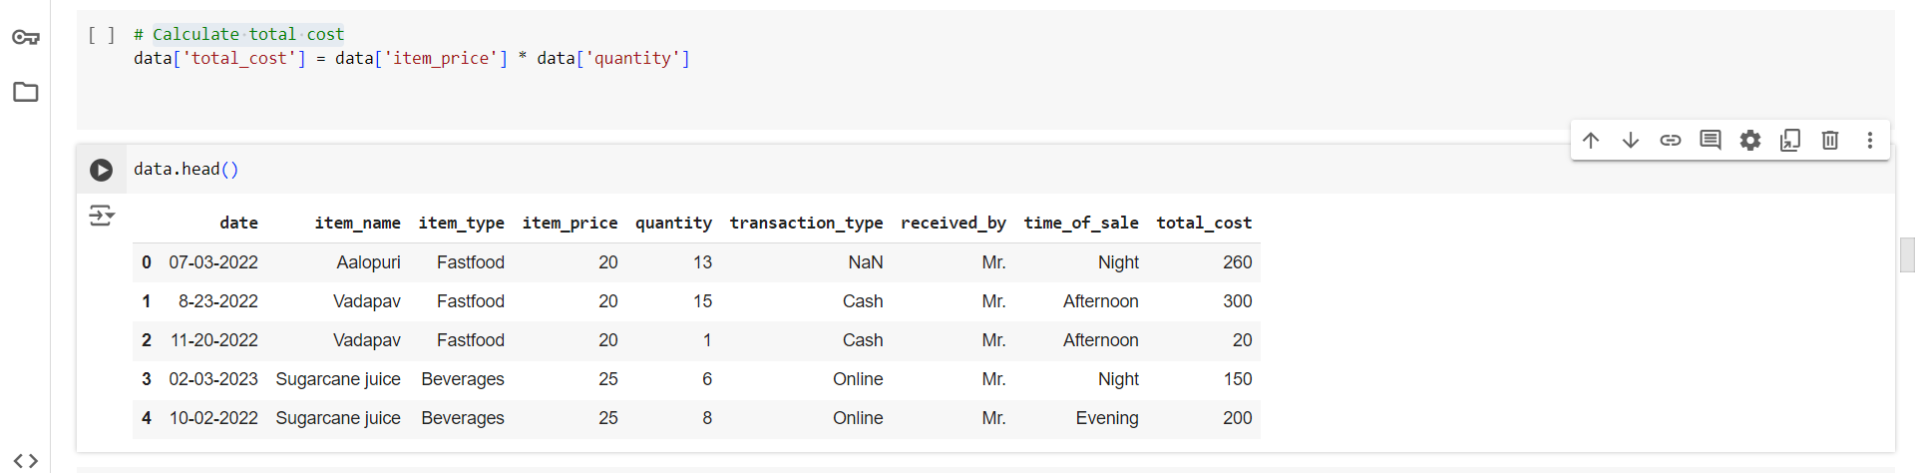
Calculate New Column

Slide 12
02
Calculate Daily Cost Over Time

Slide 13
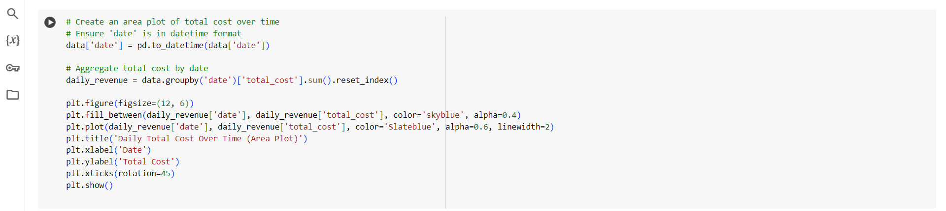
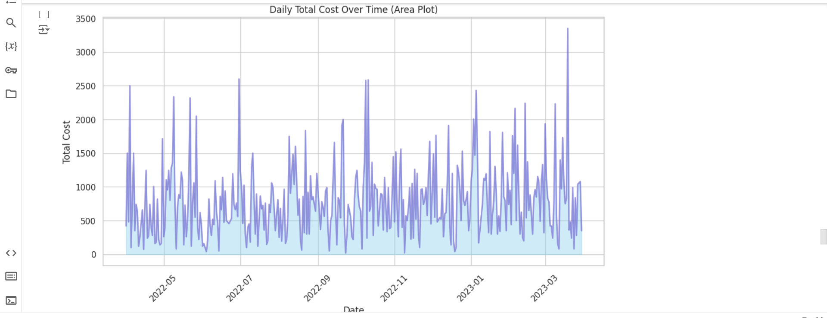
Visualization

Slide 14
03
Calculate Distribution of Total Cost

Slide 15
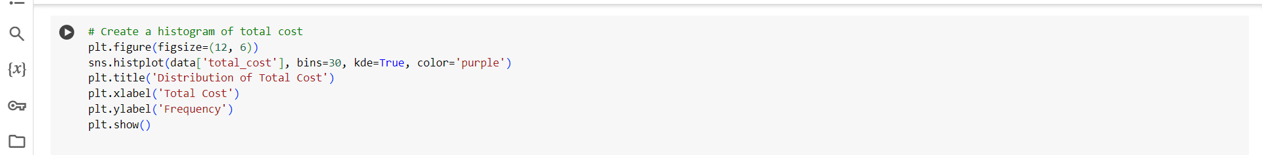
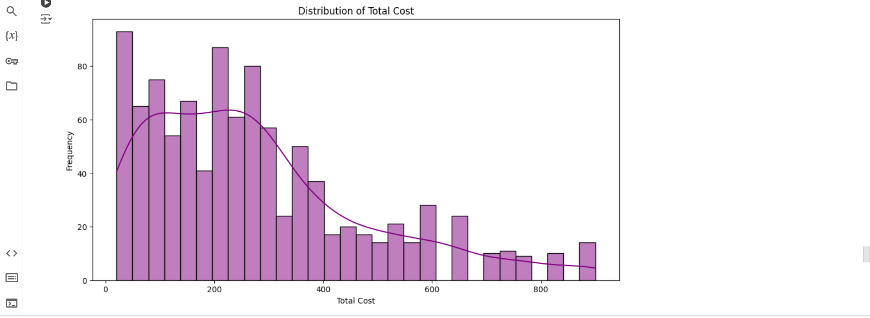
Visualization

Slide 16
04
Calculate Total Cost by Item Name

Slide 17
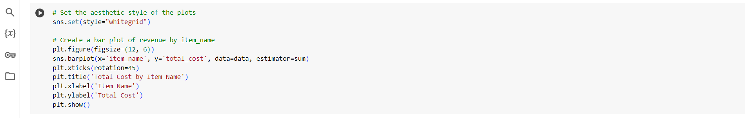
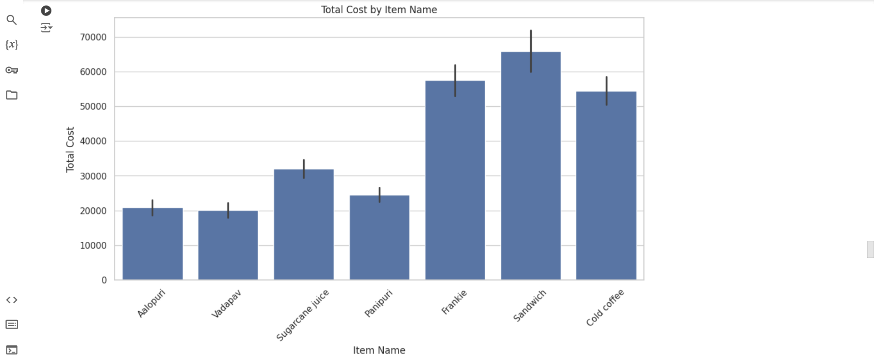
Visualization

Slide 18
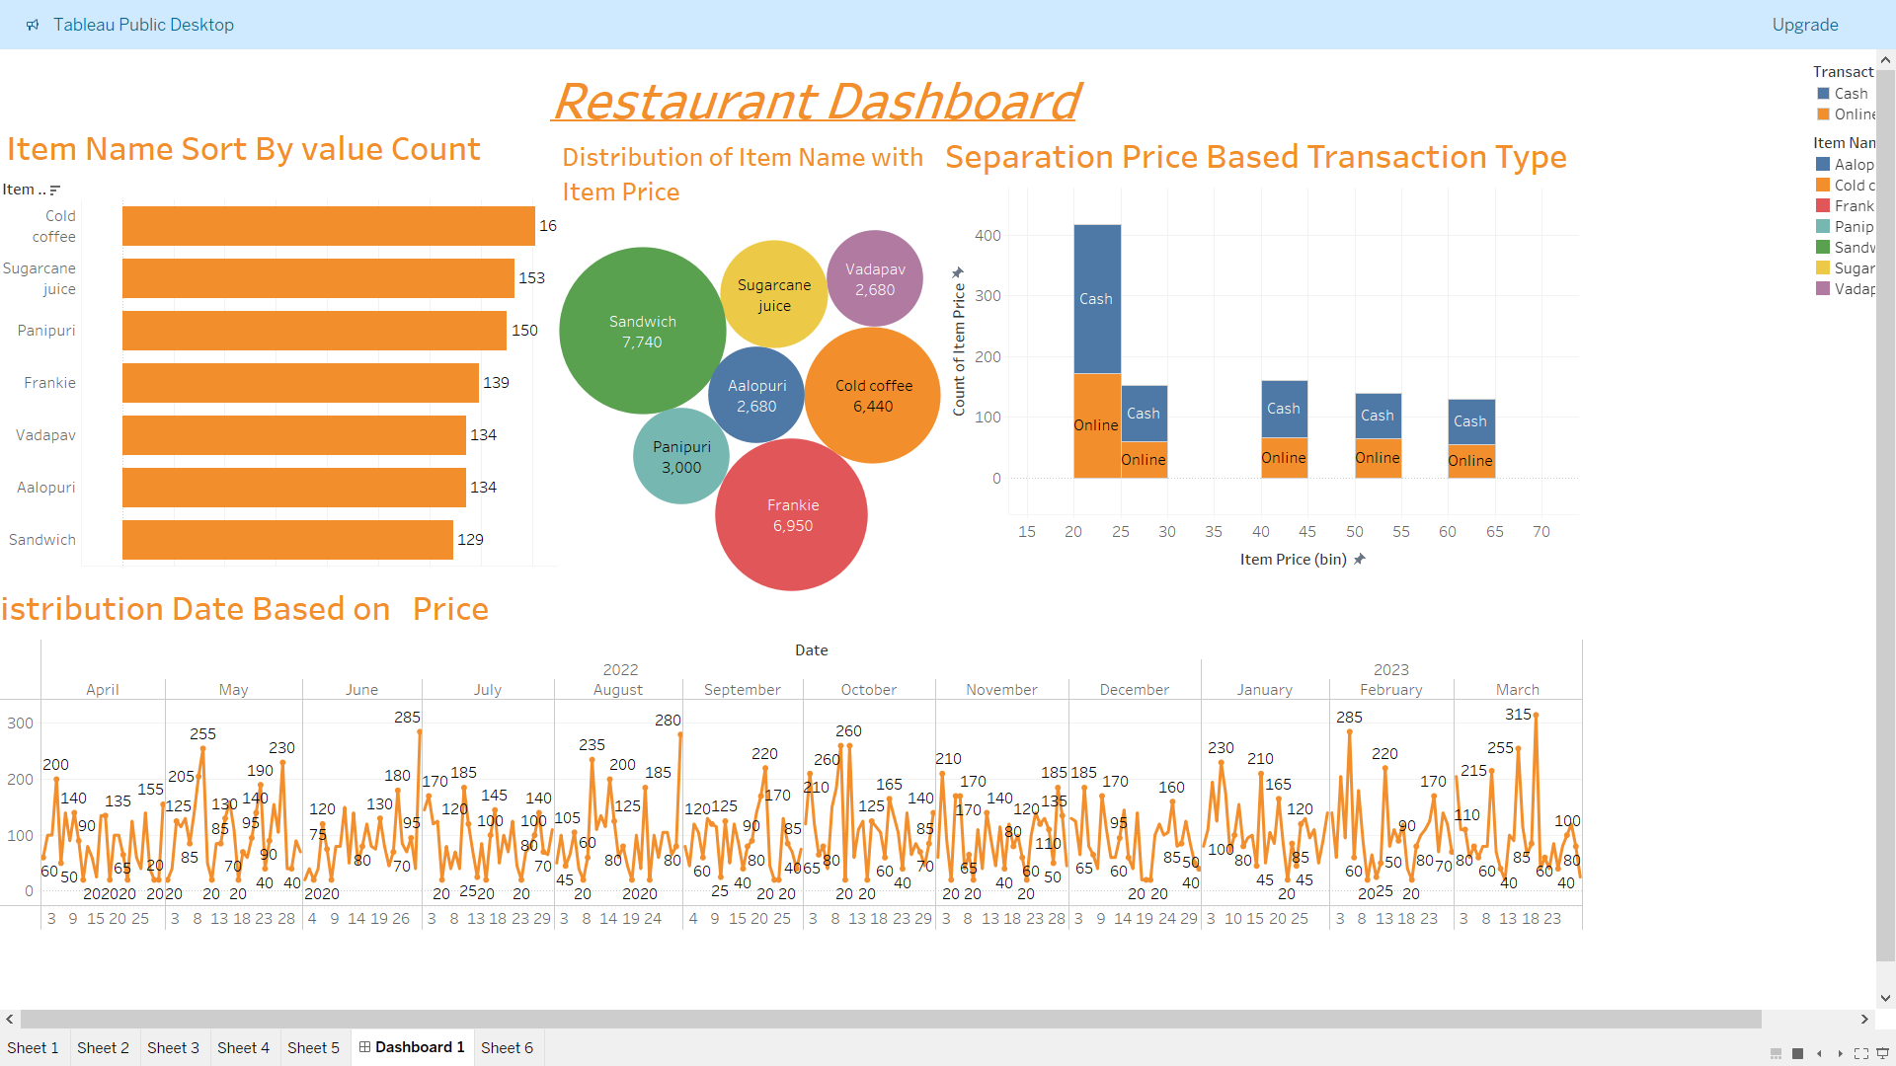

Slide 19
Thanks!

