Slide 1


HONORS PROJECT – CSCI1302
ISRAEL JAUREGUI

Slide 2
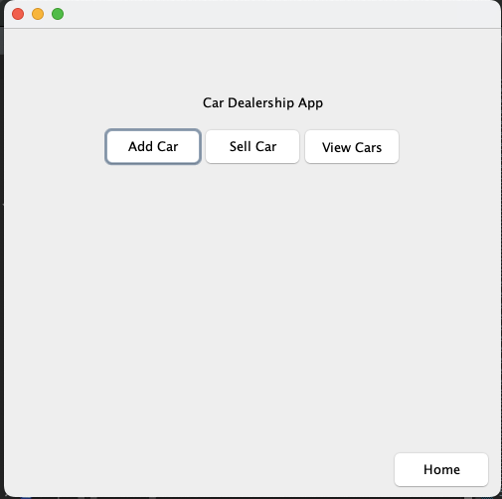
CAR DEALERSHIP
SQL
JAVA SWING
(ArrayLists / 2D Arrays)

Slide 3

SQL
Database software (alternate to writing to files for storing data)
Tables

Slide 4
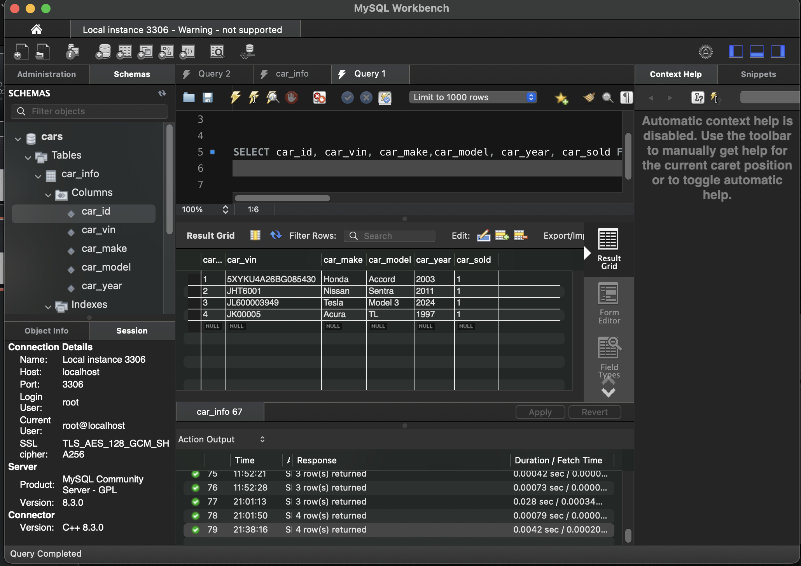
WHY SQL?
Easily Accessible / Doesn’t get deleted after runtime

Slide 5

CHAPTER 25 - Databases

Slide 6
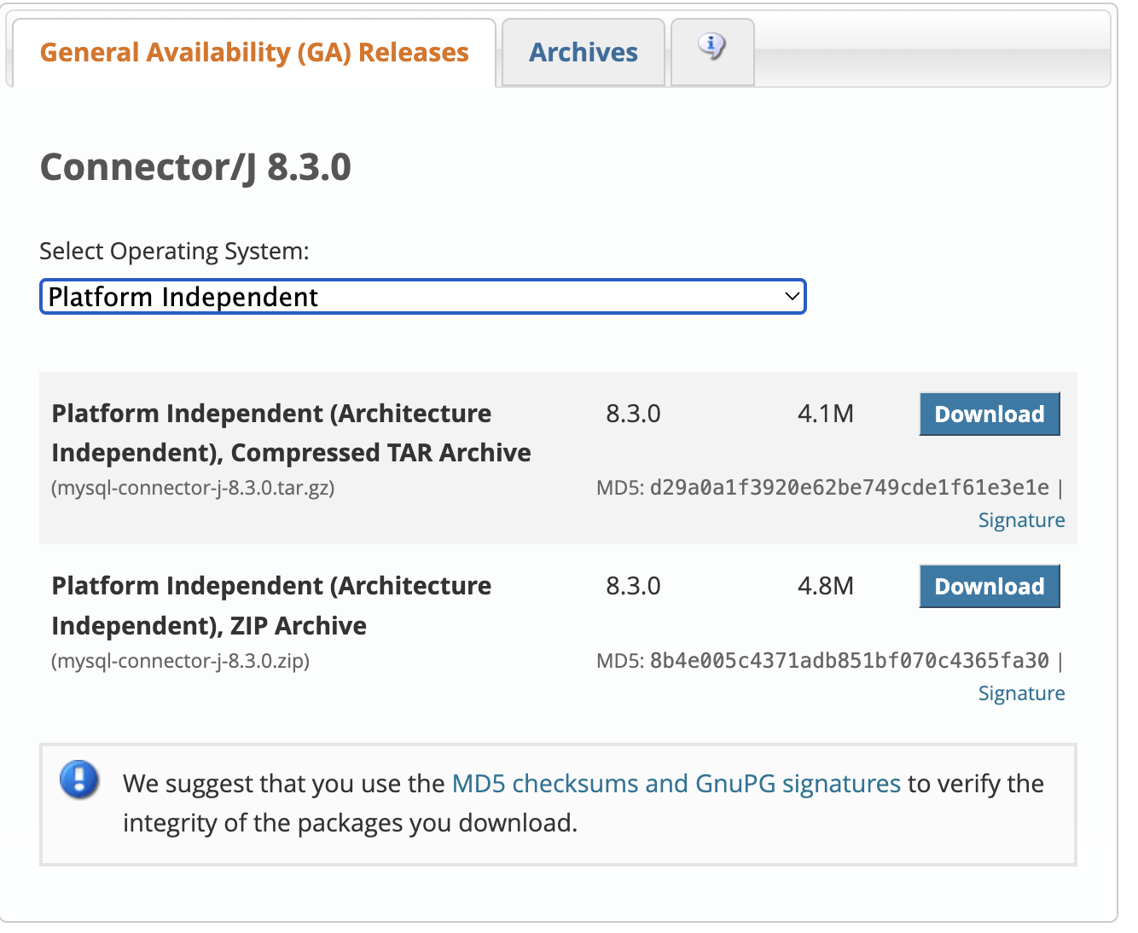
Setup

Slide 7
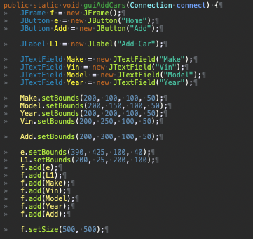
JAVA SWING
GIVES USER A USER FRIENDLY APPLICATION by implementing a graphical user interface
For this i Used Jframes, Jbuttons, Jlabels and JTextfields

Slide 8

JAVA SWING SETUP
EASY https://www.javatpoint.com/java-swing

Slide 9
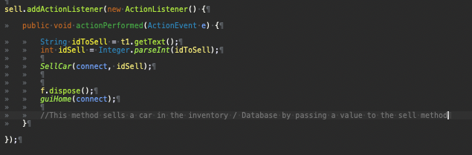
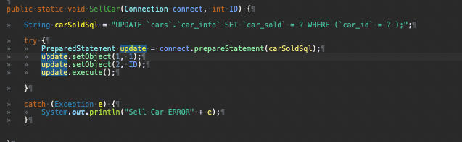
HOW DOES IT WORK?
Java Swing: Action listeners are used to add logic to gui
Java SQL: used to query or alter a
SQL database
Uses: Prepared statements (alter)
resultSets (query)
Connection (link to DB)

Slide 10

Lets go ahead and demo the program
← Java mascot (DUKE)

Slide 11
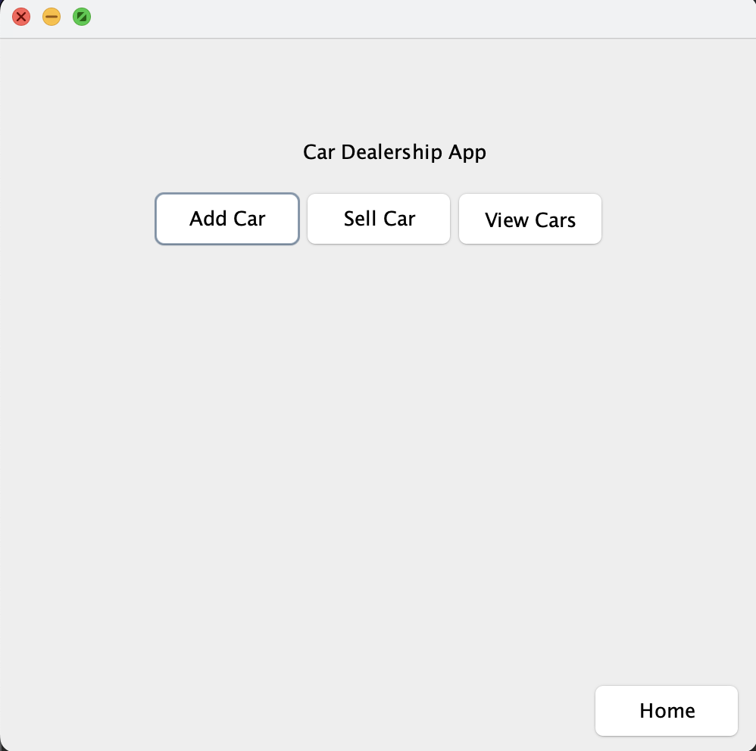
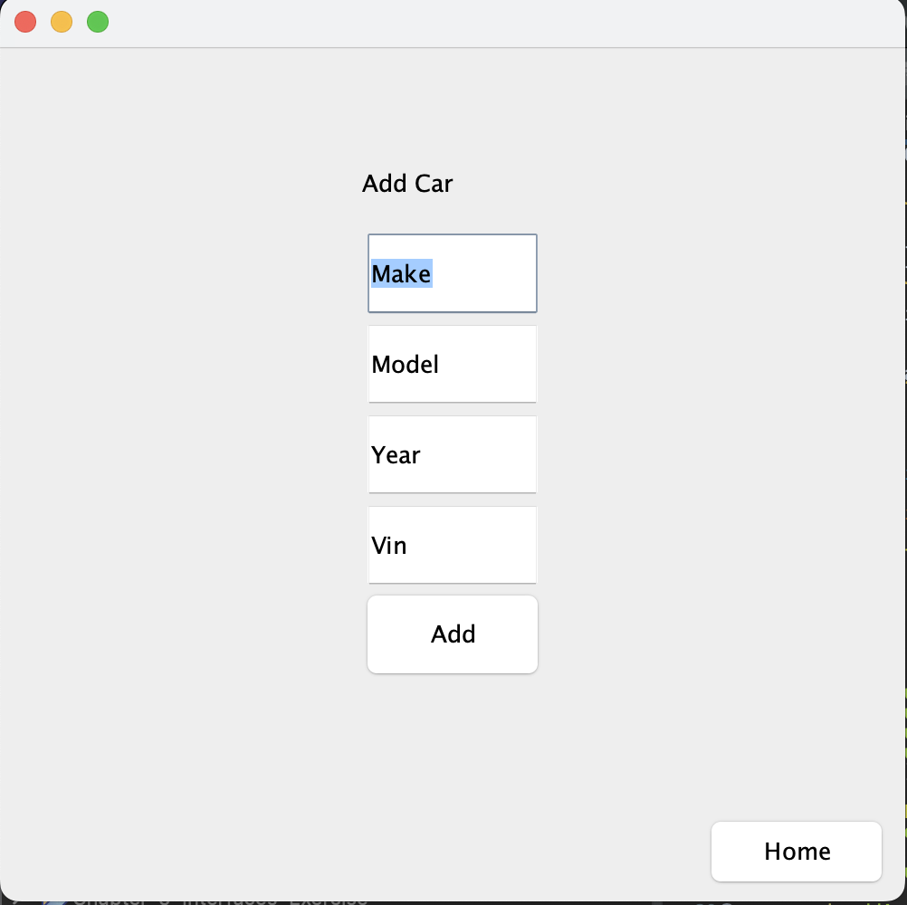
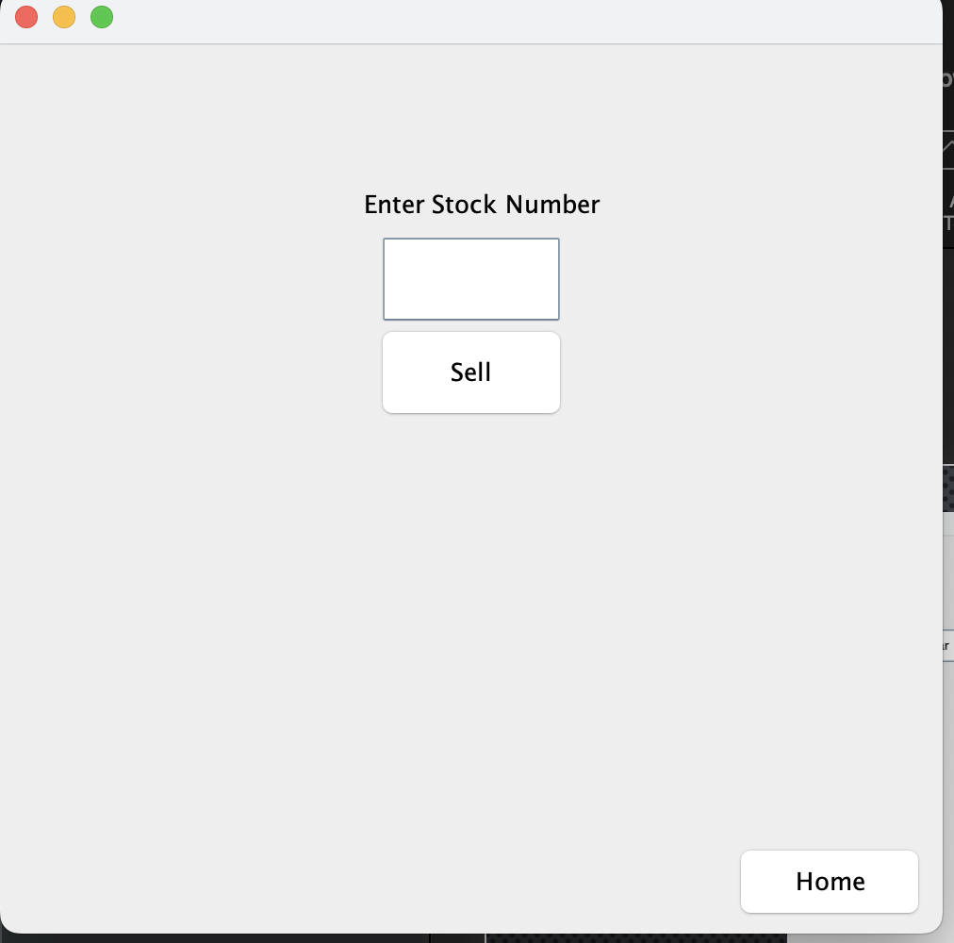
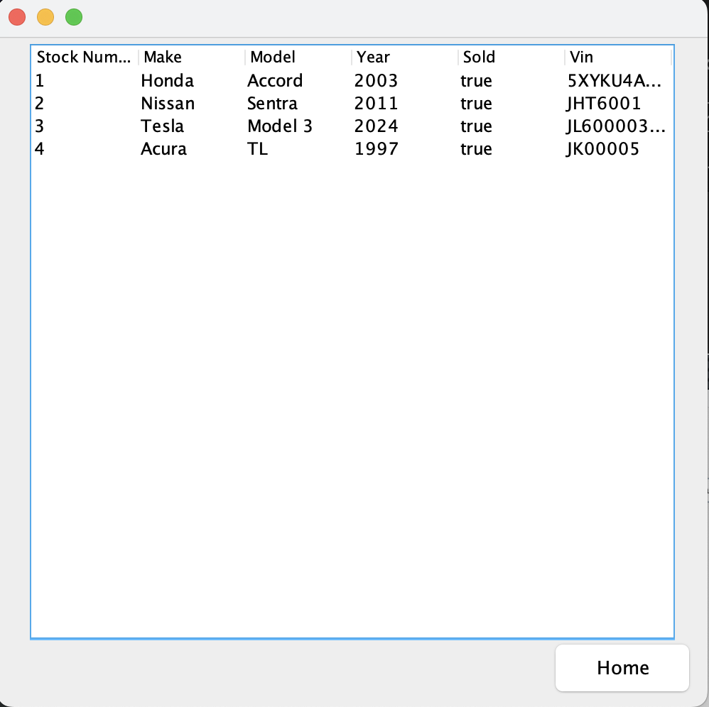
SAMPLE IMAGES OF PROGRAM

