Slide 1
Visualization

Slide 2
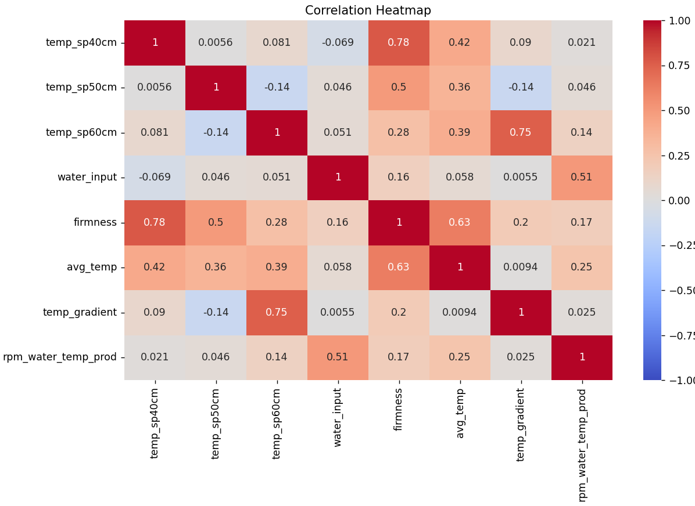

Slide 3
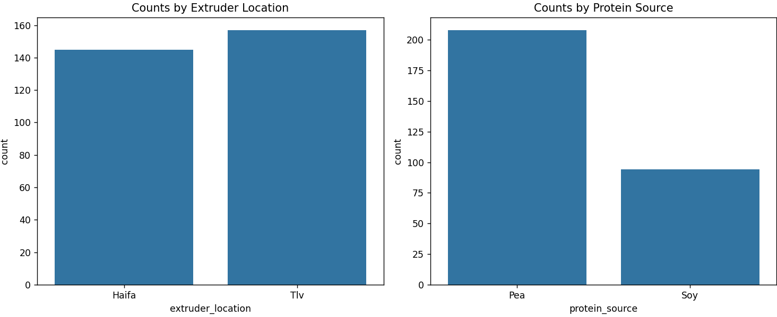

Slide 4
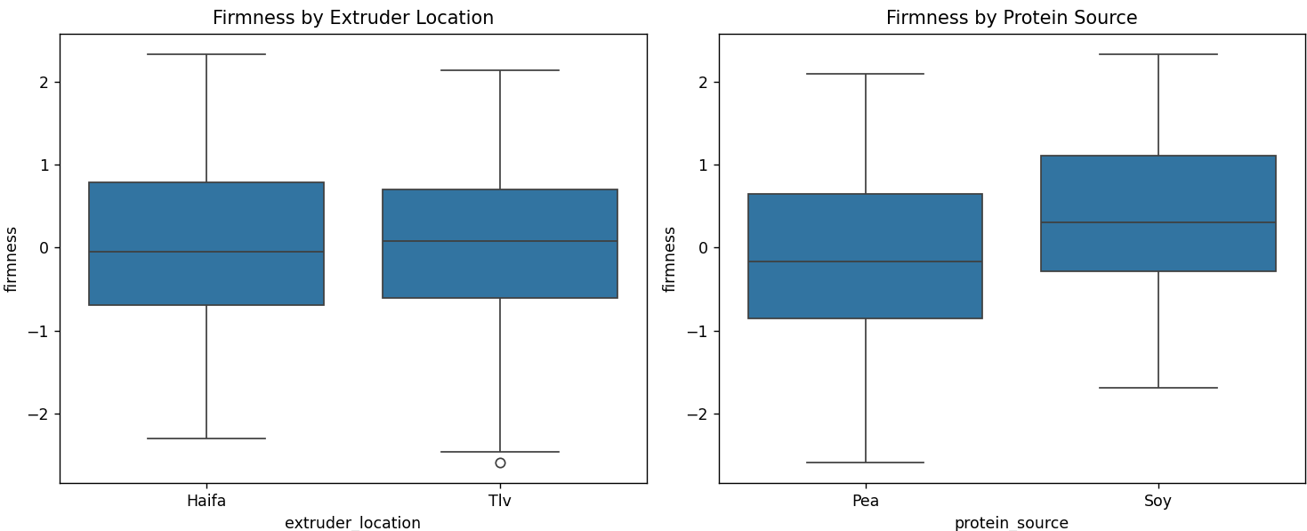

Slide 5
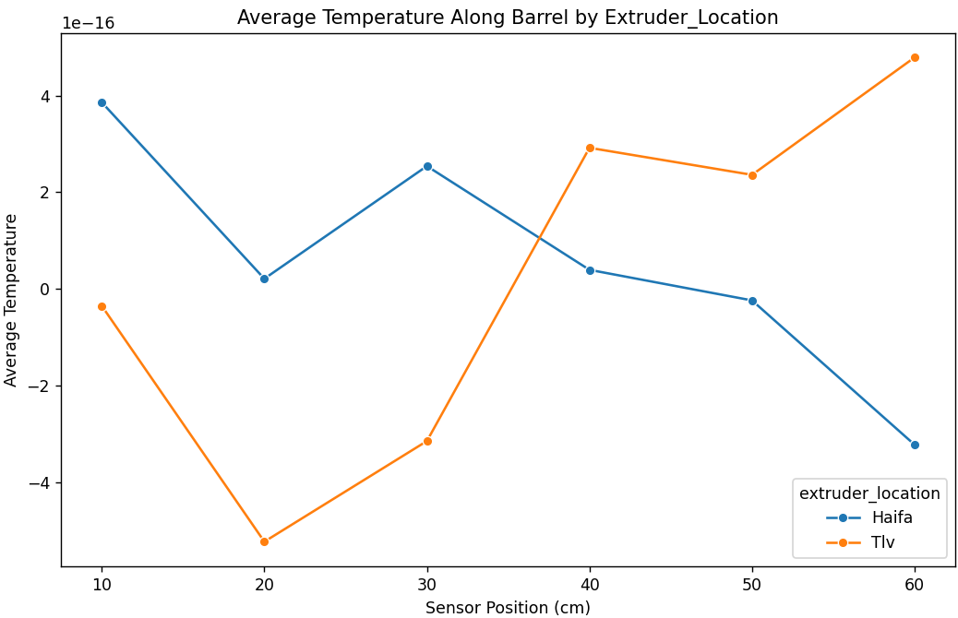

Slide 6
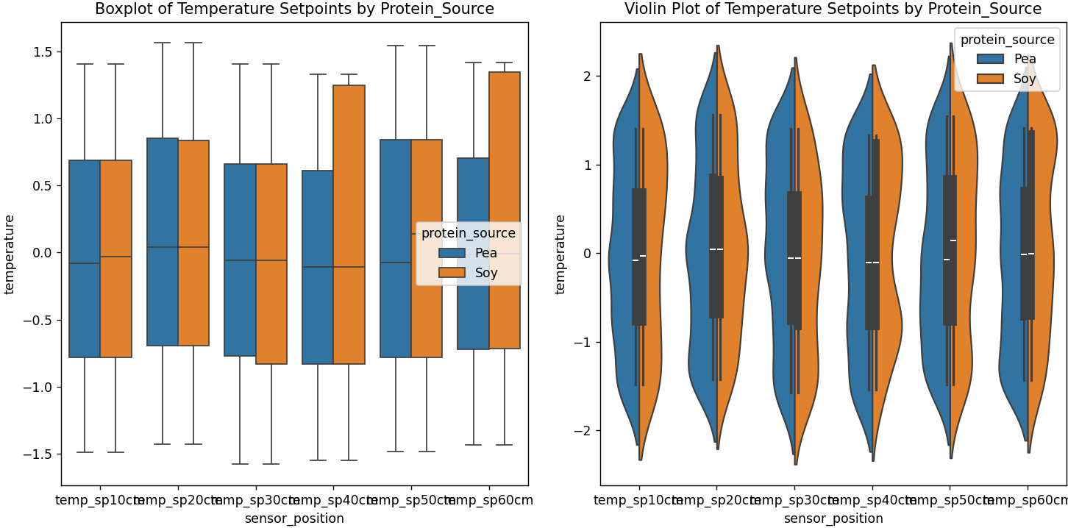

Slide 7
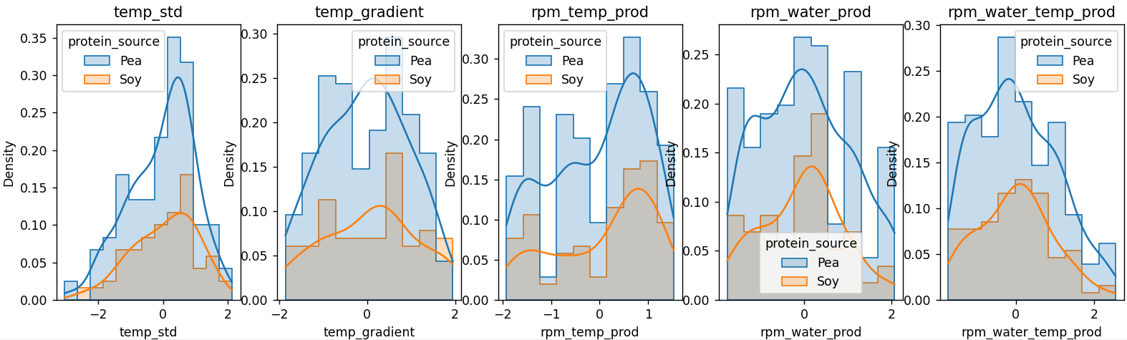

Slide 8
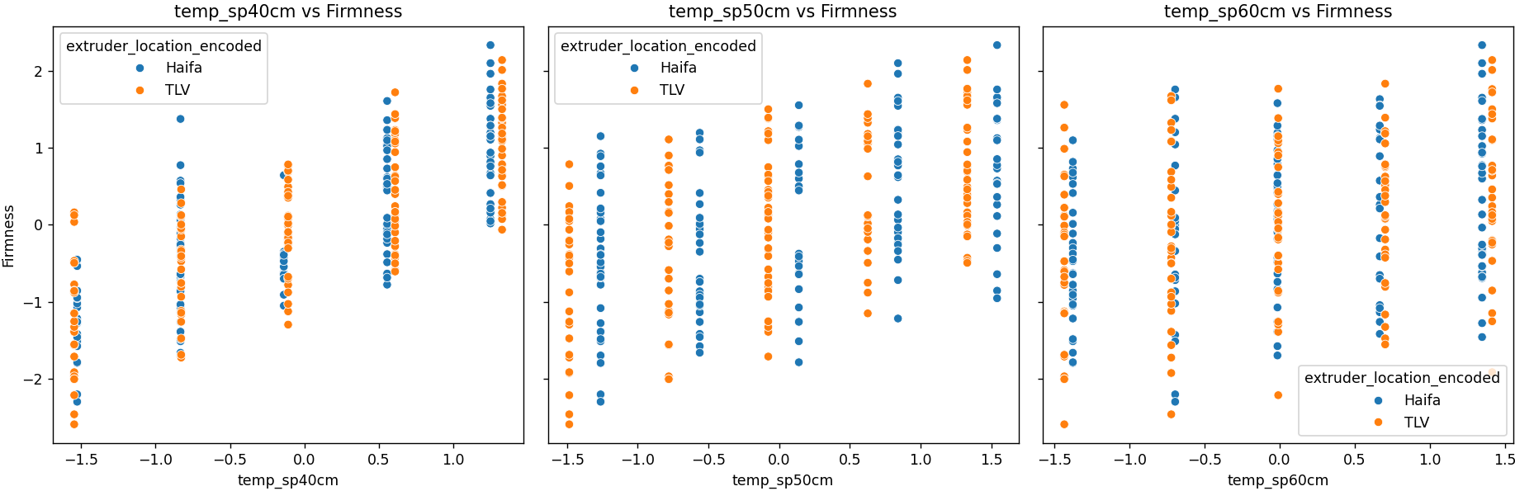

Slide 9
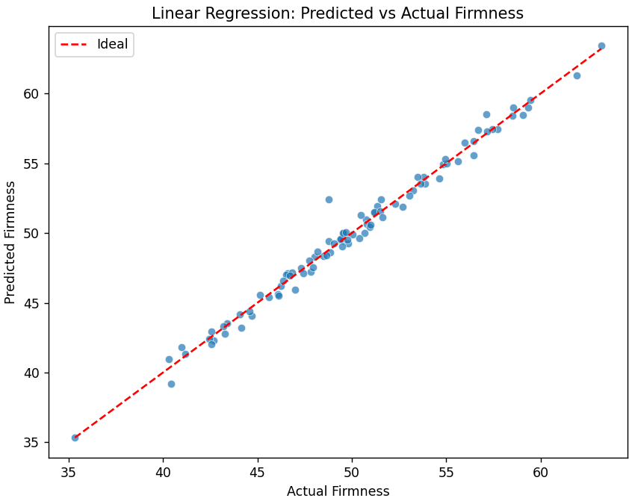

Slide 10
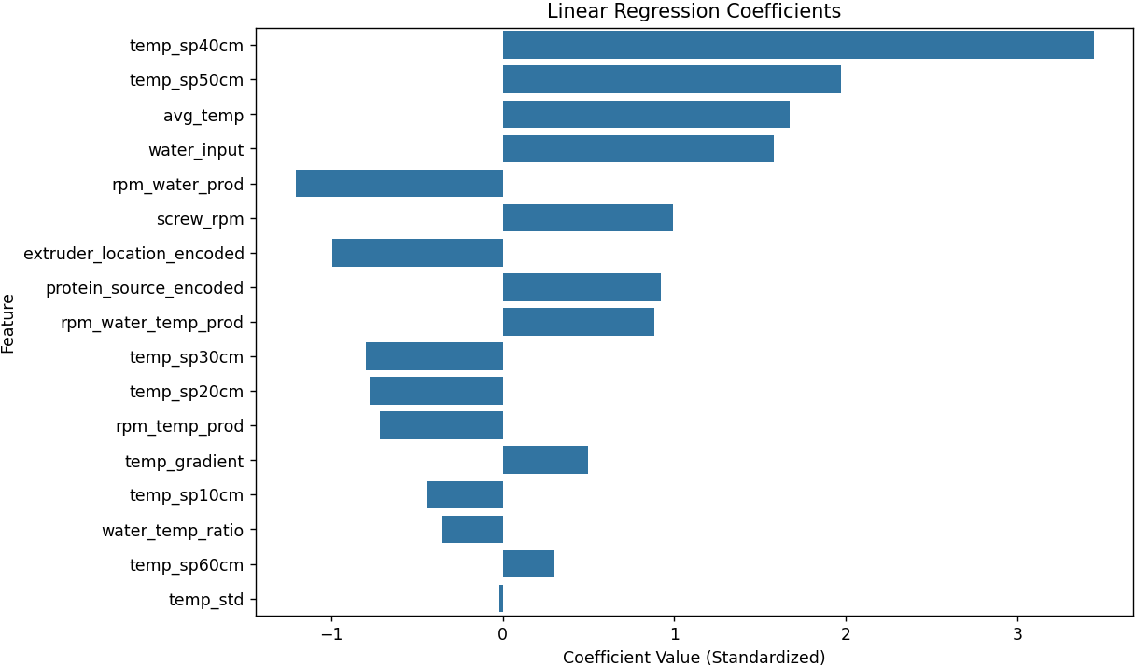

Slide 11
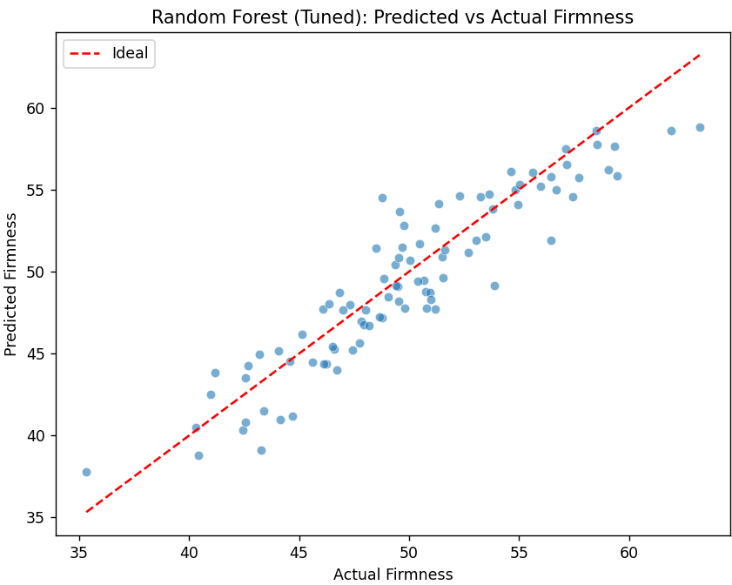

Slide 12
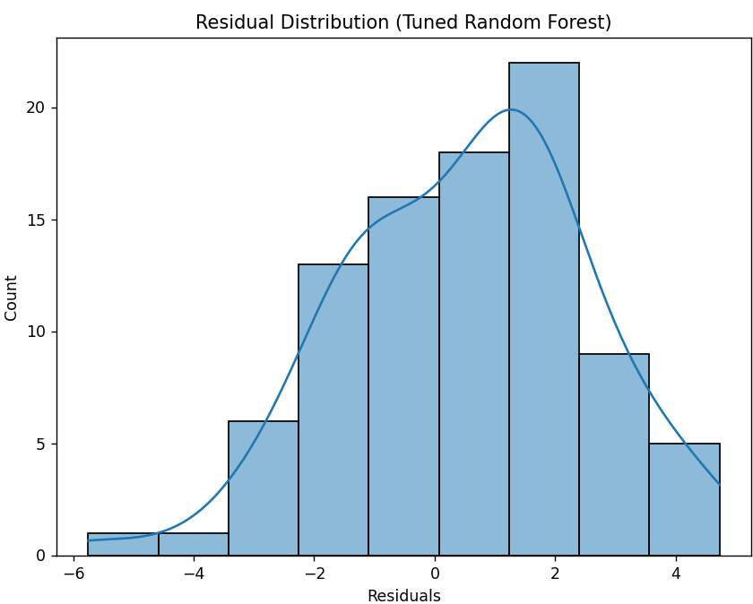

Slide 13
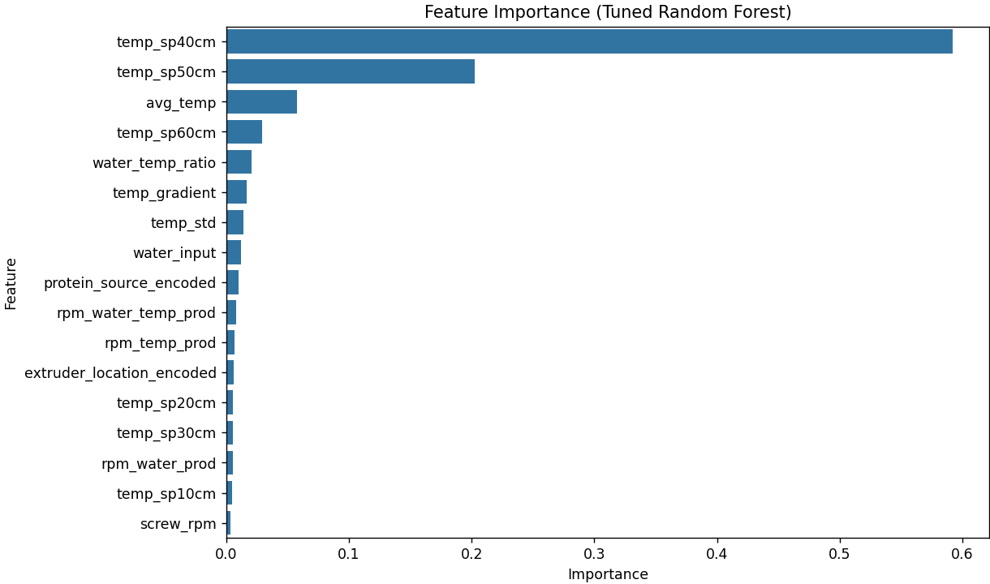

Slide 14
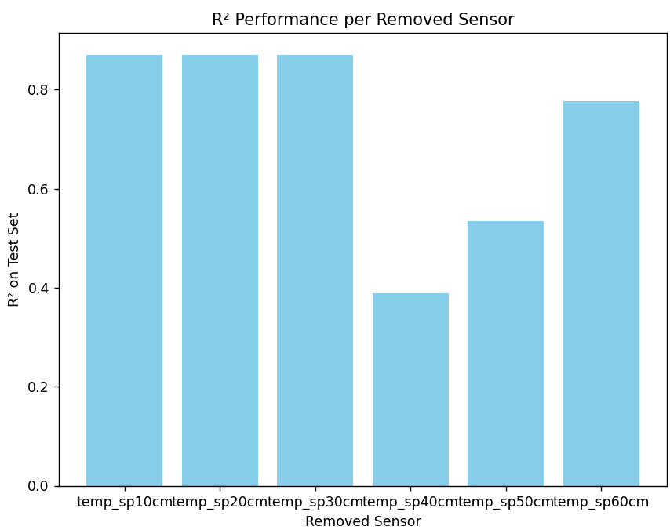

Slide 15
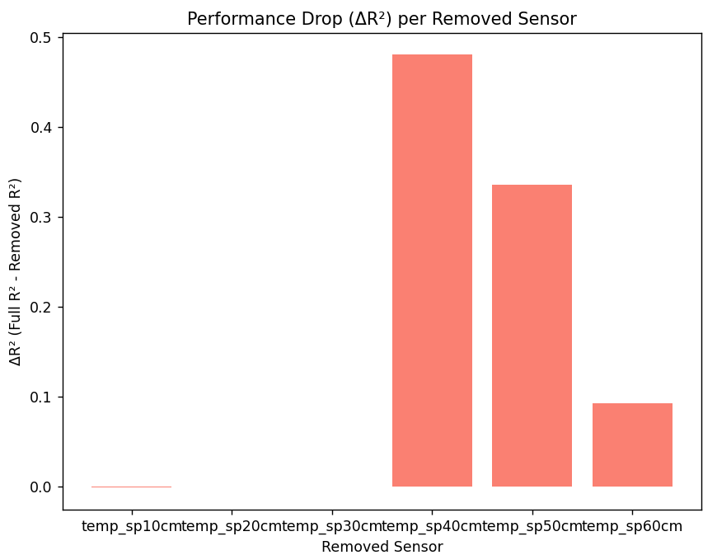

Slide 16
0 fully duplicated rows removed from Initial rows: 305
Removing 0 row(s) with 2 or more missing values.
Removing 0 row(s) missing city data.
Found 1 row(s) with exactly 1 missing value.
Row 301 is a partial duplicate. Marked for removal.
Removed 1 partial duplicate row(s).
Filling 0 row(s) with city-based averages...
Removed 2 rows as outliers in columns: ['firmness', 'screw_rpm', 'temp_sp10cm', 'temp_sp20cm', 'temp_sp30cm', 'temp_sp40cm', 'temp_sp50cm', 'temp_sp60cm']
Normalized 145 row(s) for city: Haifa
Normalized 157 row(s) for city: Tlv
Linear Regression RMSE: 0.6144, Linear Regression R²: 0.9867
Best hyperparameters: {'max_depth': None, 'min_samples_leaf': 1, 'min_samples_split': 2, 'n_estimators': 200}
Tuned Random Forest Test RMSE: 2.0770
Tuned Random Forest Test MAE: 1.7127
Tuned Random Forest Test R²: 0.8476
Full model R² using all sensors: 0.8699
Removing temp_sp10cm: R² = 0.8711, ΔR² = -0.0012
Removing temp_sp20cm: R² = 0.8697, ΔR² = 0.0002
Removing temp_sp30cm: R² = 0.8704, ΔR² = -0.0005
Removing temp_sp40cm: R² = 0.3895, ΔR² = 0.4805
Removing temp_sp50cm: R² = 0.5346, ΔR² = 0.3354
Removing temp_sp60cm: R² = 0.7774, ΔR² = 0.0925
Best sensor candidate for removal: temp_sp10cm

