Slide 1
Massachusetts Territory Analysis
Israel Colman
November 2026

Slide 2
Objective
The purpose of this analysis was to evaluate sales performance within the Massachusetts territory and discover options for growth and improvement.

Slide 3
Analysis Process
Step 1
Reviewed the sample_sales database
Step 2
Wrote queries to answer our business questions
Step 3
Evaluated Outputs gained from the queries
Step 4
Created PivotCharts in Excel
Step 5
Determined recommendations based on the results

Slide 4
Question 1
Total_Sales | Start_Date | End_Date
$ 5,733,256.27 | 1/1/2022 | 12/31/2025
What is total revenue overall for sales, plus the start date and end date that tell you what period the data covers?
Using the store_sales table I was able to determine the overall sales for our territory as well as the start and end date.
This shows us a good benchmark on where we stand as of right now.

Slide 5
Question 2
Year | Month | Total_Sales
2022 | 1 | $ 69,396.42
2022 | 2 | $ 65,616.00
2022 | 3 | $ 77,390.00
2022 | 4 | $ 81,333.60
2022 | 5 | $ 75,919.64
2022 | 6 | $ 81,227.82
2022 | 7 | $ 67,271.23
2022 | 8 | $ 73,543.48
2022 | 9 | $ 58,716.74
2022 | 10 | $ 72,514.81
What is the revenue breakdown by year and month for the sales territory?
I used the sum of our sale amount and grouped it by year and month to find how our sales have looked like monthly.

Slide 6
Question 3
Sales_Type | Total_Sales
Region | $ 24,237,526.98
Territory | $ 5,733,256.27
Provide a comparison of total revenue for the specific sales territory and the region it belongs to.
The comparison shows us that we make up for 23.65% of our total sales in the region.

Slide 7
Question 4
Month | Year | Transactions
12 | 2024 | 827
1 | 2025 | 1306
2 | 2025 | 1142
3 | 2025 | 1216
4 | 2025 | 1673
5 | 2025 | 1650
6 | 2025 | 1642
7 | 2025 | 1242
8 | 2025 | 1198
9 | 2025 | 1175
10 | 2025 | 1941
11 | 2025 | 1217
12 | 2025 | 1281
What is the number of transactions per month and average transaction amount by product
category for the sales territory?
By using two separate SQL Queries I was able to discover our monthly transactions as well as our average transactions by product category.
This shows us where we stand and how we can grow from here.

Slide 8
Question 5
StoreLocation | Total_Revenue | Start_Date | End_Date
Worcester | $ 602,183.44 | 1/1/2022 | 12/31/2025
Leominster | $ 338,009.10 | 1/1/2022 | 12/31/2025
Nantucket | $ 335,547.81 | 1/2/2022 | 12/31/2025
Provincetown | $ 328,860.51 | 1/1/2022 | 12/31/2025
Northampton | $ 322,039.24 | 1/3/2022 | 12/31/2025
Holyoke | $ 320,516.53 | 1/1/2022 | 12/31/2025
Somerville | $ 312,873.59 | 1/1/2022 | 12/27/2025
Haverhill | $ 305,762.60 | 1/1/2022 | 12/31/2025
Lynn | $ 302,049.65 | 1/1/2022 | 12/30/2025
Pittsfield | $ 301,281.50 | 1/1/2022 | 12/31/2025
New Bedford | $ 295,443.42 | 1/1/2022 | 12/30/2025
Boston | $ 295,201.29 | 1/2/2022 | 12/29/2025
Attleboro | $ 290,883.71 | 1/2/2022 | 12/31/2025
Hingham | $ 289,633.52 | 1/2/2022 | 12/31/2025
Quincy | $ 279,646.07 | 1/1/2022 | 12/29/2025
Falmouth | $ 276,965.55 | 1/2/2022 | 12/31/2025
Framingham | $ 269,375.91 | 1/1/2022 | 12/31/2025
Lowell | $ 266,982.83 | 1/2/2022 | 12/31/2025
provide a ranking of in-store sales performance by each store in the sales territory
By calculating the sum of sales and grouping by store location I was able to find the ranking of our store performances.

Slide 9
Question 6
Categoryid | Category | Total_Transaction_Amount
120 | Technology & Accessories | $ 4,059,863.21
100 | Textbooks | $ 998,901.78
130 | Apparel and Merchandise | $ 266,531.69
115 | Art Supplies | $ 217,215.46
125 | Books (General) | $ 99,532.89
110 | Stationery and Supplies | $ 91,211.24
Which Category generates the most revenue?
This was a question I created myself and found important, So I calculated another query to show me the results of which category is our top seller.

Slide 10
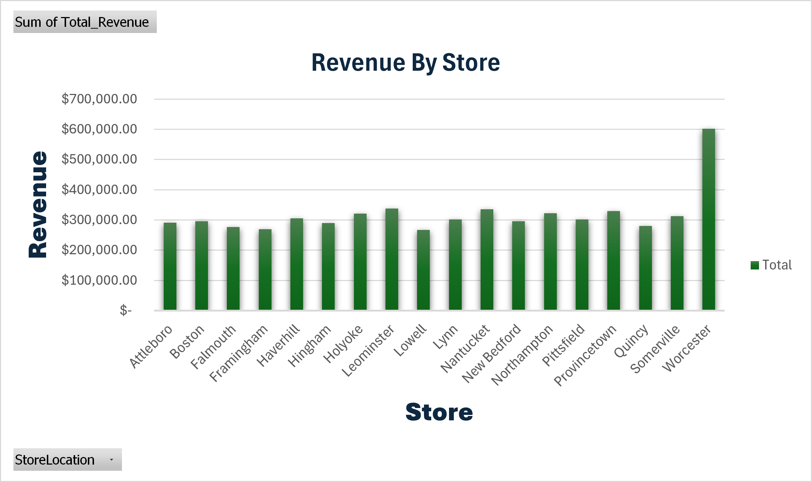
Revenue By Store
Our top performing store is Worcester and our lowest performing store is Lowell

Slide 11
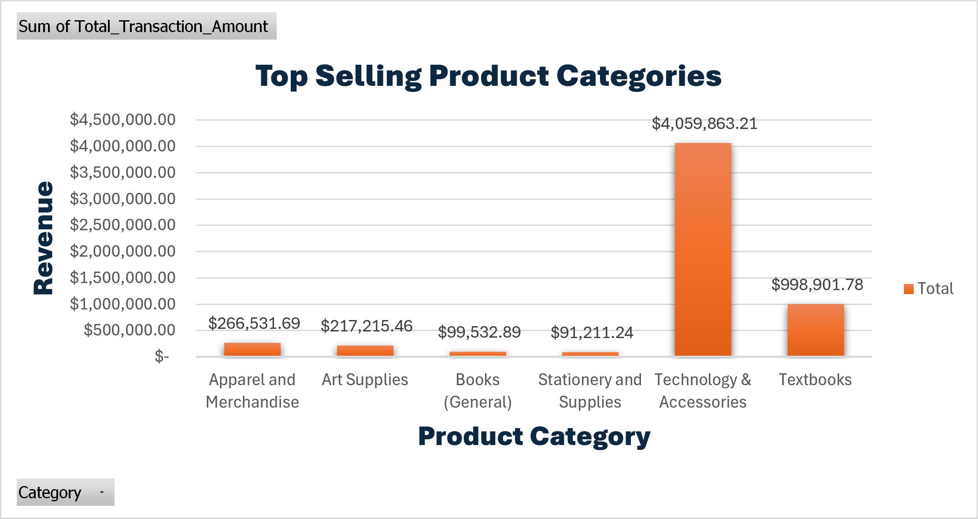
Top Selling Categories
Our top performing category is Technology & Accessories followed by textbooks.

Slide 12
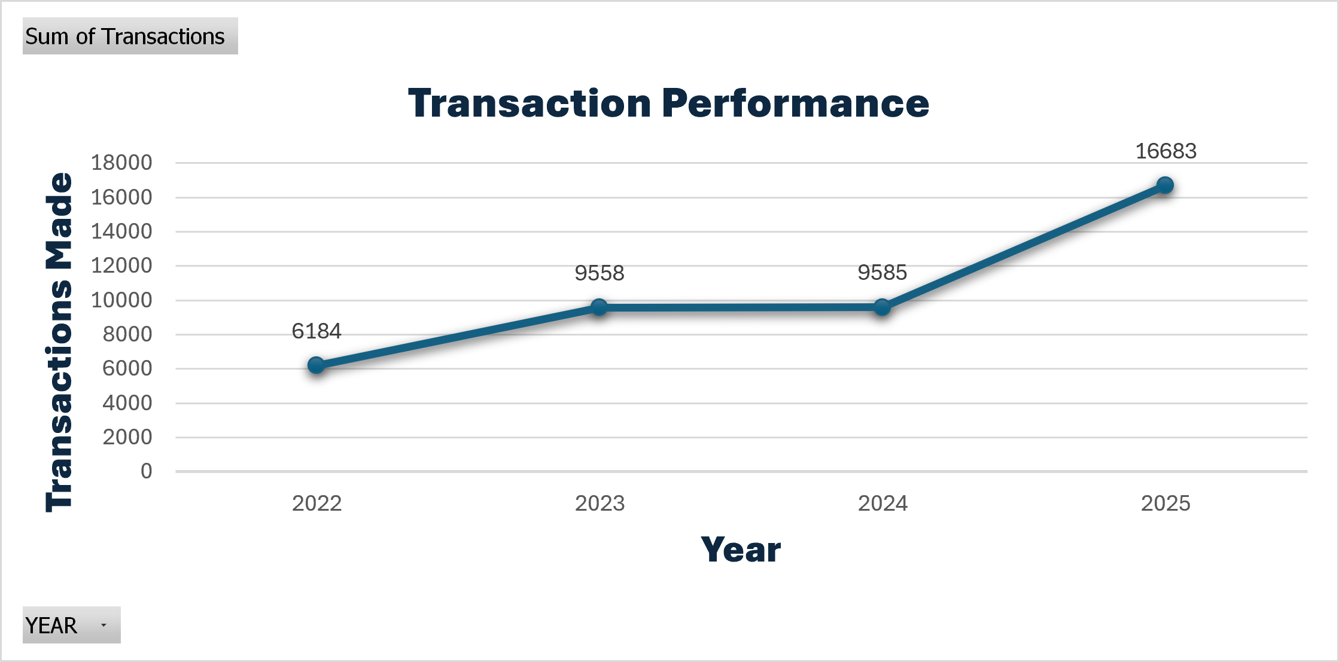
Transaction Performance
This shows our progression over time. We see a big increase between 2024 and 2025

Slide 13
Findings Summary
Key findings
total revenue is $5,733,256.27
top performer are Worcester while our lowest is Lowell
top selling product category is Technology & Accessories
On an upward trending performance

Slide 14
Final Recommendations
1. Replicate Worcester's Success
Worcester generated the highest sales performance in the territory.
Evaluate the store's sales and operational practices.
Apply successful strategies across other territory locations.
2. Focus on High-Performing Product Categories
Technology & Accessories
Textbooks
Apparel/Merchandise
These categories consistently generated the highest sales and offer the greatest opportunity for future revenue growth.

