Slide 1
Premier League Project

Slide 2

Research questions
1. Can we predict at which place a football team will finish in current
season, based on history data of the premier league?
2.Can we predict which team will score the most goals in current season, based on history data?
3.Can we predict which team will score the most penalties, based on previous data?

Slide 3
הרכשת נתונים - Data Acquisition
1. All the data Crawled by using BeautifulSoap library.
2. Filtered data for teams playing season 2008.
3. Using Python Language and Python libraries.
4. Stored all the data in the lists and created the data frames based on the lists.

Slide 4
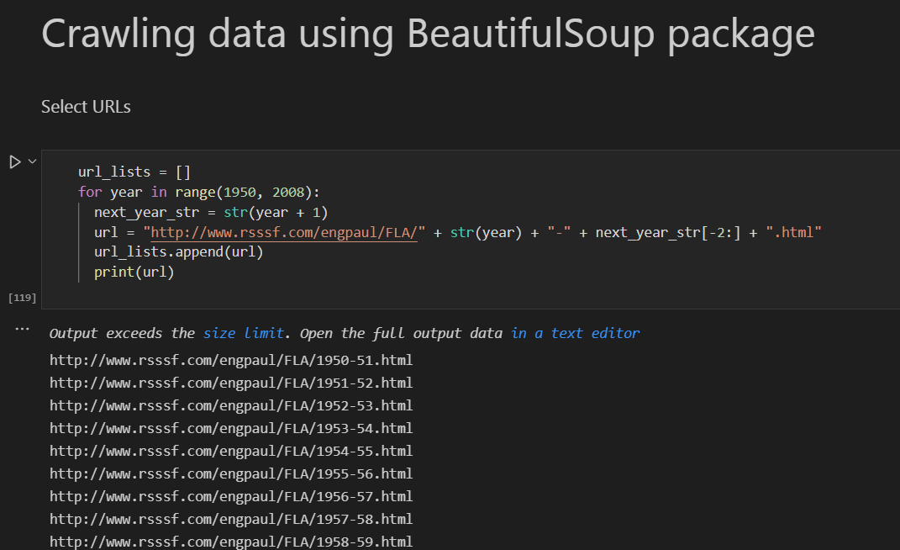
Crawling the data using BeautifulSoap
1. The Crawling is from 1950 - 2008.
2. The data is from http://www.rsssf.com/engpaul/FLA/ site. (league321)

Slide 5
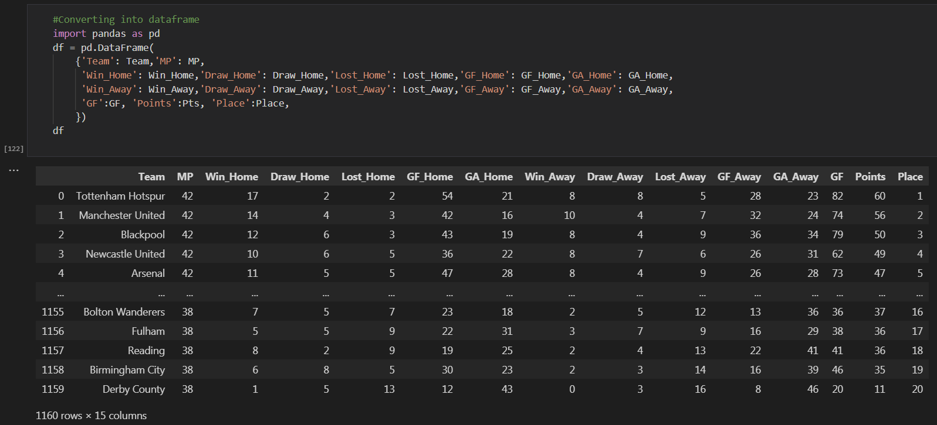
Storing the data in lists and creating the data frames
Each football team have different stats base on : team name, match played, win ,win away, draw away, lost away , GF home ,points , place home, draw home, lost ...(גולים שהבקיעו בפועל), GF

Slide 6
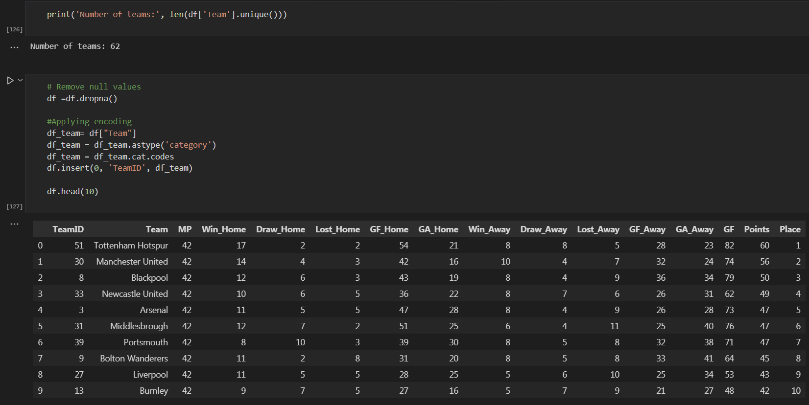
עיבוד נתונים מקדיםData pre-processing -
Checked for null values and dropped them.
Encoded the Team variable into categorical to make it target column for the ML model.

Slide 7
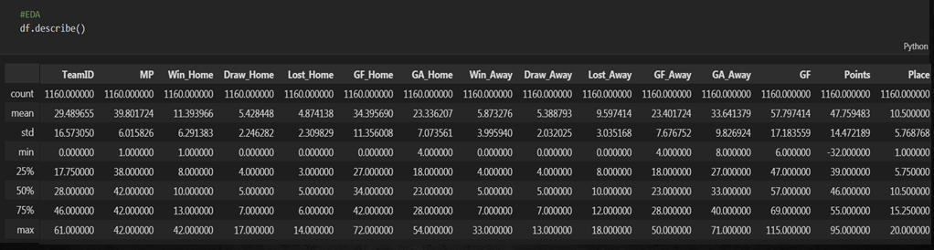
ניתוח נתונים חקרני Exploratory data analysis -
Here some description of the data in the Data Frame. For example :
count - The number of not-empty values. mean - The average value. std - The standard deviation. min - the minimum value. max - the maximum value.
Percentage - how many of the values are less than the given percentile.

Slide 8
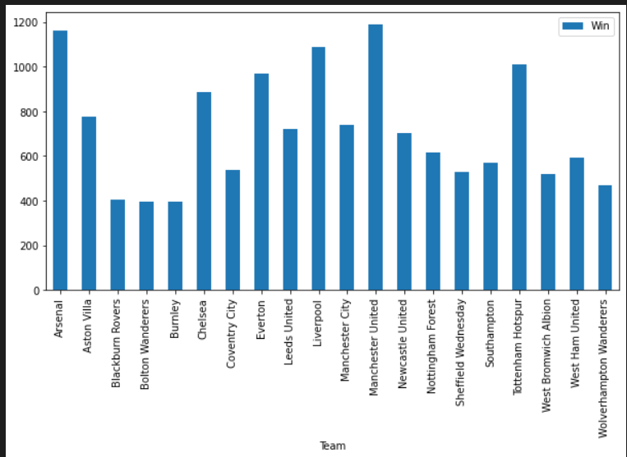
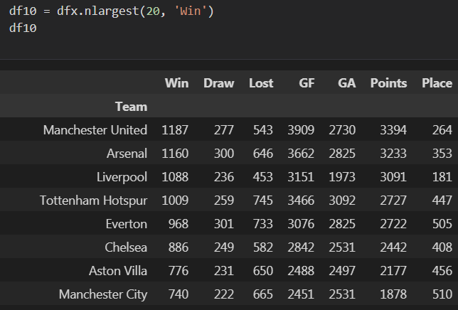
EDA Data Analysis - Top Wins
Manchester United has the most wins. The team has won the most championships in the history, compared to another team.

Slide 9
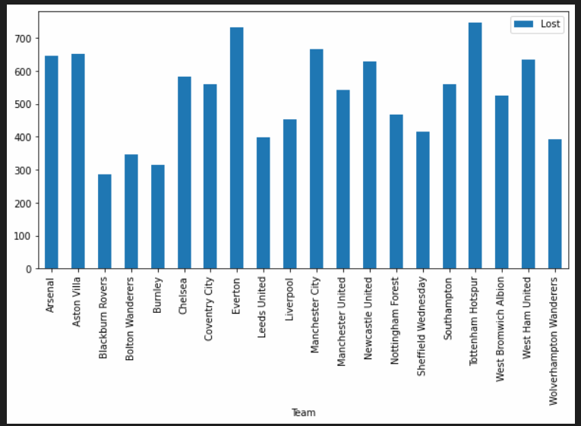
EDA Data Analysis - Most losses
Tottenham Hotspur and Everton has the most matches lost.

Slide 10
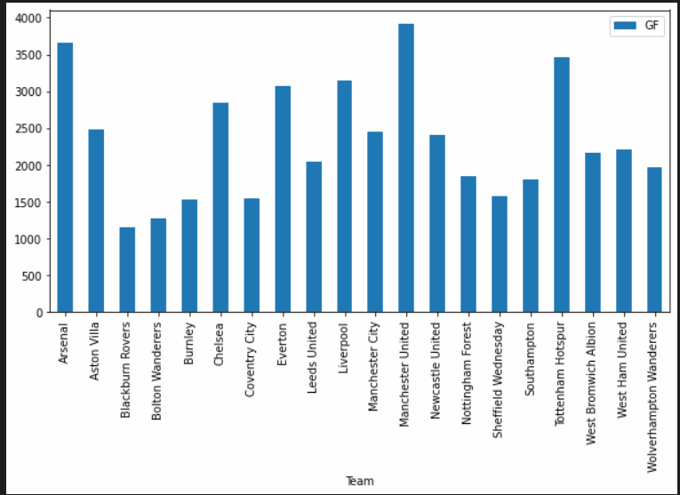
EDA Data Analysis - The team that scored the most
Manchester United and Arsenal has the most GF(Scored goals).

Slide 11
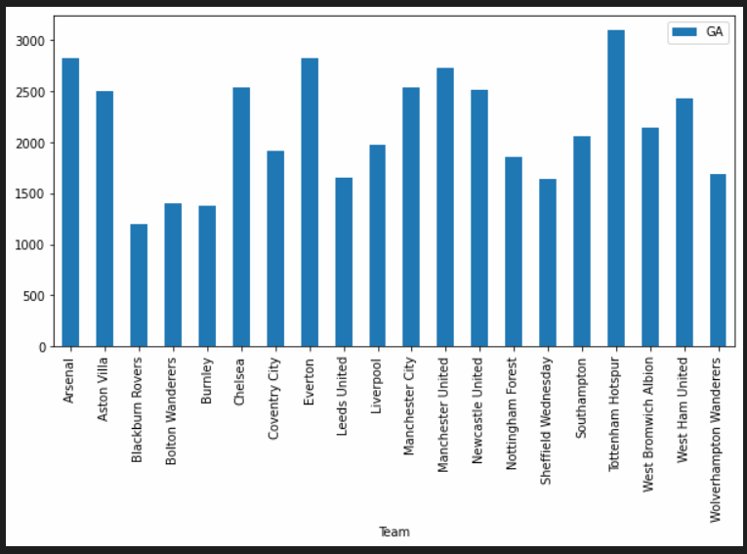
EDA Data Analysis - The team that scored the most against
(ספגה הכי הרבה שערים)
Tottenham Hotspur and Everton has the most GA(Scored goals against teams).

Slide 12
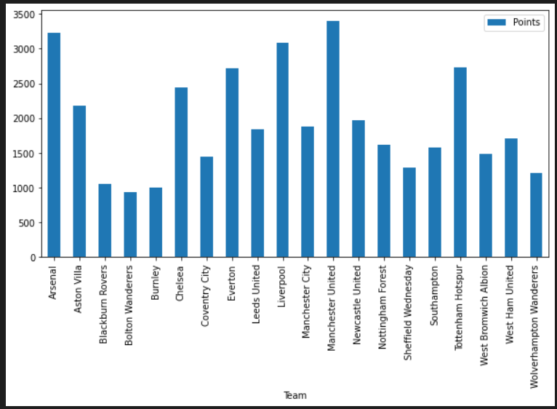
EDA Data Analysis - Top Points
Manchester United has the most Points because the team has won the most championships in the history.

Slide 13
Machine Learning Model Decision tree classifier
Research questions
1. Can we predict at which place a football team will finish in current
season, based on history data of the premier league?
2.Can we predict which team will score the most goals in current season, based on history data?
3.Can we predict which team will score the most penalties, based on previous data?

Slide 14
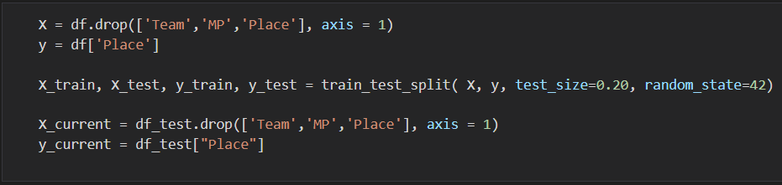
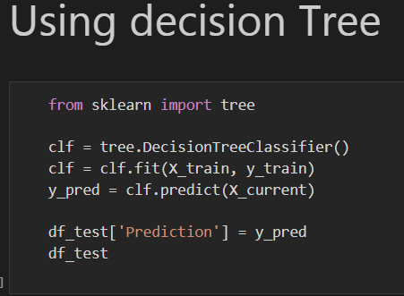
Train-Test-Prediction
1.We split the data to train and test :
2. We choose decision tree model:

Slide 15
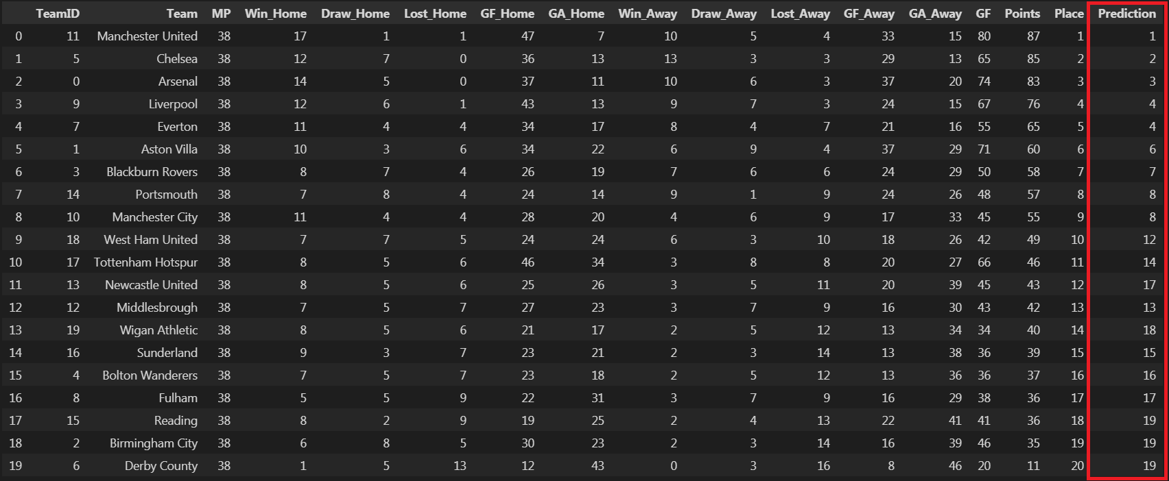
Predicted place

Slide 16
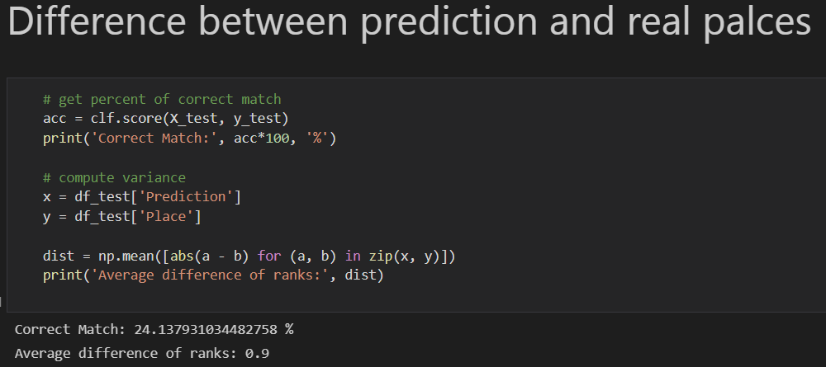
Analysis Prediction Accuracy
The test accuracy is low as 24%. But the average difference between real and predicted place is 0.9. It shows that the model predict the place almost correctly in most cases and the error is minor.
ממוצע הפרשיםaverage difference -

Slide 17
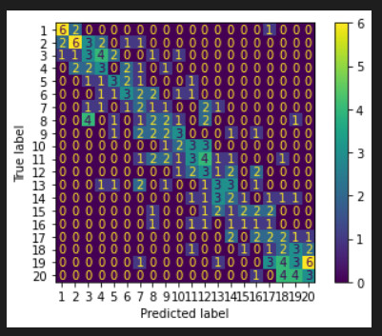
Confusion Matrix A confusion matrix is a summary of prediction results on a classification problem
From the confusion matrix, we can see that the model predict almost the rank of the teams in most cases correctly. As we easily see, almost all numbers lies on the diagonal of the matrix.

Slide 18
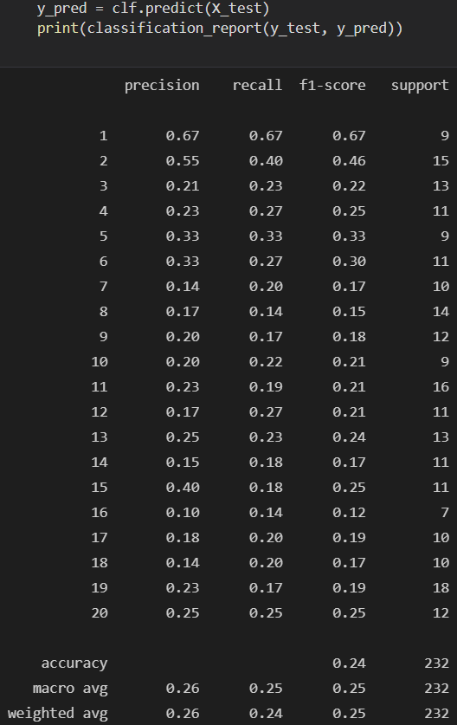
Classification Report
The prediction is a hard problem in our case(predict order of teams in
given season). In this case we got 24% accuracy. However, we can see that the model predict the order almost correctly from the confusion matrix.

Slide 19
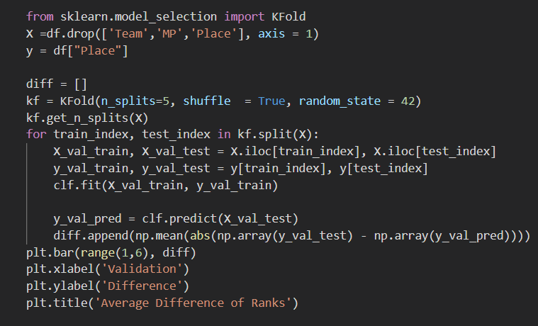
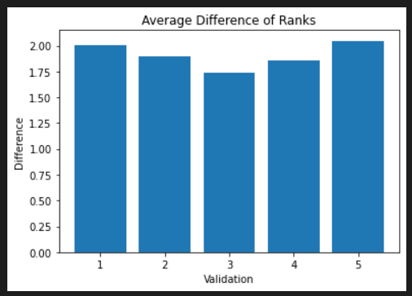
Model Validation
The average difference of validation models are less than 2. It shows that the the error between predicted and real ranks are 2. Hence, this model predict the place almost correctly and we can use this model.

Slide 20
Question one
1. Can we predict at which place a football team will finish in current
season, based on history data of the premier league?
With the decision tree model:
The table shows the real place from our data under column “Place” and
the decision tree model prediction under column “Prediction.
The target label is Place.
Result - We can see that Manchester United really the first team at
place and prediction.

Slide 21
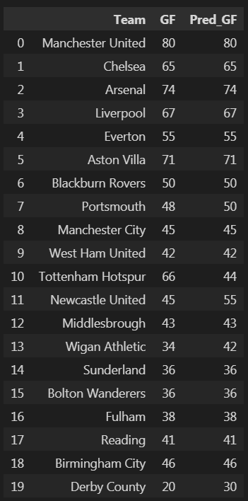
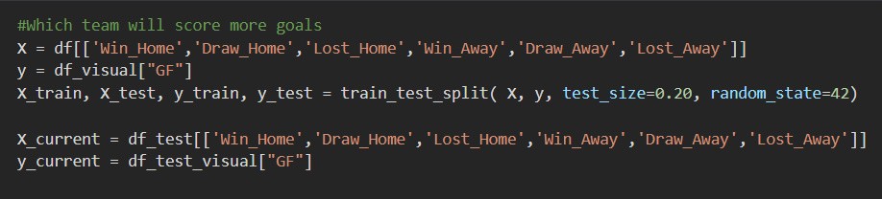
Question two
2. Can we predict which team will score the most goals in current season, based on history data?
With the decision tree model:
We built new model with new target label.
(גולים שהבקיעו בפועל) The target label is GF -

Slide 22
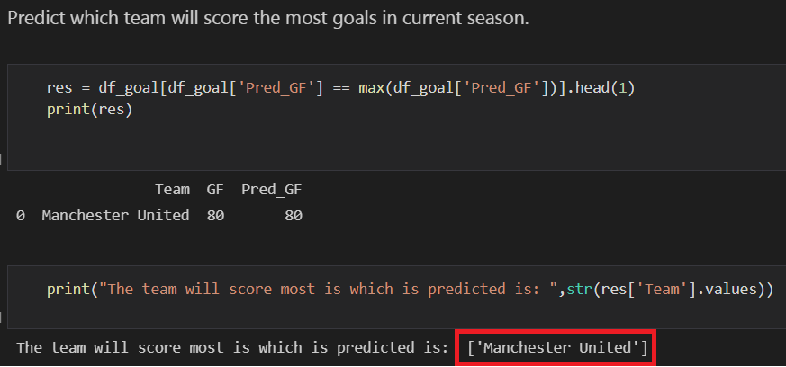
Question two - result
We can see that Manchester United will score the most goals in current season.

Slide 23
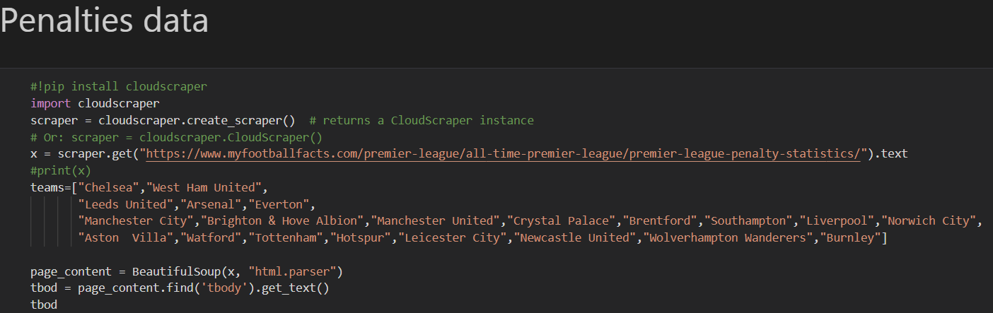
Question three
3. Can we predict which team will score the most penalties, based on
previous data?
With the decision tree model + with some more Crawling(1992-2021):
The data is from https://www.myfootballfacts.com/premier-league/all-time-premier-league/premier-league-penalty-statistics/ site.

Slide 24
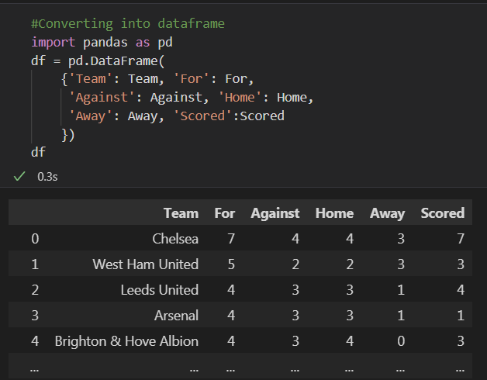
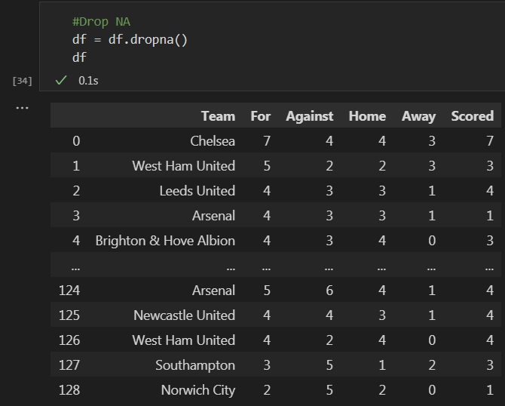
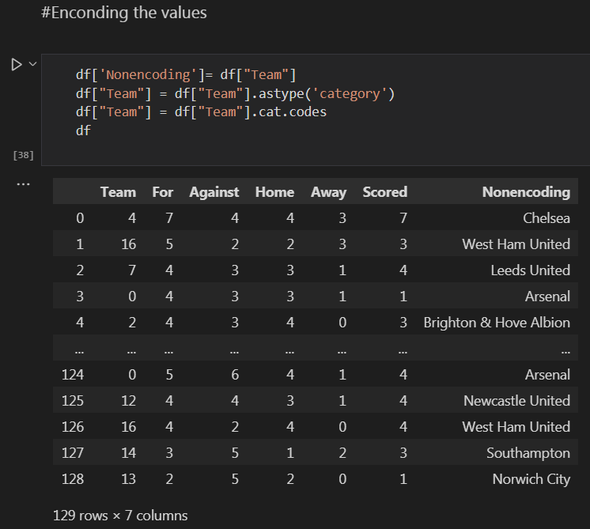
Question three - Data pre-processing
Encoding the Team name variable into categorical, to make it target column for the Machine Learning model. The target column in Scored.

Slide 25
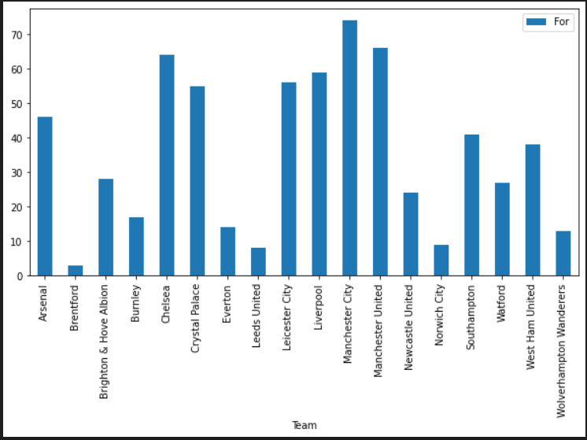
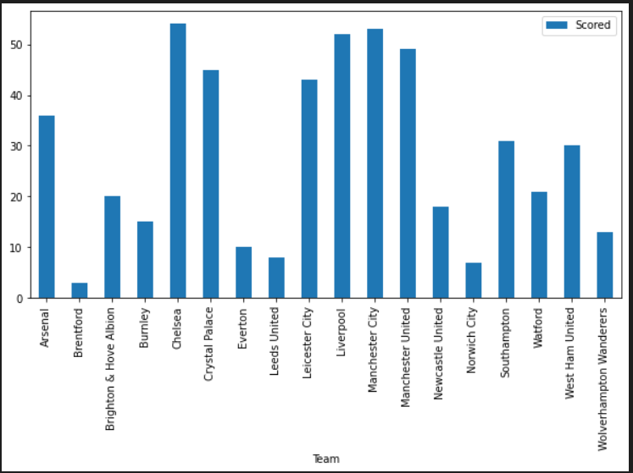
Question three - EDA
These two graphs shows the most penalty scored for and against for each team. We can see clearly that Manchester City and Chelsea has the most scored penalties for and against.

Slide 26
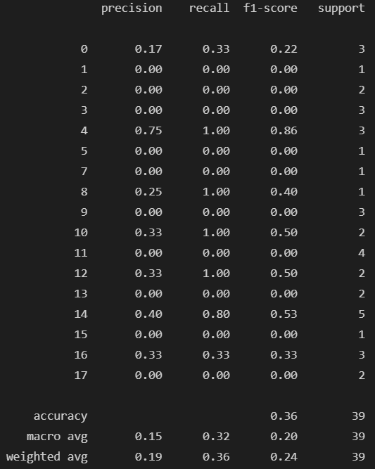
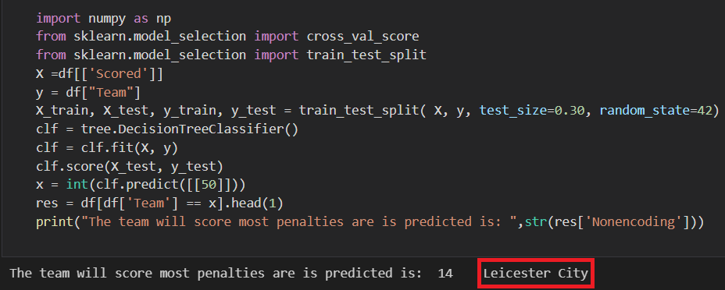
Question three - Result
We used Decision Tree Classifier model to predict which team will score most penalties. The target label is Scored.
The model result is Leicester City. In this case we got 36% accuracy.

Slide 27
Summary
We have successfully answered all the three research questions.
We did it by crawling the relevant data about the research questions, cleaning it, exploring it and finding potential features for machine learning and finally using machine learning (decision tree classifier) to answer the questions and get a prediction. Although our model has low accuracy, the actual prediction was not so far from real values, so we can infer that the model is reliable and useful.

