Slide 1
RxJS
RxJS is a library for reactive programming.
Reactive programming is programming with asynchronous data streams.
ReactiveX is a combination of the best ideas from the Observer pattern, the Iterator pattern, and functional programming.

Slide 2
We are going to talk about…
Observers.
Observables.
Subjects.
Operators.

Slide 3
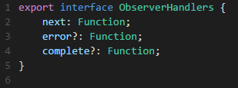
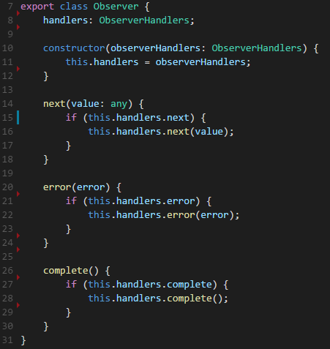
Observer
This is a simple implementation of Observer.
For a more detailed sample, click here.

Slide 4
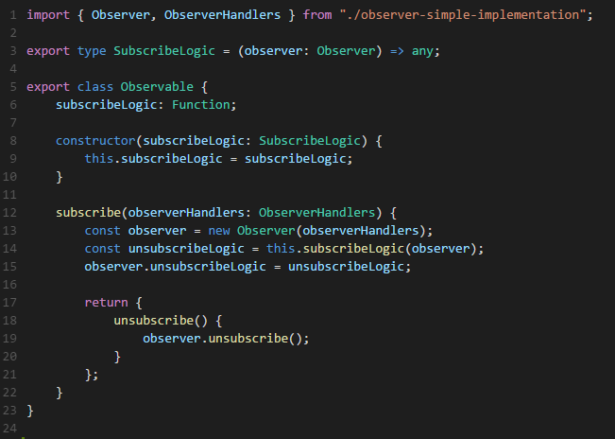
Observable

Slide 5
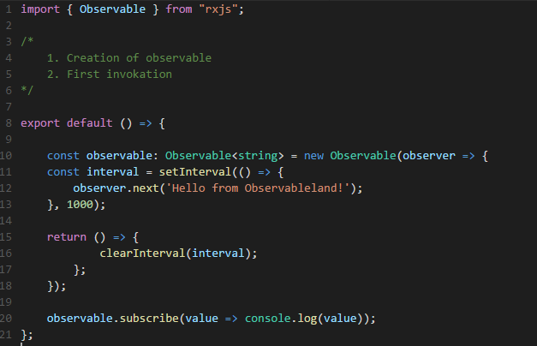
Examples

Slide 6
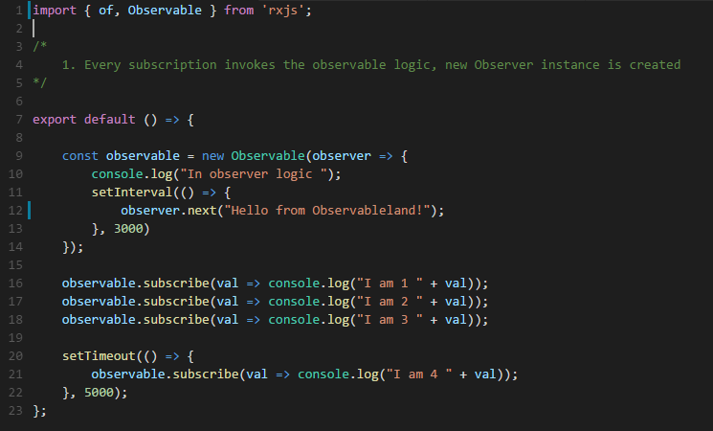
What is the output?

Slide 7
Subject
Represents an object that is both an observable as well as an observer.
Subjects are like EventEmitters: they maintain a registry of many listeners.
Each notification is broadcasted to all subscribed observers.
This class inherits both from the Observable and Observer classes.

Slide 8
Subject
There are several Subject types, e.g. Subject, BehaviorSubject, ReplaySubject and more.

Slide 9
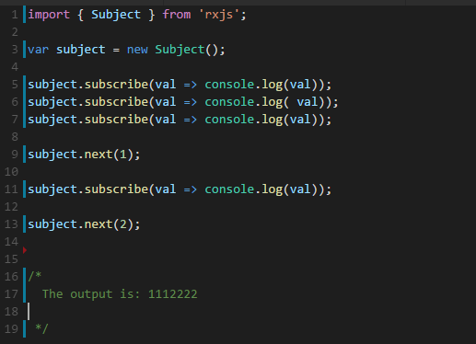
Subject
This is an example for the simplest and most common subject:

Slide 10
BehaviorSubject
BehaviorSubject has a notion of "the current value". It stores the latest value emitted to its consumers, and whenever a new Observer subscribes, it will immediately receive the "current value" from the BehaviorSubject.

Slide 11
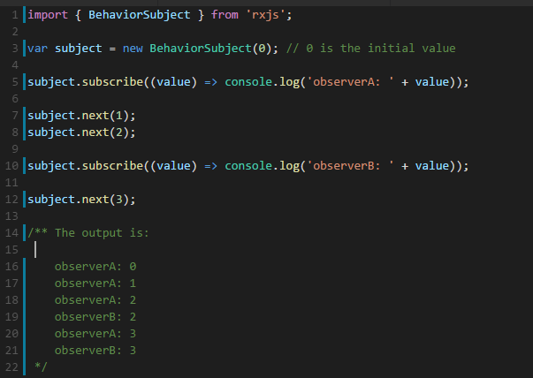
BehaviorSubject

Slide 12
Operators
Operators are the horsepower of observables, providing an elegant, declarative solution to complex asynchronous tasks.
An Operator is a function which creates a new Observable based on the current Observable. This is a pure operation: the previous Observable stays unmodified.

Slide 13
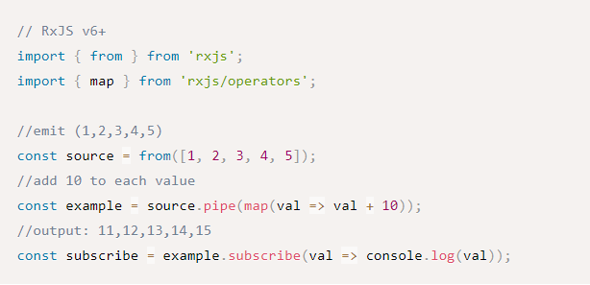
Operators
Let’s start with an example

Slide 14
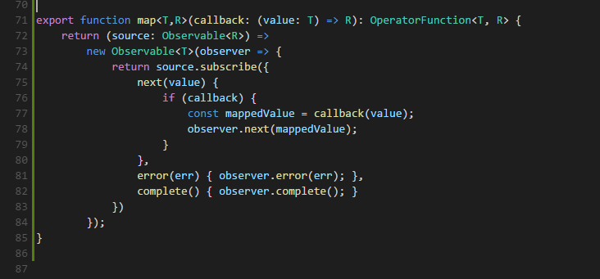
Operators
Let’s focus on map

Slide 15

Operators
What is OperatorFunction?
An Operator is a function which creates a new Observable based on the current Observable.
This is a pure operation, meaning, the previous Observable stays unmodified.

Slide 16
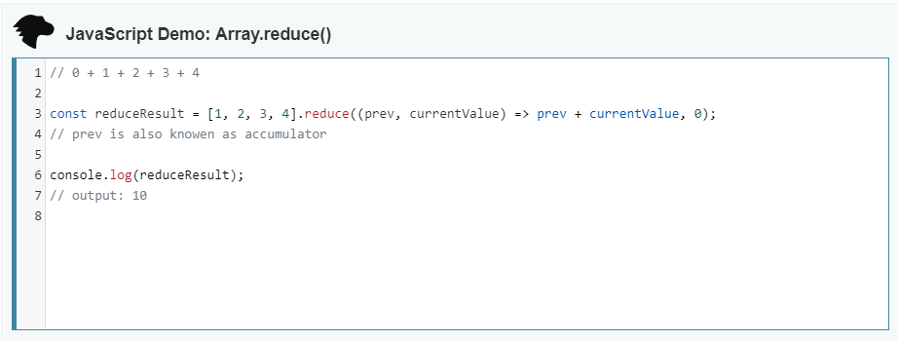
Operators
Do you remember reduce?

Slide 17
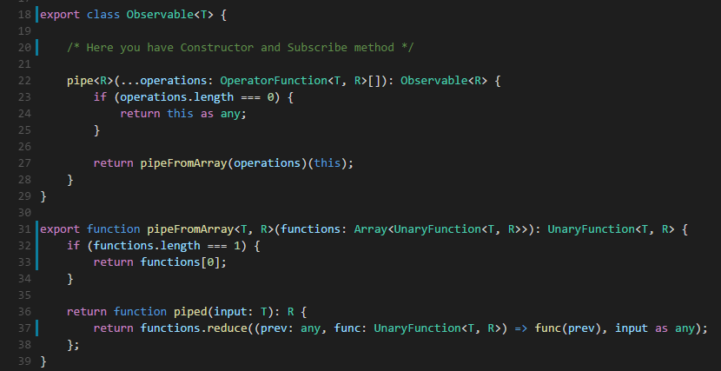
Operators
It turns out that Observable has another method

Slide 18
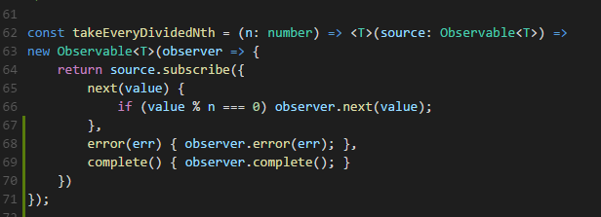
Operators
You can create custom operators

Slide 19
Operators
Some samples and explanations about operators can be found here
And the main site for learning about operators is of course:
https://www.learnrxjs.io/operators

