Slide 1
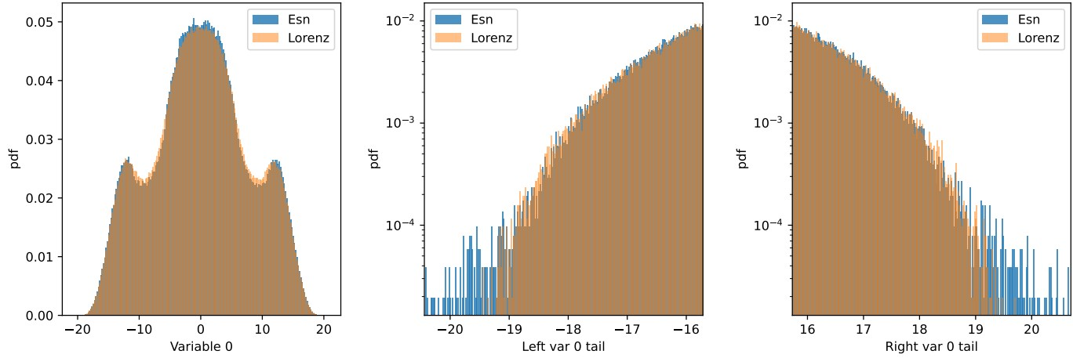
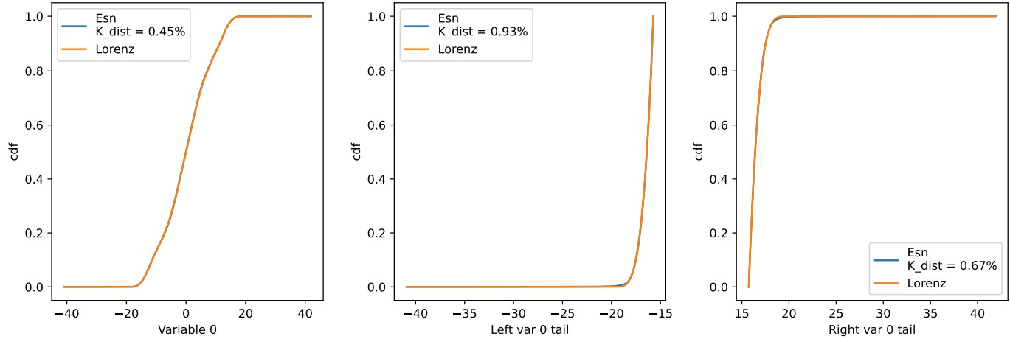

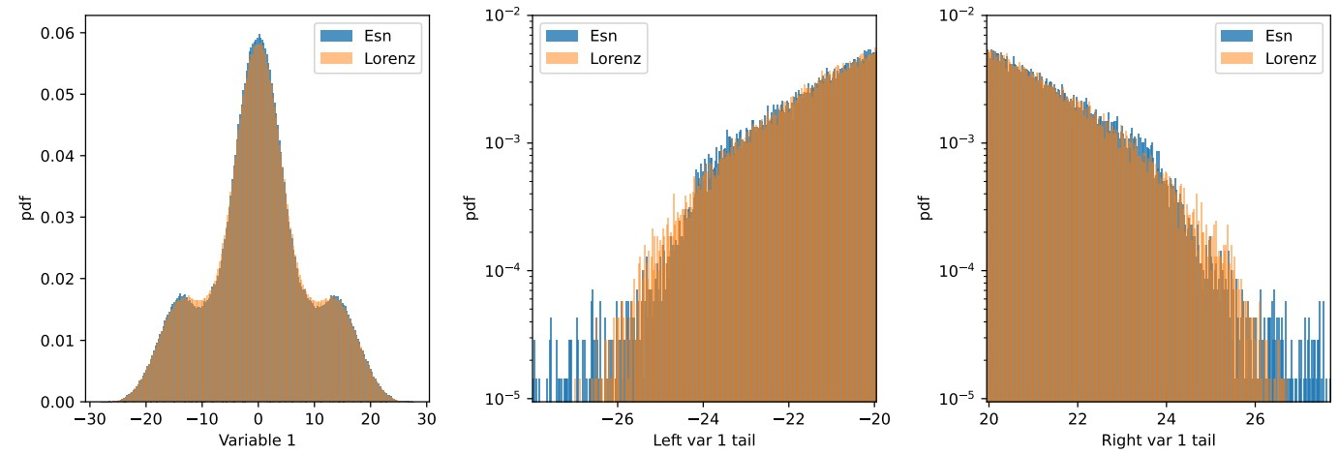

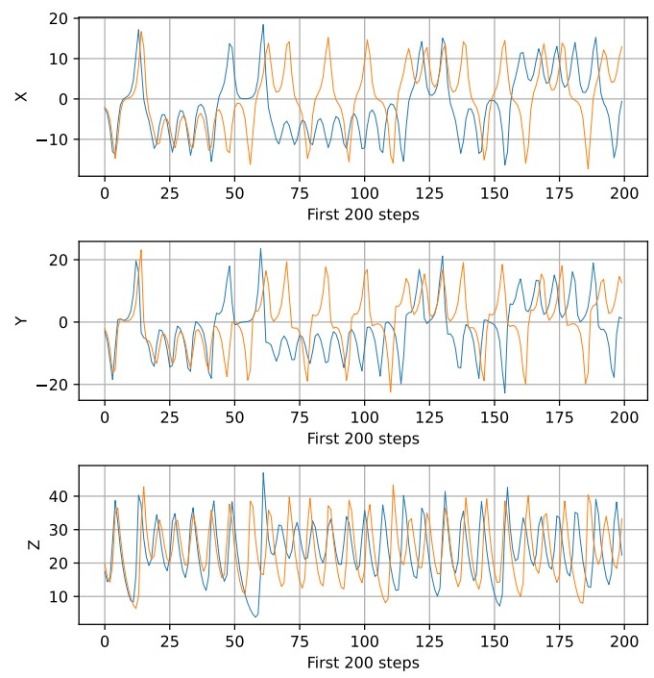
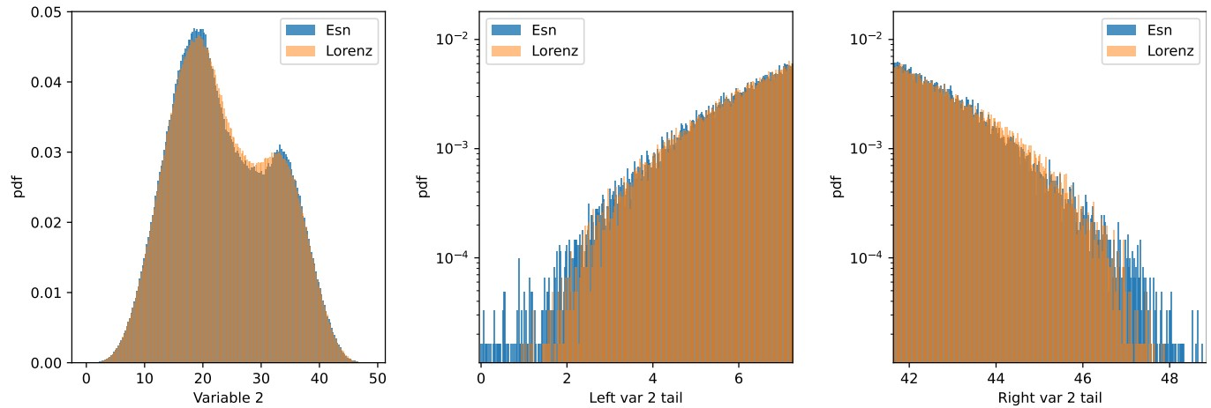
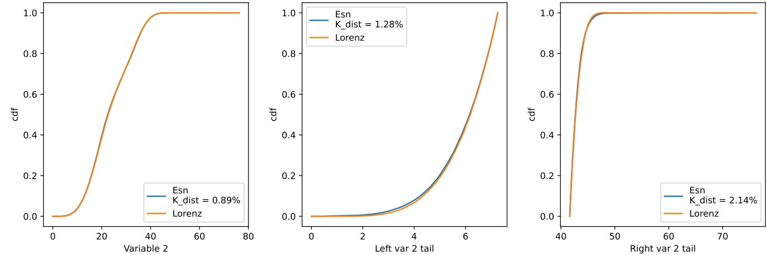
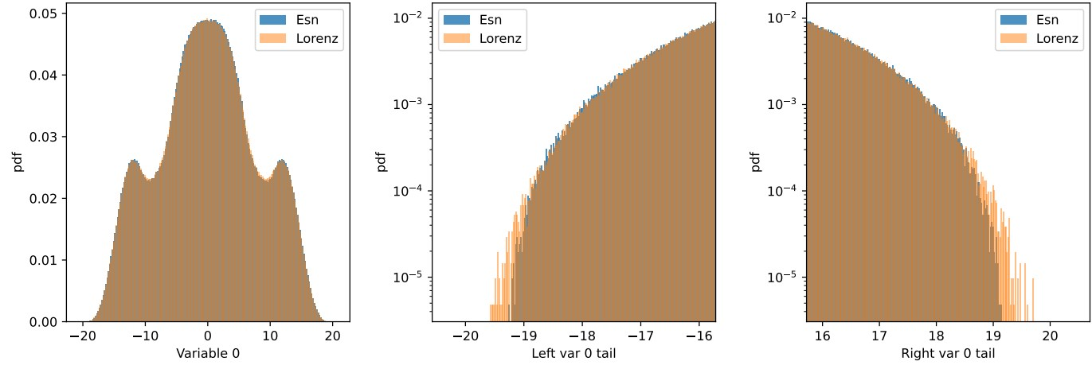
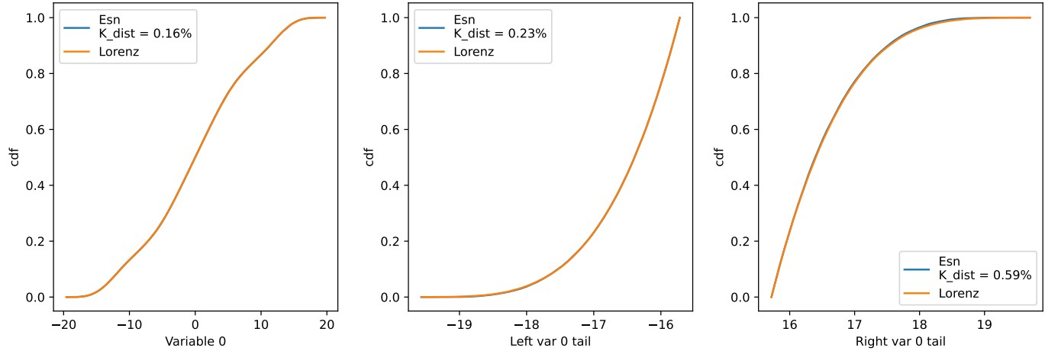
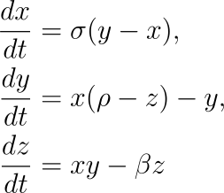
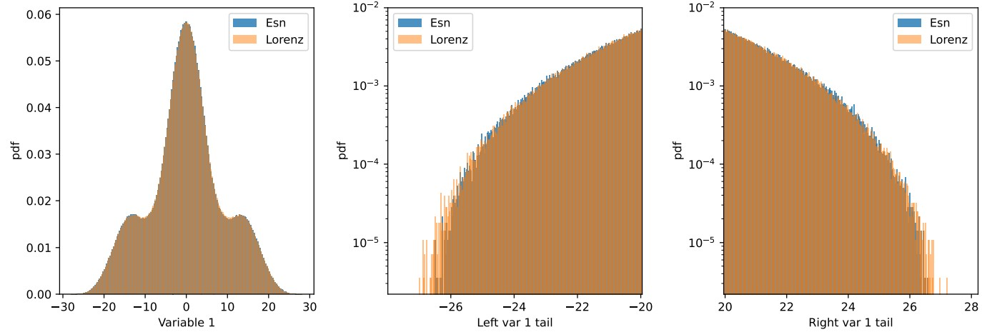
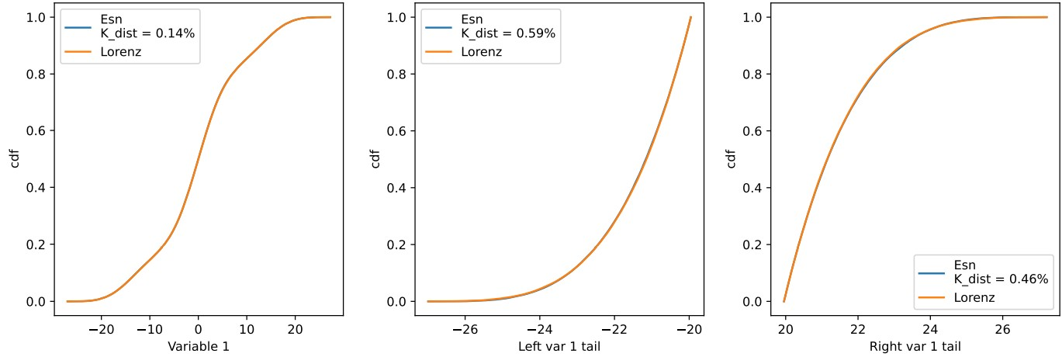
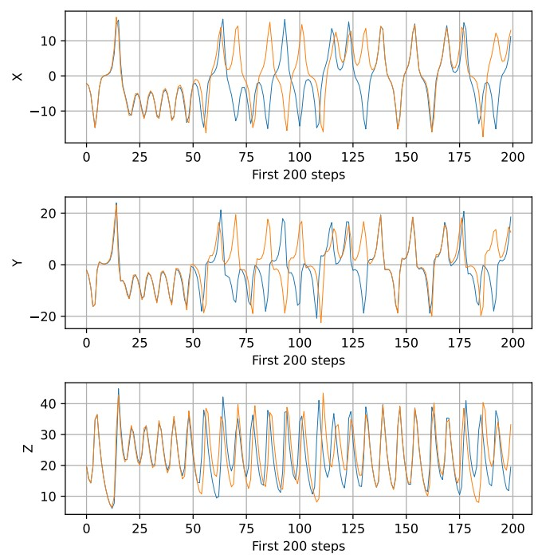
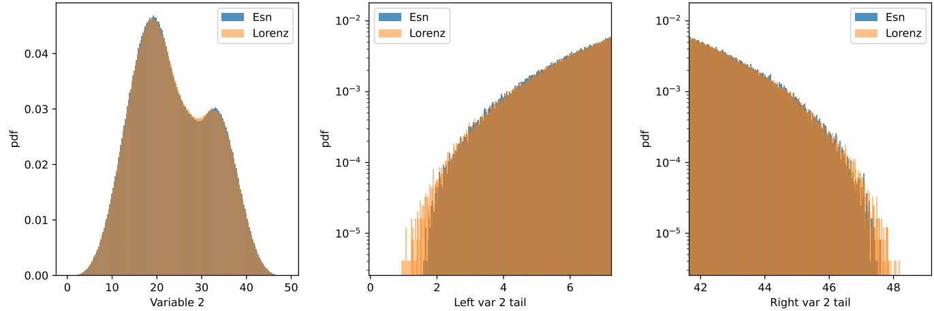
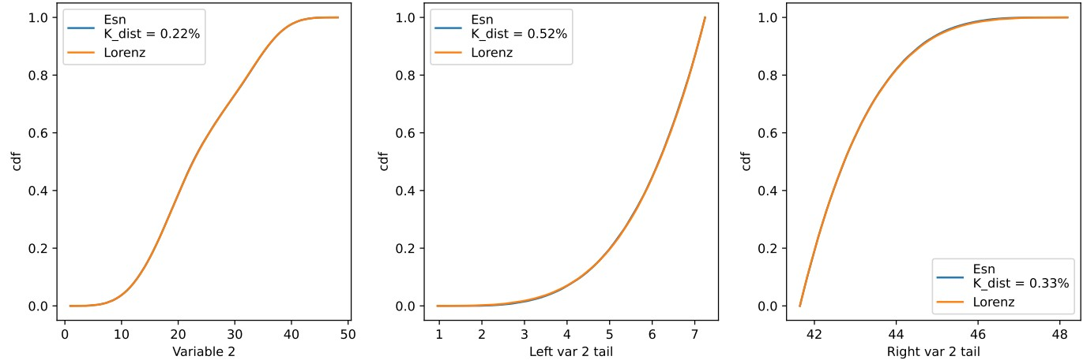
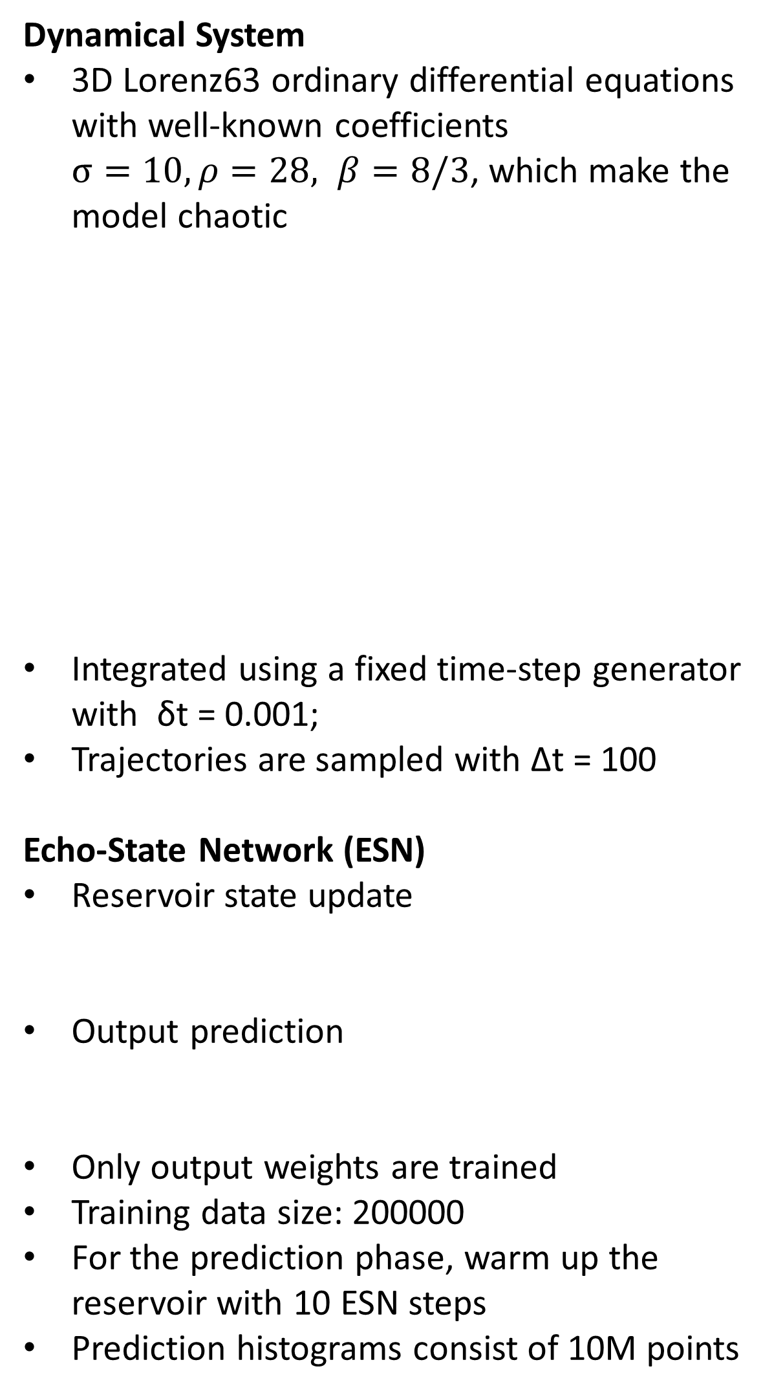
Using Echo-State Networks to Reproduce Rare Events in Chaotic Systems
Anton Erofeev, Josh Reed Lewis, Israel Trejo
University of Houston, Team number G-00103
Abstract
Original Echo State Network
We apply the Echo-State Networks to predict the time series and statistical properties of the Lorenz63 chaotic model. In particular, we demonstrate that original (1 layer) Echo-State Network successfully learn the chaotic attractor of the Lorenz63 model and reproduce histograms of dependent variables, including tails and rare events. We introduce the Authors’ (3 layer) Echo-State Networks that predict statistics better than original one. We use the Kolmogorov-Smirnov test and Kolmogorov distance to quantify the tail behavior.
Reservoir size: 1000
Sparsity: 50%
Spectral radius (reservoir characteristic): λ_{res} = 0.5
Input weights: W_{in} ∼ Unif [−0.5, 0.5]
Regularization: μ = 0.1
Data standardization: False
Original ESN - output weights consist of only one layer, which is trained by explicit formula with L2 regularization:
Original ESN successfully passes Kolmogorov-Smirnov test
However, it indicates the presence of outliers in predicted trajectories
Problem Formulation
Goal: Use Echo-State Networks (ESNs) to learn the flow map and invariant measure of a 3D chaotic Lorenz63 system.
Focus on rare events: important in systems like climate where tail behavior matters.
Challenges:
ESNs typically developed for trajectory prediction, not statistical properties.
Rare events occur in low-density regions of phase space—difficult to capture accurately.
Authors’ Echo State Network
Methods / Theory
Reservoir size: 30
Sparsity: 50%
Spectral radius (reservoir characteristic): λ_{res} = 0.5
Input weights: W_{in} ∼ Unif [−0.5, 0.5]
Adam optimizer: lr = 1e-3, wd = 1e-5
Data standardization: True
Author’s ESN - output weights consist of three layers: Linear(30,21), GeLU(), Linear(21,12), GeLU(), Linear(12,3)
Dynamical System
3D Lorenz63 ordinary differential equations with well-known coefficients $σ=10, ρ=28, β=8/3$, which make the model chaotic
Integrated using a fixed time-step generator with δt = 0.001;
Trajectories are sampled with ∆t = 100
Echo-State Network (ESN)
Reservoir state update
Output prediction
Only output weights​ are trained
Training data size: 200000
For the prediction phase, warm up the reservoir with 10 ESN steps
Prediction histograms consist of 10M points
Author’s ESN successfully passes Kolmogorov-Smirnov test
Predicted histograms stay within Lorenz63 attractor; there is no outliers
Both ESNs predict individual trajectories of the Lorenz63 system approximately for 50 ESN time steps, but the author’s does it more precisely
Both ESNs correctly reproduces histograms for all three variables, but the authors’ does it more carefully
Both ESNs pass Kolmogorov-Smirnov test. Kolmogorov distance is around zero for both ESNs, but the author’s has smaller error, especially for the tails of the distributions.
Conclusion
Acknowledgments
ESN reproduces chaotic time series, histograms and rare events of the 3D Lorenz63 model and its statistical properties with high accuracy.
ESNs can be used in problems where it is necessary to generate trajectories with given statistical properties.
Potential applications include climate studies and heat bath reservoirs.
We acknowledge support from Dr. Nouhad Rizk for teaching COSC 4337 Data Science II course and exploring selected topic in Deep Learning.

