Slide 1


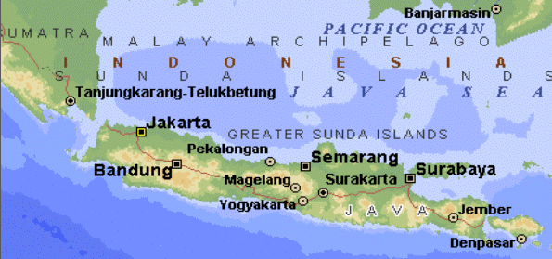
Advanced Java Topics
Written by Keren Kalif, Edited by Liron Blecher

Slide 2
Agenda
Reflection
Annotations
Dynamic Proxy

Slide 3
What is Reflection?
Reflection is a mechanism in Java that allows inspection and manipulation of an object or class without the need to know what is the type of the object or class
Allows to get the structure of an object such as its fields (data members), methods, constructors, etc.
Enables to run a method without knowing the exact type of the object it will run on
Another ability it to change (at runtime) the access modifier of methods and fields to allow changing them

Slide 4
Class class
The class Class is the root class for other reflection data classes (such as Field, Method, etc.). It’s a class that describes classes
It contains the description of how an object is constructed – but not the data itself
Each object gets to be linked (at runtime, by the JVM) with an instance of the Class object which describes it.

Slide 5
Class class
There are 3 ways to get the Class for an object:
Call getClass() on the object itself (at runtime)
Use the public member class from any class type (Student.class) (at compile time)
Use the static method Class.forName (“…full class name”). (at runtime)
if the class does not exists in the class path, the ClassNotFoundException will be thrown

Slide 6
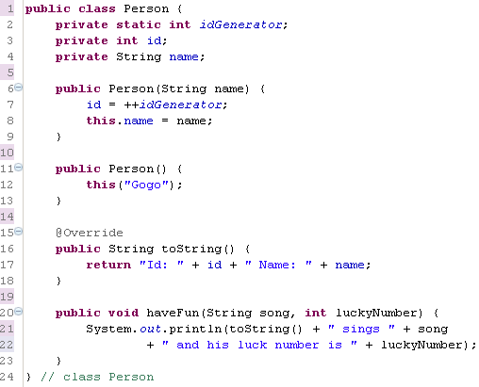
The example class Person

Slide 7
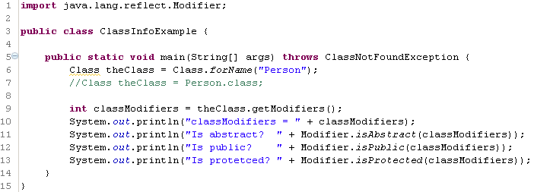

Class class - example
Returns the modifiers of the class (as bits)
Check the modifier data (bits in the form of an int) and return true/false accordingly

Slide 8
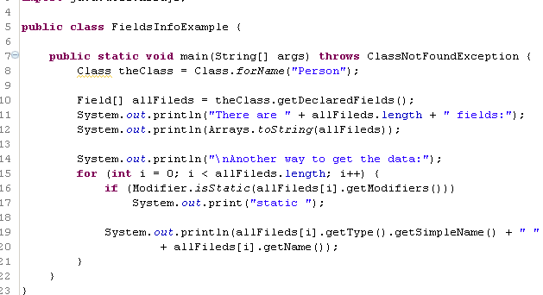
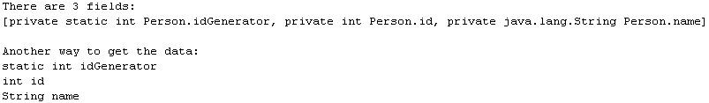
Getting data members descriptions
Get all data members
Check if a field is static
Get fields type
Get field variable name

Slide 9
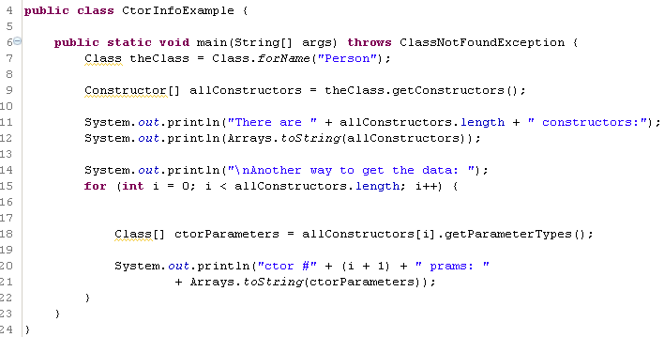
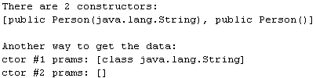
Getting constructors descriptions
Get array of all constructors
Get array of all the c’tor parameter types

Slide 10
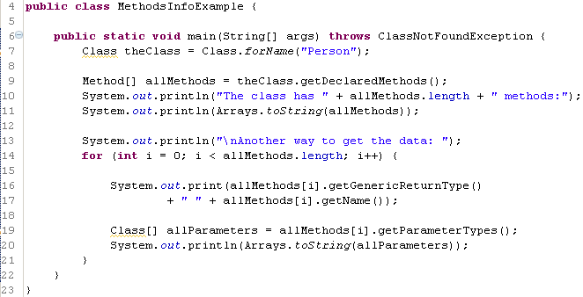
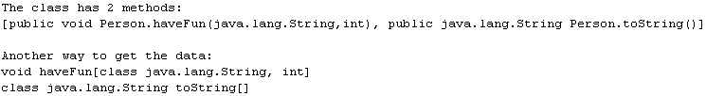
Getting methods descriptions
Get array of all methods
Get method return type

Slide 11
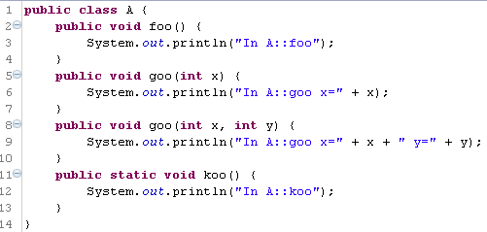
Method invocation
Once you have a Method object (which defined a method signature) you can invoke it on any object that has such a method
The class we’ll be working with:

Slide 12

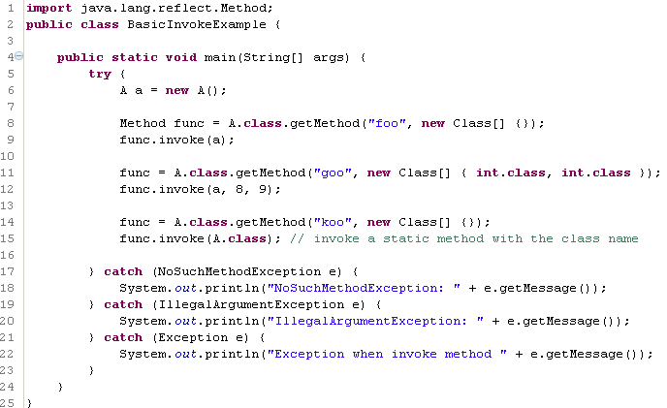

Method Invocation - Example
Get method “foo” without parameters
Invoke method on instance ‘a’

Slide 13
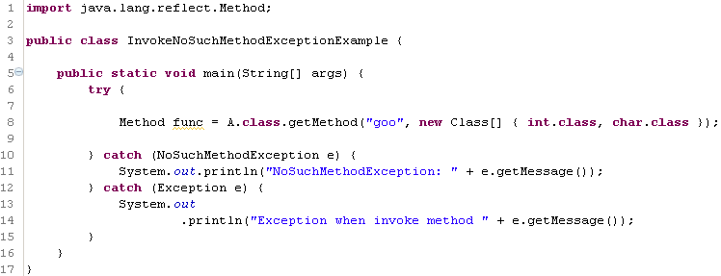
Method invocation – NoSuchMethodException

Slide 14
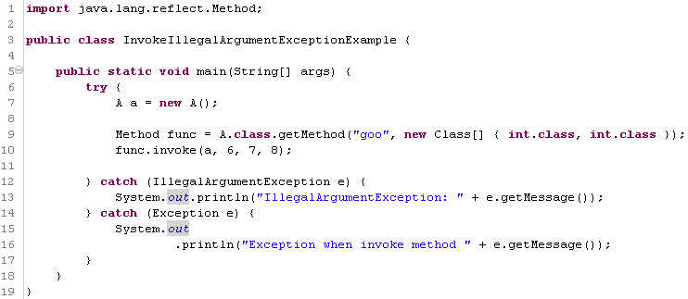
Method invocation - IllegalArgumentException
Method expects to have only 2 int parameters

Slide 15
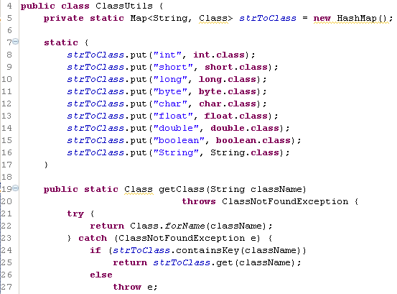
Instantiating new objects
Class.forName does not work on primitive types (int, boolean, etc.)
Utility class to enable dynamic conversion of primitive names to their class class

Slide 16
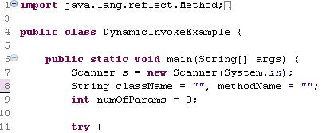
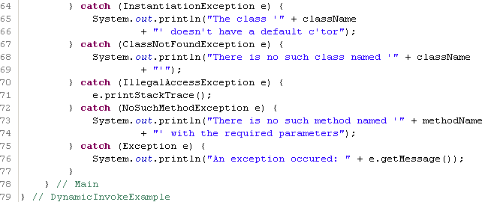
Interactive Invocation Example

Slide 17
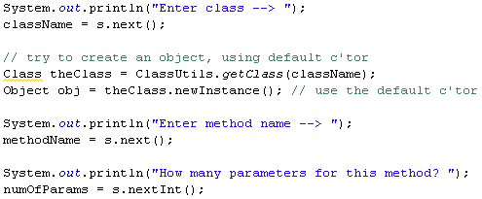
Interactive Invocation Example – cont.

Slide 18
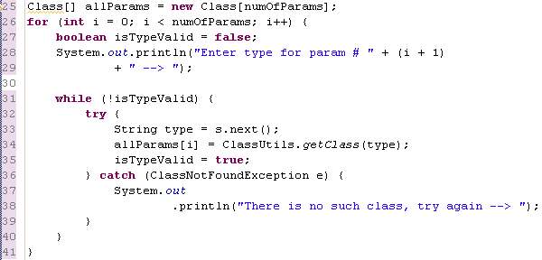
Interactive Invocation Example – cont.

Slide 19
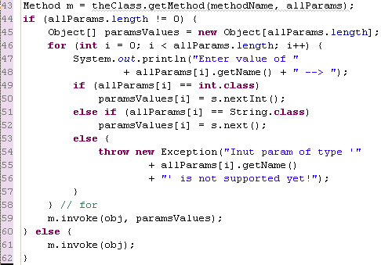
Interactive Invocation Example – cont.
Temporary support for “int” and “String” only. the rest can be added later.

Slide 20
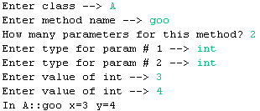

Output examples

Slide 21
Links
http://www.javacodegeeks.com/2013/07/javas-reflection-api.html

Slide 22
demo
examples.reflection

Slide 23
Agenda
Reflection
Annotations
Dynamic Proxy

Slide 24
Annotations
A mechanism to add meta-data on fields, methods and classes
Several annotations already exists out-of-the-box:
@Override – denotes a method that overrides the parent method
@Deprecated – denotes a method that is not meant to be used anymore
@SuppressWarnings – suppresses warnings categories that the compiler might generate upon compilation (e.g. ‘deprecation’ – to not show warnings when using deprecated methods…)

Slide 25
Annotations
Annotations can be read during:
Compilation time
Runtime (using reflection)
You can choose which types are allowed to use the annotation using:
Target
Retention Policy
Examples in following slides…

Slide 26
Annotations
Example 1:
public @interface MyAnnotation {
}
Usage:
public class MyClass {
@MyAnnotation
public void foo() {
}
}

Slide 27
Annotations
Example 2:
public @interface MyAnnotation {
String myValue();
}
Usage:
@MyAnnotation (myValue = “winter is coming”)
public class MyClass {
@MyAnnotation (“winter is coming”)
public void foo() {
}
}

Slide 28
Annotations
Example 3:
public @interface MyAnnotation {
String myValue();
int myNumber();
}
Usage:
public class MyClass {
@MyAnnotation (myValue = “winter is coming”)
public void foo() {
}
@MyAnnotation (myValue=“winter is coming”,myNumber=5)
public void boo() {
}
}

Slide 29
Annotations
Example 4:
public @interface MyAnnotation {
String myValue();
int myNumber() default 5;
}
Usage:
public class MyClass {
@MyAnnotation (myValue = “winter is coming”)
public void foo() {
}
@MyAnnotation (myValue = “winter is coming”,myNumber=7)
public void boo() {
}
}

Slide 30
Annotations
Example 5:
@Target ({ElementType.Method})
@Retention (RetentionPolicy.Runtime)
public @interface MyAnnotation {
String myValue();
int myNumber() default 5;
}
Usage:
public class MyClass {
@MyAnnotation (myValue = “winter is coming”)
public void foo() {
}
@MyAnnotation (myValue = “winter is coming”,myNumber=5)
public void boo() {
}
}

Slide 31
demo
examples.annotations

Slide 32
Agenda
Reflection
Annotations
Dynamic Proxy

Slide 33
Dynamic Proxy
Dynamic Proxy is a mechanism that allows a class to mimic an interface without the need to explicitly implement all the interfaces methods.
By using reflection, only a single method is invoked when a method is called
The single method will contain the method name and parameters thus allowing the Proxy to know which method was called
Dynamic Proxies are used to wrap network communications, performance testing, logging, security and more

Slide 34
Dynamic Proxy
When creating a Dynamic Proxy, a new class is created in runtime that can be casted to the interface it mimics – after that, all other classes will see it as an implementation of that interface
To create an instance of a Dynamic Proxy, the interface InvocationHandler should be implemented; It only has one method - invoke that is going to be called whenever an object calls a method on the proxy.
To create the actual proxy object, use Proxy.newProxyInstance

Slide 35
demo
examples.dynamicproxy

