Slide 1
AgriIQ
AI-Driven Crop Recommendation & Agricultural Advisory System
PROJECT REVIEW – 2
Project Design • Methodology • Technical Soundness
KONGARI ABHINAV — 2420030263
SONTIREDDY SRINIKA — 2420030617
ISRAJIWADI SRIVALLI — 2420030742
Under the guidance of Dr. Neelima Gogineni
AgriIQ — Project Review 2 1

Slide 2
Review 2 — Scope and Progress
1. Project Design
2. Methodology Adopted
3. Technical Soundness
Service-oriented architecture with Gateway
, Auth, Crop Recommendation
and Advisory services.
Incremental development:
architecture → database → service
implementation → API testing.
Spring Boot, Spring Security, JWT
, JPA/Hibernate, MySQL
and Postman validation.
• Current implemented milestone: Auth Service
• Registration and login APIs tested successfully
• User data verified in MySQL
• JWT token generation verified through Postman
• Remaining services will be integrated in later phases
AgriIQ — Project Review 2 2

Slide 3
Project Design — Problem and Objectives
Problem Statement
Objectives
Farmers may select crops using traditional knowledge or guesswork
instead of soil and weather conditions. Timely fertilizer, irrigation
and pest guidance may also be difficult to access. AgriIQ addresses this
through one connected platform.
• Build AgriIQ using SOA/microservices.
• Recommend crops using N, P, K, pH, temperature, humidity and rainfall.
• Provide crop-specific agricultural advisory.
• Secure services using JWT and role-based access.
• Use database-per-service and validate APIs using Postman.
AgriIQ — Project Review 2 3

Slide 4
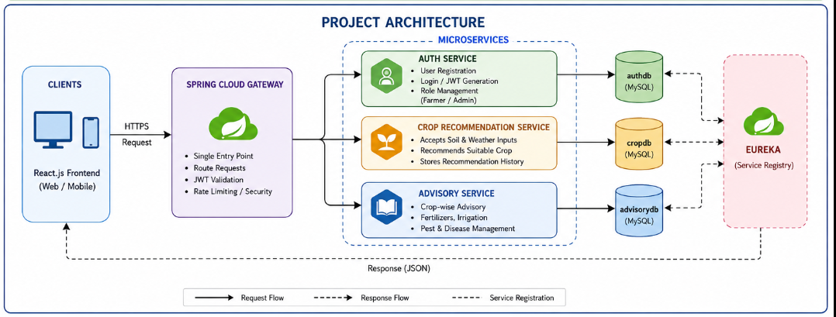
Project Architecture/Project Overview:

Slide 5
Project Design — Architecture
Auth Service
Client
Gateway
Registration, login, JWT issuance
and role management.
MySQL: authdb
React.js Frontend
(Web / Mobile)
Sends HTTPS requests.
Spring Cloud Gateway
• Single entry point
• Route requests
• JWT validation
• Security / rate limiting
Advisory Service
Crop-wise fertilizer, irrigation and
pest-management guidance.
MySQL: advisorydb
Crop Recommendation
Soil/weather inputs → recommended crop.
MySQL: cropdb
Eureka: service registration / discovery
AgriIQ — Project Review 2 4

Slide 6
Methodology Adopted — Auth Service
1. Setup
2. Data Layer
3. Security
Spring Boot + Maven project; configure
MySQL connection.
JPA entity + repository; Hibernate
creates/updates users table.
BCrypt password hashing + Spring Security
configuration.
4. APIs
5. JWT
6. Testing
REST endpoints for register and login.
Generate signed token after successful
authentication.
Build with Maven; test APIs using Postman;
verify database in MySQL.
AgriIQ — Project Review 2 5

Slide 7
Technical Soundness — Technologies and Components
• Spring Boot: REST API and application framework.
• Spring Security: authentication/security configuration.
• JWT (JJWT): token generation for stateless authentication.
• BCrypt: one-way password hashing before database storage.
• Spring Data JPA + Hibernate: object-relational mapping and persistence.
• MySQL: authdb database and users table.
• Maven: dependency management and project build.
• Postman: API request/response validation.
AgriIQ — Project Review 2 6

Slide 8
Technical Validation — MySQL Database
Database Verification
id | email | password | created_at
1 | ramesh@gmail.com | $2a$10$... | 2026-09-22 ...
Database: authdb
Table: users
A registered user was successfully persisted through the application.
The password column contains a BCrypt hash, not the original
password.
Evidence:
Spring Boot → JPA/Hibernate → MySQL persistence is working.
AgriIQ — Project Review 2 7

Slide 9
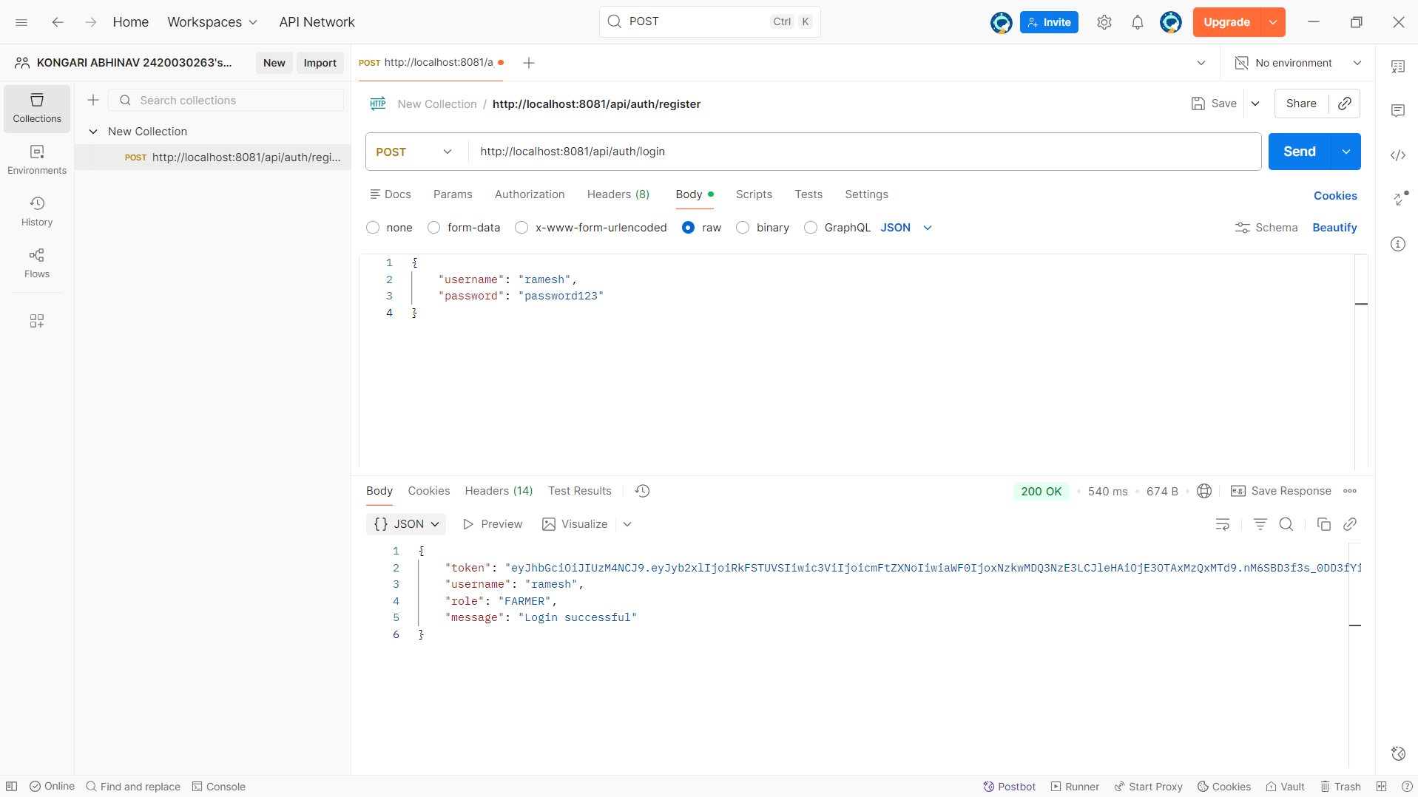
Working Output — Postman Login Test
AgriIQ — Project Review 2 8

Slide 10
Working Output — Register and Login Flow
Register
Database
Login
JWT
POST /api/auth/register
Request contains username, email, password and role.
Password is hashed with BCrypt.
Response: 201 Created + JWT.
JPA/Hibernate persists the user in
authdb.users.
MySQL verification showed the
registered record and BCrypt
password hash.
POST /api/auth/login
Request contains
username + password.
Credentials are verified against
the stored hash.
Successful login returns:
• JWT token
• username
• role
• success message
AgriIQ — Project Review 2 9

Slide 11
Technical Soundness — Evidence and Current Scope
Implemented and Verified
Remaining Integration Work
✓ Maven build completed successfully.
✓ Spring Boot service runs on port 8081.
✓ MySQL authdb/users persistence verified.
✓ Registration returned 201 Created.
✓ Login returned 200 OK.
✓ JWT token was generated.
✓ BCrypt hash observed in the database.
• Integrate Spring Cloud Gateway.
• Complete Eureka-based service discovery.
• Implement Crop Recommendation Service.
• Implement Advisory Service.
• Connect React frontend.
• Add end-to-end API/security testing and CI/CD.
AgriIQ — Project Review 2 10

Slide 12
Next Phase Plan
• Crop Recommendation Service: validated N, P, K, pH, temperature, humidity and rainfall inputs.
• Recommendation logic: rule-based engine as stated in the project plan.
• Advisory Service: crop-wise fertilizer, irrigation and pest-management guidance.
• Gateway integration: route requests and validate JWT.
• Eureka: register/discover independent services.
• React frontend: user-facing interface for the completed services.
• Final validation: Postman collection, end-to-end testing and CI/CD.
AgriIQ — Project Review 2 11

Slide 13
Conclusion
• AgriIQ follows a service-oriented design for crop recommendation and agricultural advisory.
• The Auth Service is the first implemented milestone for Review 2.
• Registration, secure password storage, MySQL persistence, login and JWT generation are working.
• Postman and MySQL provide direct technical evidence of the implementation.
• The next milestone is connecting the remaining services through the planned architecture.
Thank You
AgriIQ — Project Review 2 12

