Slide 1
Presented by-
Covid-19 Detection with images classification
Syed Ragib Israq - 1620873042
Taufiqur Rahman Anik - 1711474042

Slide 2
Background
We are doing Covid-19 detection using Image classification in deep learning. Previously we had to the same classification but the X-Ray images were unavailable. Now the data is published by Kaggle itself more than 100 images so we augmented the images and made it 500.Also how the labelling works for Covid-19 became available in internet.

Slide 3
Introduction
The coronavirus disease (COVID-19) is a global pandemic that was discovered by a Chinese physician in Wuhan, the capital city of Hubei province in mainland China, in December 2019
COVID-19 propagation is faster when people are in close proximity.
The death rate of COVID-19 is equivalent to 5% of the death rate of the 1918 Spanish flu pandemic
we advocate the use of AI to forecast COVID-19 cases and diagnose COVID-19 patients via chest X-ray images.

Slide 4
System Design
Collect the chest X-ray images for the dataset from COVID-19 patients and healthy persons
Generate almost 1000 chest X-ray images using data augmentation.
Represent the images in a feature space and apply deep learning.
Split the dataset into two sets: a training set and a validation set.
Evaluate the performance of the detector on the validation dataset.

Slide 5
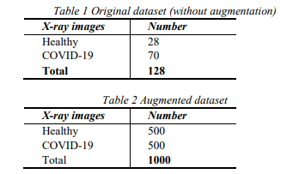
System Design

Slide 6
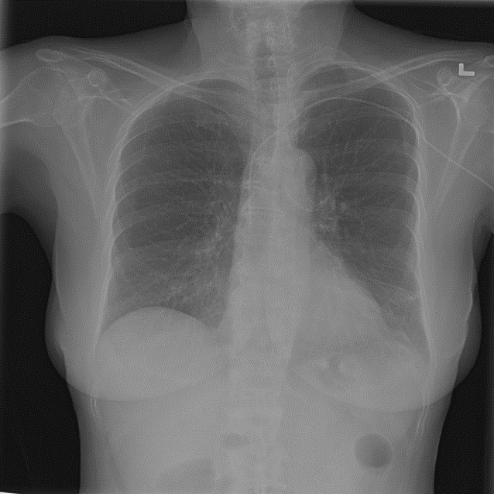
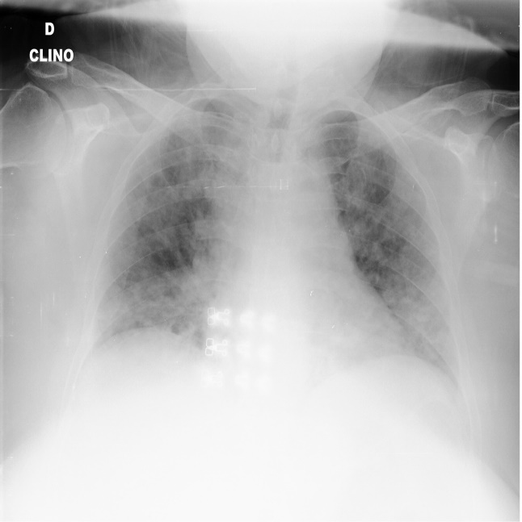
Dataset
Two types of datasets were used in the evaluation, the original dataset (without augmentation) and the augmented dataset.
Normal Covid-19

Slide 7
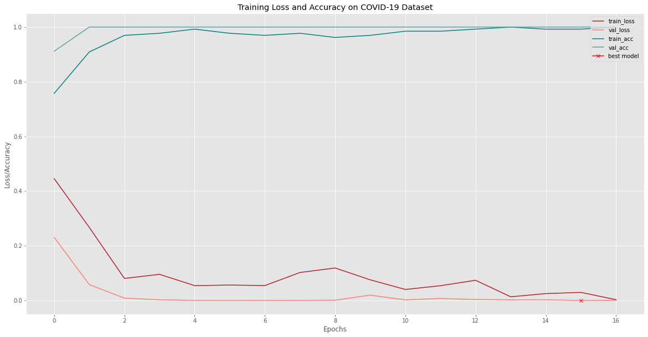
Accuracy Visualization
Training Loss and accuracy on Covid-19 dataset.

Slide 8
Environment Setup
Hardware:
For ORB and SVM classiﬁcation, an ordinary high-performance computer is enough, Like 8 GB ram, i5 (2.3 GHz), and a 256GB solid-state drive (SSD) disk. However, Training a deep neural network should use GPU to accelerate the process. In this Report, a Google Cloud GPU is used. A virtual machine instance with four core of CPU, 8 GB memory, and an NVIDIA GEFORCE is used. Concerning the detail setup Guide, please refer Google guide and other web pages.

Slide 9
Environment Setup
Software:
To test the ORB and SVM classiﬁcation, a python program which was initially used to Classify plants are ported. It was modiﬁed to use the new dataset and ran it on a Laptop. An iteration of the test needs about four hours. Because of the CNN-based Method is computing intensively, so it needs to run on a VM in Google GPU Cloud. To Test the Capsule network, a python capsule network implementation that aims to detect Brain tumors was ported to the pneumonia dataset. It also needs to be run on the GPU VM

Slide 10
Conclusion & Future Work
The rapid spread of COVID-19 across the world and the increasing number of deaths require urgent actions from all sectors. Future prediction of potential infections will enable authorities to tackle the consequences effectively.

Slide 11
Thank You

