Slide 1

Campus-Cruise: Feasibility Analysis
Revolutionizing Student Commuting with a Secure Campus-Only Network

Slide 2

The Critical Need for Feasibility Analysis
What is Feasibility Analysis and Why is it Important?
Definition
Strategic Decision-Making
A critical evaluation of a proposed project to determine if it is technically, economically, and operationally achievable.
Identifies potential problems and opportunities within the campus environment, evaluating alternatives and informing data-driven decision-making.
Risk Mitigation
Resource Allocation
Minimizes risks and maximizes the overall success of the project by preventing wasted resources on unworkable or inefficient ideas.
Ensures that resources are allocated to projects with the highest potential for success before significant investment.
2

Slide 3
Survey Objectives and Problem Statement
Bridging the Gap Between Student Needs and Solutions
The Core Problem
Survey Objectives
University students currently face significant transportation challenges that impact their academic and social life. High costs make private commutes increasingly expensive for the average student budget. Time inefficiency, characterized by long wait times and indirect public transport routes, leads to wasted productivity. Furthermore, safety concerns arise from a lack of verified transportation options, especially during late hours.
The survey was designed to bridge this gap by gauging interest and measuring the actual demand for a campus-exclusive ride-sharing platform. It aimed to identify requirements by pinpointing the most critical features students need to feel safe and comfortable. The ultimate goal is to provide a data-driven foundation for the feasibility of the Campus-Cruise platform.
3

Slide 4

Methodology and Participant Demographics
A Data-Driven Approach to Understanding Commuter Needs
Research Method
Participant Profile
Target Audience
The study utilized a structured Google Form distributed via official university channels. This approach allowed for the collection of both quantitative metrics and qualitative feedback from the student body.
The survey successfully captured responses from verified university students representing a diverse range of academic departments and commute backgrounds.
The primary focus was on daily campus commuters and student vehicle owners who are most likely to be the core users and providers of the Campus-Cruise network.
25
TOTAL RESPONDENTS
4

Slide 5
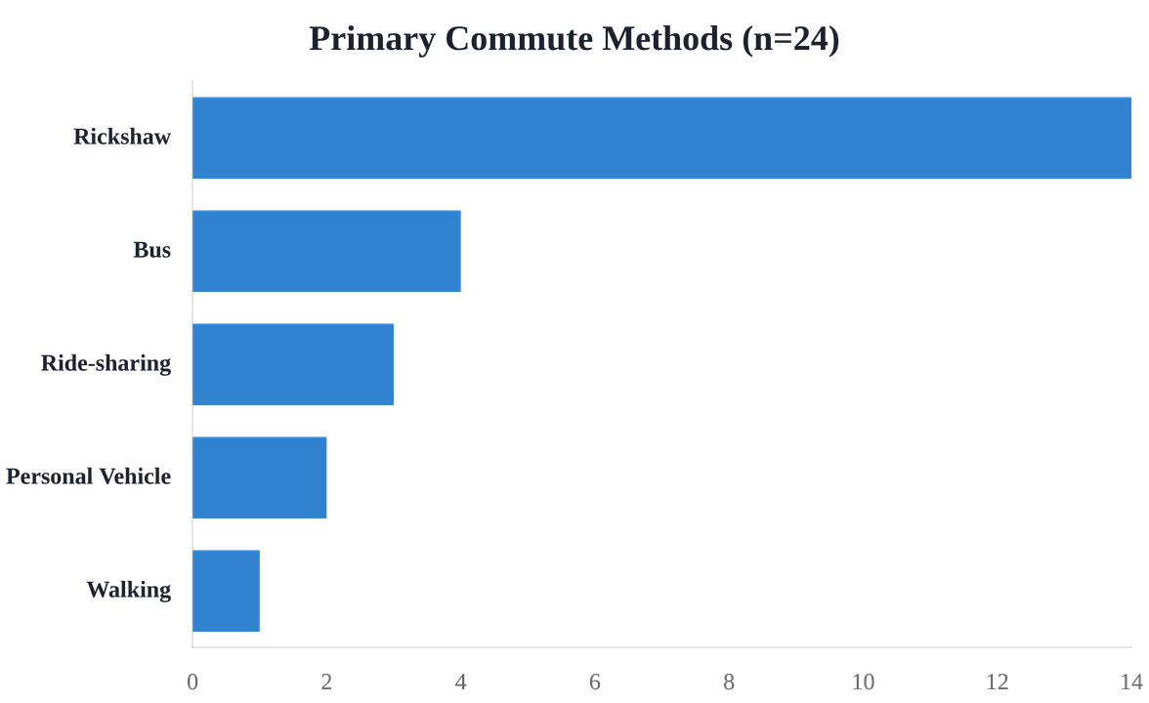
Current Commuting Landscape
Analyzing How Students Travel to Campus
Dominant Modes
The data reveals that the Rickshaw is the primary mode of transportation, utilized by over 58% of the surveyed students.
Public transport and existing ride-sharing platforms follow, indicating a fragmented market with high reliance on non-integrated services.
This landscape presents a significant opportunity for a unified, campus-specific solution to streamline the daily commute.
5

Slide 6
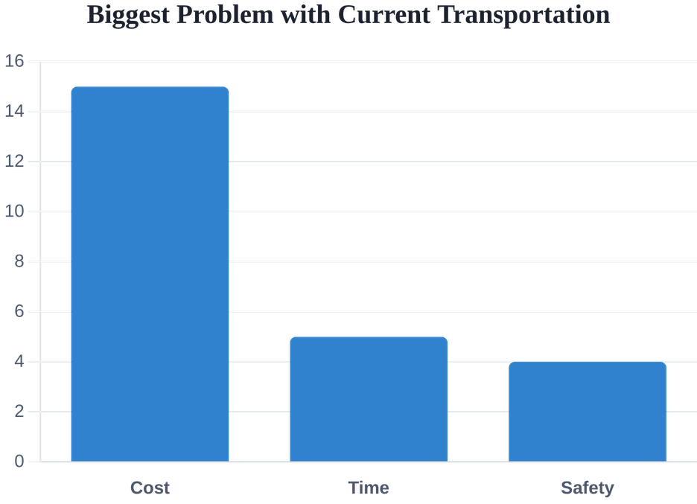
Identifying the Core Pain Points
What Bothers Students the Most About Commuting?
Economic Barriers
High costs are the primary concern for 62.5% of students. Private commutes and rising fares make daily travel a significant financial burden on student budgets.
Time Inefficiency
Long wait times and indirect routes lead to wasted productivity. Students often struggle with unpredictable public transport schedules during peak hours.
Safety Vulnerabilities
A lack of verified transportation options creates anxiety, particularly during late-hour travel or for students commuting from distant locations.
Source: Campus Cruise Feasibility Survey
6

Slide 7
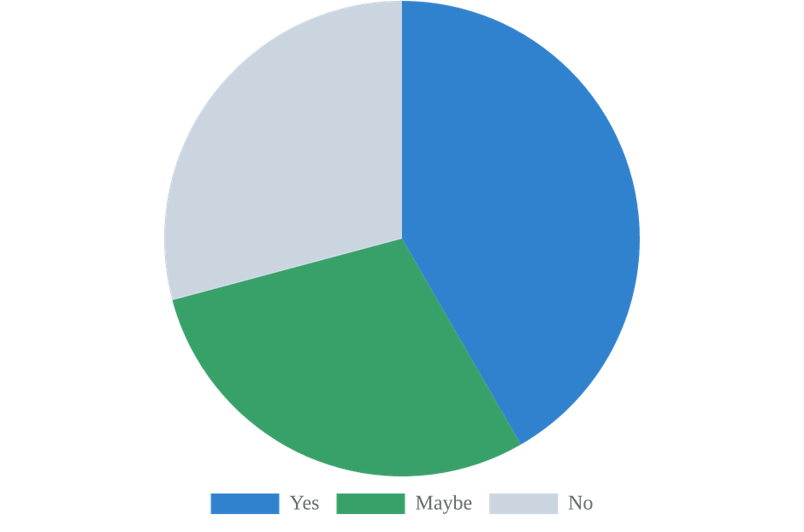
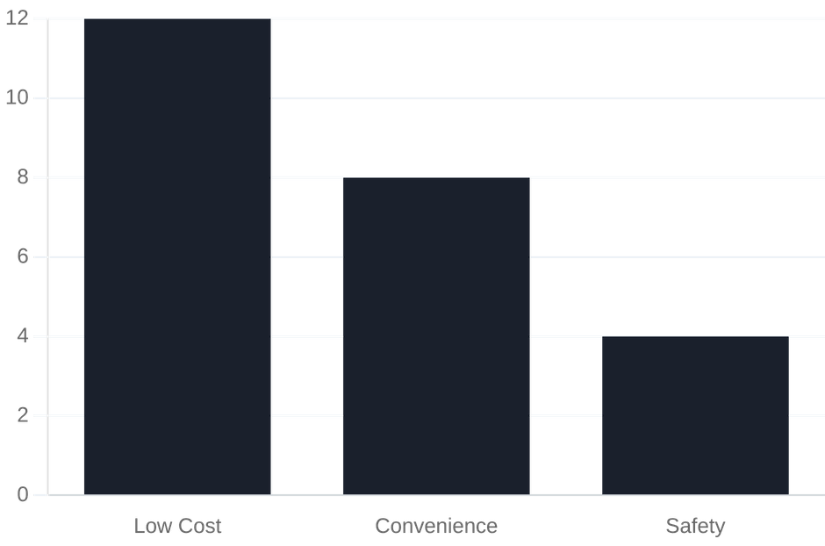
High Student Interest and Motivation
What Drives the Demand for Campus-Cruise?
Interest in Campus App
Primary Motivators
Over 70% of students expressed positive or potential interest in a dedicated campus ride-sharing platform.
Low Cost is the single most significant factor driving student adoption of the platform.
7

Slide 8
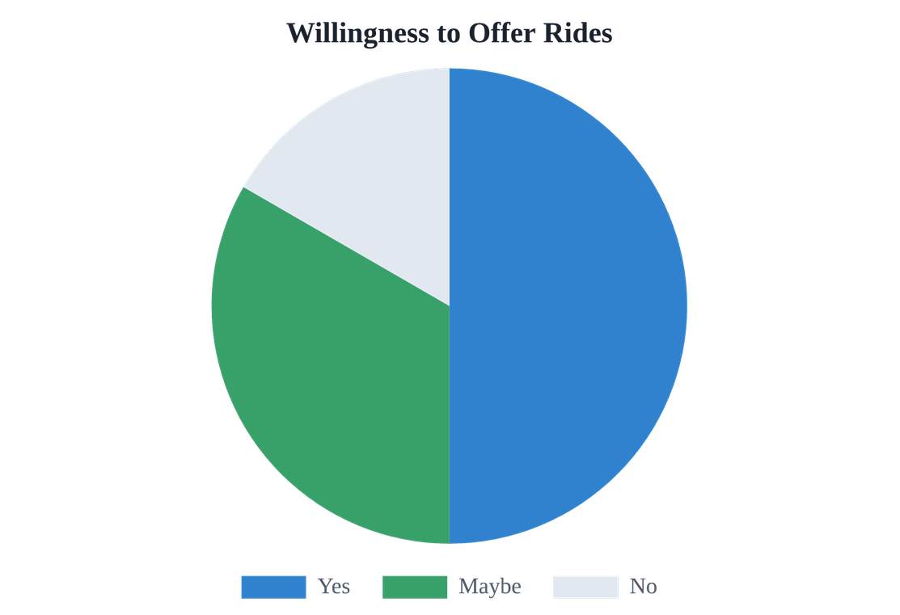
The Supply Side: Willingness to Share
Leveraging Existing Resources Within the Community
50.0%
Ready to Participate
Half of the surveyed student vehicle owners expressed a clear willingness to offer rides to their peers for a small fee. This indicates a strong internal supply potential.
Community Resource
An additional 33.3% are open to the idea ("Maybe"), suggesting that with the right incentives and trust-building features, the supply network could expand significantly.
Operational Backbone
This existing willingness transforms commuting from a simple transaction into a trusted community service, leveraging the university's social fabric.
Willingness of Student Vehicle Owners
8

Slide 9

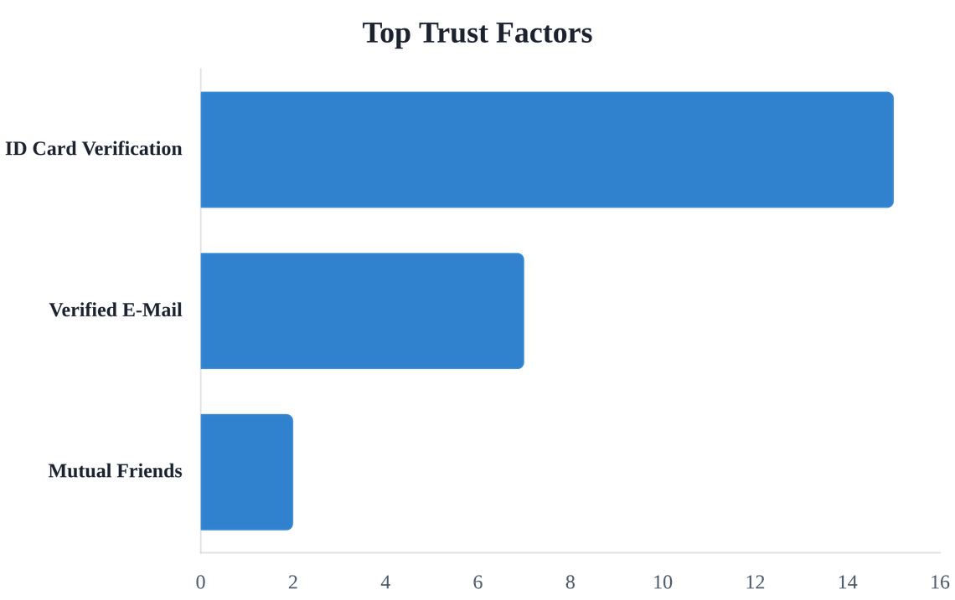
Building Trust and Ensuring Safety
The Foundation of a Campus-Only Network
Verification is Key
Mandatory university ID and email verification are the most essential features for building community trust. Restricting access to verified campus members ensures accountability.
Community Safety
By leveraging the existing university social fabric, Campus-Cruise transforms commuting into a trusted community service rather than a simple transaction.
Factors that build the most trust among students
9

Slide 10









Multi-Dimensional Feasibility Assessment
Evaluating Technical, Economic, and Operational Viability
TECHNICAL
ECONOMIC
OPERATIONAL
Scalable backend infrastructure for real-time matching and user management.
Low-cost operational model leveraging the existing student-led network.
High user acceptance and demand within the UIU student community.
Cross-platform mobile development (iOS/Android) using modern frameworks.
Potential for small transaction fees to cover server and maintenance costs.
Integration with university class schedules for automated ride matching.
Seamless integration with mapping and GPS services for live tracking.
Significant cost savings for daily student commuters compared to private options.
Verified student network ensures a high level of trust and safety.
10

Slide 11




Final Verdict: The Project is Highly Feasible
Campus-Cruise is Viable for Implementation
PROJECT FEASIBLE
Ready for Strategic Development and Launch
High Demand
Practicality
Technical Roadmap
78% student interest rate and clear dissatisfaction with current public transport options provide a strong user base from day one.
Dense student population and existing willingness of 50% of vehicle owners to share rides ensure a sustainable supply-demand balance.
Clear development milestones and existing technology stacks (GPS, Real-time matching) support a successful and scalable launch.
11

Slide 12




Core Features of Campus-Cruise
Designing a Solution Tailored for Students
Security First
Ease of Use
User Authentication
Ride Posting & Search
Secure login exclusively via university email and mandatory ID verification. This ensures that the network remains a trusted, student-only environment, significantly reducing safety risks.
An intuitive interface allows student drivers to post their routes and schedules in seconds. Riders can easily search for available trips that match their campus commute needs.
Efficiency
Fair Value
Smart Ride Matching
Dynamic Pricing
Advanced synchronization algorithms match riders and drivers based on route proximity and timing, maximizing efficiency and reducing wait times during peak academic hours.
Fair pricing models that adjust based on demand and traffic conditions. This ensures that the service remains affordable for students while providing fair compensation for drivers.
12

Slide 13



Advanced Features for Enhanced Experience
Going Beyond Basic Ride-Sharing
Smart Scheduling
Safety & Security
User Preferences
Automated ride booking integrated directly with university class routines. Students can set recurring trips based on their weekly schedules, reducing the daily hassle of finding rides.
A verified student-only network backed by mandatory ID verification. Includes an integrated Emergency SOS feature and live GPS tracking shared with trusted campus contacts.
Enhanced comfort through personalized settings, including gender-specific ride preferences and in-app chat for seamless coordination between riders and drivers.
*Features designed based on student feedback regarding safety and routine-based commuting needs.
13

Slide 14




Strategic Recommendations and Roadmap
Steps to Bring Campus-Cruise to Life
Enhanced Verification
Flexible Pricing
Inclusive Features
Implement multi-factor ID card and official email verification to maintain network integrity and student trust.
Explore variable fare options and bidding systems to accommodate different student budgets and traffic conditions.
Integrate gender-specific preferences to ensure all students feel comfortable and safe during their commute.
Implementation Roadmap
01
02
03
04
Planning
Development
Pilot Testing
Full Rollout
Business planning and financial sustainability modeling for long-term operations.
MVP development focusing on core matching and verification features.
Alpha testing with selected student focus groups to refine user experience.
Full-scale campus launch and user acquisition campaign across UIU.
14

Slide 15

Thank You
Revolutionizing Student Commuting with a Secure Campus-Only Network
.
15

