Slide 1
Presentation on: Overview of Bus in Computer Architecture
Presented by: Israt Jahan Reshma
ID: 18CSE241

Slide 2
What is Bus?
A bus is a set of electrical wires (lines) that connects the various hardware components of a computer system.
It works as a communication pathway through which information flows from one hardware component to the other hardware component.

Slide 3
The Expansion Bus
The expansion bus facilitates the easy connection of additional components and devices on a computer for example the addition of a TV card or sound card.

Slide 4
Expansion Bus Types
These are some of the common expansion bus types that have ever been used in computers:
ISA - Industry Standard Architecture
EISA - Extended Industry Standard Architecture
MCA - Micro Channel Architecture
VESA - Video Electronics Standards Association
PCI - Peripheral Component Interconnect
AGP - Accelerated Graphics Port

Slide 5
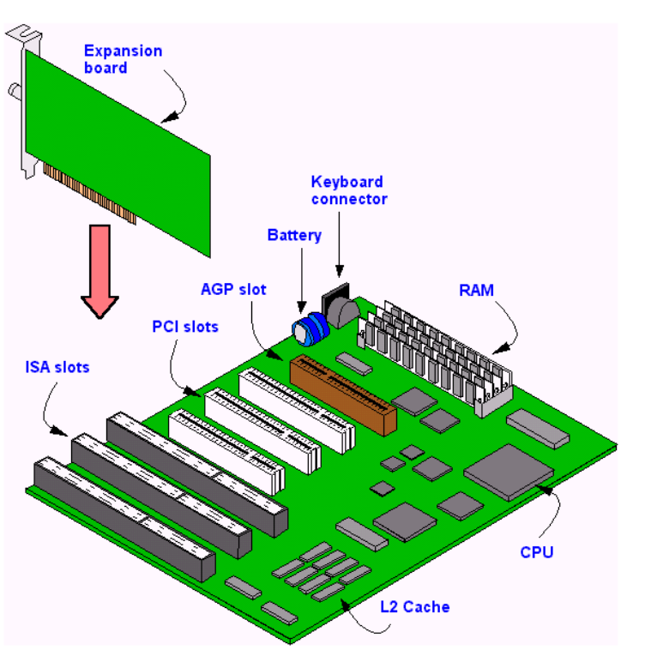
Expansion Buses:

Slide 6
ISA Bus(Industry Standard Architecture)
The most common type of early expansion bus
Was designed for use in the original IBM PC.
The 8088 CPU in IBM PC-XT used an 8-bit bus design.(speed 4.77MHZ)
The 80286 CPU in IBM PC-AT used an 16-bit bus design. (AT-Advanced Technology) .(speed 8MHZ)
Modern computer uses PCI bus in place of ISA bus.

Slide 7
Limitations of 8 bit ISA Bus
Low data transfer rates.
Very limited IRQ (Interrupt Request).
The bus provide very limited System Resources like IRQ ( 3 Requests at a time).
Very limited DMA channel. Out of 3 DMA channel, two channels are used by floppy and Hard Drive. So only one DMA channel is left for expansion cards.
Hardwired and complex configuration with no conflict resolving.

Slide 8
Advantages of 16 bit ISA Bus
8 more data lines and 4 more address lines provide high speed functionality.
Interrupt- 5
DMA channel- 2

Slide 9
MCA (Micro Channel Architecture)
Developed by IBM as a replacement for ISA .
The bus improvements over the ISA bus.
speed of 10MHz
support either 16-bit or 32- bit data.
also supports bus mastering –(a technology that placed a mini-processor on each expansion card).

Slide 10
EISA (Extended Industry Standard Architecture)
alternative to MCA
It was designed to use a 32-bit data and provided 32 address lines.
ISA cards will work in EISA slots(Twice of ISA slot)
supports bus mastering

Slide 11
Local Bus:
a local bus is a computer bus that connects directly, or almost directly, from the central processing unit (CPU) to one or more slots on the expansion bus
There are various types of computers to increase the speed of data transfer. Local buses for expanded memory and video boards are the most common.
VESA Local Bus is an example of a local bus design.

Slide 12
VESA(Video Electronics Standards Association) Bus / VESA Local Bus(VLB)
The major reason for the development of VLB was to improve the video performance in PCs.
VLB was 32 bit bus and it runs at the speed of 33MHz.
Extension of ISA. So ISA works on VLB port.
it acted high-speed for memory-mapped I/O and DMA, while the ISA bus handled interrupts and port-mapped I/O.
So ISA card can be used in VLB slots but we should use ISA slot first and leave VLB slot open for VLB cards which will not work on ISA slots.

Slide 13
Limitations of VESA bus:
The design was strongly based on the 486 processor
and adapting it to the Pentium caused a host of compatibility and other problems. • The bus itself was tricky electrically, for example, the number of cards that could be used on the bus was low (often only two or even one). • The bus did not support bus mastering properly since there was no good arbitration scheme ,and did not support plug and play

Slide 14
AGP BUS (Accelerated Graphics Port)
Expansion slot- for graphics card

Slide 15
PCI(Peripheral Component Interconnect )

