Slide 1
System Analysis & Design
Lecture-2
The System Development Life cycle

Slide 2
System Development Life cycle
An effective System Development Life Cycle (SDLC) should result in a high quality system that meets customer expectations, reaches completion within time and cost evaluations, and works effectively and efficiently in the current and planned Information Technology infrastructure.

Slide 3
System Development Life cycle
System Development Life Cycle (SDLC) is a conceptual model which includes policies and procedures for developing or altering systems throughout their life cycles. SDLC includes the following stages−
1. Recognition of need
2. Feasibility study
3. Analysis
4. Design
5. Implementation
6. Post implementation and maintenance

Slide 4
Recognition of need
Preliminary survey/ initial investigation
Statement of scope and objectives, performance criteria

Slide 5
Feasibility Study
Statement of new scope and objectives.
Cost/benefit analysis
Confirm project Technical and behavioral feasibility
During this phase, threats, constraints, integration and security of system are also considered.
A feasibility report for the entire project is created at the end of this phase.

Slide 6
Analysis
Detailed evaluation of present system
Data collection
Define logical model of the system like: Data dictionary, data flow diagram,
A Software Requirement Specification (SRS) document, which specifies the software, hardware, functional, and network requirements of the system is prepared at the end of this phase.

Slide 7
System Design
Includes the design of application, network, databases, user interfaces, and system interfaces.
Transform the SRS document into logical structure, which contains detailed and complete set of specifications that can be implemented in a programming language.
Create a contingency, training, maintenance, and operation plan.
Review the proposed design. Ensure that the final design must meet the requirements stated in SRS document.
Finally, prepare a design document which will be used during next phases.

Slide 8
Implementation
Implement the design into source code through coding.
Combine all the modules together into training environment that detects errors and defects.
A test report which contains errors is prepared through test plan that includes test related tasks such as test case generation, testing criteria, and resource allocation for testing.
Integrate the information system into its environment and install the new system.

Slide 9
Post implementation and maintenance
Include all the activities such as phone support or physical on-site support for users that is required once the system is installing.
Implement the changes that software might undergo over a period of time, or implement any new requirements after the software is deployed at the customer location.
It also includes handling the residual errors and resolve any issues that may exist in the system even after the testing phase.
Maintenance and support may be needed for a longer time for large systems and for a short time for smaller systems.

Slide 10
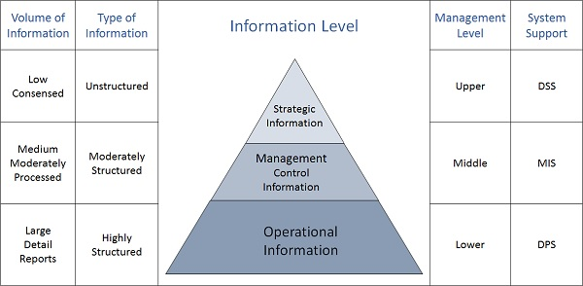
Categories of Information

Slide 11
Strategic Information
This information is required by topmost management for long range planning policies for next few years. For example, trends in revenues, financial investment, and human resources, and population growth.
This type of information is achieved with the aid of Decision Support System (DSS).
Managerial Information
This type of Information is required by middle management for short and intermediate range planning which is in terms of months. For example, sales analysis, cash flow projection, and annual financial statements.
It is achieved with the aid of Management Information Systems (MIS).
Operational information
This type of information is required by low management for daily and short term planning to enforce day-to-day operational activities. For example, keeping employee attendance records, overdue purchase orders, and current stocks available.
It is achieved with the aid of Data Processing Systems (DPS).

