Slide 1
System Analysis & Design
Lecture-3
The role of the systems analyst

Slide 2
System Analyst
The system analyst is a person who is thoroughly aware of the system and guides the system development project by giving proper directions. He is an expert having technical and interpersonal skills to carry out development tasks required at each phase.

Slide 3
Main Roles of a System Analyst
Defining and understanding the requirement of user through various fact finding techniques.
Prioritizing the requirements.
Maintains analysis and evaluation to arrive at appropriate system which is more user friendly.
Suggests many flexible alternative solutions, pick the best solution, and quantify cost and benefits.
Draw certain specifications which are easily understood by users and programmer in precise and detailed form.
Implemented the logical design of system which must be modular.

Slide 4
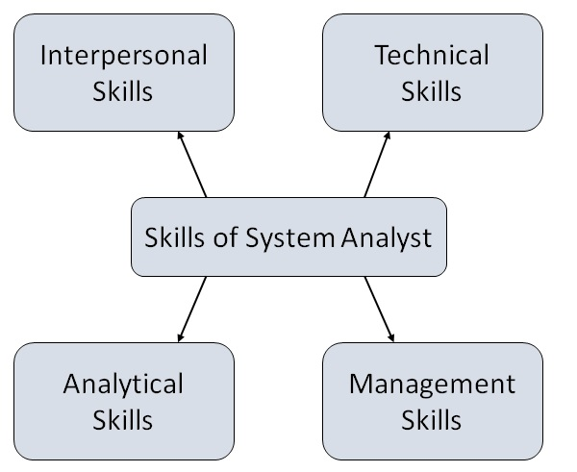
Skills of a System Analyst

Slide 5
Interpersonal Skills
Communication
Understanding
Teaching
Selling

Slide 6
Technical Skills
Creativity
Problem solving
Project management
Dynamic interface
Questioning attitude and inquiring mind
Knowledge of the basics of the computer and the business function

Slide 7
Analytical Skills
Organizational knowledge
Problem identification, problem analysis, and problem solving
Sound commonsense
Ability to access trade-off
Curiosity to learn about new organization

Slide 8
Management Skills
Understand users terminology and practices.
Resource & project management.
Change & risk management.
Understand the management functions thoroughly.

