Slide 1
System Analysis & Design
Lecture-4
Information gathering

Slide 2
What kinds of information do we need??
Much of the information we need to analyze relates to the organization as below:
Policies
Goals
Objectives
Organization structure
Authority relationships
Job functions information requirements
Interpersonal relationships
Work flow
Methods and procedures
Work schedules
The organization
User staff
Work flow itself

Slide 3
Where does information originate??
Primary external sources are:
Vendors
Government documents
Newspapers and professional journals
The primary internal sources are:
Financial reports
Personnel staff
Professional staff(legal counsel, auditor)
System documentation or manuals
Reports and transaction documents

Slide 4
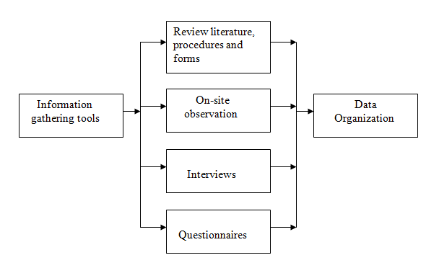
Information gathering methods

Slide 5
Review of Records, Procedures, and Forms
Review of existing records, procedures, and forms helps to seek insight into a system which describes the current system capabilities, its operations, or activities.
Advantages
It helps user to gain some knowledge about the organization or operations by themselves before they impose upon others.
It helps in documenting current operations within short span of time as the procedure manuals and forms describe the format and functions of present system.
It can provide a clear understanding about the transactions that are handled in the organization, identifying input for processing, and evaluating performance.
It can help an analyst to understand the system in terms of the operations that must be supported.
It describes the problem, its affected parts, and the proposed solution.

Slide 6
On site Observation
This is a method of gathering information by noticing and observing the people, events, and objects. The analyst visits the organization to observe the working of current system and understands the requirements of the system.
Advantages
It is useful in situation where authenticity of data collected is in question or when complexity of certain aspects of system prevents clear explanation by end-users.
It produces more accurate and reliable data.
It produces all the aspect of documentation that are incomplete and outdated.

Slide 7
Interviewing
Systems analyst collects information from individuals or groups by interviewing. The analyst can be formal, legalistic, play politics, or be informal; as the success of an interview depends on the skill of analyst as interviewer.
It can be done in two ways −
Unstructured Interview − The system analyst conducts question-answer session to acquire basic information of the system.
Structured Interview − It has standard questions which user need to respond in either close (objective) or open (descriptive) format.

Slide 8
Advantages of Interviewing
This method is frequently the best source of gathering qualitative information.
It is useful for them, who do not communicate effectively in writing or who may not have the time to complete questionnaire.
Information can easily be validated and cross checked immediately.
It can handle the complex subjects.
It is easy to discover key problem by seeking opinions.
It bridges the gaps in the areas of misunderstandings and minimizes future problems.

Slide 9
Questionnaires
This method is used by analyst to gather information about various issues of system from large number of persons.
There are two types of questionnaires −
Open-ended Questionnaires − It consists of questions that can be easily and correctly interpreted. They can explore a problem and lead to a specific direction of answer.
Closed-ended Questionnaires − It consists of questions that are used when the systems analyst effectively lists all possible responses, which are mutually exclusive

Slide 10
Advantages of questionnaires
It is very effective in surveying interests, attitudes, feelings, and beliefs of users which are not co-located.
It is useful in situation to know what proportion of a given group approves or disapproves of a particular feature of the proposed system.
It is useful to determine the overall opinion before giving any specific direction to the system project.
It is more reliable and provides high confidentiality of honest responses.
It is appropriate for electing factual information and for statistical data collection which can be emailed and sent by post.

