Slide 1
System Analysis & Design
Lecture-5
Structured Analysis(DFD)

Slide 2
Structured Analysis
Structured analysis is a set of techniques and graphical tools that allow the analyst to develop a new kind of system specifications that are easily understandable to the user.
The new goals specify the following
Use graphics wherever possible to help communicate better with the user.
Differentiate between logical and physical systems.
Build a logical system model to familiarize the user the system characteristics and interrelationships before implementation.

Slide 3
Structured Analysis Tools
Structured Analysis tools are −
Data Flow Diagrams
Data Dictionary
Decision Trees
Decision Tables
Structured English

Slide 4
Data Flow Diagrams (DFD)
The DFD was first developed by Larry Constantin. Also known as a “bubble chart”
It shows the flow of data between various functions of system and specifies how the current system is implemented.
It is an initial stage of design phase that functionally divides the requirement specifications.
It is a good communication tool between user and analyst or analyst and system designer.
It gives an overview of what data a system processes, what transformations are performed, what data are stored, what results are produced and where they flow.

Slide 5
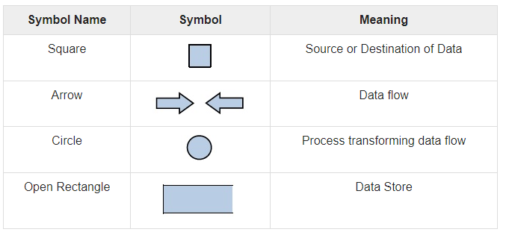
Basic Elements of DFD

Slide 6
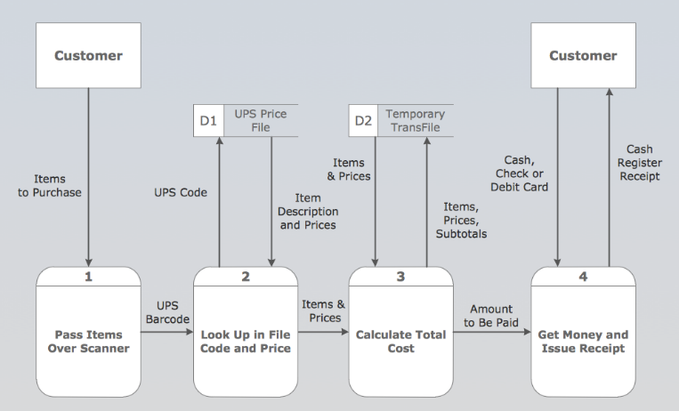
Example-1

Slide 7
Rules of constructing a DFD
Rule1: Processes should be named and numbered for easy reference. Each name should be representative of the process.
Rule2: The direction of flow is from top to bottom and from left to right. Data traditionally flow from the source (upper left corner) to the destination (lower right corner), although they may flow back to a source.
Rule3: When a process is exploded into lower level details (Sub processes), they are numbered.
Rule4: The names of data stores, sources, and destinations are written in capital letters. Process and data flow names have the first letter of each word capitalized.

Slide 8
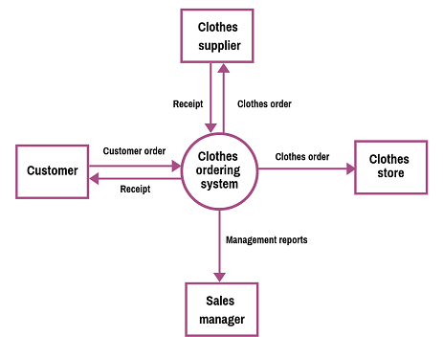
Example-2

Slide 9
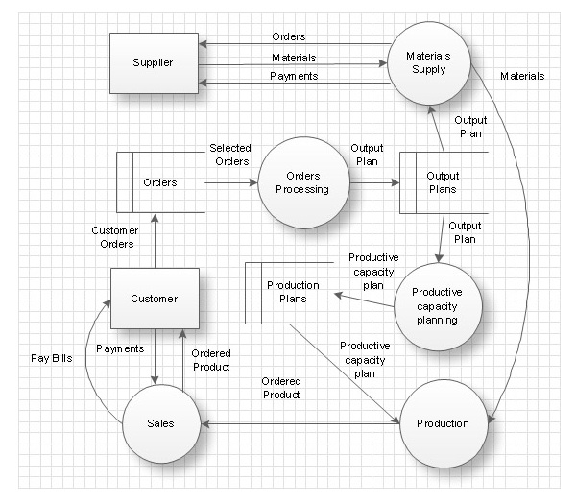
Example-3

