Slide 1
BUBBLE SORT

Slide 2
Bubble Sort
Idea:
  Repeatedly pass through the array
  Swaps adjacent elements that are out of order
Easier to implement, but slower than Insertion sort
i
1
2
3
n
8
4
6
9
2
3
1
j

Slide 3
Example
8
4
6
9
2
3
1
1
8
4
6
9
2
3
i = 1
j
i = 2
j
8
4
6
9
2
1
3
1
2
8
4
6
9
3
i = 1
j
i = 3
j
8
4
6
9
1
2
3
1
2
3
8
4
6
9
i = 1
j
i = 4
j
8
4
6
1
9
2
3
1
2
3
4
8
6
9
i = 1
j
i = 5
j
8
4
1
6
9
2
3
1
2
3
4
6
8
9
i = 1
j
i = 6
j
8
1
4
6
9
2
3
1
2
3
4
6
8
9
i = 1
j
i = 7
1
8
4
6
9
2
3
j
i = 1
j

Slide 4
Bubble Sort
Alg.: BUBBLESORT(A)
for i ← 1 to length[A]
do for j ← length[A] downto i + 1
do if A[j] < A[j -1]
then exchange A[j] ↔ A[j-1]
i
8
4
6
9
2
3
1
i = 1
j

Slide 5




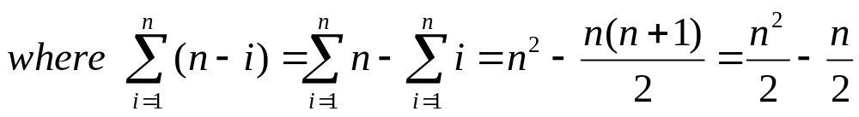
Bubble-Sort Running Time
Alg.: BUBBLESORT(A)
for i ← 1 to length[A]
do for j ← length[A] downto i + 1
do if A[j] < A[j -1]
then exchange A[j] ↔ A[j-1]
c₁
c₂
Comparisons: ≈ n²/2
c₃
c₄
Exchanges: ≈ n²/2
T(n) =
c₁(n+1) +
c₂
c₃
c₄
= Θ(n) +
(c₂ + c₂ + c₄)
Thus,T(n) = Θ(n²)

