Slide 1


Slide 2


Single-Source Shortest Path Problem - The problem of finding shortest paths from a source vertex v to all other vertices in the graph.

Slide 3

Dijkstra's algorithm - is a solution to the single-source shortest path problem in graph theory.
Works on both directed and undirected graphs. However, all edges must have nonnegative weights.
Approach: Greedy
Input: Weighted graph G={E,V} and source vertex v∈V, such that all edge weights are nonnegative
Output: Lengths of shortest paths (or the shortest paths themselves) from a given source vertex v∈V to all other vertices

Slide 4

dist[s] ←0 (distance to source vertex is zero)
for all v ∈ V–{s}
do dist[v] ←∞ (set all other distances to infinity)
S←∅ (S, the set of visited vertices is initially empty)
Q←V (Q, the queue initially contains all vertices)
while Q ≠∅ (while the queue is not empty)
do u ← mindistance(Q,dist) (select the element of Q with the min. distance)
S←S∪{u} (add u to list of visited vertices)
for all v ∈ neighbors[u]
do if dist[v] > dist[u] + w(u, v) (if new shortest path found)
then d[v] ←d[u] + w(u, v) (set new value of shortest path)
(if desired, add traceback code)
return dist

Slide 5

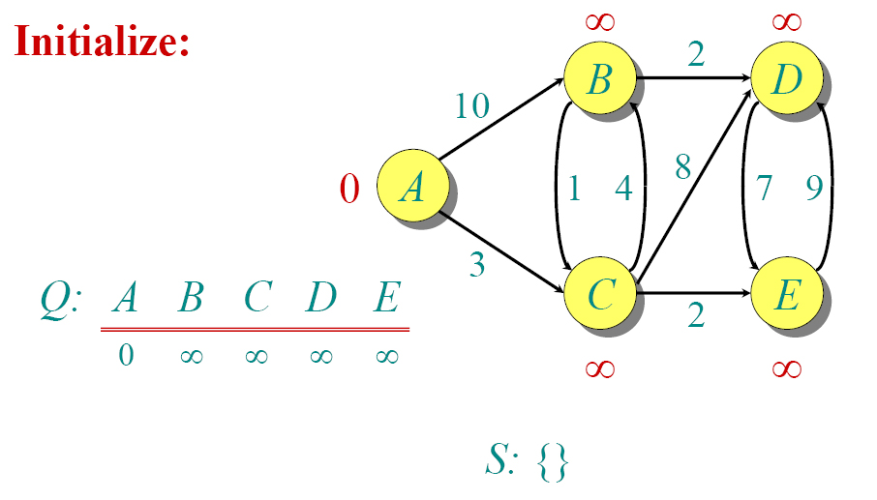

Slide 6


Slide 7


Slide 8


Slide 9


Slide 10


Slide 11


Slide 12


Slide 13


Slide 14


Slide 15



- Traffic Information Systems are most prominent use
- Mapping (Map Quest, Google Maps)
- Routing Systems

