Slide 1
Graph

Slide 2
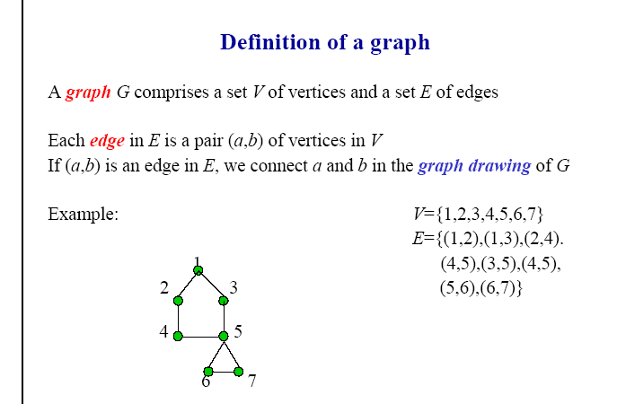

Slide 3
Elementary Concepts
A graph is represented with dots or circles (vertices) joined by lines (edges)
The magnitude of graph G is characterized by number of vertices |V| (called the order of G) and number of edges |E| (size of G)
The running time of algorithms are measured in terms of the order and size

Slide 4
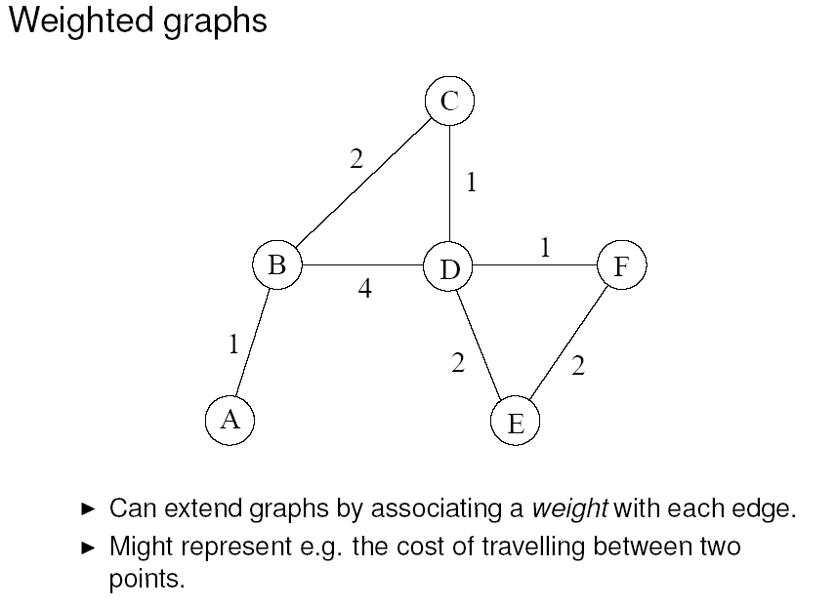

Slide 5
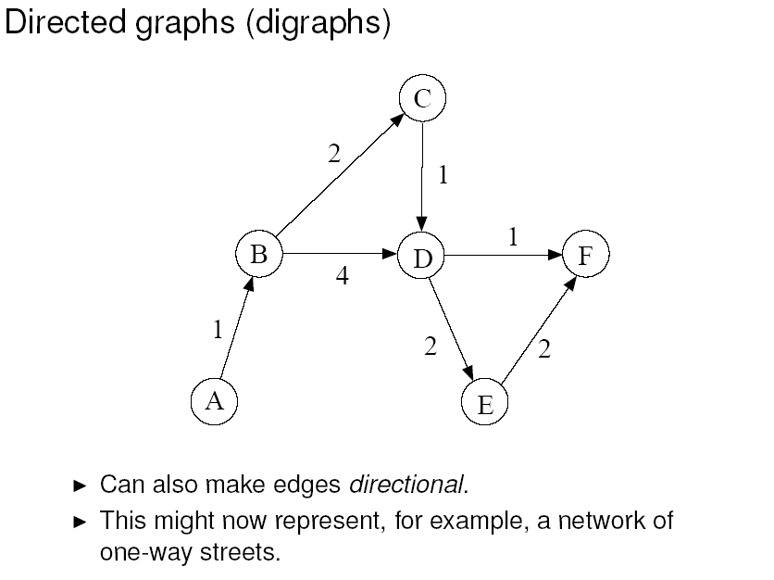

Slide 6
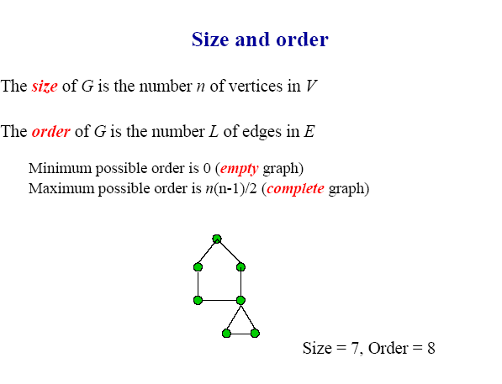
order
size
size
size
order
size

Slide 7
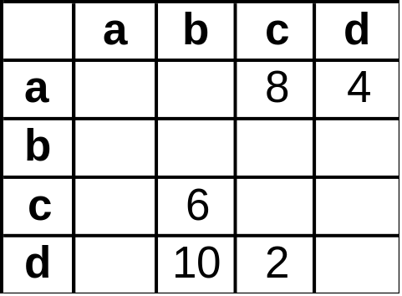
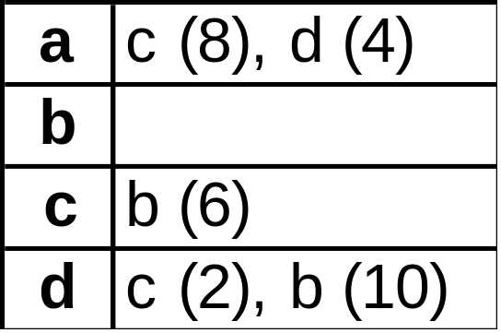
Computer representation
adjacency matrix: a |V| x |V| array where each cell i,j contains the weight of the edge between v_{i} and v_{j} (or 0 for no edge)
adjacency list: a |V| array where each cell i contains a list of all vertices adjacent to v_{i}
6
c
b
2
8
10
4
a
d
adjacency
matrix
adjacency
list

