Slide 1
Intro to Digital Electronics

Slide 2
Brief History of Digital Electronics
Digital electronics can be found in many applications in the form of microprocessors, microcontrollers, PCs, DSPs, and an uncountable number of other systems.
The historic development of design of digital circuits:
resistor-transistor logic (RTL)
diode-transistor logic (DTL)
transistor-transistor logic (TTL)
emitter-coupled logic (ECL)
NMOS
complementary MOS (CMOS)

Slide 3
Digital Binary Logic
Digital electronics represent signals by discrete bands of analog levels, rather than by a continuous range.

Slide 4
Digital Binary Logic
Digital electronics represent signals by discrete bands of analog levels, rather than by a continuous range.
All levels within a band represent the same signal state.
Small changes to the analog signal levels due to manufacturing tolerance, or noise do not leave the discrete envelope, and as a result are ignored by signal state sensing circuitry.

Slide 5
Digital Binary Logic
Digital electronics represent signals by discrete bands of analog levels, rather than by a continuous range.
All levels within a band represent the same signal state.
Small changes to the analog signal levels due to manufacturing tolerance, or noise do not leave the discrete envelope, and as a result are ignored by signal state sensing circuitry.
Binary logic is the most common style of digital logic.
The signal is either a 0 (low, false) or a 1 (high, true) - Positive Logic Convention

Slide 6
Digital Binary Logic
Digital electronics represent signals by discrete bands of analog levels, rather than by a continuous range.
All levels within a band represent the same signal state.
Small changes to the analog signal levels due to manufacturing tolerance, or noise do not leave the discrete envelope, and as a result are ignored by signal state sensing circuitry.
Binary logic is the most common style of digital logic.
The signal is either a 0 (low, false) or a 1 (high, true) - Positive Logic Convention
Mathematical representation of logical operations is Boolean algebra: set of operations (NOT, AND, OR, NAND, NOR, etc.) with binary or logical elements.
To perform general logical operations, a logic family must contain NOT and at least one another function of two inputs OR or AND.

Slide 7

Review of Boolean Algebra
A | Z
0 | 1
1 | 0
A | B | Z
0 | 0 | 0
0 | 1 | 1
1 | 0 | 1
1 | 1 | 1
A | B | Z
0 | 0 | 0
0 | 1 | 0
1 | 0 | 0
1 | 1 | 1
A | B | Z
0 | 0 | 1
0 | 1 | 0
1 | 0 | 0
1 | 1 | 0
A | B | Z
0 | 0 | 1
0 | 1 | 1
1 | 0 | 1
1 | 1 | 0
NOT
Truth Table
OR
Truth Table
AND
Truth Table
NOR
Truth Table
NAND
Truth Table

Slide 8
Review of Boolean Algebra
A | Z
0 | 1
1 | 0
A | B | Z
0 | 0 | 0
0 | 1 | 1
1 | 0 | 1
1 | 1 | 1
A | B | Z
0 | 0 | 0
0 | 1 | 0
1 | 0 | 0
1 | 1 | 1
A | B | Z
0 | 0 | 1
0 | 1 | 0
1 | 0 | 0
1 | 1 | 0
A | B | Z
0 | 0 | 1
0 | 1 | 1
1 | 0 | 1
1 | 1 | 0
NOT
Truth Table
OR
Truth Table
AND
Truth Table
NOR
Truth Table
NAND
Truth Table

Slide 9
Review of Boolean Algebra
A | Z
0 | 1
1 | 0
A | B | Z
0 | 0 | 0
0 | 1 | 1
1 | 0 | 1
1 | 1 | 1
A | B | Z
0 | 0 | 0
0 | 1 | 0
1 | 0 | 0
1 | 1 | 1
A | B | Z
0 | 0 | 1
0 | 1 | 0
1 | 0 | 0
1 | 1 | 0
A | B | Z
0 | 0 | 1
0 | 1 | 1
1 | 0 | 1
1 | 1 | 0
NOT
Truth Table
OR
Truth Table
AND
Truth Table
NOR
Truth Table
NAND
Truth Table

Slide 10
Review of Boolean Algebra
A | Z
0 | 1
1 | 0
A | B | Z
0 | 0 | 0
0 | 1 | 1
1 | 0 | 1
1 | 1 | 1
A | B | Z
0 | 0 | 0
0 | 1 | 0
1 | 0 | 0
1 | 1 | 1
A | B | Z
0 | 0 | 1
0 | 1 | 0
1 | 0 | 0
1 | 1 | 0
A | B | Z
0 | 0 | 1
0 | 1 | 1
1 | 0 | 1
1 | 1 | 0
NOT
Truth Table
OR
Truth Table
AND
Truth Table
NOR
Truth Table
NAND
Truth Table

Slide 11
Review of Boolean Algebra
A | Z
0 | 1
1 | 0
A | B | Z
0 | 0 | 0
0 | 1 | 1
1 | 0 | 1
1 | 1 | 1
A | B | Z
0 | 0 | 0
0 | 1 | 0
1 | 0 | 0
1 | 1 | 1
A | B | Z
0 | 0 | 1
0 | 1 | 0
1 | 0 | 0
1 | 1 | 0
A | B | Z
0 | 0 | 1
0 | 1 | 1
1 | 0 | 1
1 | 1 | 0
NOT
Truth Table
OR
Truth Table
AND
Truth Table
NOR
Truth Table
NAND
Truth Table

Slide 12


Review of Boolean Algebra
A | Z
0 | 1
1 | 0
A | B | Z
0 | 0 | 0
0 | 1 | 1
1 | 0 | 1
1 | 1 | 1
A | B | Z
0 | 0 | 0
0 | 1 | 0
1 | 0 | 0
1 | 1 | 1
A | B | Z
0 | 0 | 1
0 | 1 | 0
1 | 0 | 0
1 | 1 | 0
A | B | Z
0 | 0 | 1
0 | 1 | 1
1 | 0 | 1
1 | 1 | 0
NOT
Truth Table
OR
Truth Table
AND
Truth Table
NOR
Truth Table
NAND
Truth Table
De Morgan's laws

Slide 13
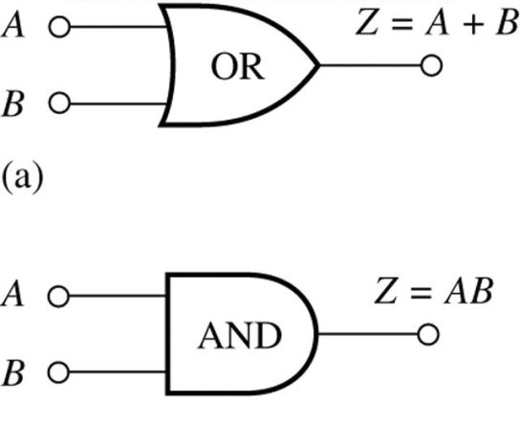
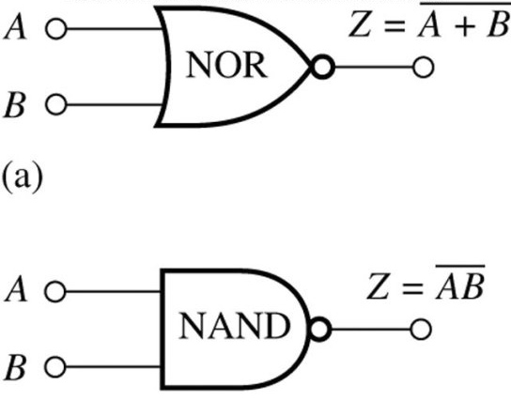
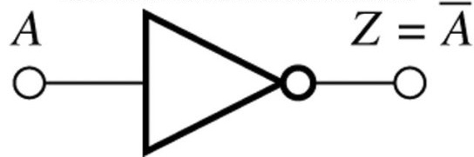
Logic Gate Symbols and Boolean Expressions
A logic gate is a physical model of a Boolean function: it performs a logical operation on one or more logic inputs and produces a single logic output.

Slide 14
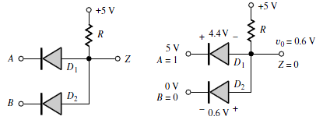
Logic Gates: AND
The simples gates are AND and OR. They can be built from switches or using the simplest form of electronic logic - diode logic.
A = 0 , B = 0 → both diodes are forward biased → both diodes conduct →out is LOW → 0.

Slide 15
Logic Gates: AND
The simples gates are AND and OR. They can be built from switches or using the simplest form of electronic logic - diode logic.
A = 0 , B = 0 → both diodes are forward biased → both diodes conduct →out is LOW → 0.
A = 0 , B = 1 → DB is reverse biased → does not conduct,
DA is forward biased → conducts →out is LOW → 0.

Slide 16
Logic Gates: AND
The simples gates are AND and OR. They can be built from switches or using the simplest form of electronic logic - diode logic.
A = 0 , B = 0 → both diodes are forward biased → both diodes conduct →out is LOW → 0.
A = 0 , B = 1 → DB is reverse biased → does not conduct,
DA is forward biased → conducts →out is LOW → 0.
A = 1 , B = 0 → DA is reverse biased → does not conduct,
DB is forward biased → conducts →out is LOW → 0.

Slide 17
Logic Gates: AND
The simples gates are AND and OR. They can be built from switches or using the simplest form of electronic logic - diode logic.
A = 0 , B = 0 → both diodes are forward biased → both diodes conduct →out is LOW → 0.
A = 0 , B = 1 → DB is reverse biased → does not conduct,
DA is forward biased → conducts →out is LOW → 0.
A = 1 , B = 0 → DA is reverse biased → does not conduct,
DB is forward biased → conducts →out is LOW → 0.
A = 1 , B = 1 → both diodes are reverse biased →
both the diodes do not conduct → out is HIGH → 1.

Slide 18
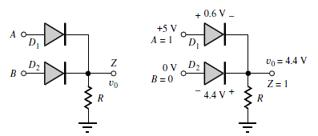
Logic Gates: OR
A = 0 , B = 0 → both diodes are reverse biased → does not conduct →out is LOW → 0.
A = 0 , B = 1 → DA is reverse biased → does not conduct,
DB is forward biased → conducts →out is HIGH → 1.
A = 1 , B = 0 → DB is reverse biased → does not conduct,
DA is forward biased → conducts →out is HIGH → 1.
A = 1 , B = 1 → both diodes are reverse biased →
both the diodes conduct → out is HIGH → 1.

Slide 19
Logic Gates: NAND & NOR
The simple diode logic allows AND and OR, but not inverters → an incomplete form of logic.
Also, without some kind of amplification it is not possible to have such basic logic operations cascaded as required for more complex logic functions.

Slide 20
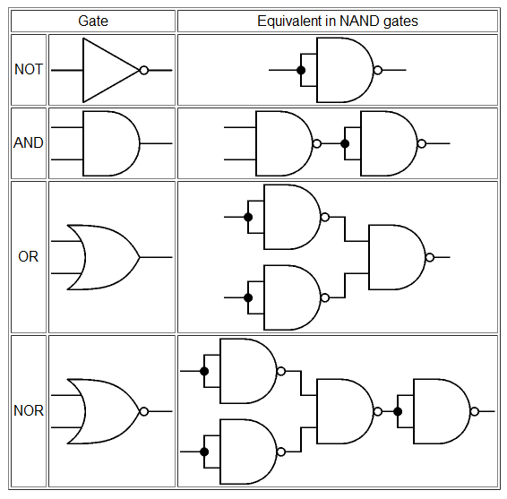
Logic Gates: NAND & NOR
The simple diode logic allows AND and OR, but not inverters → an incomplete form of logic.
Also, without some kind of amplification it is not possible to have such basic logic operations cascaded as required for more complex logic functions.
However, any gate can be built from NAND or NOR gates. This enables a circuit to be built from just one type of gate, either NAND or NOR.
To build NAND or NOR inverter is required → transistors needed.

Slide 21
Logic Gates: NAND & NOR
The simple diode logic allows AND and OR, but not inverters → an incomplete form of logic.
Also, without some kind of amplification it is not possible to have such basic logic operations cascaded as required for more complex logic functions.
However, any gate can be built from NAND or NOR gates. This enables a circuit to be built from just one type of gate, either NAND or NOR.
To build NAND or NOR inverter is required → transistors needed.
Conclusion.
To build a functionally complete logic systems transistors are used.
The most basic digital building block is the inverter.

Slide 22
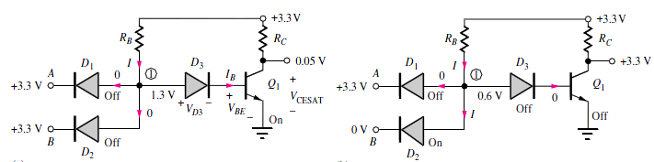

Diode-Transistor Logic (DTL) Gate
The inversion and level-restoration problem associated with diode logic can be solved by adding a diode and transistor to form the diode-transistor logic (DTL) gate
It will be analyzed in detail sin Chapter 9; here is a brief overview.

Slide 23
Diode-Transistor Logic (DTL) Gate
The inversion and level-restoration problem associated with diode logic can be solved by adding a diode and transistor to form the diode-transistor logic (DTL) gate
It will be analyzed in detail sin Chapter 9; here is a brief overview.
On the left, diodes D1 and D2 are both off, whereas D3 and Q1 are on. Node 1 is at 1.3 V:
V1 = VD3 + VBE = 0.6 V + 0.7 V = 1.3 V
The current I through resistor RB and diode D3 becomes the base current IB of transistor Q1. The
value of IB is designed to cause Q1 to saturate so that v_{O} = VCESAT (for example, 0.05 to 0.1 V).

Slide 24
Diode-Transistor Logic (DTL) Gate
The inversion and level-restoration problem associated with diode logic can be solved by adding a diode and transistor to form the diode-transistor logic (DTL) gate
It will be analyzed in detail sin Chapter 9; here is a brief overview.
On the right, input B is now at 0 V, corresponding to a logical 0. Diode D2 is conducting,
holding node 1 at 0.6 V. Now diode D3 and transistor Q1 must both be off, because the voltage at
node 1 is now less than the two diode voltage drops required to turn on both D3 and Q1. The base
current of Q1 is now zero; Q1 will be off with IC = 0, and the output voltage will be at +3.3 V,
corresponding to a logical 1. A similar situation holds for the circuit if both inputs are low.

Slide 25
Diode-Transistor Logic (DTL) Gate
The inversion and level-restoration problem associated with diode logic can be solved by adding a diode and transistor to form the diode-transistor logic (DTL) gate
It will be analyzed in detail sin Chapter 9; here is a brief overview.
On the left, diodes D1 and D2 are both off, whereas D3 and Q1 are on. Node 1 is at 1.3 V:
V1 = VD3 + VBE = 0.6 V + 0.7 V = 1.3 V
The current I through resistor RB and diode D3 becomes the base current IB of transistor Q1. The
value of IB is designed to cause Q1 to saturate so that v_{O} = VCESAT (for example, 0.05 to 0.1 V).
On the right, input B is now at 0 V, corresponding to a logical 0. Diode D2 is conducting,
holding node 1 at 0.6 V. Now diode D3 and transistor Q1 must both be off, because the voltage at
node 1 is now less than the two diode voltage drops required to turn on both D3 and Q1. The base
current of Q1 is now zero; Q1 will be off with IC = 0, and the output voltage will be at +3.3 V,
corresponding to a logical 1. A similar situation holds for the circuit if both inputs are low.

Slide 26

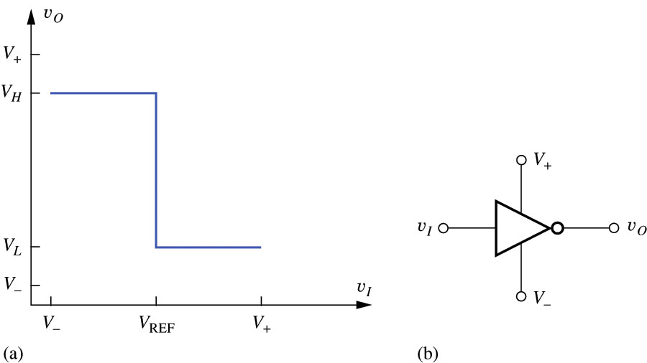
The Ideal Inverter
The ideal inverter has the following voltage transfer characteristic (VTC) and is described by the following symbol
?

Slide 27
The Ideal Inverter
The ideal inverter has the following voltage transfer characteristic (VTC) and is described by the following symbol
V₊ and V₋ are the supply rails
V_{H} and V_{L} describe the high and low logic levels at the output

Slide 28

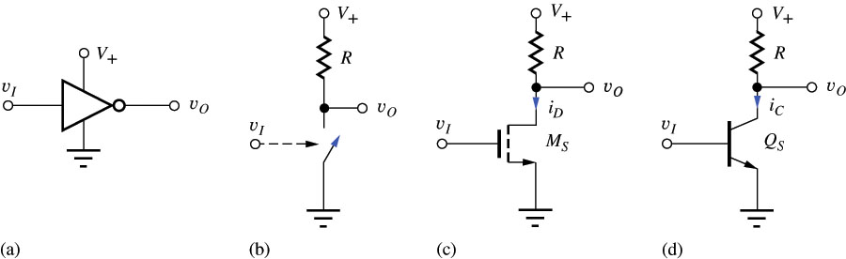
Inverter - circuit
An inverter operating with power supplies at V₊ and 0 V can be implemented using a switch with a resistive load.
?
MOSFET

Slide 29
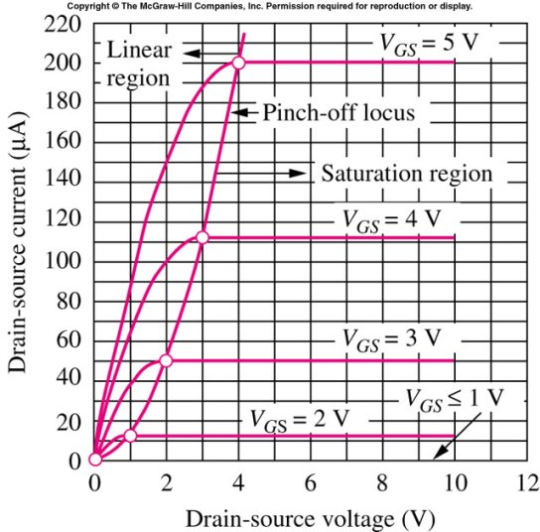
Inverter - circuit
An inverter operating with power supplies at V₊ and 0 V can be implemented using a switch with a resistive load.
?
Q-point

Slide 30
Inverter - circuit
An inverter operating with power supplies at V₊ and 0 V can be implemented using a switch with a resistive load.
Q-point

Slide 31
Inverter - circuit
An inverter operating with power supplies at V₊ and 0 V can be implemented using a switch with a resistive load.

Slide 32
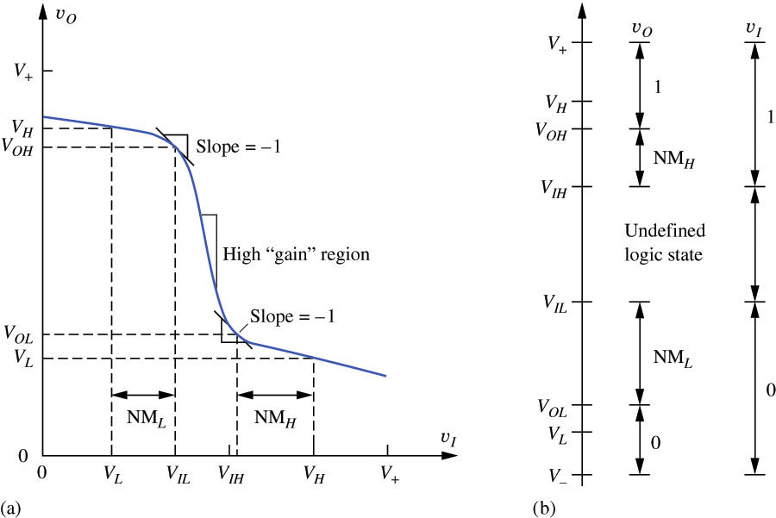
VTC of Non-Ideal Inverter Voltage Level Definitions
For the (VTC) of the non-ideal inverter no Vref is defined. There is now an undefined logic state. The points (V_{IH} ,V_{OL} ) and (V_{IL} ,V_{OH} ) are defined as the points on the VTC curve where slope is -1.

Slide 33
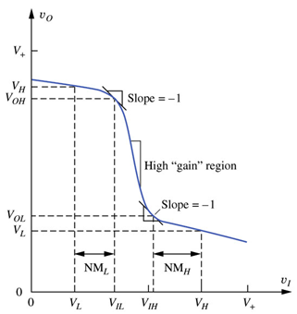
Logic Voltage Level Definitions
V_{L} – The nominal voltage corresponding to a low-logic
state at the output of a logic gate for v_{i} = V_{H}

Slide 34
Logic Voltage Level Definitions
V_{L} – The nominal voltage corresponding to a low-logic
state at the output of a logic gate for v_{i} = V_{H}
V_{H} – The nominal voltage corresponding to a high-logic
state at the output of a logic gate for v_{i} = V_{L}

Slide 35
Logic Voltage Level Definitions
V_{L} – The nominal voltage corresponding to a low-logic
state at the output of a logic gate for v_{i} = V_{H}
V_{H} – The nominal voltage corresponding to a high-logic
state at the output of a logic gate for v_{i} = V_{L}
V_{IL} – The maximum input voltage that will be recognized
as a low input logic level

Slide 36
Logic Voltage Level Definitions
V_{L} – The nominal voltage corresponding to a low-logic
state at the output of a logic gate for v_{i} = V_{H}
V_{H} – The nominal voltage corresponding to a high-logic
state at the output of a logic gate for v_{i} = V_{L}
V_{IL} – The maximum input voltage that will be recognized
as a low input logic level
V_{IH} – The minimum input voltage that will be recognized
as a high input logic level

Slide 37
Logic Voltage Level Definitions
V_{L} – The nominal voltage corresponding to a low-logic
state at the output of a logic gate for v_{i} = V_{H}
V_{H} – The nominal voltage corresponding to a high-logic
state at the output of a logic gate for v_{i} = V_{L}
V_{IL} – The maximum input voltage that will be recognized
as a low input logic level
V_{IH} – The minimum input voltage that will be recognized
as a high input logic level
V_{OH} – The output voltage corresponding to an input
voltage of V_{IL}

Slide 38
Logic Voltage Level Definitions
V_{L} – The nominal voltage corresponding to a low-logic
state at the output of a logic gate for v_{i} = V_{H}
V_{H} – The nominal voltage corresponding to a high-logic
state at the output of a logic gate for v_{i} = V_{L}
V_{IL} – The maximum input voltage that will be recognized
as a low input logic level
V_{IH} – The minimum input voltage that will be recognized
as a high input logic level
V_{OH} – The output voltage corresponding to an input
voltage of V_{IL}
V_{OL} – The output voltage corresponding to an input
voltage of V_{IH}

Slide 39
Logic Voltage Level Definitions
V_{L} – The nominal voltage corresponding to a low-logic
state at the output of a logic gate for v_{i} = V_{H}
V_{H} – The nominal voltage corresponding to a high-logic
state at the output of a logic gate for v_{i} = V_{L}
V_{IL} – The maximum input voltage that will be recognized
as a low input logic level
V_{IH} – The minimum input voltage that will be recognized
as a high input logic level
V_{OH} – The output voltage corresponding to an input
voltage of V_{IL}
V_{OL} – The output voltage corresponding to an input
voltage of V_{IH}
Typically, V₋=0.
V₊=5 for bipolar logic,
V₊=1.8, 2.5, 3.3 for MOS logic
V₊=1.0-1.5 for ultra low voltage logic

Slide 40
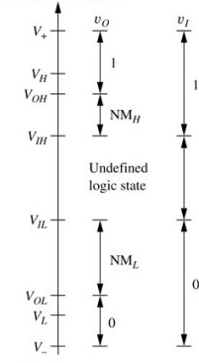
Noise Margins
Noise margins represent “safety margins” that prevent the circuit from producing erroneous outputs in the presence of noisy inputs
Noise margins are defined for low and high input levels using the following equations:
NM_{L} = V_{IL} – V_{OL}
NM_{H} = V_{OH} – V_{IH}

Slide 41
Logic Gate Design Goals
An ideal logic gate is highly nonlinear and attempts to quantize the input signal to two discrete states. In an actual gate, the designer should attempt to minimize the undefined input region while maximizing noise margins

Slide 42
Logic Gate Design Goals
An ideal logic gate is highly nonlinear and attempts to quantize the input signal to two discrete states. In an actual gate, the designer should attempt to minimize the undefined input region while maximizing noise margins
The logic gate is unidirectional. Changes at the output should have no effect on the input.

Slide 43
Logic Gate Design Goals
An ideal logic gate is highly nonlinear and attempts to quantize the input signal to two discrete states. In an actual gate, the designer should attempt to minimize the undefined input region while maximizing noise margins
The logic gate is unidirectional. Changes at the output should have no effect on the input.
Voltage levels at the output of one gate should be compatible with the input levels of a following gate

Slide 44
Logic Gate Design Goals
An ideal logic gate is highly nonlinear and attempts to quantize the input signal to two discrete states. In an actual gate, the designer should attempt to minimize the undefined input region while maximizing noise margins
The logic gate is unidirectional. Changes at the output should have no effect on the input.
Voltage levels at the output of one gate should be compatible with the input levels of a following gate
The output of one gate should be capable of driving the input of more than one gate: the gate should have sufficient fan-out and fan-in capabilities

Slide 45
Logic Gate Design Goals
An ideal logic gate is highly nonlinear and attempts to quantize the input signal to two discrete states. In an actual gate, the designer should attempt to minimize the undefined input region while maximizing noise margins
The logic gate is unidirectional. Changes at the output should have no effect on the input.
Voltage levels at the output of one gate should be compatible with the input levels of a following gate
The output of one gate should be capable of driving the input of more than one gate: the gate should have sufficient fan-out and fan-in capabilities
The gate should consume minimal power (and area for ICs) and still operate under the design specifications

Slide 46
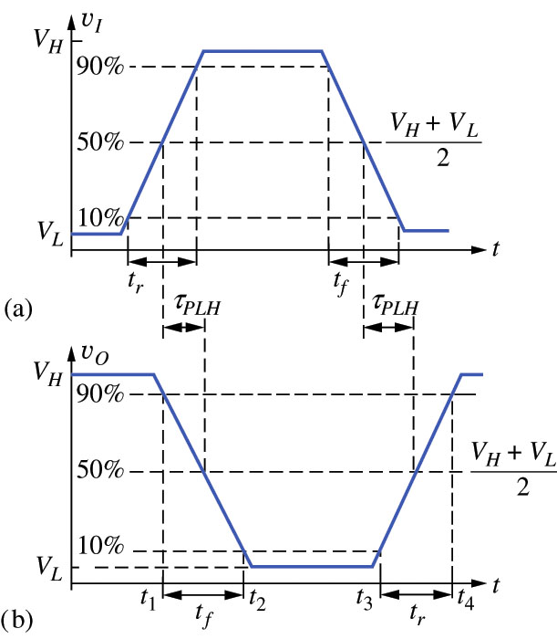

Dynamic Response of Logic Gates
An important characteristic of the logical gates is the response in the time domain
To describe the typical pulse signal at the input, we introduce:
The rise and fall times: t_{f} and t_{r}, are measured at the 10% and 90% points on the transitions between the two states as shown by the following expressions:
V_{10%} = V_{L} + 0.1ΔV
V_{90%} = V_{L} + 0.9ΔV = V_{H} – 0.1ΔV
where ΔV is the logic swing given by ΔV = V_{H} - V_{L}

Slide 47
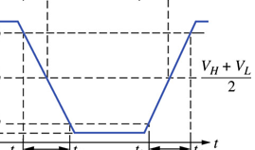
Dynamic Response of Logic Gates
For the input on the top, will the output will be like the signal on the bottom plot?

Slide 48
Dynamic Response of Logic Gates
For the input on the top, will the output will be like the signal on the bottom plot?
No, It will be delayed.

Slide 49
Dynamic Response of Logic Gates
For the input on the top, will the output will be like the signal on the bottom plot?
No, It will be delayed.
Propagation delay describes the amount of time between the input reaching the 50% point and the output reaching the 50% point. The 50% point is described by the following:
The high-to-low propagation delay, τ_{PHL}, and the low-to-high propagation delay, τ_{PLH}, are usually not equal, but can be combined as an average value:

Slide 50
NMOS Logic Design
MOS transistors (both PMOS and NMOS) can be combined with resistive loads to create single channel logic gates.

Slide 51
NMOS Logic Design
MOS transistors (both PMOS and NMOS) can be combined with resistive loads to create single channel logic gates.
In most logic design situations, the power supply voltage is predetermined by either technology reliability constraints or system-level criteria
The circuit designer is limited to altering circuit topology and the width-to-length (W/L) ratio since the other factors are dependent upon processing parameters

Slide 52
NMOS Logic Design
MOS transistors (both PMOS and NMOS) can be combined with resistive loads to create single channel logic gates.
In most logic design situations, the power supply voltage is predetermined by either technology reliability constraints or system-level criteria
The circuit designer is limited to altering circuit topology and the width-to-length (W/L) ratio since the other factors are dependent upon processing parameters
We begin our study of MOS logic circuit design by considering the detailed design of the NMOS inverter with the resistor load.

Slide 53
NMOS Logic Design
MOS transistors (both PMOS and NMOS) can be combined with resistive loads to create single channel logic gates.
In most logic design situations, the power supply voltage is predetermined by either technology reliability constraints or system-level criteria
The circuit designer is limited to altering circuit topology and the width-to-length (W/L) ratio since the other factors are dependent upon processing parameters
We begin our study of MOS logic circuit design by considering the detailed design of the NMOS inverter with the resistor load.
In integrated logic circuits, the load resistor occupies too much silicon area, and is replaced by a second NMOS transistor. This “load device” can be connected in three different configurations called the saturated load, linear load, and depletion-mode load circuits.

Slide 54
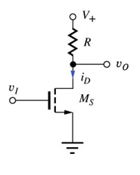
NMOS Inverter with a Resistive Load
The basic inverter circuit consists of an NMOS switching device M_{S} and a resistor load element.
M_{S} is the switching transistor used to “pull” the output high - toward to the power supply V_{DD}
The resistor R is used to “pull” the output low, to force v_{O} to V_{L}
The size of R and the W/L ratio of M_{S} are the design factors that need to be chosen.

Slide 55
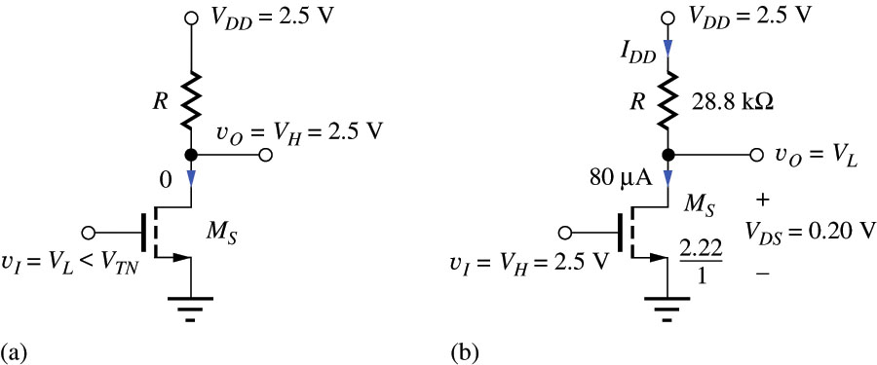
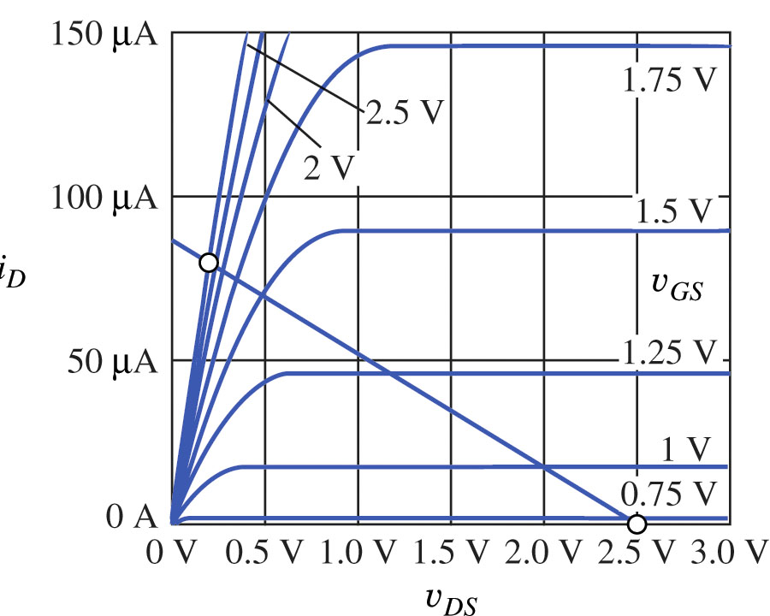
NMOS Inverter with a Resistive Load
When the input voltage is at a low state, v_{I} = V_{L} , M_{S} should be cut off, with i_{D} = 0, so that
v_{O} = V_{DD} = V_{H}
Thus, in this particular logic circuit, the value of V_{H} is set by the power supply voltage V_{DD} = 2.5V.
To ensure that switching transistor M_{S} is cut off when the input is in the low logic state, V_{L} is designed to be 25 to 50 percent of the threshold voltage V_{TN} of switch M_{S}. This choice also provides a reasonable value for noise margin NML .
The equation for the output voltage (load line): v_{O} = v_{DS} = V_{DD} − i_{D} R

Slide 56
NMOS Inverter with a Resistive Load
When the input voltage is at a low state, v_{I} = V_{L} , M_{S} should be cut off, with i_{D} = 0, so that
v_{O} = V_{DD} = V_{H}
Thus, in this particular logic circuit, the value of V_{H} is set by the power supply voltage V_{DD} = 2.5V.
To ensure that switching transistor M_{S} is cut off when the input is in the low logic state, V_{L} is designed to be 25 to 50 percent of the threshold voltage V_{TN} of switch M_{S}. This choice also provides a reasonable value for noise margin NML .
The equation for the output voltage (load line): v_{O} = v_{DS} = V_{DD} − i_{D} R
When the input voltage is at a high state, v_{I} = V_{H} , switch M_{S} is set in the triode region by the design of W/L parameter and load line to ensure that v_{O} = V_{L.}

Slide 57
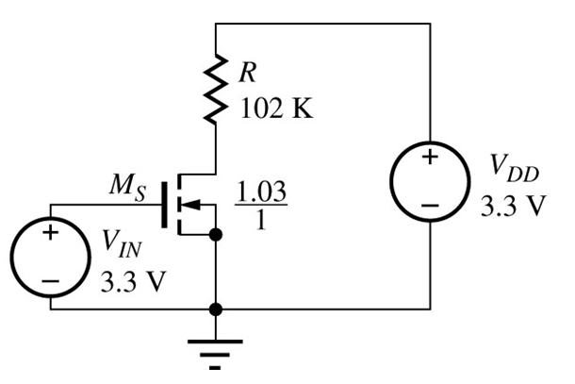

NMOS with Resistive Load Design Example (1)
Design a NMOS resistive load inverter for
V_{DD} = 3.3 V
P = 0.1 mW when V_{L} = 0.2 V
K_{n} = 60 μA/V²
V_{TN} = 0.75 V
Find the value of the load resistor R and the W/L ratio of the switching transistor M_{S}

Slide 58
NMOS with Resistive Load Design Example (2)
First the value of the current through the resistor (for v_{O} = V_{L}) must be determined by using the following:
The value of the resistor can now be found by the following, which assumes that the transistor is on and the output is low:

Slide 59
NMOS with Resistive Load Design Example (3)
For v_{I} = V_{H} = 3.3 V, and v_{O} = V_{L} = 0.2V, the transistor’s drain-source voltage V_{DS} =V_{L} will be less than V_{GS} -V_{TN}=V_{H} -V_{TN}
Therefore it will be operating in the triode region. Using the triode region equation for the MOSFET, the W/L ratio can be found:

Slide 60
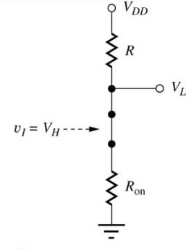
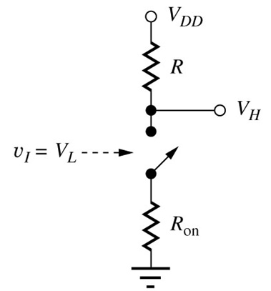
On-Resistance of the Switching Device
The NMOS resistive load inverter can be thought of as a resistive voltage divider when the output is low:
where the On-Resistance R_{on} of the NMOS can be calculated with the following expression:
Note : 1. R_{on} should be kept small compared to R to ensure that V_{L} remains low. 2. Its value is nonlinear, since it has a dependence on v_{DS.}

Slide 61

Noise Margin Analysis
The following equations (base on the calculation of the derivatives of v_{O} =V_{DD} –i_{D}R with respect to v_{I} ) can be used to determine the various parameters needed to determine the noise margin of NMOS resistive load inverters

Slide 62
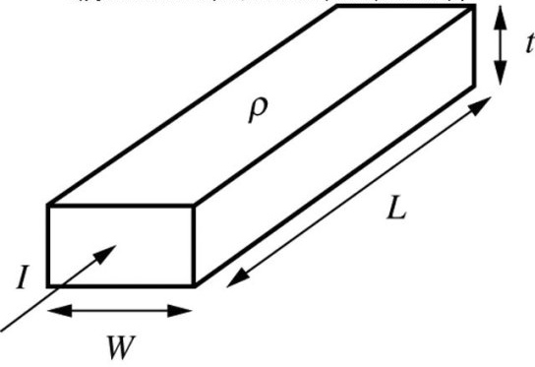
Load Resistor Issue
For completely integrated circuits, R must be implemented on chip using the shown structure.

Slide 63
Load Resistor Issue
For completely integrated circuits, R must be implemented on chip using the shown structure.
If the resistor width W were made a line width of 1μm (minimum feature size F), then the length L would be 2880 μm, and the area would be 2880 μm².

Slide 64
Load Resistor Issue
For completely integrated circuits, R must be implemented on chip using the shown structure.
If the resistor width W were made a line width of 1μm (minimum feature size F), then the length L would be 2880 μm, and the area would be 2880 μm².
For the transistor M_{S}, W/L was found to be 2.22/1. If the device channel length is equal to the minimum feature size of 1 μm, then the gate area of the NMOS is only 2.22 μm². Thus, the load resistor would consume more than 1000 times the area of the switching transistor M_{S}.

Slide 65
Load Resistor Issue
For completely integrated circuits, R must be implemented on chip using the shown structure.
If the resistor width W were made a line width of 1μm (minimum feature size F), then the length L would be 2880 μm, and the area would be 2880 μm².
For the transistor M_{S}, W/L was found to be 2.22/1. If the device channel length is equal to the minimum feature size of 1 μm, then the gate area of the NMOS is only 2.22 μm². Thus, the load resistor would consume more than 1000 times the area of the switching transistor M_{S}.
This is simply not an acceptable utilization of area in IC design.

Slide 66
Load Resistor Issue
For completely integrated circuits, R must be implemented on chip using the shown structure.
If the resistor width W were made a line width of 1μm (minimum feature size F), then the length L would be 2880 μm, and the area would be 2880 μm².
For the transistor M_{S}, W/L was found to be 2.22/1. If the device channel length is equal to the minimum feature size of 1 μm, then the gate area of the NMOS is only 2.22 μm². Thus, the load resistor would consume more than 1000 times the area of the switching transistor M_{S}.
This is simply not an acceptable utilization of area in IC design.
The solution to this problem is to replace the load resistor with a transistor.

Slide 67
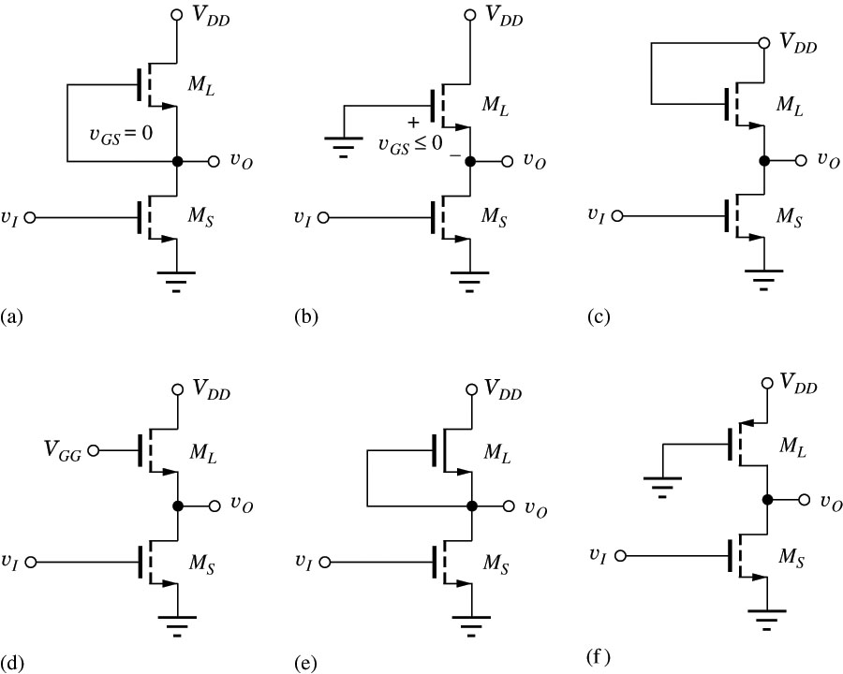
Using Transistors in Place of a Resistor
We are replacing a 2-terminal device with a 3(4)-terminal device and need to figure our what to do with the gate (since drain and source are conducting).
NMOS load transistor with
a) gate connected to the source
b) gate connected to ground
c) gate connected to V_{DD}
d) gate biased to linear region
e) a depletion-mode NMOSFET
f) gate grounded PMOS load

Slide 68
Using Transistors in Place of a Resistor
We are replacing a 2-terminal device with a 3(4)-terminal device and need to figure our what to do with the gate (since drain and source are conducting).
NMOS load with
a) gate connected to the source
b) gate connected to ground
c) gate connected to V_{DD}
d) gate biased to linear region
e) a depletion-mode NMOSFET
f) gate grounded PMOS load
Note that a) and b) are not useful, since with 0 at the gate, the enhancement mode NMOS is not conducting.
We’ll consider other methods starting from (c)

Slide 69
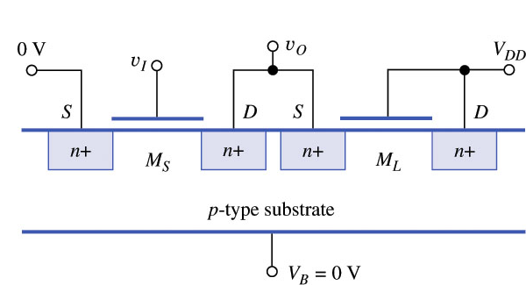
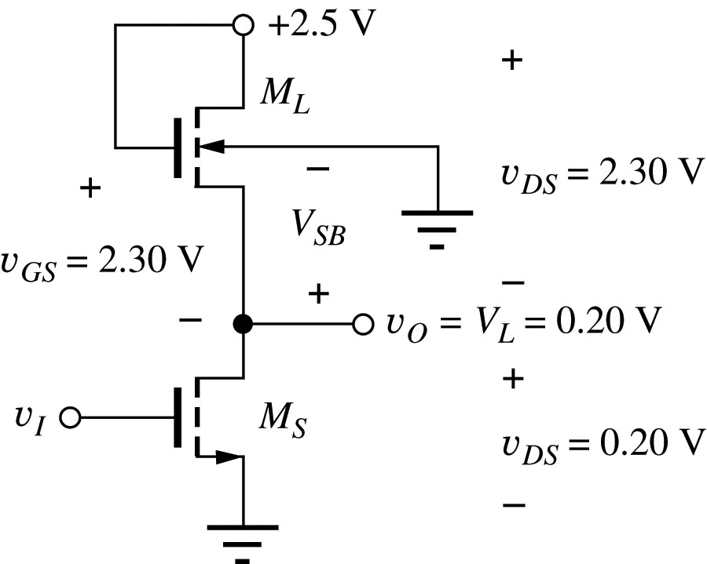
NMOS Saturated Load Inverter
It’s the (c) on diagram, called saturated because M_{L} is in saturation region:
v_{DS} = v_{GS} → v_{DS} ≥ v_{GS} − V_{TN} for V_{TN} ≥ 0
The substrate is common and grounded:
Schematic for a NMOS
saturated load inverter

Slide 70
NMOS Saturated Load Inverter
It’s the (c) on diagram, called saturated because M_{L} is in saturation region:
v_{DS} = v_{GS} → v_{DS} ≥ v_{GS} − V_{TN} for V_{TN} ≥ 0
The substrate is common and grounded:
→ v_{SB}=0 for M_{S} .
Schematic for a NMOS
saturated load inverter

Slide 71
NMOS Saturated Load Inverter
It’s the (c) on diagram, called saturated because M_{L} is in saturation region:
v_{DS} = v_{GS} → v_{DS} ≥ v_{GS} − V_{TN} for V_{TN} ≥ 0
The substrate is common and grounded:
→ v_{SB}=0 for M_{S} .
→ v_{SB}=v_{O} for M_{L} ,
Schematic for a NMOS
saturated load inverter

Slide 72
NMOS Saturated Load Inverter
It’s the (c) on diagram, called saturated because M_{L} is in saturation region:
v_{DS} = v_{GS} → v_{DS} ≥ v_{GS} − V_{TN} for V_{TN} ≥ 0
The substrate is common and grounded:
→ v_{SB}=0 for M_{S} .
→ v_{SB}=v_{O} for M_{L} ,
thus V_{TN} is generally different for both.
Schematic for a NMOS
saturated load inverter

Slide 73
NMOS Saturated Load Inverter-Design Strategy
Given V_{DD}, V_{L}, and the power level, find I_{DD} from V_{DD} and power.

Slide 74
NMOS Saturated Load Inverter-Design Strategy
Given V_{DD}, V_{L}, and the power level, find I_{DD} from V_{DD} and power.
Assume M_{S} off, and find high output voltage level V_{H}

Slide 75
NMOS Saturated Load Inverter-Design Strategy
Given V_{DD}, V_{L}, and the power level, find I_{DD} from V_{DD} and power.
Assume M_{S} off, and find high output voltage level V_{H}
Use the value of V_{H} for the gate voltage of M_{S} and calculate (W/L)_{S} of the switching transistor based on the design values of I_{DD} and V_{L}

Slide 76
NMOS Saturated Load Inverter-Design Strategy
Given V_{DD}, V_{L}, and the power level, find I_{DD} from V_{DD} and power.
Assume M_{S} off, and find high output voltage level V_{H}
Use the value of V_{H} for the gate voltage of M_{S} and calculate (W/L)_{S} of the switching transistor based on the design values of I_{DD} and V_{L}
Use the value of V_{H} for the gate voltage of M_{S} and find (W/L)_{L} of the load transistor based on I_{DD} and V_{L}

Slide 77
NMOS Saturated Load Inverter-Design Strategy
Given V_{DD}, V_{L}, and the power level, find I_{DD} from V_{DD} and power.
Assume M_{S} off, and find high output voltage level V_{H}
Use the value of V_{H} for the gate voltage of M_{S} and calculate (W/L)_{S} of the switching transistor based on the design values of I_{DD} and V_{L}
Use the value of V_{H} for the gate voltage of M_{S} and find (W/L)_{L} of the load transistor based on I_{DD} and V_{L}
Check the operating region assumptions of M_{S} and M_{L} for v_{o} = V_{L}

Slide 78


NMOS Saturated Load Inverter - Example
Design an saturated load inverter given the following specifications:

Slide 79

NMOS Saturated Load Inverter - Example
First, set v_{i} = V_{H} ,v_{O} = V_{L}, M_{S} - on, and find the value of the current through the resistor using the power :
SAT
LIN
Design an saturated load inverter given the following specifications:

Slide 80


NMOS Saturated Load Inverter - Example
First, set v_{i} = V_{H} ,v_{O} = V_{L}, M_{S} - on, and find the value of the current through the resistor using the power :
Now set v_{i} = V_{L} ,v_{O} = V_{H}, M_{S} - off, M_{L} - off and then, find V_{H} (since now, V_{H} is not equal V_{DD}.) Why?
Design an saturated load inverter given the following specifications:

Slide 81
NMOS Saturated Load Inverter - Example
First, set v_{i} = V_{H} ,v_{O} = V_{L}, M_{S} - on, and find the value of the current through the resistor using the power :
Now set v_{i} = V_{L} ,v_{O} = V_{H}, M_{S} - off, M_{L} - off and then, find V_{H} (since now, V_{H} is not equal V_{DD}.) Why?
When M_{S} turns off from the on state, the current I_{DD} will stop when the value of v_{GSL} will reach V_{TNL}, (v_{GS} > V_{TN}, for I_{DD} to exist)
v_{GSL} = V_{DD} − v_{O} = V_{TN} → V_{H} = V_{DD} − V_{TN} .
Thus, taking into account the body effect (γ) and surface potential parameter (φ_{F}):
(The output cannot exceed the positive power supply voltage.)
Design an saturated load inverter given the following specifications:

Slide 82
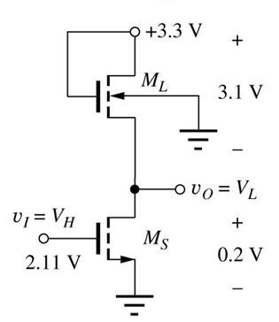
NMOS Saturated Load Inverter - Example
SAT
LIN
Now we can find W/L for both transistors M_{S} and then M_{L.}
Set v_{i} = V_{H} , v_{o} = V_{L}: M_{S} is in the triode region (on) M_{L} is in saturation (on).
Check the operating region. For the switch, V_{GS} − V_{TN} = 2.11 − 0.75 = 1.36 V, which is greater than V_{DS} = 0.2 V, and the triode region assumption is correct. For the load device, V_{GS} − V_{TN} =3.1 − 0.81 = 2.29 V and is less than V_{DS} = 3.1 V, which is consistent with the saturation region of operation.

Slide 83
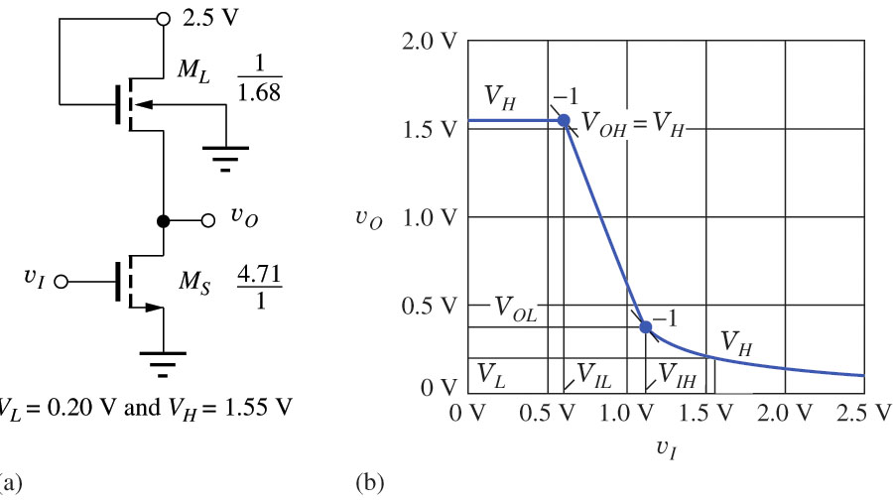
NMOS Saturated Load Inverter -Noise Margin
The detailed analysis of the noise margins for saturated load inverter is quite tedious. Instead, the PSPICE simulation can be used. Example:
From the PSPICE simulation typical noise margins are:
NM_{H} = V_{OH} - V_{IH} = 1.55 - 1.42 = 0.33 V
NM_{L} = V_{IL} - V_{OL} = 0.90 - 0.38 = 0.22 V

Slide 84
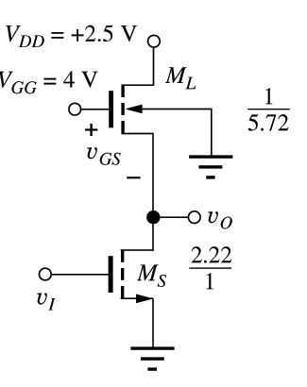
NMOS Inverter with a Linear Load
This inverter has a load transistor that is biased with V_{GG} defined by the following:

Slide 85
NMOS Inverter with a Linear Load
This inverter has a load transistor that is biased with V_{GG} defined by the following:
This causes the load transistor to operate in the linear region:
v_{GSL} − V_{TNL} = V_{GG} − v_{o} − V_{TNL}

Slide 86
NMOS Inverter with a Linear Load
This inverter has a load transistor that is biased with V_{GG} defined by the following:
This causes the load transistor to operate in the linear region:
v_{GSL} − V_{TNL} = V_{GG} − v_{o} − V_{TNL}
≥ V_{DD} + V_{TNL} − v_{o} − V_{TNL}
≥ V_{DD} − v_{o} = v_{DSL}
For this value of V_{GG}, the output voltage in the high output state V_{H} is equal to V_{DD}:
M_{S} -off, i_{D}=0 → v_{DSL}=0 (linear region) →
v_{DSL}= V_{DD} − v_{o} = V_{DD} − V_{H} =0 → V_{H} = V_{DD}

Slide 87
NMOS Inverter with a Linear Load
This inverter has a load transistor that is biased with V_{GG} defined by the following:
This causes the load transistor to operate in the linear region:
v_{GSL} − V_{TNL} = V_{GG} − v_{o} − V_{TNL}
≥ V_{DD} + V_{TNL} − v_{o} − V_{TNL}
≥ V_{DD} − v_{o} = v_{DSL}
For this value of V_{GG}, the output voltage in the high output state V_{H} is equal to V_{DD}:
M_{S} -off, i_{D}=0 → v_{DSL}=0 (linear region) →
v_{DSL}= V_{DD} − v_{o} = V_{DD} − V_{H} =0 → V_{H} = V_{DD}
The W/L ratios for M_{S} and M_{L} can be calculated as in previous section ( easier, since V_{H} is equal to V_{DD})

Slide 88
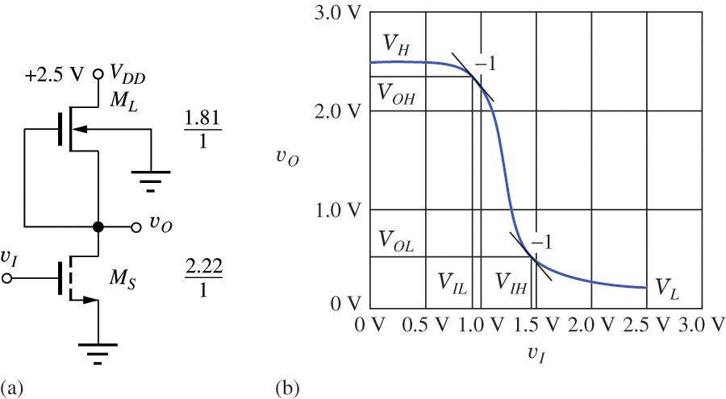
NMOS Inverter with a Depletion-mode Load
The saturated load and linear load circuits were used when all the devices had the same threshold voltages in early NMOS and PMOS technologies.
However, once ion-implantation technology was perfected, it became possible to selectively adjust the threshold of the load transistors to alter their characteristics to become those of NMOS depletion mode devices with V_{TN} < 0.
D
E

Slide 89
NMOS Inverter with a Depletion-mode Load
The saturated load and linear load circuits were used when all the devices had the same threshold voltages in early NMOS and PMOS technologies.
However, once ion-implantation technology was perfected, it became possible to selectively adjust the threshold of the load transistors to alter their characteristics to become those of NMOS depletion mode devices with V_{TN} < 0.
When M_{S} is off (v_{I} = V_{L} ), the current i_{D} =0, hence from the linear region (which is now possible even for v_{GSL} =0 because of depletion mode) we have v_{DSL} =0 (< v_{GSL} - V_{TN} >0) and output voltage rises to V_{H} = V_{DD}
D
LIN
i_{D} =0
E

Slide 90
NMOS Inverter with a Depletion-mode Load
The saturated load and linear load circuits were used when all the devices had the same threshold voltages in early NMOS and PMOS technologies.
However, once ion-implantation technology was perfected, it became possible to selectively adjust the threshold of the load transistors to alter their characteristics to become those of NMOS depletion mode devices with V_{TN} < 0.
When M_{S} is off (v_{I} = V_{L} ), the current i_{D} =0, hence from the linear region (which is now possible even for v_{GSL} =0 because of depletion mode) we have v_{DSL} =0 (< v_{GSL} - V_{TN} >0) and output voltage rises to V_{H} = V_{DD}
For M_{S} on and conducting (v_{I} = V_{H} ), v_{O} = V_{L}, M_{L} is designed to be saturated (v_{DSL} = 2.5 - v_{O} > v_{GSL} - V_{TN} ) and M_{S} , as usual, in the triode region.
D
SAT
E
LIN

Slide 91
NMOS Inverter with a Depletion-mode Load
Then we set input to V_{H} a(both transistors on) and find W/L
To find (W/L)_{L} given i_{DL} (which we find from power requirements) we use the saturation mode for M_{L} with v_{GS} =0 :
To find (W/L)_{S} where V_{H} = V_{DD}, use the same technique as used for the resistor load inverter:

Slide 92
NMOS Inverter with a Depletion-mode Load - Noise Margins
The detailed analysis of the noise margins for saturated load inverter is quite tedious. Instead, the PSPICE simulation can be used. Example:
From PSPICE simulation, typical noise margins are:
NM_{H} = V_{OH} - V_{IH} = 2.35 - 1.45 = 0.90 V
NM_{L} = V_{IL} - V_{OL} = 0.93 - 0.50 = 0.43 V

Slide 93
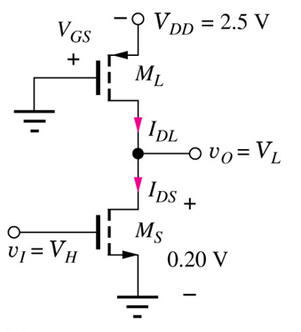
Pseudo NMOS Inverter
It is possible to replace the load resistor with a PMOS transistor with its source connected to V_{DD}, its drain connected to the output node and its gate grounded.
This circuit is called pseudo NMOS since circuit operates very similar to NMOS although has a PMOS in it.
For v_{o} = V_{L} (M_{S} is on), M_{L} is in the saturation region.
SAT
LIN

Slide 94
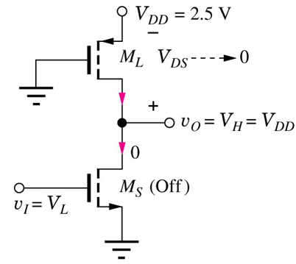
Pseudo NMOS Inverter
It is possible to replace the load resistor with a PMOS transistor with its source connected to V_{DD}, its drain connected to the output node and its gate grounded.
This circuit is called pseudo NMOS since circuit operates very similar to NMOS although has a PMOS in it.
For v_{o} = V_{L} (M_{S} is on), M_{L} is in the saturation region.
For v_{o} = V_{H} (M_{S} is off) M_{L} is in the triode region (i=0, 0=V_{DS} < |V_{GS} - V_{TN} |=|2.5 - V_{TN} |.
For this circuit, V_{H} = V_{DD} because M_{L} is in the linear triode region and V_{DS} =0 when M_{S} is off.
LIN

Slide 95
Pseudo NMOS Inverter
It is possible to replace the load resistor with a PMOS transistor with its source connected to V_{DD}, its drain connected to the output node and its gate grounded.
This circuit is called pseudo NMOS since circuit operates very similar to NMOS although has a PMOS in it.
For v_{o} = V_{L} (M_{S} is on), M_{L} is in the saturation region.
For v_{o} = V_{H} (M_{S} is off) M_{L} is in the triode region (i=0, 0=V_{DS} < |V_{GS} - V_{TN} |=|2.5 - V_{TN} |.
For this circuit, V_{H} = V_{DD} because M_{L} is in the linear triode region and V_{DS} =0 when M_{S} is off.
LIN

Slide 96
Pseudo NMOS Inverter Design - Example
Design an pseudo NMOS inverter given the following specifications:

Slide 97
Pseudo NMOS Inverter Design - Example
First calculate (W/L)_{P} to limit inverter current to 80 uA.
Design an pseudo NMOS inverter given the following specifications:

Slide 98
Pseudo NMOS Inverter Design - Example
First calculate (W/L)_{P} to limit inverter current to 80 uA.
M_{S} is on, M_{L} is in saturation:
SAT
LIN
Design an pseudo NMOS inverter given the following specifications:

Slide 99
Pseudo NMOS Inverter Design - Example
Now calculate (W/L)_{S} for the same condition and current of 80 uA.
SAT
LIN

Slide 100
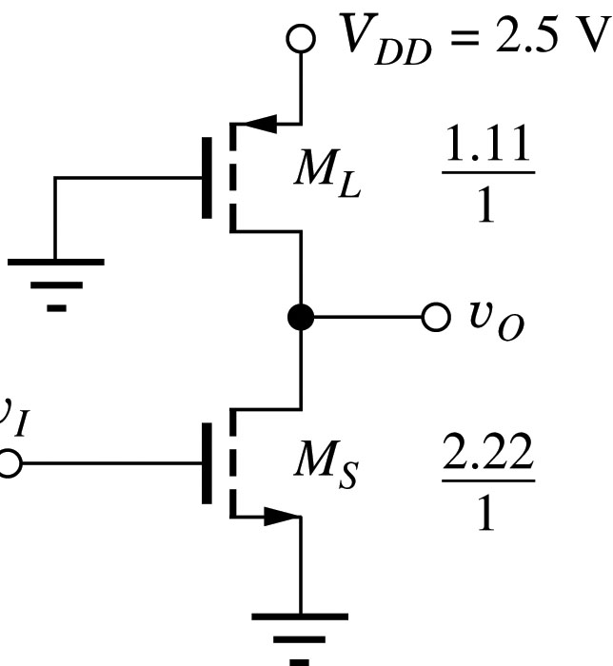
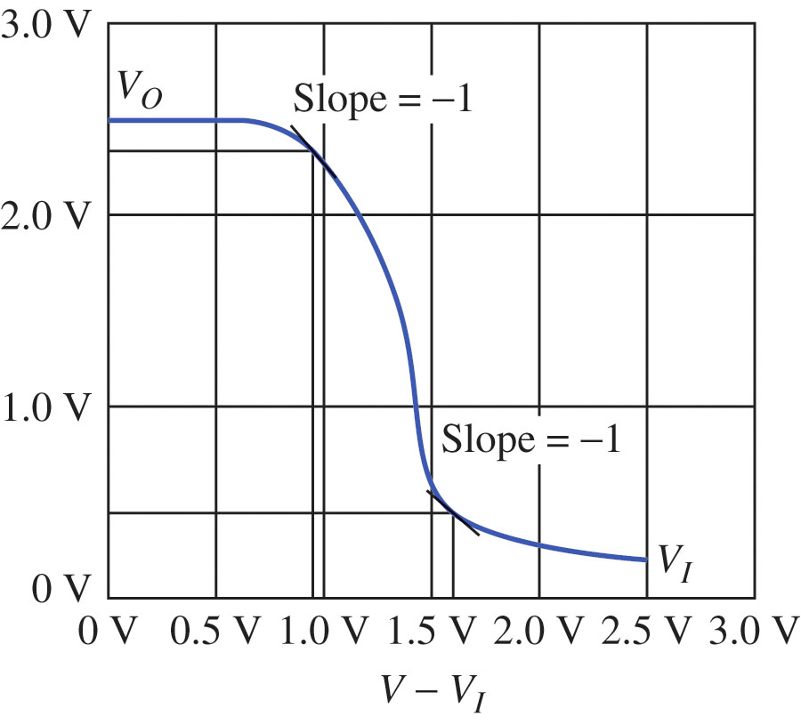
Pseudo NMOS Inverter - Noise Margins
From SPICE simulation, typical noise margins are:
NM_{H} = V_{OH} - V_{IH} = 2.33 - 1.58 = 0.75 V
NM_{L} = V_{IL} - V_{OL} = 0.95 - 0.49 = 0.46 V

Slide 101
NMOS Inverter Summary
Resistive load inverter takes up too much area for and IC design.

Slide 102
NMOS Inverter Summary
Resistive load inverter takes up too much area for and IC design.
The saturated load configuration is the simplest design, but V_{H} never reaches V_{DD}, and it has a slow switching speed.

Slide 103
NMOS Inverter Summary
Resistive load inverter takes up too much area for and IC design.
The saturated load configuration is the simplest design, but V_{H} never reaches V_{DD}, and it has a slow switching speed.
The linear load inverter fixes the speed and logic level issues, but it requires an additional power supply for the load gate.

Slide 104
NMOS Inverter Summary
Resistive load inverter takes up too much area for and IC design.
The saturated load configuration is the simplest design, but V_{H} never reaches V_{DD}, and it has a slow switching speed.
The linear load inverter fixes the speed and logic level issues, but it requires an additional power supply for the load gate.
The depletion-mode NMOS load requires the most processing steps, but needs small area to achieve the high speed, V_{H} = V_{DD}, and best combination of noise margins.

Slide 105
NMOS Inverter Summary
Resistive load inverter takes up too much area for and IC design.
The saturated load configuration is the simplest design, but V_{H} never reaches V_{DD}, and it has a slow switching speed.
The linear load inverter fixes the speed and logic level issues, but it requires an additional power supply for the load gate.
The depletion-mode NMOS load requires the most processing steps, but needs small area to achieve the high speed, V_{H} = V_{DD}, and best combination of noise margins.
The Pseudo NMOS inverter offers the best speed with the lowest area.

Slide 106
Typical Inverter Characteristics
 | Inverter w/ Resistor Load | Saturated Load Inverter | Linear Load Inverter | Inverter w/ Depletion-Mode Load | Pseudo-NMOS Inverter
V_{H} (V) | 2.50 | 1.55 | 2.50 | 2.50 | 2.50
V_{L} (V) | 0.20 | 0.20 | 0.20 | 0.20 | 0.20
N_{ML} (V) | 0.25 | 0.25 | 0.12 | 0.43 | 0.46
N_{MH} (V) | 0.96 | 0.33 | 0.96 | 0.90 | 0.75
Relative Area | 2880 | 6.39 | 7.94 | 4.03 | 3.33

Slide 107
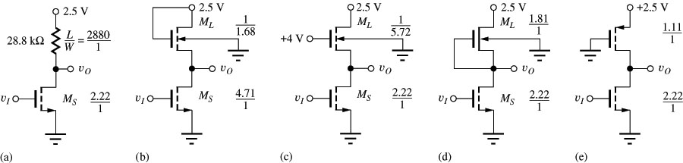
Reference of NMOS Inverter Designs

Slide 108
NOR Gates
To obtain the complete logical family we need inverter and AND or OR function, or just one NAND or NOR element.

Slide 109
NOR Gates
To obtain the complete logical family we need inverter and AND or OR function, or just one NAND or NOR element.
This type of element can be easily created by replacing one switch with two switches in parallel for NOR or in series for NAND.

Slide 110
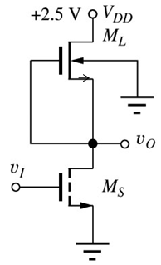

NOR Gates
To obtain the complete logical family we need inverter and AND or OR function, or just one NAND or NOR element.
This type of element can be easily created by replacing one switch with two switches in parallel for NOR or in series for NAND.

Slide 111
NOR Gates
To obtain the complete logical family we need inverter and AND or OR function, or just one NAND or NOR element.
This type of element can be easily created by replacing one switch with two switches in parallel for NOR or in series for NAND.

Slide 112
NOR Gates
To obtain the complete logical family we need inverter and AND or OR function, or just one NAND or NOR element.
This type of element can be easily created by replacing one switch with two switches in parallel for NOR or in series for NAND.

Slide 113
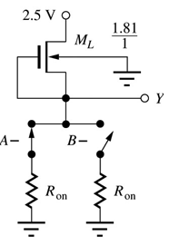
NOR Gates
To obtain the complete logical family we need inverter and AND or OR function, or just one NAND or NOR element.
This type of element can be easily created by replacing one switch with two switches in parallel for NOR or in series for NAND.

Slide 114
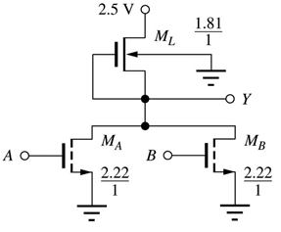
NOR Gates
To obtain the complete logical family we need inverter and AND or OR function, or just one NAND or NOR element.
This type of element can be easily created by replacing one switch with two switches in parallel for NOR or in series for NAND.

Slide 115
NOR Gates
To obtain the complete logical family we need inverter and AND or OR function, or just one NAND or NOR element.
This type of element can be easily created by replacing one switch with two switches in parallel for NOR or in series for NAND.
The worst condition for the output low (to have it as low as possible) is when only one switch is closed (since R_{on} for both are in parallel).

Slide 116
NOR Gates
To obtain the complete logical family we need inverter and AND or OR function, or just one NAND or NOR element.
This type of element can be easily created by replacing one switch with two switches in parallel for NOR or in series for NAND.
The worst condition for the output low (to have it as low as possible) is when only one switch is closed (since R_{on} for both are in parallel).
Thus the M/L ratio should be chosen the same as for one switch.

Slide 117
NOR Gates
To obtain the complete logical family we need inverter and AND or OR function, or just one NAND or NOR element.
This type of element can be easily created by replacing one switch with two switches in parallel for NOR or in series for NAND.
The worst condition for the output low (to have it as low as possible) is when only one switch is closed (since R_{on} for both are in parallel).
Thus the M/L ratio should be chosen the same as for one switch.
When both are closed, the V_{L} at the output will be even lower then for one.

Slide 118
NAND Gates

Slide 119
NAND Gates

Slide 120
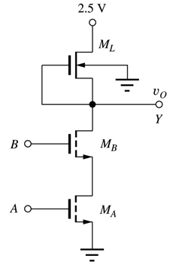
NAND Gates

Slide 121
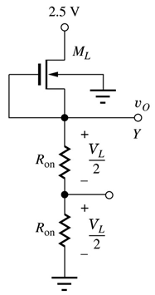

NAND Gate Device Size Selection
Consider the equivalent of switching transistors in the ‘on” state as R_{on}.

Slide 122
NAND Gate Device Size Selection
Consider the equivalent of switching transistors in the ‘on” state as R_{on}.
To keep the low voltage level comparable with simple inverter, the desired R_{on} of M_{A} and M_{B} must be 0.5R_{on} of M_{S} switch.

Slide 123
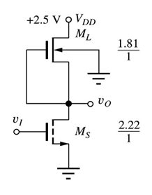
NAND Gate Device Size Selection
Consider the equivalent of switching transistors in the ‘on” state as R_{on}.
To keep the low voltage level comparable with simple inverter, the desired R_{on} of M_{A} and M_{B} must be 0.5R_{on} of M_{S} switch.
This can be accomplished by approximately doubling (W/L)_{A} and (W/L)_{B}

Slide 124
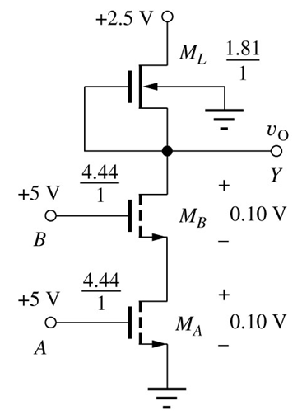
NAND Gate Device Size Selection
Consider the equivalent of switching transistors in the ‘on” state as R_{on}.
To keep the low voltage level comparable with simple inverter, the desired R_{on} of M_{A} and M_{B} must be 0.5R_{on} of M_{S} switch.
This can be accomplished by approximately doubling (W/L)_{A} and (W/L)_{B}

Slide 125
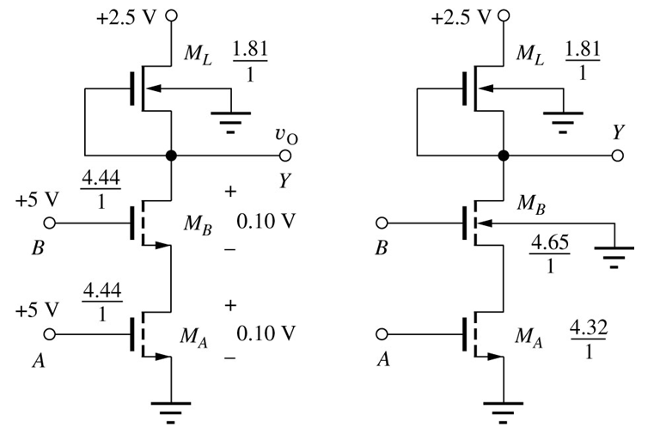
NAND Gate Device Size Selection (cont)
Two sources of error that arise are that 1) V_{SB}’s and 2) V_{GS}’s of the two transistors are not equal → the values of V_{TN} should be adjusted (see problem 6.28)
The technique used to calculate the size of the load transistor for the NAND gate is exactly the same as for the depletion-load inverter.

Slide 126
Complex NMOS Logic Design
An advantage of NMOS technology is that it is simple to design complex logic functions based on the NOR and NAND gates.

Slide 127
Complex NMOS Logic Design
An advantage of NMOS technology is that it is simple to design complex logic functions based on the NOR and NAND gates.
The typical problem that arises is the transistor sizing.

Slide 128
Complex NMOS Logic Design
An advantage of NMOS technology is that it is simple to design complex logic functions based on the NOR and NAND gates.
The typical problem that arises is the transistor sizing.
There are two ways to find the W/L ratios of the switching transistors
Use the worst-case path (most devices in series) and choose the W/L ratios to achieve the value of R_{on} equivalent to that of the inverter

Slide 129
Complex NMOS Logic Design
An advantage of NMOS technology is that it is simple to design complex logic functions based on the NOR and NAND gates.
The typical problem that arises is the transistor sizing.
There are two ways to find the W/L ratios of the switching transistors
Use the worst-case path (most devices in series) and choose the W/L ratios to achieve the value of R_{on} equivalent to that of the inverter
Partitioning the circuit into a series sub-networks, and make the equivalent on-resistances equal

Slide 130
Complex NMOS Logic Design (1)
Example 1. Design a logic function:
Y = A + B(C + D)
Base inverter:

Slide 131
Complex NMOS Logic Design (1)
Example 1. Design a logic function:
Y = A + B(C + D)
Base inverter:

Slide 132
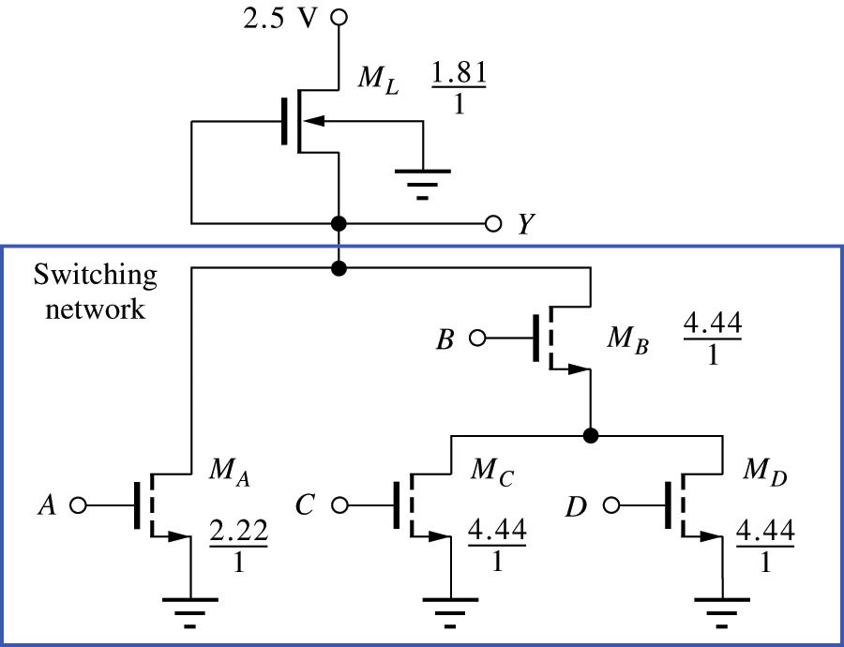
Complex NMOS Logic Design (1)
Example 1. Design logic function:
Y = A + B(C + D)
Base inverter:

Slide 133
Complex NMOS Logic Design (1)
Example 1. Design logic function:
Y = A + B(C + D)
Base inverter:
Referring to the base inverter design, we have for the M_{S} W/L=2.22/1 in order to maintain the low output of 0.20V

Slide 134
Complex NMOS Logic Design (1)
Example 1. Design logic function:
Y = A + B(C + D)
Base inverter:
Referring to the base inverter design, we have for the M_{S} W/L=2.22/1 in order to maintain the low output of 0.20V
We’ll have the same for M_{A} (in parallel).

Slide 135
Complex NMOS Logic Design (1)
Example 1. Design logic function:
Y = A + B(C + D)
Base inverter:
Referring to the base inverter design, we have for the M_{S} W/L=2.22/1 in order to maintain the low output of 0.20V
We’ll have the same for M_{A} (in parallel).
In another parallel branch we have a series connection, so M_{B} and combination of M_{C} and M_{D} should have double width W/L=4.44/1

Slide 136
Complex NMOS Logic Design (1)
Example 1. Design logic function:
Y = A + B(C + D)
Base inverter:
Referring to the base inverter design, we have for the M_{S} W/L=2.22/1 in order to maintain the low output of 0.20V
We’ll have the same for M_{A} (in parallel).
In another parallel branch we have a series connection, so M_{B} and combination of M_{C} and M_{D} should have double width W/L=4.44/1
Finally, M_{C} and M_{D} are in parallel, so their W/L does not change.

Slide 137
Complex NMOS Logic Design (2)
Example 2. Design logic function:
Y = A B + CDB = (A+CD)B
Base inverter :

Slide 138

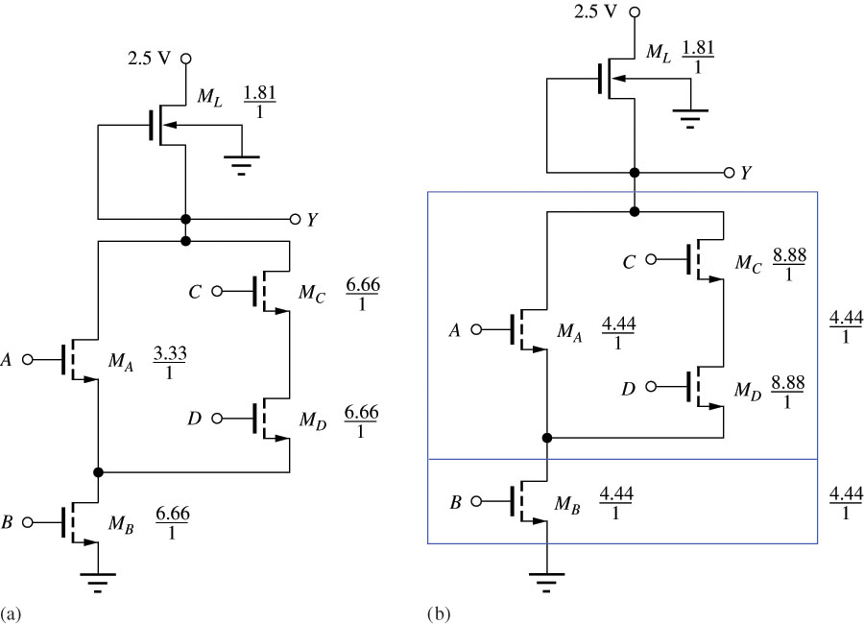
Complex NMOS Logic Design (2)
Example 2. Design logic function:
Y = A B + CDB = (A+CD)B
Base inverter :
The figure on the left shows the worst case method. The longest path is 3 transistors in series, so (W/L)=6.66 /1 is the size for each element in series.

Slide 139
Complex NMOS Logic Design (2)
Example 2. Design logic function:
Y = A B + CDB = (A+CD)B
Base inverter :
The figure on the left shows the worst case method. The longest path is 3 transistors in series, so (W/L)=6.66 /1 is the size for each element in series. One M_{A} is in parallel with two transistors, so its W/L is halved.

Slide 140
Complex NMOS Logic Design (2)
Example 2. Design logic function:
Y = A B + CDB = (A+CD)B
Base inverter :
The figure on the left shows the worst case method. The longest path is 3 transistors in series, so (W/L)=6.66 /1 is the size for each element in series. One M_{A} is in parallel with two transistors, so its W/L is halved.
The figure on the right shows the partitioning technique : the longest path is 2, so (W/L)= 4.44/1.

Slide 141
Complex NMOS Logic Design (2)
Example 2. Design logic function:
Y = A B + CDB = (A+CD)B
Base inverter :
The figure on the left shows the worst case method. The longest path is 3 transistors in series, so (W/L)=6.66 /1 is the size for each element in series. One M_{A} is in parallel with two transistors, so its W/L is halved.
The figure on the right shows the partitioning technique : the longest path is 2, so (W/L)= 4.44/1. However, now we put 2 series transistors M_{C} and M_{D} in parallel with M_{A} , so their with is doubled.

Slide 142
Static Power Dissipation
Static Power Dissipation is the average power dissipation of the logic gate for the high and low logic states. If the duty cycle is 50% it is:
I_{DDH} = current in the circuit for v_{O} = V_{H}
I_{DDL} = current in the circuit for v_{O} = V_{L}
Since I_{DDH} = 0 for v_{O} = V_{H} :
If the duty cycle is different, 2 in the denominator should be changed appropriatly.

Slide 143
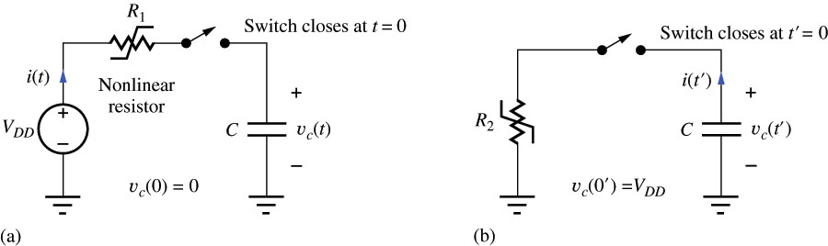
Dynamic Power Dissipation
Dynamic Power Dissipation is the power dissipated during the process of charging and discharging the load capacitance connected to the logic gate
?
?
Charging
Discharging

Slide 144
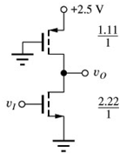


Dynamic Power Dissipation
Dynamic Power Dissipation is the power dissipated during the process of charging and discharging the load capacitance connected to the logic gate
R_{L}
Charging
Discharging

Slide 145
Dynamic Power Dissipation
Dynamic Power Dissipation is the power dissipated during the process of charging and discharging the load capacitance connected to the logic gate
R_{S}
Charging
Discharging

Slide 146
Dynamic Power Dissipation
Dynamic Power Dissipation is the power dissipated during the process of charging and discharging the load capacitance connected to the logic gate
R_{L}
R_{S}
Charging
Discharging

Slide 147
Dynamic Power Dissipation
Based on the energy equation, the energy delivered to the capacitor can be found by:

Slide 148
Dynamic Power Dissipation
Based on the energy equation, the energy delivered to the capacitor can be found by:
The energy stored by the capacitor is:

Slide 149
Dynamic Power Dissipation
Based on the energy equation, the energy delivered to the capacitor can be found by:
The energy stored by the capacitor is:
The energy lost in the resistive elements is given by:

Slide 150
Dynamic Power Dissipation
Based on the energy equation, the energy delivered to the capacitor can be found by:
The energy stored by the capacitor is:
The energy lost in the resistive elements is given by:
The total energy lost in the first charging and discharging of the capacitor through resistive elements is given by:

Slide 151
Dynamic Power Dissipation
Based on the energy equation, the energy delivered to the capacitor can be found by:
The energy stored by the capacitor is:
The energy lost in the resistive elements is given by:
The total energy lost in the first charging and discharging of the capacitor through resistive elements is given by:
Thus, if the logic circuit is switching at a frequency f, the dynamic power dissipation is given by:

Slide 152
Dynamic Power Dissipation
Based on the energy equation, the energy delivered to the capacitor can be found by:
The energy stored by the capacitor is:
The energy lost in the resistive elements is given by:
The total energy lost in the first charging and discharging of the capacitor through resistive elements is given by:
Thus, if the logic circuit is switching at a frequency f, the dynamic power dissipation is given by:
In the high speed logic circuits this component becomes dominant and constitutes the primary source of power dissipation in CMOS logic gates.

Slide 153


Power Scaling in MOS Logic
With the transistor load, the current in both the load and switch transistors is determined by the similar expressions, e.g.:
By reducing the W/L of the load and switching transistors of an inverter, it is possible to reduce the power dissipation by the same factor without sacrificing V_{H} and V_{L}.
This same concept works for increasing the power which will increase the dynamic response.

Slide 154
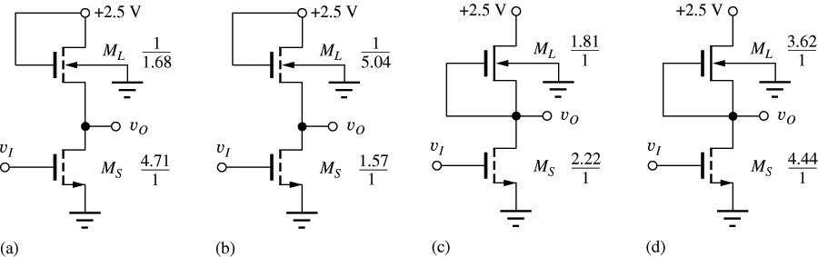
Power Scaling in MOS Logic
Original Saturated Load Inverter
Saturated Load inverter designed to operate at 1/3 the power
Original Depletion-Mode Inverter
Depletion-mode inverter designed to operate at twice the power

Slide 155
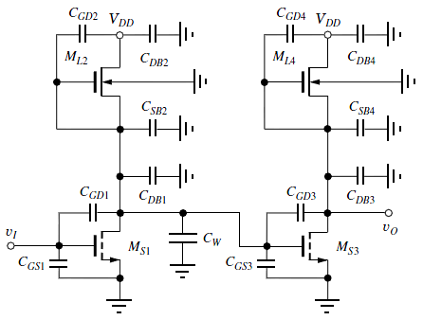
Dynamic Behavior Capacitance in MOS Logic Circuits
The MOS device has capacitances C_{SB}, C_{GS}, C_{DB}, and C_{GD} that need to be considered for dynamic response analysis.

Slide 156
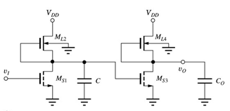
Dynamic Behavior Capacitance in MOS Logic Circuits
The MOS device has capacitances C_{SB}, C_{GS}, C_{DB}, and C_{GD} that need to be considered for dynamic response analysis.
The capacitances seen at a node can be lumped together.

Slide 157
Dynamic Behavior Capacitance in MOS Logic Circuits
The MOS device has capacitances C_{SB}, C_{GS}, C_{DB}, and C_{GD} that need to be considered for dynamic response analysis.
The capacitances seen at a node can be lumped together.
DC loading constraints are not usually important for MOS logic circuits since they normally drive capacitive loads (i.e. the gate of a MOS)

Slide 158
Dynamic Behavior Capacitance in MOS Logic Circuits
The MOS device has capacitances C_{SB}, C_{GS}, C_{DB}, and C_{GD} that need to be considered for dynamic response analysis.
The capacitances seen at a node can be lumped together.
DC loading constraints are not usually important for MOS logic circuits since they normally drive capacitive loads (i.e. the gate of a MOS)
As the number of gates the output (fan-out) of a logic device has to drive increases, the load capacitance increases, and the time response degrades.

Slide 159
Dynamic Behavior Capacitance in MOS Logic Circuits
The MOS device has capacitances C_{SB}, C_{GS}, C_{DB}, and C_{GD} that need to be considered for dynamic response analysis.
The capacitances seen at a node can be lumped together.
DC loading constraints are not usually important for MOS logic circuits since they normally drive capacitive loads (i.e. the gate of a MOS)
As the number of gates the output (fan-out) of a logic device has to drive increases, the load capacitance increases, and the time response degrades.
This notion implies that the fan-out that a logic circuit can drive will be limited by time delay tolerances of the circuit.

Slide 160
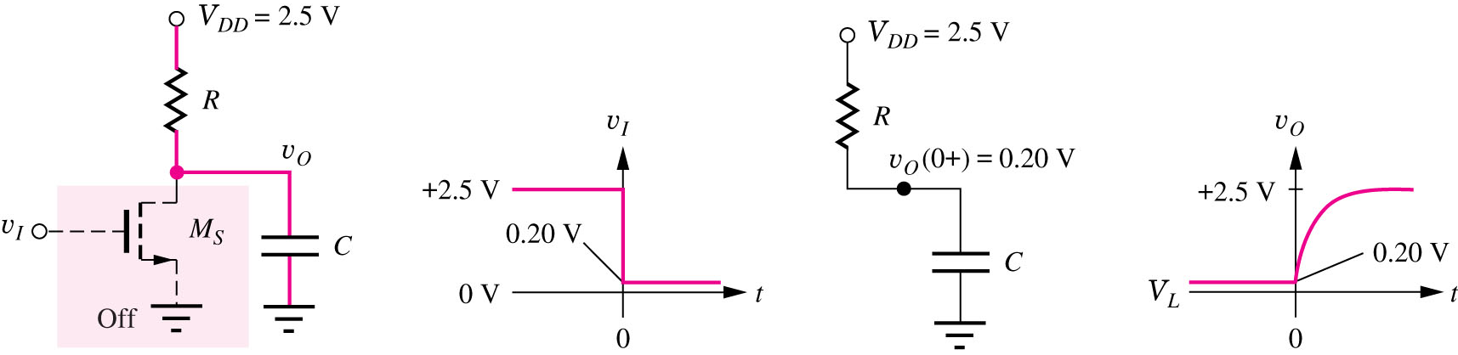
Dynamic Response of the NMOS Inverter with a Resistive Load
Closing switch: v_{I} high → low
Charging capacitor
Rise time is defined as the time for the output to change from 10% to 90% of the complete transition.

Slide 161

Dynamic Response of the NMOS Inverter with a Resistive Load
Delay time τ_{PLH} is defined as the time required for the output to change 50: v_{O}(τ_{PLH}) = V_{I} + 0.5ΔV, which yields :
where R and C are the resistance and capacitance seen at the output.
For high-to-low transitions, the on resistance of M_{S}, R_{onS}, varies during the transition but an effective R, R_{eff}, can be approximated as 1.7 R_{onS}.
For low-to-high transitions, R is the load resistance (M_{S} is off):

Slide 162

Pseudo NMOS Inverter - Dynamic Response
Closing switch: v_{I} high → low
Opening switch: v_{I} low → high
The expressions for the propagation delays are the same as for resistive

Slide 163
Pseudo NMOS Inverter - Dynamic Response Example
Find t_{f}, t_{r}, τ_{PHL}, τ_{PLH} for a pseudo NMOS inverter where:
(W/L)_{S} = 2.22/1 and (W/L)_{L} = 1.11/1
C_{LOAD} = 1 pF
V_{TN} = 0.6 V and V_{TP} = -0.6 V
V_{DD} = 2.5 V
K_{n} = (2.06)(100 × 10⁻⁶ A/V²)
K_{L} = (1.11)(40 × 10⁻⁶ A/V²)

Slide 164
Pseudo NMOS Inverter - Dynamic Response Example
Find t_{f}, t_{r}, τ_{PHL}, τ_{PLH} for a pseudo NMOS inverter where:
(W/L)_{S} = 2.22/1 and (W/L)_{L} = 1.11/1
C_{LOAD} = 1 pF
V_{TN} = 0.6 V and V_{TP} = -0.6 V
V_{DD} = 2.5 V
K_{n} = (2.06)(100 × 10⁻⁶ A/V²)
K_{L} = (1.11)(40 × 10⁻⁶ A/V²)
First find the on-resistances of the two switch and load devices

Slide 165
Pseudo NMOS Inverter - Dynamic Response Example
Find t_{f}, t_{r}, τ_{PHL}, τ_{PLH} for a pseudo NMOS inverter where:
(W/L)_{S} = 2.22/1 and (W/L)_{L} = 1.11/1
C_{LOAD} = 1 pF
V_{TN} = 0.6 V and V_{TP} = -0.6 V
V_{DD} = 2.5 V
K_{n} = (2.06)(100 × 10⁻⁶ A/V²)
K_{L} = (1.11)(40 × 10⁻⁶ A/V²)
Now calculate delays from the R_{eff} approximations:
First find the on-resistances of the two switch and load devices

Slide 166

Comparison of Load Devices
The simulation results for all five inverters. The current has been normalized to 80 μA for v_{o} = V_{OL}= 0.20 V
The saturated load devices have the poorest fall time since they have the lowest load current delivery
The saturated load devices also reach zero current before the output reaches 2.5 V
The linear load device is faster than the saturated load device, but about equal to the resistive load speed.
The fastest τ_{PLH} is for the pseudo NMOS device as a result of the PMOS device

Slide 167

PMOS Logic
PMOS logic circuits predated NMOS logic circuit, but were replaced since they operate at slower speeds
Resistive Load
Saturated Load
Linear Load
Depletion-Mode Load
Pseudo PMOS

Slide 168

PMOS NAND and NOR Gates
NOR Gate
NAND Gate

