Slide 1
Local Search and Optimization

Slide 2
Outline
Local search techniques and optimization
  Hill-climbing
  Simulated annealing
  Genetic algorithms
  Issues with local search

Slide 3
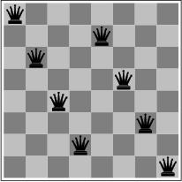
Local search and optimization
  Previous lecture: path to goal is solution to problem
  systematic exploration of search space.
This lecture: a state is solution to problem
  for some problems path is irrelevant.
  E.g., 8-queens
Different algorithms can be used
  Depth First Branch and Bound
  Local search

Slide 4
Goal Satisfaction
Optimization
reach the goal node
Constraint satisfaction
optimize(objective fn)
Constraint Optimization
You can go back and forth between the two problems
Typically in the same complexity class

Slide 5
Local search and optimization
Local search
  Keep track of single current state
  Move only to neighboring states
  Ignore paths
Advantages:
  Use very little memory
  Can often find reasonable solutions in large or infinite (continuous) state spaces.
“Pure optimization” problems
  All states have an objective function
  Goal is to find state with max (or min) objective value
  Does not quite fit into path-cost/goal-state formulation
  Local search can do quite well on these problems.

Slide 6
Trivial Algorithms
Random Sampling
  Generate a state randomly
Random Walk
  Randomly pick a neighbor of the current state
Both algorithms asymptotically complete.

Slide 7
Hill-climbing (Greedy Local Search) max version
function HILL-CLIMBING( problem) return a state that is a local maximum
input: problem, a problem
local variables: current, a node.
neighbor, a node.
current ← MAKE-NODE(INITIAL-STATE[problem])
loop do
neighbor ← a highest valued successor of current
if VALUE [neighbor] ≤ VALUE[current] then return STATE[current]
current ← neighbor
min version will reverse inequalities and look for lowest valued successor

Slide 8
Hill-climbing search
“a loop that continuously moves towards increasing value”
  terminates when a peak is reached
  Aka greedy local search
Value can be either
  Objective function value
  Heuristic function value (minimized)
Hill climbing does not look ahead of the immediate neighbors
Can randomly choose among the set of best successors
  if multiple have the best value
“climbing Mount Everest in a thick fog with amnesia”

Slide 9

“Landscape” of search
Hill Climbing gets stuck in local minima
depending on?

Slide 10

Example: n-queens
Put n queens on an n x n board with no two queens on the same row, column, or diagonal
Is it a satisfaction problem or optimization?

Slide 11
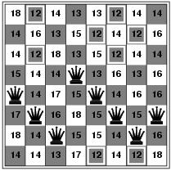
Hill-climbing search: 8-queens problem
Need to convert to an optimization problem
h = number of pairs of queens that are attacking each other
h = 17 for the above state

Slide 12
Search Space
State
  All 8 queens on the board in some configuration
Successor function
  move a single queen to another square in the same column.
Example of a heuristic function h(n):
  the number of pairs of queens that are attacking each other
  (so we want to minimize this)

Slide 13

Hill-climbing search: 8-queens problem
Is this a solution?
What is h?

Slide 14
Hill-climbing on 8-queens
Randomly generated 8-queens starting states…
14% the time it solves the problem
86% of the time it get stuck at a local minimum
However…
  Takes only 4 steps on average when it succeeds
  And 3 on average when it gets stuck
  (for a state space with 8^8 =~17 million states)

Slide 15
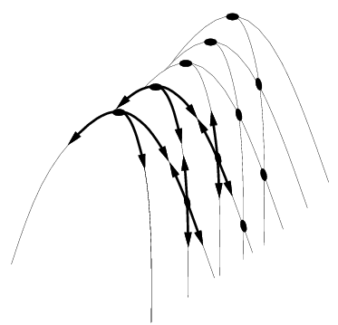
Hill Climbing Drawbacks
  Local maxima
  Plateaus
  Diagonal ridges

Slide 16
Hill-climbing: stochastic variations
Stochastic hill-climbing
  Random selection among the uphill moves.
  The selection probability can vary with the steepness of the uphill move.
To avoid getting stuck in local minima
  Random-walk hill-climbing
  Random-restart hill-climbing
  Hill-climbing with both

Slide 17
Hill Climbing: stochastic variations
When the state-space landscape has local minima, any search that moves only in the greedy direction cannot be complete
Random walk, on the other hand, is
asymptotically complete
Idea: Put random walk into greedy hill-climbing

Slide 18

Hill-climbing with random restarts
If at first you don’t succeed, try, try again!
Different variations
  For each restart: run until termination vs. run for a fixed time
  Run a fixed number of restarts or run indefinitely
Analysis
  Say each search has probability p of success
    E.g., for 8-queens, p = 0.14 with no sideways moves
  Expected number of restarts?
  Expected number of steps taken?
If you want to pick one local search algorithm, learn this one!!

Slide 19
Hill-climbing with random walk
At each step do one of the two
  Greedy: With prob p move to the neighbor with largest value
  Random: With prob 1-p move to a random neighbor
Hill-climbing with both
At each step do one of the three
  Greedy: move to the neighbor with largest value
  Random Walk: move to a random neighbor
  Random Restart: Resample a new current state
© Mausam

Slide 20
Simulated Annealing
Simulated Annealing = physics inspired twist on random walk
Basic ideas:
  like hill-climbing identify the quality of the local improvements
  instead of picking the best move, pick one randomly
  say the change in objective function is δ
  if δ is positive, then move to that state
  otherwise:
    move to this state with probability proportional to δ
    thus: worse moves (very large negative δ) are executed less often
  however, there is always a chance of escaping from local maxima
  over time, make it less likely to accept locally bad moves
  (Can also make the size of the move random as well, i.e., allow “large” steps in state space)

Slide 21
Physical Interpretation of Simulated Annealing
A Physical Analogy:
    imagine letting a ball roll downhill on the function surface
      this is like hill-climbing (for minimization)
    now imagine shaking the surface, while the ball rolls, gradually reducing the amount of shaking
      this is like simulated annealing
Annealing = physical process of cooling a liquid or metal until particles achieve a certain frozen crystal state
    simulated annealing:
      free variables are like particles
      seek “low energy” (high quality) configuration
      slowly reducing temp. T with particles moving around randomly

Slide 22
Simulated annealing
function SIMULATED-ANNEALING( problem, schedule) return a solution state
input: problem, a problem
schedule, a mapping from time to temperature
local variables: current, a node.
next, a node.
T, a “temperature” controlling the prob. of downward steps
current ← MAKE-NODE(INITIAL-STATE[problem])
for t ← 1 to ∞ do
T ← schedule[t]
if T = 0 then return current
next ← a randomly selected successor of current
∆E ← VALUE[next] - VALUE[current]
if ∆E > 0 then current ← next
else current ← next only with probability e^{∆E /T}

Slide 23
Temperature T
high T: probability of “locally bad” move is higher
low T: probability of “locally bad” move is lower
typically, T is decreased as the algorithm runs longer
i.e., there is a “temperature schedule”

Slide 24
Simulated Annealing in Practice
  method proposed in 1983 by IBM researchers for solving VLSI layout problems (Kirkpatrick et al, Science, 220:671-680, 1983).
    theoretically will always find the global optimum
  Other applications: Traveling salesman, Graph partitioning, Graph coloring, Scheduling, Facility Layout, Image Processing, …
  useful for some problems, but can be very slow
    slowness comes about because T must be decreased very gradually to retain optimality

Slide 25
Genetic algorithms
Twist on Local Search: successor is generated by combining two parent states
A state is represented as a string over a finite alphabet (e.g. binary)
  8-queens
    State = position of 8 queens each in a column
Start with k randomly generated states (population)
Evaluation function (fitness function):
  Higher values for better states.
  Opposite to heuristic function, e.g., # non-attacking pairs in 8-queens
Produce the next generation of states by “simulated evolution”
  Random selection
  Crossover
  Random mutation

Slide 26
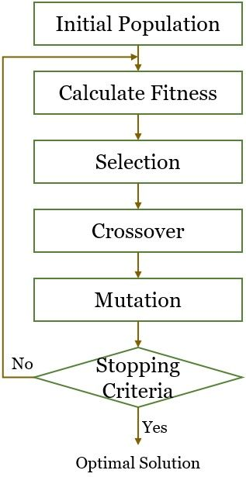
Genetic algorithms

Slide 27

8
7
6
5
4
3
2
1
String representation
16257483
Can we evolve 8-queens through genetic algorithms?

Slide 28

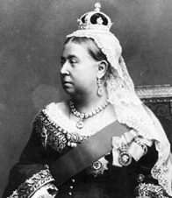
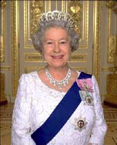

Evolving 8-queens
?
Sorry! Wrong queens

Slide 29

Genetic algorithms
Fitness function: number of non-attacking pairs of queens (min = 0, max = 8 × 7/2 = 28)
24/(24+23+20+11) = 31%
23/(24+23+20+11) = 29% etc
4 states for
8-queens
problem
2 pairs of 2 states randomly selected based on fitness. Random crossover points selected
New states
after crossover
Random
mutation
applied

Slide 30

Genetic algorithms
Has the effect of “jumping” to a completely different new
part of the search space (quite non-local)

Slide 31
Comments on Genetic Algorithms
Genetic algorithm is a variant of “stochastic beam search”
Positive points
  Random exploration can find solutions that local search can’t
    (via crossover primarily)
  Appealing connection to human evolution
    “neural” networks, and “genetic” algorithms are metaphors!
Negative points
  Large number of “tunable” parameters
    Difficult to replicate performance from one problem to another
  Lack of good empirical studies comparing to simpler methods
  Useful on some (small?) set of problems but no convincing evidence that GAs are better than hill-climbing w/random restarts in general

