Slide 1
Inference in FOL
All rules of inference for propositional logic apply to first-order logic
We just need to reduce FOL sentences to PL sentences by instantiating variables and removing quantifiers

Slide 2
Reduction of FOL to PL
Suppose the KB contains the following:
∀x King(x) ∧ Greedy(x) ⇒ Evil(x)
King(John) Greedy(John) Brother(Richard,John)
How can we reduce this to PL?
Let’s instantiate the universal sentence in all possible ways:
King(John) ∧ Greedy(John) ⇒ Evil(John)
King(Richard) ∧ Greedy(Richard) ⇒ Evil(Richard)
King(John) Greedy(John) Brother(Richard,John)
The KB is propositionalized
Proposition symbols are King(John), Greedy(John), Evil(John), King(Richard), etc.

Slide 3
Reduction of FOL to PL
What about existential quantification, e.g.,
∃x Crown(x) ∧ OnHead(x,John) ?
Let’s instantiate the sentence with a new constant that doesn’t appear anywhere in the KB:
Crown(C₁) ∧ OnHead(C₁,John)

Slide 4
Propositionalization
Every FOL KB can be propositionalized so as to preserve entailment
A ground sentence is entailed by the new KB iff it is entailed by the original KB
Idea: propositionalize KB and query, apply resolution, return result
Problem: with function symbols, there are infinitely many ground terms
For example, Father(X) yields Father(John), Father(Father(John)), Father(Father(Father(John))), etc.

Slide 5
Propositionalization
Theorem (Herbrand 1930):
If a sentence α is entailed by an FOL KB, it is entailed by a finite subset of the propositionalized KB
Idea: For n = 0 to Infinity do
Create a propositional KB by instantiating with depth-n terms
See if α is entailed by this KB
Problem: works if α is entailed, loops if α is not entailed
Theorem (Turing 1936, Church 1936):
Entailment for FOL is semidecidable: algorithms exist that say “yes” to every entailed sentence, but no algorithm exists that also says “no” to every nonentailed sentence

Slide 6
Inference in FOL
“All men are mortal. Socrates is a man; therefore, Socrates is mortal.”
Can we prove this without full propositionalization as an intermediate step?
We have a rule ∀x Man(x) ⇒ Mortal(x) and a fact Man(Socrates). We can just “plug in” Socrates instead of x into the rule to conclude Mortal(Socrates).

Slide 7
Substitution
Substitution of variables by ground terms:
SUBST({v/g},P)
Result of SUBST({x/Harry, y/Sally}, Loves(x,y)):
Loves(Harry,Sally)
Result of SUBST({x/John}, King(x) ∧ Greedy(x) ⇒ Evil(x)):
King(John) ∧ Greedy(John) ⇒ Evil(John)

Slide 8
Universal instantiation (UI)
A universally quantified sentence entails every instantiation of it:
∀v P(v) SUBST({v/g}, P(v))
for any variable v and ground term g
E.g., ∀x King(x) ∧ Greedy(x) ⇒ Evil(x) yields:
King(John) ∧ Greedy(John) ⇒ Evil(John)
King(Richard) ∧ Greedy(Richard) ⇒ Evil(Richard)
King(Father(John)) ∧ Greedy(Father(John)) ⇒ Evil(Father(John)), …

Slide 9
Existential instantiation (EI)
An existentially quantified sentence entails the instantiation of that sentence with a new constant:
∃v P(v)
SUBST({v/C}, P(v))
for any sentence P, variable v, and constant C that does not appear elsewhere in the knowledge base
E.g., ∃x Crown(x) ∧ OnHead(x,John) yields:
Crown(C₁) ∧ OnHead(C₁,John)
provided C₁ is a new constant symbol, called a Skolem constant

Slide 10
Generalized Modus Ponens (GMP)
(p₁ ∧ p₂ ∧ … ∧ p_{n} ⇒q), r₁, r₂, … , r_{n}
such that SUBST(θ, p_{i})= SUBST(θ, r_{i}) for all i
SUBST(θ, q)
Example (all variables assumed universally quantified):
King(x) ∧ Greedy(x) ⇒ Evil(x)
King(John) Greedy(y) Brother(Richard,John)
p₁ is King(x), p₂ is Greedy(x), q is Evil(x)
r₁ is King(John), r₂ is Greedy(y), θ is {x/John,y/John}
SUBST(θ, q) is Evil(John)

Slide 11
Unification
UNIFY(α,β) = θ means that SUBST(θ, α) = SUBST(θ, β)
p q θ
Knows(John,x) Knows(John,Jane) {x/Jane}
Knows(John,x) Knows(y,Mary) {x/Mary, y/John}
Knows(John,x) Knows(y,Mother(y)) {y/John, x/Mother(John)}
Knows(John,x) Knows(x,Mary) {x₁/John, x₂/Mary}
Knows(John,x) Knows(y,z) {y/John, x/z}
Standardizing apart eliminates overlap of variables
Most general unifier

Slide 12
Inference with GMP
(p₁ ∧ p₂ ∧ … ∧ p_{n} ⇒q), r₁, r₂, … , r_{n}
such that SUBST(θ, p_{i})= SUBST(θ, r_{i}) for all i
SUBST(θ, q)
Forward chaining
Like search: keep proving new things and adding them to the KB until we can prove q
Backward chaining
Find p₁, …, p_{n} such that knowing them would prove q
Recursively try to prove p₁, …, p_{n}

Slide 13
Example knowledge base
The law says that it is a crime for an American to sell weapons to hostile nations. The country Nono, an enemy of America, has some missiles, and all of its missiles were sold to it by Colonel West, who is American.
Prove that Col. West is a criminal

Slide 14
Example knowledge base
It is a crime for an American to sell weapons to hostile nations:
American(x) ∧ Weapon(y) ∧ Sells(x,y,z) ∧ Hostile(z) ⇒ Criminal(x)
Nono has some missiles
∃x Owns(Nono,x) ∧ Missile(x)
Owns(Nono,M₁) ∧ Missile(M₁)
All of its missiles were sold to it by Colonel West
Missile(x) ∧ Owns(Nono,x) ⇒ Sells(West,x,Nono)
Missiles are weapons:
Missile(x) ⇒ Weapon(x)
An enemy of America counts as “hostile”:
Enemy(x,America) ⇒ Hostile(x)
West is American
American(West)
The country Nono is an enemy of America
Enemy(Nono,America)

Slide 15
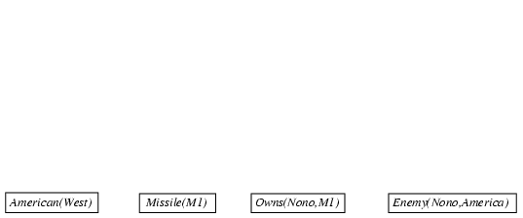
Forward chaining proof
American(x) ∧ Weapon(y) ∧ Sells(x,y,z) ∧ Hostile(z) ⇒ Criminal(x)
Owns(Nono,M₁) ∧ Missile(M₁)
Missile(x) ∧ Owns(Nono,x) ⇒ Sells(West,x,Nono)
Missile(x) ⇒ Weapon(x) Enemy(x,America) ⇒ Hostile(x)
American(West) Enemy(Nono,America)

Slide 16
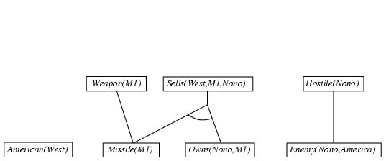
Forward chaining proof
American(x) ∧ Weapon(y) ∧ Sells(x,y,z) ∧ Hostile(z) ⇒ Criminal(x)
Owns(Nono,M₁) ∧ Missile(M₁)
Missile(x) ∧ Owns(Nono,x) ⇒ Sells(West,x,Nono)
Missile(x) ⇒ Weapon(x) Enemy(x,America) ⇒ Hostile(x)
American(West) Enemy(Nono,America)

Slide 17
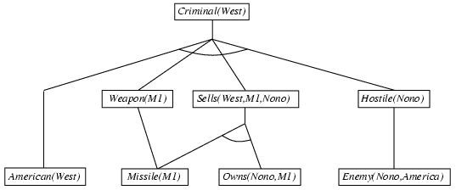
Forward chaining proof
American(x) ∧ Weapon(y) ∧ Sells(x,y,z) ∧ Hostile(z) ⇒ Criminal(x)
Owns(Nono,M₁) ∧ Missile(M₁)
Missile(x) ∧ Owns(Nono,x) ⇒ Sells(West,x,Nono)
Missile(x) ⇒ Weapon(x) Enemy(x,America) ⇒ Hostile(x)
American(West) Enemy(Nono,America)

Slide 18

Backward chaining example
American(x) ∧ Weapon(y) ∧ Sells(x,y,z) ∧ Hostile(z) ⇒ Criminal(x)
Owns(Nono,M₁) ∧ Missile(M₁)
Missile(x) ∧ Owns(Nono,x) ⇒ Sells(West,x,Nono)
Missile(x) ⇒ Weapon(x) Enemy(x,America) ⇒ Hostile(x)
American(West) Enemy(Nono,America)

Slide 19
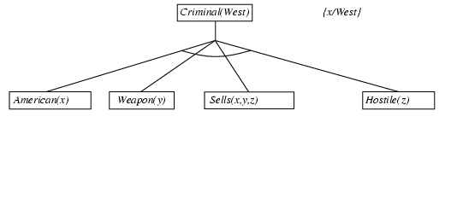
Backward chaining example
American(x) ∧ Weapon(y) ∧ Sells(x,y,z) ∧ Hostile(z) ⇒ Criminal(x)
Owns(Nono,M₁) ∧ Missile(M₁)
Missile(x) ∧ Owns(Nono,x) ⇒ Sells(West,x,Nono)
Missile(x) ⇒ Weapon(x) Enemy(x,America) ⇒ Hostile(x)
American(West) Enemy(Nono,America)

Slide 20
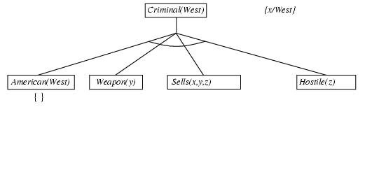
Backward chaining example
American(x) ∧ Weapon(y) ∧ Sells(x,y,z) ∧ Hostile(z) ⇒ Criminal(x)
Owns(Nono,M₁) ∧ Missile(M₁)
Missile(x) ∧ Owns(Nono,x) ⇒ Sells(West,x,Nono)
Missile(x) ⇒ Weapon(x) Enemy(x,America) ⇒ Hostile(x)
American(West) Enemy(Nono,America)

Slide 21
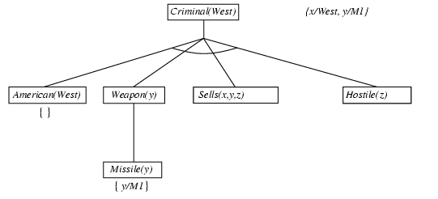
Backward chaining example
American(x) ∧ Weapon(y) ∧ Sells(x,y,z) ∧ Hostile(z) ⇒ Criminal(x)
Owns(Nono,M₁) ∧ Missile(M₁)
Missile(x) ∧ Owns(Nono,x) ⇒ Sells(West,x,Nono)
Missile(x) ⇒ Weapon(x) Enemy(x,America) ⇒ Hostile(x)
American(West) Enemy(Nono,America)

Slide 22
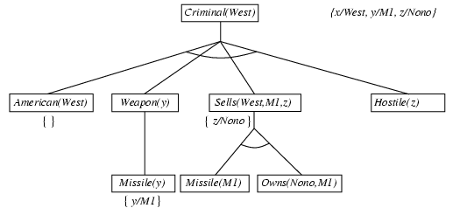
Backward chaining example
American(x) ∧ Weapon(y) ∧ Sells(x,y,z) ∧ Hostile(z) ⇒ Criminal(x)
Owns(Nono,M₁) ∧ Missile(M₁)
Missile(x) ∧ Owns(Nono,x) ⇒ Sells(West,x,Nono)
Missile(x) ⇒ Weapon(x) Enemy(x,America) ⇒ Hostile(x)
American(West) Enemy(Nono,America)

Slide 23
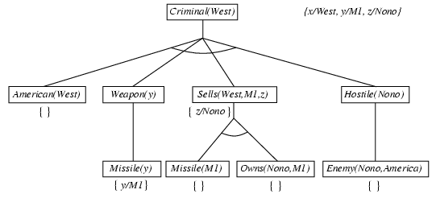
Backward chaining example
American(x) ∧ Weapon(y) ∧ Sells(x,y,z) ∧ Hostile(z) ⇒ Criminal(x)
Owns(Nono,M₁) ∧ Missile(M₁)
Missile(x) ∧ Owns(Nono,x) ⇒ Sells(West,x,Nono)
Missile(x) ⇒ Weapon(x) Enemy(x,America) ⇒ Hostile(x)
American(West) Enemy(Nono,America)

