Slide 1
INTRODUCTION TO ROBOTICS AND MICROCONTROLLERS

Slide 2
Module Overview
A general overview of what robots are, and the essential components embedded within
Relevant examples of microcontroller and robot applications to help the participants understand contexts and applications of these technologies
Contextual understanding makes it easier to relate programming efforts to basic science, math, or engineering concepts

Slide 3
What is a Microcontroller?
A microcontroller is a kind of miniature computer that found in all kinds of gizmos
Generally speaking, if a device has buttons and a digital display, chances are it also has a programmable microcontroller brain.

Slide 4
Microcontrollers cont.
Microcontrollers are 'single chip' computers specifically designed to:
Read input devices, such as buttons and sensors
Process data or information
Control output devices, such as lights, displays, motors and speakers

Slide 5
Embedded Control
Microcontrollers are placed in devices, or embedded, for operation and control.
Can you name other devices in your life that have embedded control?

Slide 6
Microprocessor vs. Microcontroller
A microprocessor is the “brain” of a computer system
Generally referred to as the central processing unit (CPU), the microprocessor by itself is practically useless
To be useful, one must have means of communicating with it using input and output devices
One must also add memory (ROM and RAM) so that the system can be programmed.

Slide 7
Microprocessor vs. Microcontroller Cont.
A microcontroller is a computer chip designed for control-oriented applications
Unlike ordinary microprocessors, microcontrollers have built-in features that make them operate almost independent of additional circuitry
This is possible because microcontrollers contain things like
memory (ROM, EPROM, RAM, etc)
input and output ports
timers
serial and parallel communication capability
analog-to-digital converters

Slide 8
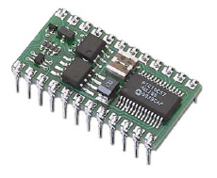
Boe-Bot’s Brain: The BASIC Stamp
The BASIC Stamp 2 embeds a microcontroller, the PIC16C57, on a module to make programming and use very simple, yet very powerful.
Additional components on the module provide everything needed to systems and applications, like robotics.

Slide 9
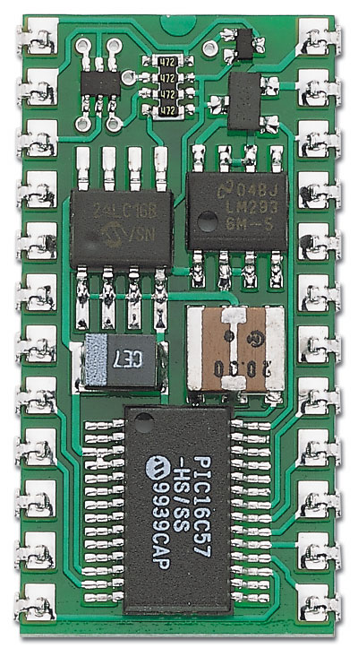
BASIC Stamp Module Components
Serial Signal Conditioning Conditions voltage signals between PC serial connection (+/- 12V) and BASIC Stamp (5V) for
Programming.
5V Regulator Regulates voltage to 5V with a supply of 5.5VDC to 15VDC
EEPROM Stores the your PBASIC program.
Resonator Sets the speed at which instructions are processed.
Interpreter Chip Reads the BASIC program from the EEPROM and executes the instructions.

Slide 10
So What is a Robot?
A robot is a machine that gathers information about its environment (senses) and uses that information (thinks) to follow instructions to do work (acts)
The “sensing” part provides input to the robot through switches, light sensors,
The thinking part is the microcontroller brain
The acting part could be through lights, motors, actuators, sounds, etc

Slide 11
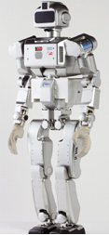
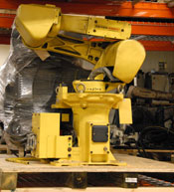
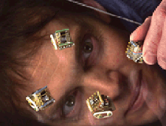
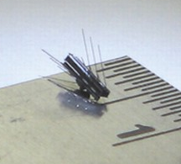
Robots and Applications
Robots come in many shapes and sizes
Kawada's HRP-3P humanoid robot
Fanuc ArcMate 100i precision, high-speed welding and cutting robot
MINI-ROBOT RESEARCH — Sandia National Laboratories
Mini-robot that can travel through the bloodstream

Slide 12

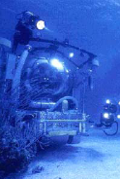
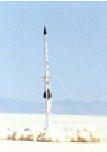
High-Tech and Aerospace use
Ecological
Data Collection EME Systems
Undersea Research Harbor Branch Institute
JP Aerospace Test Launch

Slide 13
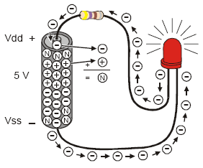
Fundamentals of Electricity
Electric Current (I), measured in amperes (A)
Resistance (R), measured in Ohms (Ω)
Voltage (V), measured in volts (V)
A complete path or circuit is required for current to flow
R
I
V

Slide 14
Fundamentals of Electricity Cont.
Robotics requires a basic understanding of electricity and simple wiring diagrams
The relationship between current, voltage and resistance is expressed by what is known as Ohm’s Law, variations of which are expressed below:
V = IR; I = V/R; R = V/I
R
+V
I
R
+
-
V

Slide 15
Use Accelerometers to Measure
Acceleration
Tilt and tilt angle
Incline
Rotation
Vibration
Collision
Gravity

Slide 16

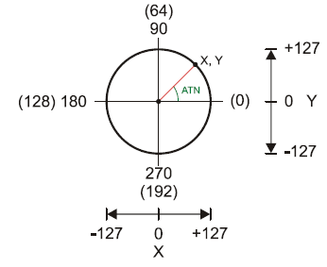
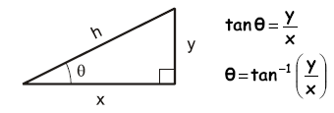
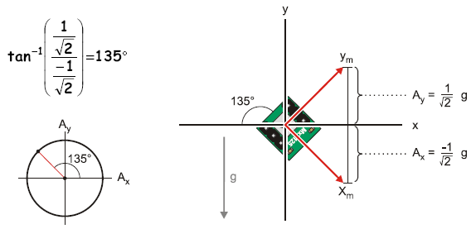
Something for Everyone

