Slide 1
Robot Kinematics
Robot arm kinematics deals with the analytic study of the motion of a robot arm with respect to a fixed reference coordinate system as a function of time. The mechanical manipulator can be modeled as an open loop articulated chain with several rigid links connected in series by either 'revolute' or 'prismatic' joints driven by the actuators.
For a manipulator, if the position and orientation of the end-effectors are derived from the given joint angles and link parameters, the scheme is called the forward kinematics problem.
If, on the other hand, the joint angles and the different configuration of the manipulator are derived from the position and orientation of the end-effector, the scheme is called the reverse kinematics problem. Figure 2.1 illustrates the scheme of forward and reverse kinematics.

Slide 2
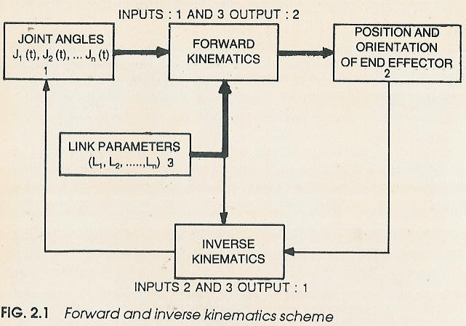
Robot Kinematics

Slide 3
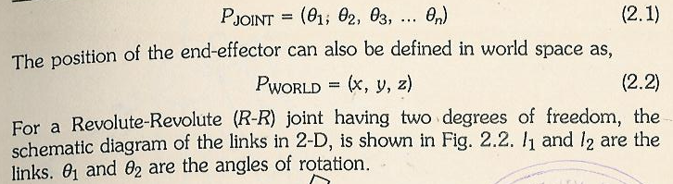
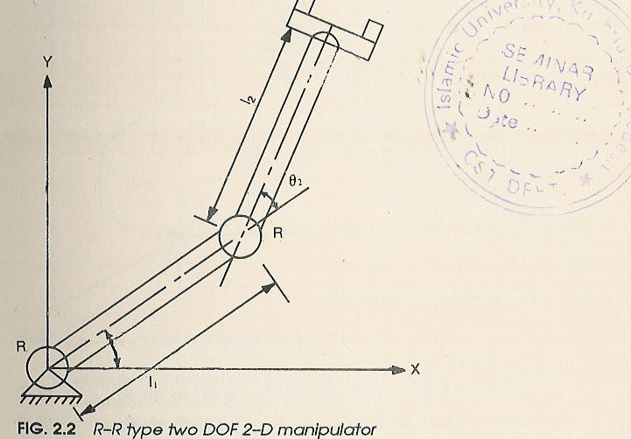
Robot Kinematics : Representing the Position

Slide 4
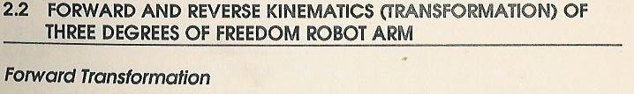
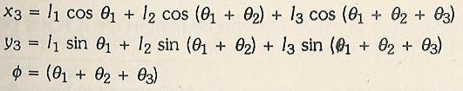

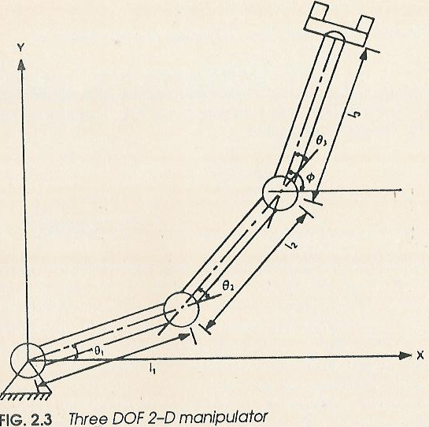






Slide 5
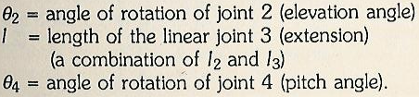

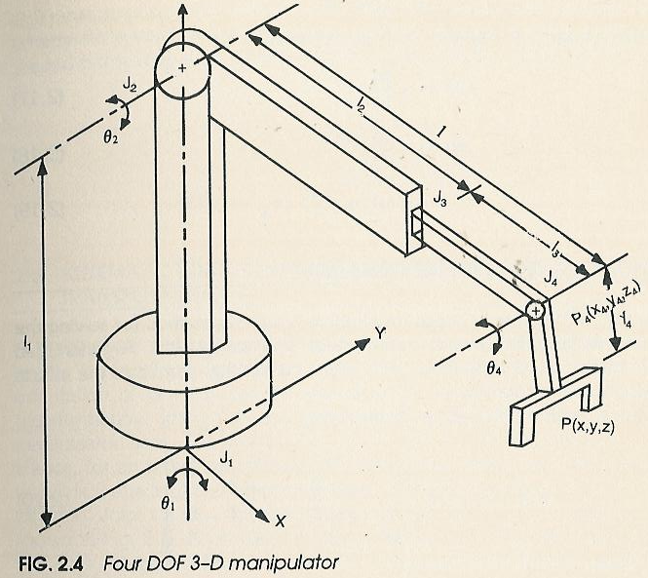
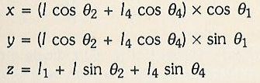


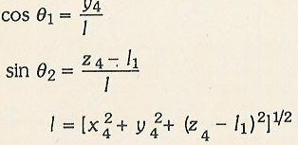

Slide 6

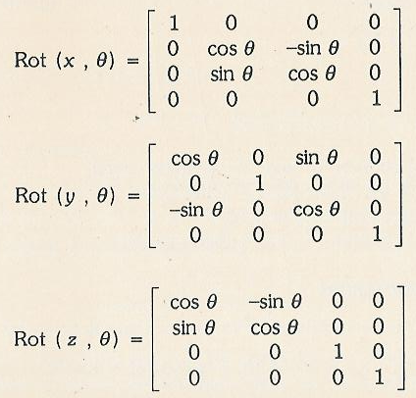
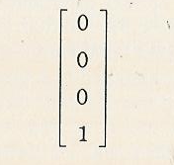
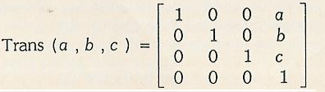

Slide 7

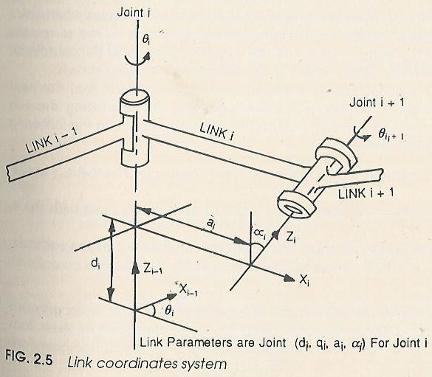

Slide 8

