Slide 1
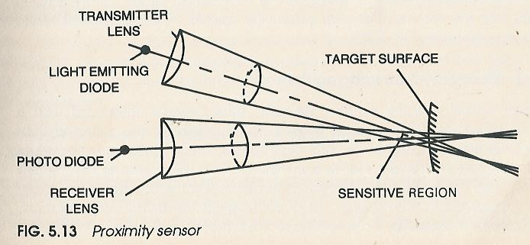
Proximity and Range Sensors

Slide 2
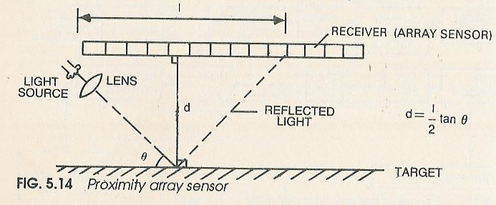
Proximity Array Sensors

Slide 3
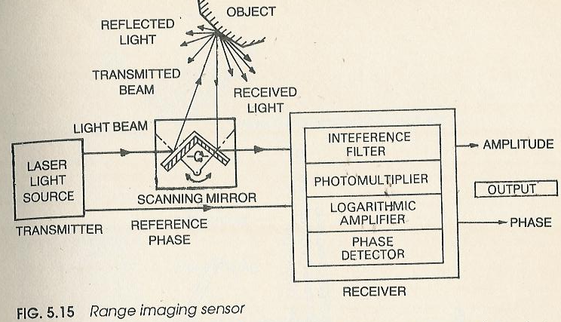
Range Imaging Sensor

Slide 4
Robot vision
Robot vision, also termed computer vision or machine vision, is an important sensor technology with potential applications in many industrial operations.
Robot vision may be defined as the process of extracting, characterizing and interpreting information from images of a three-dimensional world.
The operation consists of three functions, broadly:
1. Sensing and digitizing-It is the process that yields a visual image of sufficient contrast that is typically digitized and stored in the computer memory.
2. Image processing and analysis-The digitized image is subjected to image processing and analysis for data reduction and interpretation of the image. It may be further subdivided into:
Preprocessing segmentation description recognition interpretation
3. Application-The current applications of robot vision include inspection, part identification, location and orientation. Research is ongoing in advanced application in complex inspection, guidance and navigation.

Slide 5
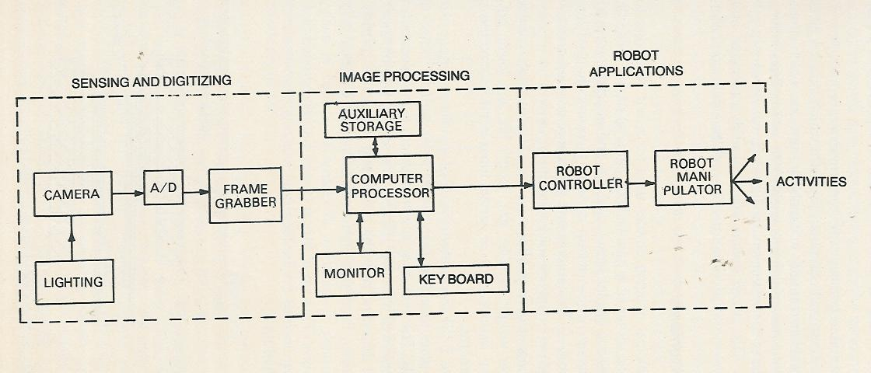
Robot vision

Slide 6
Low Level Vision
Sensing and Digitizing
Vision Camera and CCD Line Scan Sensor
Illumination
A/D Conversion
Image Storage
Preprocessing
Noise Reduction or Smoothing
Enhancement

Slide 7
Higher Level Vision
Segmentation
Thresholding
Region Growing
Edge Detection
Object Description
Object Recognition
Interpretation

