Slide 1
Robot Languages and Programming
VAL Programming
Locations: Robot locations refer to the data that represents the position and orientation of the robot tool (end point).
VAL has got two ways of representing robot locations.
One way is to express a location in terms of the positions of the individual robot joints, which is then called a precision point.
Another way is to express in terms of the Cartesian coordinates (x, y, z) and orientation angles of the robot tool relative to a reference frame fixed in the robot base. Such locations are called transformations and provide a more intuitive representation of locations than do precision points, since the components are easily related to the workspace.
Compound transformations are also available in VAL which define a location relative to other locations and are written as strings of transformation names separated by colons

Slide 2
Trajectory Control
VAL uses two different methods to control the path of a robot from one location to another.
The methods either (i) interpolate between the initial and final position of each joint, producing a complicated tool-tip curve in space, or (ii) move the robot tip along a straight-line path.
For the first case, called joint interpolated motion, the total motion time is set to that of the joint requiring the longest time to complete its motion. This provides the fastest response of the robot.
On the other hand, straight-line motion is produced by applying an interpolating function to the world-coordinate location of the robot tool and rapidly transforming the interpolated tool location to joint commands. In this case, the motion speed of the robot tool-tip can be accurately controlled, but it has the disadvantage of being slower than corresponding joint-interpolated motions.
Next Figure shows an example of a VAL program, where the meaning of each line is as follows:

Slide 3
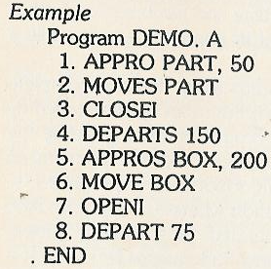
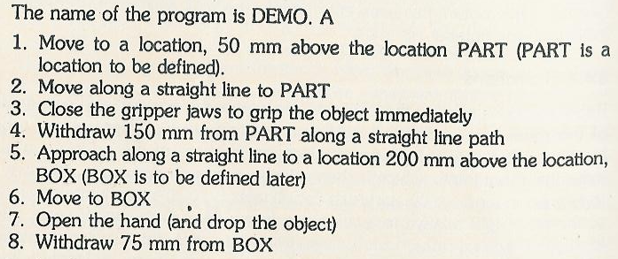
Trajectory Control

Slide 4
Monitor Commands
Monitor commands are used to enter and execute a VAL program.
VAL commands can be divided into the following categories:
(i) defining and determining locations
(ii) editing programs
(iii) listing program and location data
(iv) storing and retrieving program and location data and
(v) program control

Slide 5
Defining and Determining Locations
Location variables can be set equal to the current location or a previously defined location by HERE and POINT command.
The current location can be displayed using WHERE command.
TEACH command records a series of location values under the control of RECORD button on manual control unit.
The following example shows how to teach a position PART by HERE Command, and the resulting positions displayed on the screen.
HERE PART or HERE P1
X/JT1 Y/JT2 Z/JT3 O/JT4 A/JT5 T/JT6
248.63 592.97 148.53 141.141 30.822 1.225
To define a position, a command like
POINT PART = P1
may be given where a location variable PART is equal to the value P1.
A command, say,
TEACH P1
is used to record a location variable P1 when the record button on the teach pendant is pressed. Successive location variables can be assigned P1, next P2, next P3 and so forth by teaching new locations on the path and pressing the record button each time. The motion path is taught by the command TECH

Slide 6
Monitor Commands
Editing Programs:
EDIT permits to create or modify (edit) a user program.
A typical command for editing is,
EDIT SRD
_{O}
_{O}
_{O}
_{O}
E
E means exit of the editing mode and return to the monitor mode.
Listing Program and Location Data:
The command DIR displays the names of all user programs in the system memory.
The commands LISTL and LISTP
display the value of location variables and the steps of user programs respectively.

Slide 7
Monitor Commands
Storing and Retrieving Program and Location-data
The command that displays the file directory of the diskette is
LISTF
The specified programs, location and both programs and locations can be stored respectively in a program file and a location file by entering the commands
STOREP
STOREL
and STORE
The commands that can be used for loading the programs, locations and both programs and locations respectively contained in a specified disk into the system memory are
LOADP
LOADL
and LOAD
In VALII, an additional command can be constructed as
FLIST - for listing the file names kept on a disk.
Besides, VAL and VAL II can accept commands
COPY - for copying the program
RENAME - for renaming the files
DELETE - for deleting the files.

Slide 8
Program Control
The command that specifies the speed for all subsequent robot motions under program control is
SPEED 30
The commands that execute a specified user program for once, any number of times or indefinitely are
EXECUTE
EXECUTE, 5 (execute five times)
EXECUTE, -1 (indefinitely)
The command that terminates program execution after completion of the current step is
ABORT
In VALII, a single joint (say joint number 2) may be changed by driving it, say 60° at a speed of 30 per cent of the monitor speed. The command, for example, is
DRIVE 2, 60, 30
The DO command allows a robot to execute a program instruction, say, ALIGN which is used for motion control to align the end-effector. In order to grip some objects, the end-effector is required to align such that its Z-axis is parallel to the nearest axis of the World Coordinate System. The command is
DO ALIGN
Similarly the other DO command may be
DO MOVE PART (Part is variable location)

