Slide 1
Robotics : Introduction
With the revolution of technology, human works are replaced by automatic machines. Thus automation technology becomes popular in industry, office works and even in homes.
A new type of automation technology has become available that is adjustable, adaptable and flexible enough not only to the change in the design of the product, but also to the change in the process of manufacture of the products.
This type of automation is termed as Programmable automation. Here Programmable means that one set of tasks can be easily switched over to another set by changing the computerized instructions.

Slide 2
Robotics : Introduction
An Example of Programmable Automation technology is the robot. The name Robot came from Czechoslovakian word Robota, which means a worker or a slave doing heavy work.
In 1921-22, Karel Capek, a Czechoslovakian playwright introduce the concepts of humanoid in his play titled “Rossum’s Universal Robots”.
In the same time, a Gyrocompass used in a ship and governor used for controlling the speed of steam locomotives or automobiles had also been called robots.
In the 70's, automatic machines with the capability of lifting materials, tools, etc. and performing tasks as instructed by the master had also been called robots.

Slide 3
Robotics : Introduction
Therefore a robot is a machine that carries out the tasks done by a human being. A robot may do assembly work where some sort of intelligence decision- making capability as expected from a man is needed. A robot sometime does heavy work and automatically performs the same task repetitively.
An Industrial Robot has been defined as a reprogrammable multifunctional manipulator designed to move material, parts, tools or specialized devices through various programmed motions for the performance of a variety of tasks. [Robotics Industries Association, Nov., 1979]

Slide 4
Robotics : Introduction
Robotics is the Science of designing and build robots suitable for real-life applications in automated manufacturing and other non-manufacturing environments.
Though robots came into focus in 1961 when Unimation Inc., USA introduced the first servo-controlled industrial robots, their historical background may be divided into three stages.
Ancient and post historic ages
Post-Industrial renaissance age
Microelectronics and microprocessor age

Slide 5
Robotics : Introduction
During 5000 B.C., Human and animal like figures were made to imitate movements in Indus-Valley civilization.
During 3000 B.C., water clocks were built by Egyptians.
Around 500 B.C., Artificial hands/legs were used by romans.
In 400 B.C. Archytas of Tarentum made a wooden pigeon which could fly.
During middle age, German astronomer Johann Muller made an iron fly, able to flutter around the room and return to his hand.

Slide 6
Robotics : Introduction
In the age of industrial revolution, steam power become main source of energy.
Various type of machines gave a new trust to the concept of mechanization like textile, drilling, boring, milling machines.
In 1805, J.M. Jacquard introduced an automatic loom with punched card control mechanism. In 1823, Charles Babbages attempt to build modern computing machine. And many other automation elements were invented to relieve man from the hazards with heavy and odd jobs.
Automation found wide applications in spray painting in this age.

Slide 7
Robotics : Introduction
The history finds new dimension when remote teleoperated master-slave manipulators were developed around 1944 by R.C. Goertz and found important application to handle radioactive materials from a safe distance.
Electronic computer ENIVAC, IBM701 etc. and NC machine tools became a turning point in the development of robotics.
A battery operated mechanical man was made in Stanford Unversity. That could walk from room to room, identify some items and able to introduce its battery charger plug to a nearby electric socket.

Slide 8
Robotics : Introduction
In 1959, The planet corporation introduced a pick and place robot.
In 1961, Unimation Inc., USA introduced the first industrial robots and Intel introduced microprocessor technology.
Gradual development of robotics introduced MarkII in 1967, “Shakey” with AI by stanford research Institute in 1968, A rectangular coordinate robot, IBM 7565 by IBM in 1972 and Cincinnati Milacron was introduced T³, the first computer controlled robot in 1974.

Slide 9
Robotics : Introduction
Stanford and IBM introduced “structured light” vision system and WAVE, the first robot programming language was developed in Stanford in 1971. Another robot programming language AL was developed in 1974.
In 1996, Space hunting of robots started Viking-I robot rover, built by NASA, landed on Mars. BARPY speech understanding system was completed at Carnegie Melton by Reddy.
First PUMA prototype, based on Scheinman's MIT model arm was built for General Motors in 1978.

Slide 10
Robotics : Introduction
The largest academic robot lab in the US, the Robotics Institute at Carnegie Melton was established and First robot to pick randomly stacked connecting rods out of a bin was developed at the University or Rhode Island in 1980.
In 1983-84, Southerland's hexapod of Carnegie Melton University-the first man­carrying computer-controlled walking machine by Raibert (1983) and Southerland and Ullner (1984). BIPER-4-A two-legged walking machine designed by Miura-Shimoyana.

Slide 11
Robotics : Introduction
In last two decades the invention in robotics spreads in multidimensional sectors. Misubishi introduces Robot dog and Honda build a Humanoid with latest intelligent technology.
Several robots and robotic systems were build to work in space.
Various robotic systems like Drone fighter plane were introduced in war sectors.

Slide 12
LAWS OF ROBOTICS
Sir Isaac Asimov dealing on the subject of robotics framed three basic laws which the robotocists still obey with respect. The laws are philosophical in nature. They are as follows:
First Law: A robot must not harm a human being or, through inaction, allow one to come to harm.
Second Law: A robot must always obey human beings unless it is in conflict with the first law.
Third Law: A robot must protect itself from harm unless that is in conflict with the first and/or the second laws.

Slide 13
A Simple Robotic System
A system is an integrated whole of parts or subsystems.
A system has a specified goal or output for a given set of inputs; a system may have many goals as well.
A robot is a system as it combines many subsystems that interact among themselves as well as with the environment in which the robot works.

Slide 14
A Simple Robotic System
A robot has many components which include:
1) A base-fixed or mobile.
2) A manipulator arm with several degrees of freedom (DOF).
3) An end-effector or gripper holding a part or a tool.
4) Drives or actuators causing the manipulator arm or end-effector
to move in a space.
5) Controller with hardware and software support for giving
commands to the drives.
6) Sensors to feed back the information for subsequent actions of
the arm or gripper as well as to interact with the environment in
which the robot is working.
7) Interfaces connecting the robotic subsystems to the external world.

Slide 15
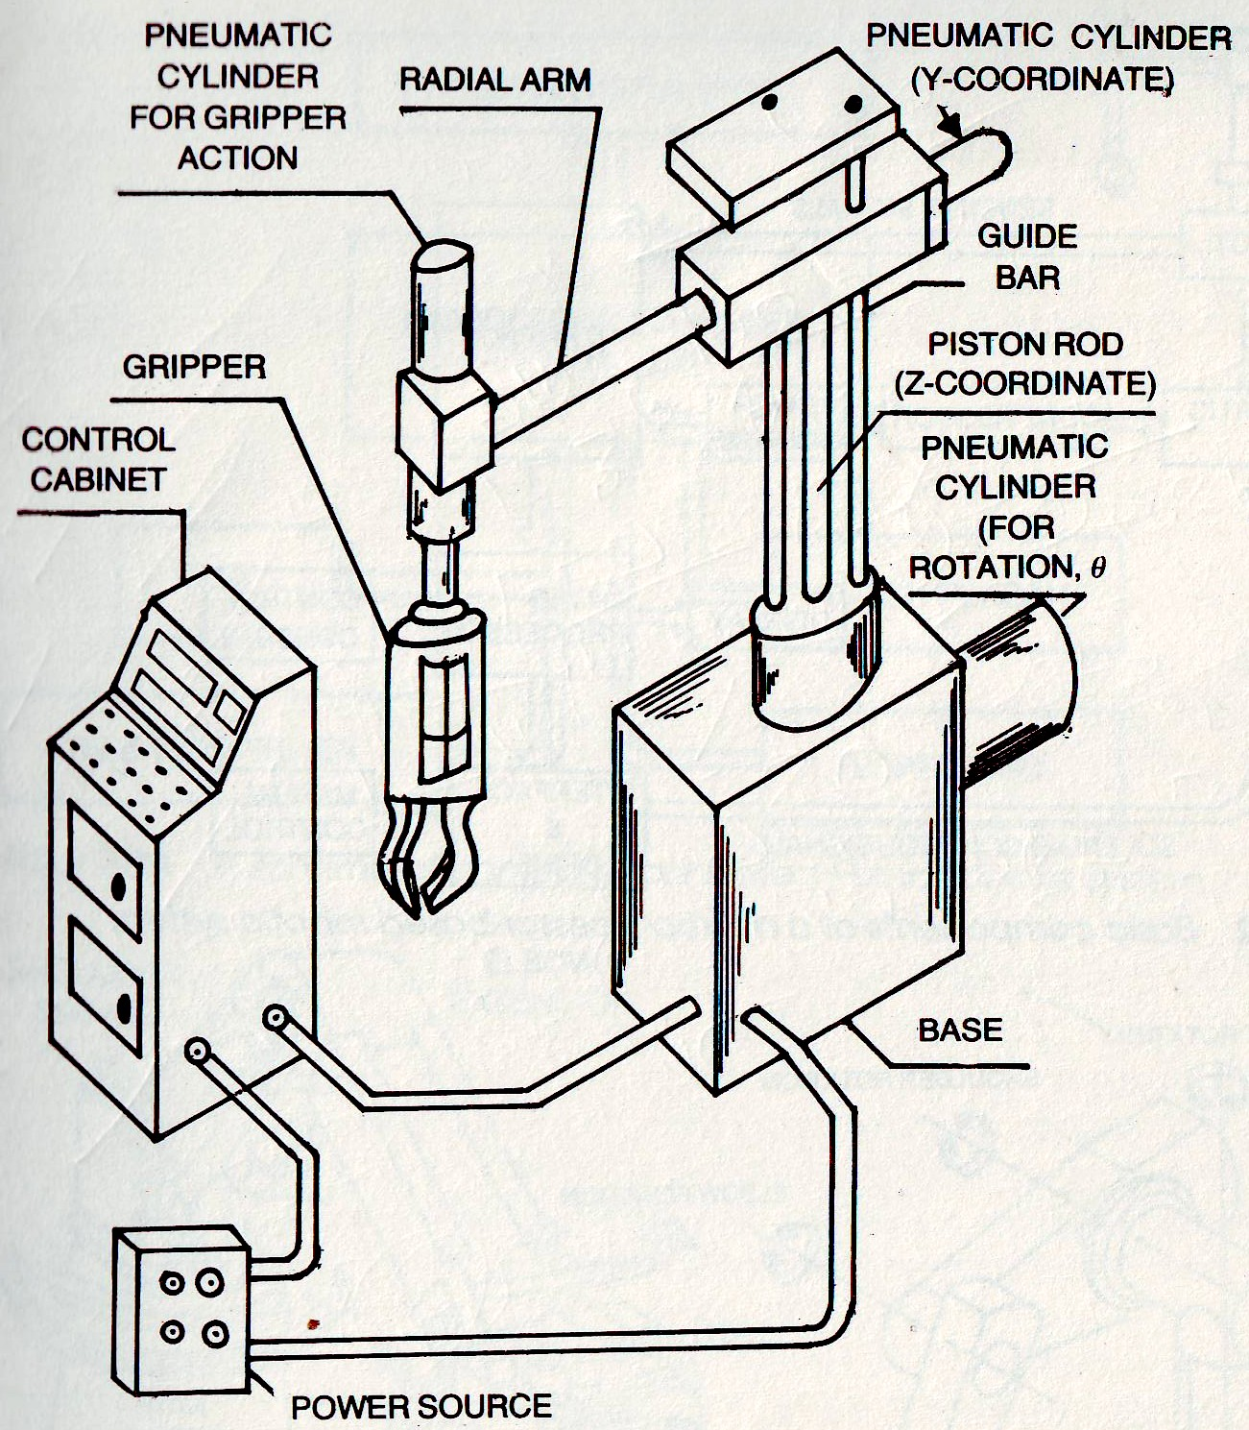
A Simple Robotic System

Slide 16
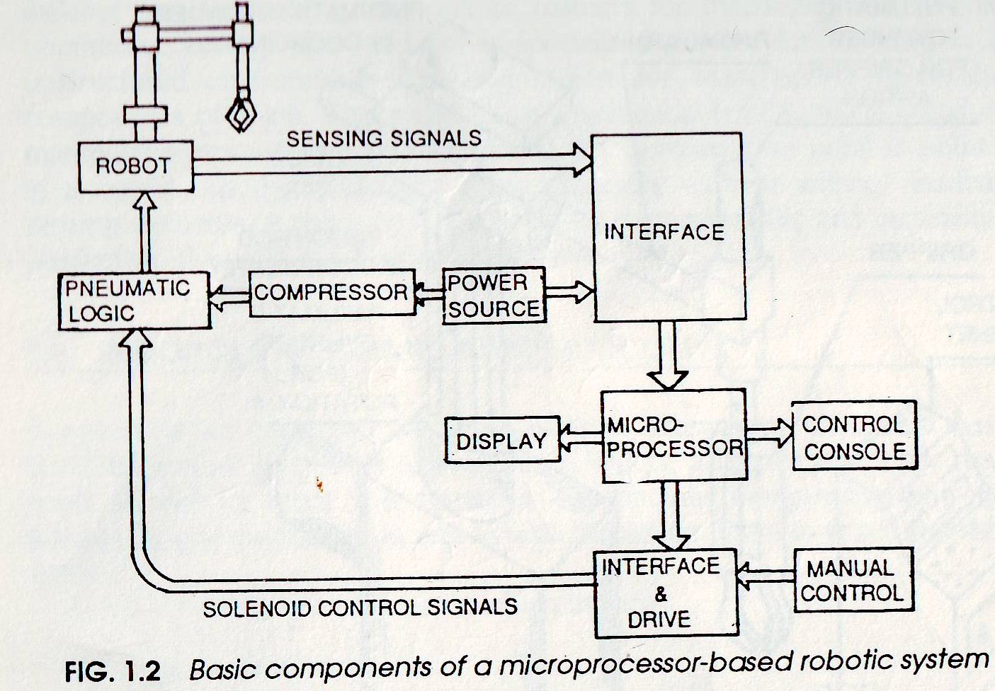
A Simple Robotic System

