Slide 1
A Novel Framework for Privacy-Preserving Heart Disease Prediction Using Machine Learning
A Secure Framework for Heart Disease Prediction: Integrating Encryption and Machine Learning.
Protecting Patient Privacy While Improving Heart Disease Diagnosis: A Machine Learning Approach.
Privacy-Preserving Method for Heart Disease Prediction.

Slide 2





CC
CRs
SP
SU
SYS
Combined and Categorized Dataset, Public Keys
Encrypted Dataset
Decrypt Dataset for Validation
Encrypted Dataset
Model Training and Evaluation
Scaler, Test Datasets, Best Models, F1-Scores
Model Consistency Verification
SYS Development
SYS
Key Exchange
Encrypted Input, Digital Signature
Digital Signature Verification,
Input Decryption
Encrypted Output, Digital Signature
Digital Signature Verification,
Output Decryption

Slide 3
CC
CRs
SP
SU
SYS
Combined and Categorized Dataset, Public Keys
Encrypted Dataset
Decrypt Dataset for Validation
Encrypted Dataset
Model Training and Evaluation
Scaler, Test Datasets, Best Models, F1-Scores
Model Consistency Verification
SYS Development
SYS
Key Exchange
Encrypted Input, Digital Signature
Digital Signature Verification,
Input Decryption
Encrypted Output, Digital Signature
Digital Signature Verification,
Output Decryption

Slide 4
SU
32
Input
34
59
AES Encryption
Decryption
33
58
35
AES Key
60
AES Key
Encrypted Input
Result
CRs
8
Public Keys for Each Attributes
CC
1
38
Digital Signature
4
2
Dataset 1
36
57
9
3
Encryption
Encryption
Categorize Attributes
Duplicate Value Remove
Combined Dataset
Decryption
1
29
36
Dataset N
SYS
Encrypted Key
7
6
5
56
Keys Generation
Public Key
Keys Generation
28
31
Encrypted Key
SYS Development
30
SU’s Private Key
10
11
6
Key Generation
Encrypted Dataset
Combine Encrypted Dataset Parts
Private Key
27
31
55
56
13
12
Model Verification
SU’s Public Key
Verify Signature
Encrypted Result
Verified Encrypted Dataset
Dataset Verification
SP
24
14
19
21
Training and Testing
Hyper-Parameters
Missing Value Remove
Train Data
26
SYS
31
26
Best Model
30
SYS’s Public Key
F1-Score
Key Generation
18
20
25
39
15
Train Test Split
DT, XGB, RF
22
Verify Signature
Scaling
Best ML Model
Training and Testing
16
40
31
Scaler
19
23
Encrypted Input
40
SYS’s Private Key
Test Data
PCA, iForest, Ensemble
Encrypted Key
17
41
Preprocessed Dataset
Decryption
53
Encrypted Key
42
54
52
AES Key
Digital Signature
Encryption
43
Decryption
44
49
Input
AES Key
51
45
48
Encrypted Result
Encryption
Result
46
47
50
Preprocessing
Evaluate
AES Encryption

Slide 5
SU
32
Input
34
59
AES Encryption
Decryption
33
58
33
60
AES Key
35
AES Key
Result
Encrypted Input
CRs
8
Public Keys for Each Attributes
CC
1
38
Digital Signature
4
2
Dataset 1
36
57
9
3
Encryption
Encryption
Categorize Attributes
Duplicate Value Remove
Combined Dataset
Decryption
1
29
36
Dataset N
SYS
Encrypted Key
7
6
5
56
Keys Generation
Public Key
Keys Generation
28
31
Encrypted Key
SYS Development
30
SU’s Private Key
10
11
6
Key Generation
Encrypted Dataset
Combine Encrypted Dataset Parts
Private Key
27
31
55
56
13
12
Dataset Verification
Model Verification
SU’s Public Key
Verify Signature
Encrypted Result
Verified Encrypted Dataset
SP
24
14
19
21
Training and Testing
Hyper-Parameters
Missing Value Remove
Train Data
26
SYS
31
26
Best Model
30
SYS’s Public Key
F1-Score
Key Generation
18
20
25
39
15
Train Test Split
DT, XGB, RF
22
Verify Signature
Scaling
Best ML Model
Training and Testing
16
40
31
Scaler
19
23
Encrypted Input
40
SYS’s Private Key
Test Data
PCA, iForest, Ensemble
Encrypted Key
17
41
Preprocessed Dataset
Decryption
53
Encrypted Key
42
54
52
AES Key
Digital Signature
Encryption
43
Decryption
44
49
Input
AES Key
51
45
48
Encrypted Result
Encryption
Result
46
47
50
Preprocessing
Evaluate
AES Encryption

Slide 6


CC
SD
SP
SU
BC
MN
SYS
SU
Combined Categorized Dataset
Input
User Input Output
Output
Encrypted Dataset
Mine, Accept Block
Best Model
Block Add to BC
SYS
SYS
History Added

Slide 7










User
User Input and Output
Digital Signature
Private Key
Public Key
Registration
Decentralized System

Slide 8








Block Queue
Multiple User’s Inputs and Outputs
Mining
Miner
Verify and Accept
Verify
Add to Blockchain
Accepted Block
Decentralized System

Slide 9
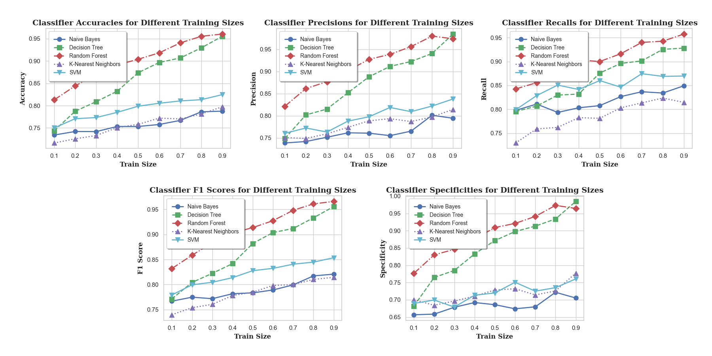

Slide 10
Attribute | Unit | Type of Data
Age | Numeric | In Years
Sex | Nominal | Male Female
Chest Pain Type | Nominal | Typical Angina Atypical Angina Non-anginal Pain Asymptomatic
Resting Blood Pressure | Numeric | 94-200 (mm HG)
Cholesterol | Numeric | 126-564 (mg/dl)
Fasting Blood Sugar | Binary | Yes / No > 120 mg/dl
Resting ECG | Nominal | Normal Abnormal ST-T Wave Left Ventricular Hypertrophy
Maximum Heart Rate | Numeric | 71-202
Exercise Angina | Binary | Yes / No
Oldpeak | Numeric | 0 - 6.2
ST Slope | Nominal | Upsloping Flat Downsloping
Heart Disease | Binary | Yes / No

Slide 11
t0
d=1
p=1
pp=0
f=1
t1
t10
t8
tl=0
pt=0
pp=1
tl=1
pt=1
pm=0
ptl=0
t2
pm=1
t5
t11
t9
ptl=1
dtl=0
t12
rh=0
t3
t6
dtl=1
rh=1
t7
t13
t4

Slide 12
f=1
temperature
d=1
particle
rh=1
ROM
Comparator
AC On/Off
password
pt=1
rh=1
p=1
ptl=1
pm=1
ptl=1
ALU
Control Unit
SecurityAlarm
pm=0
ptl=0
pm=1
pt=1
Door Open
Fire Alarm
Counter
dtt=1
dtl=1
Timer
Door Close

Slide 13
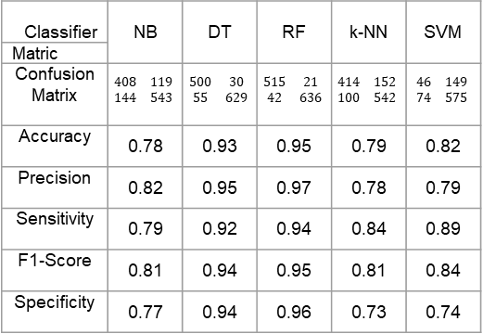
Classifier | NB | DT | RF | k-NN | SVM
Matric
Confusion Matrix | $$\begin{matrix}408 & 119 \\ 144 & 543\end{matrix}$$ | $$\begin{matrix}500 & 30 \\ 55 & 629\end{matrix}$$ | $$\begin{matrix}515 & 21 \\ 42 & 636\end{matrix}$$ | $$\begin{matrix}414 & 152 \\ 100 & 542\end{matrix}$$ | $$\begin{matrix}46 & 149 \\ 74 & 575\end{matrix}$$
Accuracy | 0.78 | 0.93 | 0.95 | 0.79 | 0.82
Precision | 0.82 | 0.95 | 0.97 | 0.78 | 0.79
Sensitivity | 0.79 | 0.92 | 0.94 | 0.84 | 0.89
F1-Score | 0.81 | 0.94 | 0.95 | 0.81 | 0.84
Specificity | 0.77 | 0.94 | 0.96 | 0.73 | 0.74

Slide 14
Classifier | Hyper-parameters |  |  | Train Size |  |  |  |  |  |  |  |  | Mean
 |  |  |  | 0.1 | 0.2 | 0.3 | 0.4 | 0.5 | 0.6 | 0.7 | 0.8 | 0.9 | Mean
DT | Data Splitting (train_test_split) random_state: 4749 | DecisionTreeClassifier random_state: 436 |  | 0.76 | 0.81 | 0.83 | 0.85 | 0.88 | 0.90 | 0.91 | 0.94 | 0.97 | 0.87
DT PCA | Data Splitting (train_test_split) random_state: 1418 | PCA n_components: 9 | DecisionTreeClassifier random_state: 2066 | 0.73 | 0.75 | 0.78 | 0.81 | 0.83 | 0.85 | 0.87 | 0.88 | 0.92 | 0.82
DT Isolation | Data Splitting (train_test_split) random_state: 2009 | IsolationForest: n_estimators: 173 contamination: 0.08 random_state: 2009 max_samples: 1 | DecisionTreeClassifier random_state: 2009 criterion: gini | 0.79 | 0.80 | 0.81 | 0.85 | 0.89 | 0.90 | 0.90 | 0.92 | 0.93 | 0.87
DT LSTM | Data Splitting (train_test_split) random_state: 274 | Optimizer (Adam) learning_rate: ~0.1429 (1/7) | Model Training (model.fit) epochs: 47 batch_size: 10000 verbose: 0 | 0.74 | 0.78 | 0.79 | 0.82 | 0.84 | 0.85 | 0.87 | 0.87 | 0.86 | 0.82
 | Sequential Dropout rate: 0.04 Dense units: 1 activation: sigmoid | Model Compilation (model.compile) loss: binary_crossentropy | DecisionTreeClassifier random_state: 274
RF | Data Splitting (train_test_split) random_state: 1694 n_estimators: 95 | RandomForestClassifier random_state: 1694 |  | 0.83 | 0.85 | 0.88 | 0.91 | 0.93 | 0.94 | 0.94 | 0.95 | 0.96 | 0.91
RF PCA | Data Splitting (train_test_split) random_state: 983 | PCA n_components: 9 | RandomForestClassifier random_state: 983 n_estimators: 91 | 0.79 | 0.83 | 0.85 | 0.87 | 0.89 | 0.91 | 0.92 | 0.93 | 0.93 | 0.88
RF Isolation | Data Splitting (train_test_split) random_state: 1341 | IsolationForest: n_estimators: 26 contamination: 0.01 random_state: 530 max_samples: 105 | RandomForestClassifier random_state: 530 n_estimators: 63 criterion: gini | 0.83 | 0.85 | 0.88 | 0.91 | 0.93 | 0.94 | 0.94 | 0.96 | 0.96 | 0.91
RF LSTM | Data Splitting (train_test_split) random_state: 47 | Optimizer (Adam) learning_rate: ~0.0667 (1/15) | Model Training (model.fit) epochs: 107 batch_size: 10000 verbose: 0 | 0.74 | 0.80 | 0.80 | 0.82 | 0.84 | 0.86 | 0.88 | 0.88 | 0.90 | 0.83
 | Sequential Dropout rate: 0.05 Dense units: 1 activation: sigmoid | Model Compilation (model.compile) loss: binary_crossentropy | RandomForestClassifier random_state: 47 n_estimators: 47

Slide 15
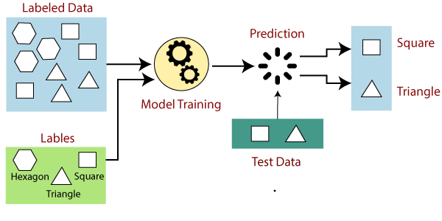
Labeled Data
Prediction
Square
Triangle
Model Training
Labels
Test Data
Hexagon
Square
Triangle

Slide 16
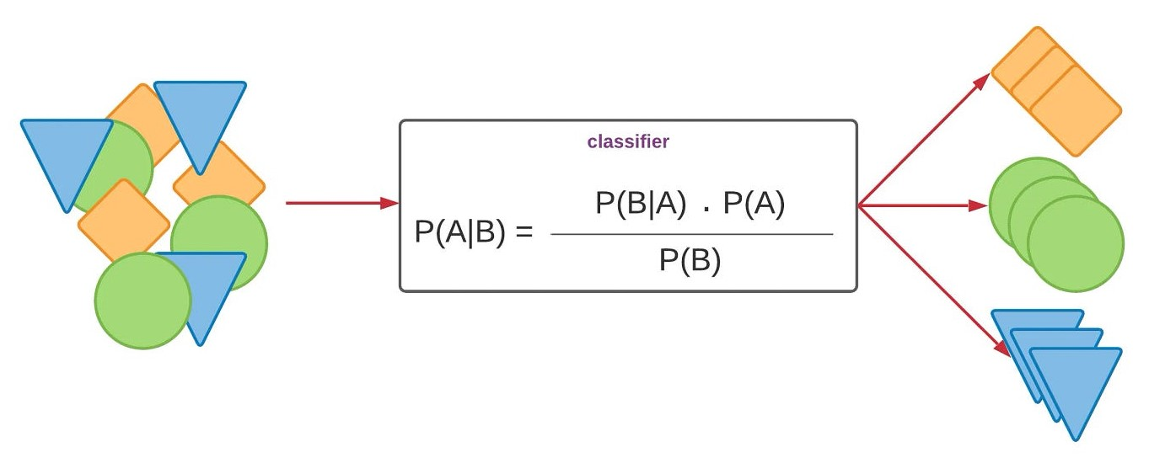
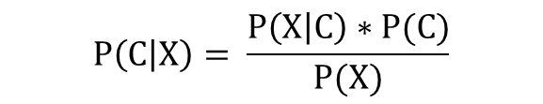
Classifier
$$P\left(C | X\right)= \frac{P\left(X | C\right)∗P(C)}{P(X)}$$

Slide 17
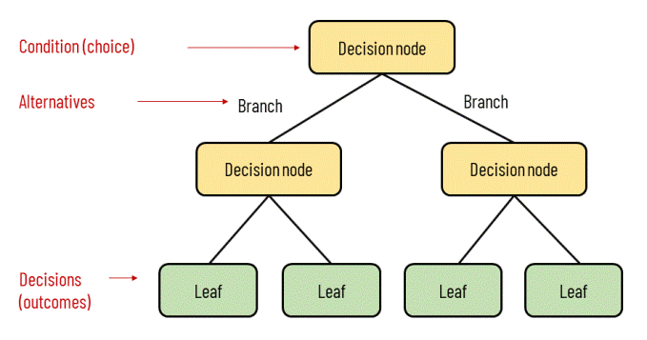
Condition (Choice)
Decision Node
Alternatives
Branch
Branch
Decision Node
Decision Node
Decisions
(Outcomes)
Leaf
Leaf
Leaf
Leaf

Slide 18
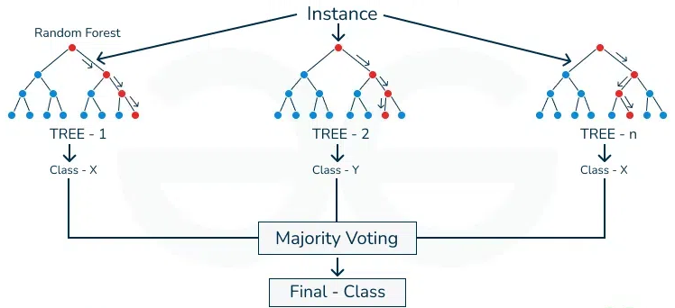
Instance
Random Forest
Tree -1
Tree - 2
Tree - n
Class - X
Class - Y
Class - X
Majority Voting
Final - Class

Slide 19
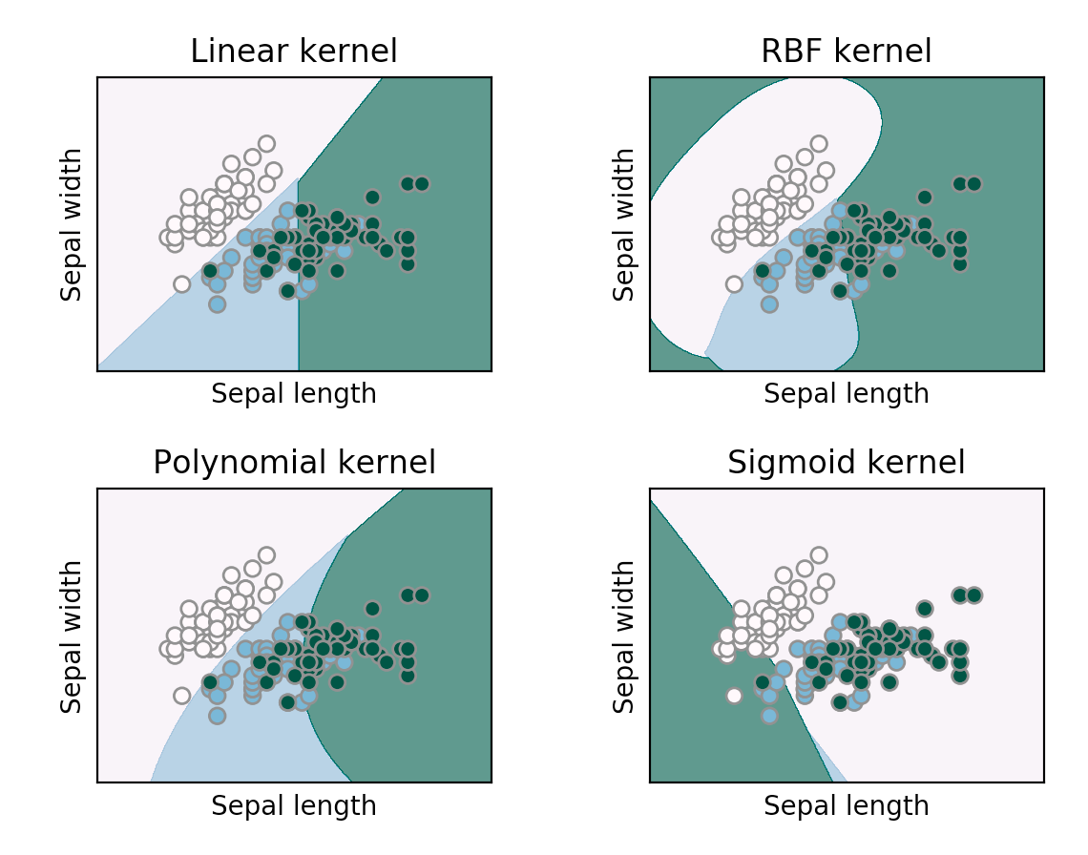
Linear Kernel
RBF Kernel
Sepal Width
Sepal Width
Sepal Length
Sepal Length
Sigmoid Kernel
Polynomial Kernel
Sigmoid Kernel
Sepal Width
Sepal Width
Sepal Length
Sepal Length

Slide 20
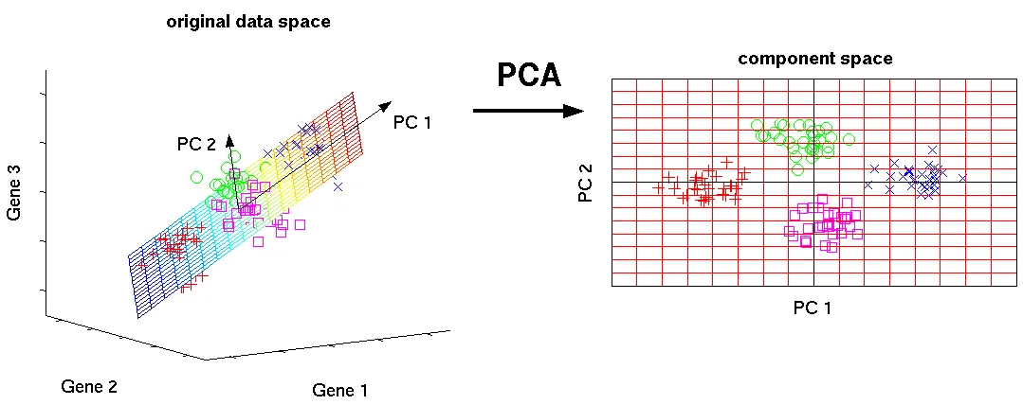
Original Data Space
Component Space
PC 1
PCA
PC 2
Gene 3
PC 2
PC 1
Gene 2
Gene 1

Slide 21
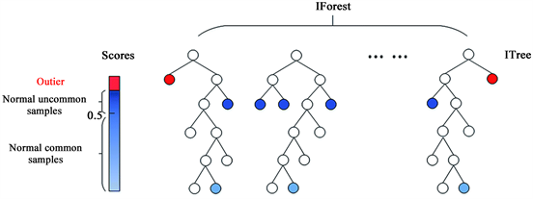
IForest
Scores
ITree
Outlier
Normal Uncommon Samples
0.5
Normal Common Samples

Slide 22
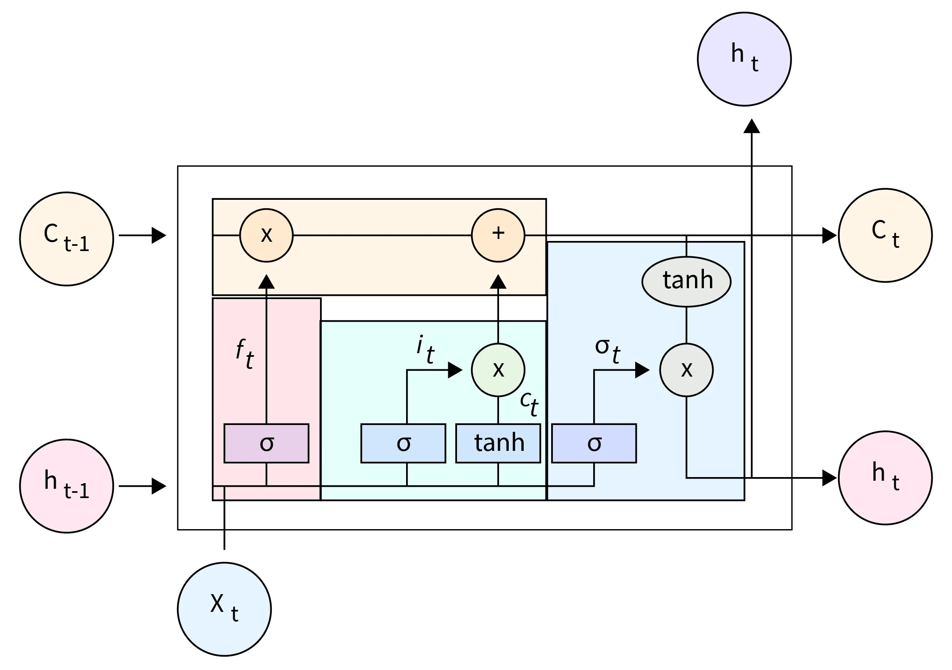
h_{t}
x
C_{t}
C_{t-1}
+
tanh
f_{t}
i_{t}
σ_{t}
x
x
C_{t}
σ
σ
tanh
σ
h_{t}
h_{t-1}
X_{t}

Slide 23
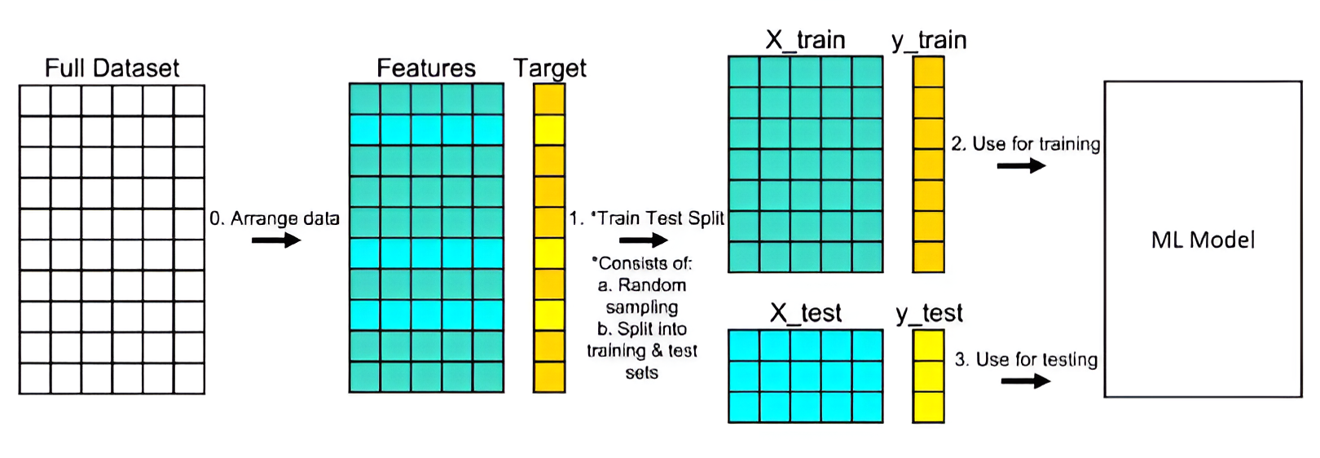
X_train
Y_test
Full Dataset
Features
Target
0. Arrange Data
2. Use for training
ML Model
1. *Train Test Split
X_train
Y_test
*Consists of
Random sampling
Split into training and test sets
3. Use for testing

