Slide 1
A Novel Framework for Privacy-Preserving Heart Disease Prediction Using Machine Learning
A Secure Framework for Heart Disease Prediction: Integrating Encryption and Machine Learning.
Protecting Patient Privacy While Improving Heart Disease Diagnosis: A Machine Learning Approach.
Privacy-Preserving Method for Heart Disease Prediction.

Slide 2




CC
CR
SP
SU
Combined Dataset, Public Keys
Encrypted Dataset
Decrypt Dataset for Validation
Encrypted Dataset
Model Training and Evaluation
Scaler, Test Datasets, Best Models, F1-Scores
Model Consistency Verification
SYS Development
SYS

Slide 3
SU
CC
SYS
CR
1
27
28
Dataset 1
SYS
Input
5
2
29
Encryption
Combined Dataset
Encryption
1
26
SYS Development
30
31
32
3
Dataset N
Preprocessing
Testing
Output
4
Keys Generation
Public Keys
24
6
4
Model Verification
Encrypted Dataset
Private Keys
8
7
25
Verified Encrypted Dataset
Dataset Verification
Choose The Best Model
SP
20
Hyper-Parameters
23
22
9
15
Training and Testing
F1-Scores
Best Models
13
Preprocessing
Train Data
16
21
10
12
14
Best ML Model
Training and Testing
Preprocessing Transformer
Train Test Split
NB, DT, RF, KNN, SVM
19
PCA, iForest, LSTM
13
11
Test Data
Preprocessed Dataset
18
Train Data
17
18
K-Fold Cross Validation
Test Data

Slide 4
CC
1
SYS
SD
Dataset 1
17
2
Patient Data
5
Combined Dataset
Encryption
18
3
1
Encryption
Keys Generation
Dataset N
6
19
Encrypted Dataset
Encrypted Data
4
Public Keys
20
SP
10
12
Preprocessing
Train Data
Training
9
13
16
7
Train Test Split
11
Trained Models
Best Model
Preprocessing
Hyper-Parameters
22
21
15
Save History
Predicted Output
8
10
14
Compare Models
Scaler
Test Data
Testing

Slide 5


CC
SD
SP
SU
BC
MN
SYS
SU
Combined Dataset
Input
User Input Output
Output
Encrypted Dataset
Mine, Accept Block
Best Model
Block Add to BC
SYS
SYS
History Added

Slide 6










User
User Input and Output
Digital Signature
Private Key
Public Key
Registration
Decentralized System

Slide 7








Block Queue
Multiple User’s Inputs and Outputs
Mining
Miner
Verify and Accept
Verify
Add to Blockchain
Accepted Block
Decentralized System

Slide 8
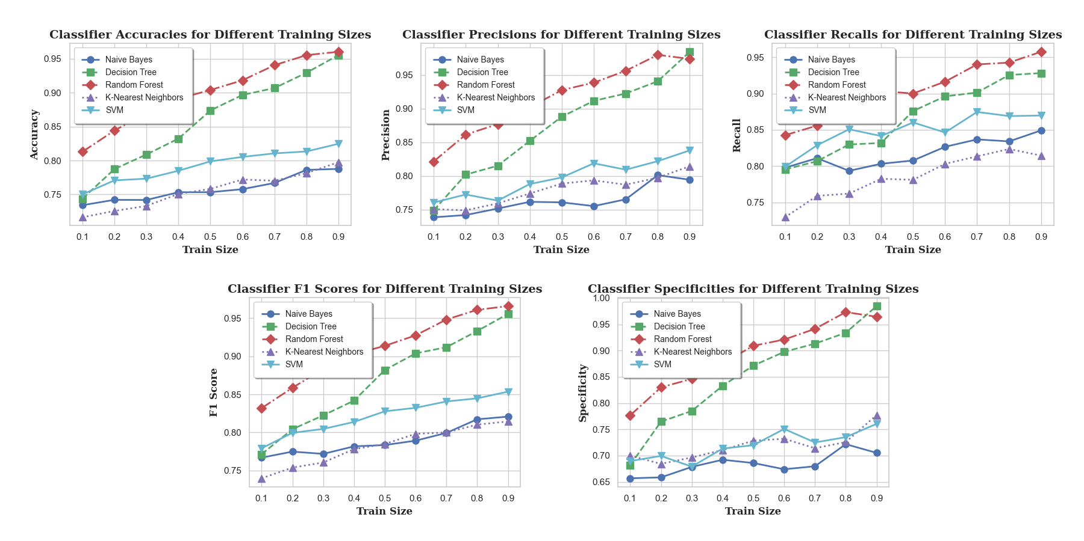

Slide 9
Attribute | Unit | Type of Data
Age | Numeric | In Years
Sex | Nominal | Male Female
Chest Pain Type | Nominal | Typical Angina Atypical Angina Non-anginal Pain Asymptomatic
Resting Blood Pressure | Numeric | 94-200 (mm HG)
Cholesterol | Numeric | 126-564 (mg/dl)
Fasting Blood Sugar | Binary | Yes / No > 120 mg/dl
Resting ECG | Nominal | Normal Abnormal ST-T Wave Left Ventricular Hypertrophy
Maximum Heart Rate | Numeric | 71-202
Exercise Angina | Binary | Yes / No
Oldpeak | Numeric | 0 - 6.2
ST Slope | Nominal | Upsloping Flat Downsloping
Heart Disease | Binary | Yes / No

Slide 10
T0
T1
T10
T8
TL=1
PT=1
PM=0
TL=0
PT=0
PP=0
PM=1
PP=1
PTL=1
T2
T5
T11
T9
T12
PTL=0
DTL=1
T3
T6
DTL=0
T7
T4

Slide 11
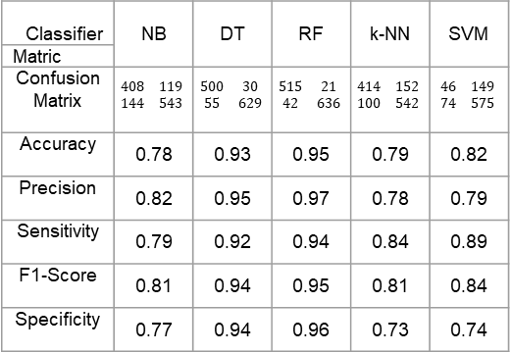
Classifier | NB | DT | RF | k-NN | SVM
Matric
Confusion Matrix | $$\begin{matrix}408 & 119 \\ 144 & 543\end{matrix}$$ | $$\begin{matrix}500 & 30 \\ 55 & 629\end{matrix}$$ | $$\begin{matrix}515 & 21 \\ 42 & 636\end{matrix}$$ | $$\begin{matrix}414 & 152 \\ 100 & 542\end{matrix}$$ | $$\begin{matrix}46 & 149 \\ 74 & 575\end{matrix}$$
Accuracy | 0.78 | 0.93 | 0.95 | 0.79 | 0.82
Precision | 0.82 | 0.95 | 0.97 | 0.78 | 0.79
Sensitivity | 0.79 | 0.92 | 0.94 | 0.84 | 0.89
F1-Score | 0.81 | 0.94 | 0.95 | 0.81 | 0.84
Specificity | 0.77 | 0.94 | 0.96 | 0.73 | 0.74

Slide 12
Classifier | Hyper-parameters |  |  | Train Size |  |  |  |  |  |  |  |  | Mean
 |  |  |  | 0.1 | 0.2 | 0.3 | 0.4 | 0.5 | 0.6 | 0.7 | 0.8 | 0.9 | Mean
DT | Data Splitting (train_test_split) random_state: 4749 | DecisionTreeClassifier random_state: 436 |  | 0.76 | 0.81 | 0.83 | 0.85 | 0.88 | 0.90 | 0.91 | 0.94 | 0.97 | 0.87
DT PCA | Data Splitting (train_test_split) random_state: 1418 | PCA n_components: 9 | DecisionTreeClassifier random_state: 2066 | 0.73 | 0.75 | 0.78 | 0.81 | 0.83 | 0.85 | 0.87 | 0.88 | 0.92 | 0.82
DT Isolation | Data Splitting (train_test_split) random_state: 2009 | IsolationForest: n_estimators: 173 contamination: 0.08 random_state: 2009 max_samples: 1 | DecisionTreeClassifier random_state: 2009 criterion: gini | 0.79 | 0.80 | 0.81 | 0.85 | 0.89 | 0.90 | 0.90 | 0.92 | 0.93 | 0.87
DT LSTM | Data Splitting (train_test_split) random_state: 274 | Optimizer (Adam) learning_rate: ~0.1429 (1/7) | Model Training (model.fit) epochs: 47 batch_size: 10000 verbose: 0 | 0.74 | 0.78 | 0.79 | 0.82 | 0.84 | 0.85 | 0.87 | 0.87 | 0.86 | 0.82
 | Sequential Dropout rate: 0.04 Dense units: 1 activation: sigmoid | Model Compilation (model.compile) loss: binary_crossentropy | DecisionTreeClassifier random_state: 274
RF | Data Splitting (train_test_split) random_state: 1694 n_estimators: 95 | RandomForestClassifier random_state: 1694 |  | 0.83 | 0.85 | 0.88 | 0.91 | 0.93 | 0.94 | 0.94 | 0.95 | 0.96 | 0.91
RF PCA | Data Splitting (train_test_split) random_state: 983 | PCA n_components: 9 | RandomForestClassifier random_state: 983 n_estimators: 91 | 0.79 | 0.83 | 0.85 | 0.87 | 0.89 | 0.91 | 0.92 | 0.93 | 0.93 | 0.88
RF Isolation | Data Splitting (train_test_split) random_state: 1341 | IsolationForest: n_estimators: 26 contamination: 0.01 random_state: 530 max_samples: 105 | RandomForestClassifier random_state: 530 n_estimators: 63 criterion: gini | 0.83 | 0.85 | 0.88 | 0.91 | 0.93 | 0.94 | 0.94 | 0.96 | 0.96 | 0.91
RF LSTM | Data Splitting (train_test_split) random_state: 47 | Optimizer (Adam) learning_rate: ~0.0667 (1/15) | Model Training (model.fit) epochs: 107 batch_size: 10000 verbose: 0 | 0.74 | 0.80 | 0.80 | 0.82 | 0.84 | 0.86 | 0.88 | 0.88 | 0.90 | 0.83
 | Sequential Dropout rate: 0.05 Dense units: 1 activation: sigmoid | Model Compilation (model.compile) loss: binary_crossentropy | RandomForestClassifier random_state: 47 n_estimators: 47

Slide 13
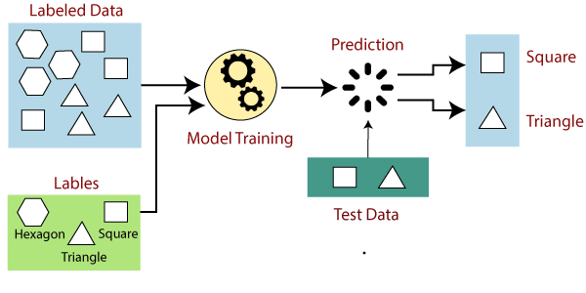
Labeled Data
Prediction
Square
Triangle
Model Training
Labels
Test Data
Hexagon
Square
Triangle

Slide 14
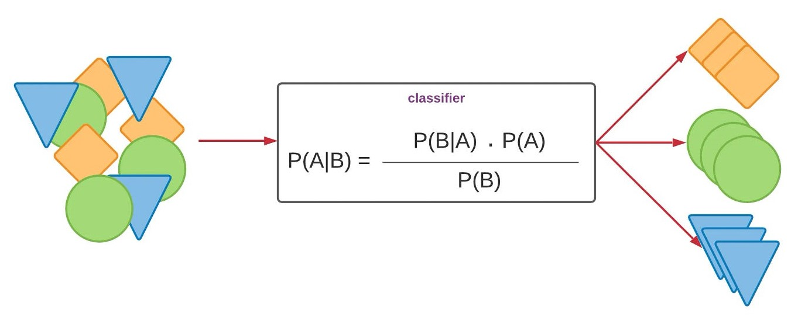
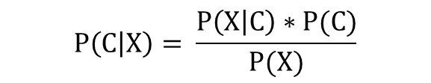
Classifier
$$P\left(C | X\right)= \frac{P\left(X | C\right)∗P(C)}{P(X)}$$

Slide 15
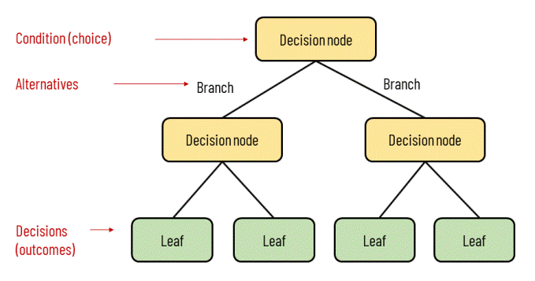
Condition (Choice)
Decision Node
Alternatives
Branch
Branch
Decision Node
Decision Node
Decisions
(Outcomes)
Leaf
Leaf
Leaf
Leaf

Slide 16
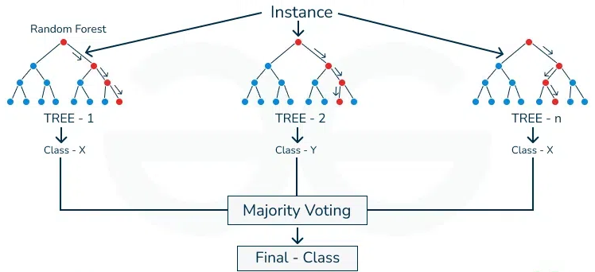
Instance
Random Forest
Tree -1
Tree - 2
Tree - n
Class - X
Class - Y
Class - X
Majority Voting
Final - Class

Slide 17
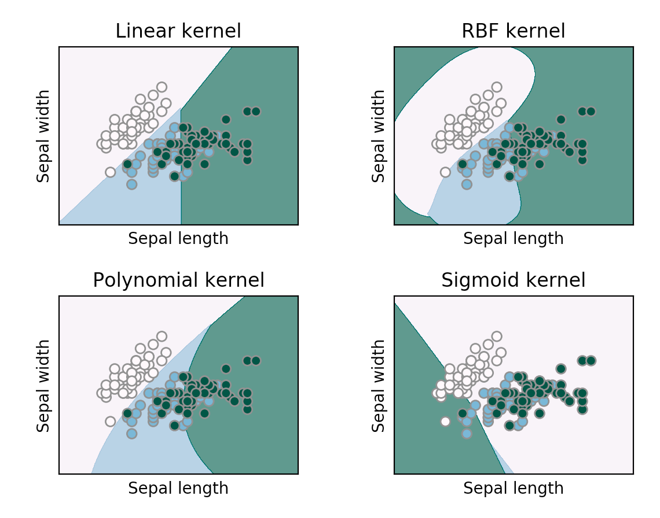
Linear Kernel
RBF Kernel
Sepal Width
Sepal Width
Sepal Length
Sepal Length
Sigmoid Kernel
Polynomial Kernel
Sigmoid Kernel
Sepal Width
Sepal Width
Sepal Length
Sepal Length

Slide 18
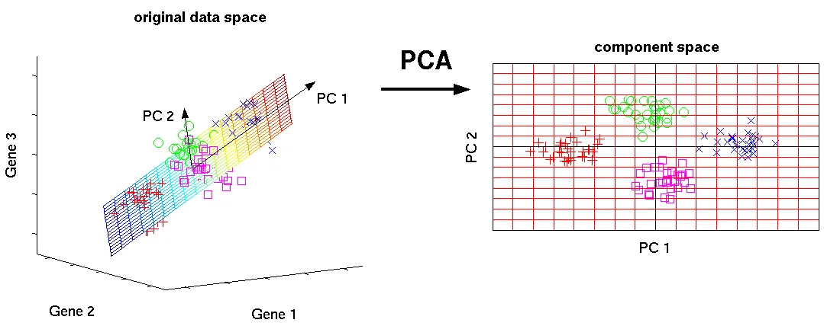
Original Data Space
Component Space
PC 1
PCA
PC 2
Gene 3
PC 2
PC 1
Gene 2
Gene 1

Slide 19
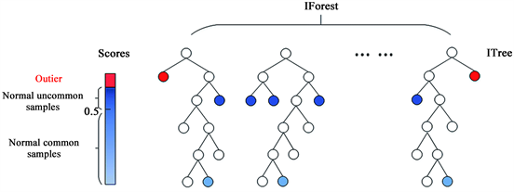
IForest
Scores
ITree
Outlier
Normal Uncommon Samples
0.5
Normal Common Samples

Slide 20
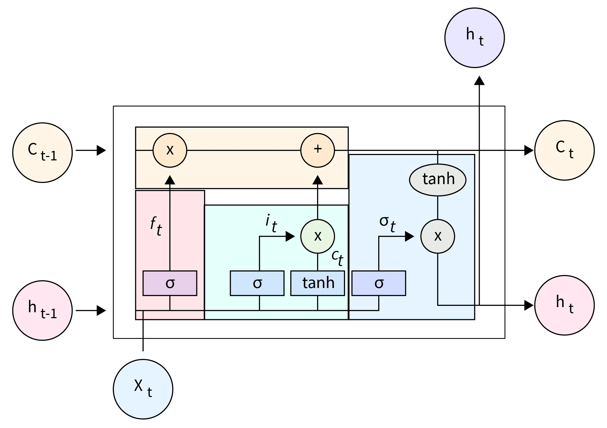
h_{t}
x
C_{t}
C_{t-1}
+
tanh
f_{t}
i_{t}
σ_{t}
x
x
C_{t}
σ
σ
tanh
σ
h_{t}
h_{t-1}
X_{t}

Slide 21
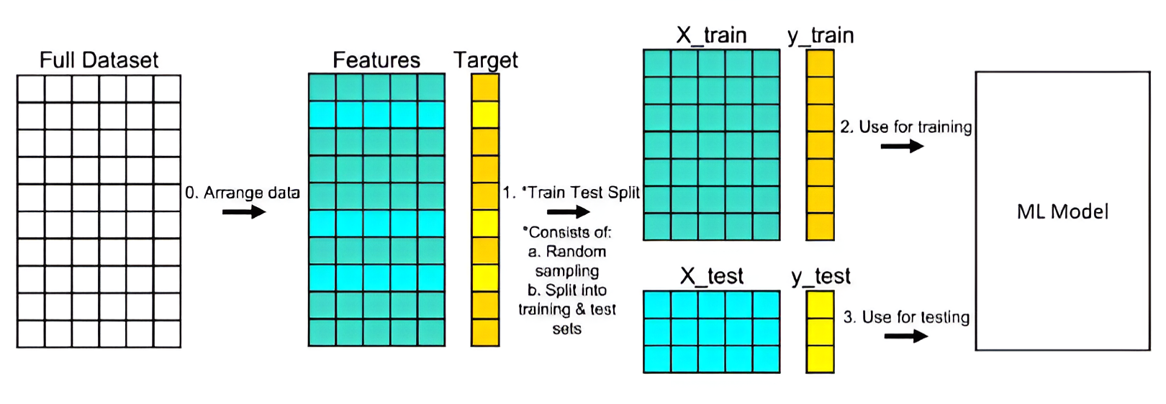
X_train
Y_test
Full Dataset
Features
Target
0. Arrange Data
2. Use for training
ML Model
1. *Train Test Split
X_train
Y_test
*Consists of
Random sampling
Split into training and test sets
3. Use for testing

