Slide 1
Protecting Patient Privacy While Improving Heart Disease Diagnosis: A Machine Learning Approach
Thesis/ Project
CSE 4000
Supervisor: Dola Das Assistant Professor | Presented By: Israt Tasnim Esha Roll: 1907090
Computer Science and Technology
Khulna University of Engineering & Technology, Khulna-9203

Slide 2
Outline
Introduction
Problem Statement
Objectives
Related Works
Research Gaps and Solutions
Proposed System Architecture
Methodology
Datasets
Results
Comparison
Conclusion
Limitations
Future Works
Gantt Chart
Socio-Economic Impact and Sustainability
Financial Analyses and Budget
References

Slide 3

Introduction
Heart disease is a type of disease that affects the heart or blood vessels.
It’s a major global health problem.
Early detection and accurate diagnosis are crucial.
Existing diagnostic methods have limitations.
Machine learning offers potential for improvement.

Slide 4
Problem Statement
Ensuring patient data privacy and security is challenging.
The system must be fast for real-time use.
Users need transparency in prediction processes.
Blockchain storage must be efficient and secure.

Slide 5
Objectives
Accurate heart disease prediction
Data security and privacy
Secure data storage

Slide 6
Related Works
Table 1: Contributions and Limitations in Existing Solutions
Works | Method | Accuracy | Limitations
[7] | FCMIM-SVM | 92.37% | Limited data hindered DNN performance
[8] | HRFLM | 95.74% | Lacked methodological details
[9] | SMOTE | 98.5% | Lacked privacy focus
[10] | XGBoost | 91.30% | Limited discussion on feature selection

Slide 7
Related Works
cont’d
Table 1: Contributions and Limitations in Existing Solutions (contd.)
Works | Method | Accuracy | Limitations
[11] | Sequential backward selection | 90% | May overlook trade-offs
[12] | RF classifiers with GridSearchCV | 99% | Risk of overfitting
[15] | Ensemble methods, QMBC | 98.53% | QMBC validation may be insufficient

Slide 8
Research Gaps and Solutions
Table 2: Research Gaps and Solutions
Research Gaps | Solutions
Limited data privacy and security | Encryption, blockchain technology
Incomplete system lifecycle | End-to-end framework and user-centric design
Limited evaluation metrics | Comprehensive set of evaluation metrics
Challenges in handling large-scale datasets and distributed systems | Blockchain can potentially handle large-scale datasets and distributed systems

Slide 9
Proposed System Architecture
Key entities:
Client Company (CC)
System Developer (SD)
Service Provider (SP)
System User (SU)
System (SYS)
Miners (MN)
Blockchain (BC)

Slide 10
Proposed System Architecture
cont’d
CC collects and processes datasets.
SD encrypts and sends data to SP.
SP trains ML models and sends the best to SD.
SD develops the SYS and releases it to SU.
SU inputs data and receives predictions.
SYS processes data and predicts heart disease.
MN validates medical records and mine blocks.
BC stores medical records securely.

Slide 11
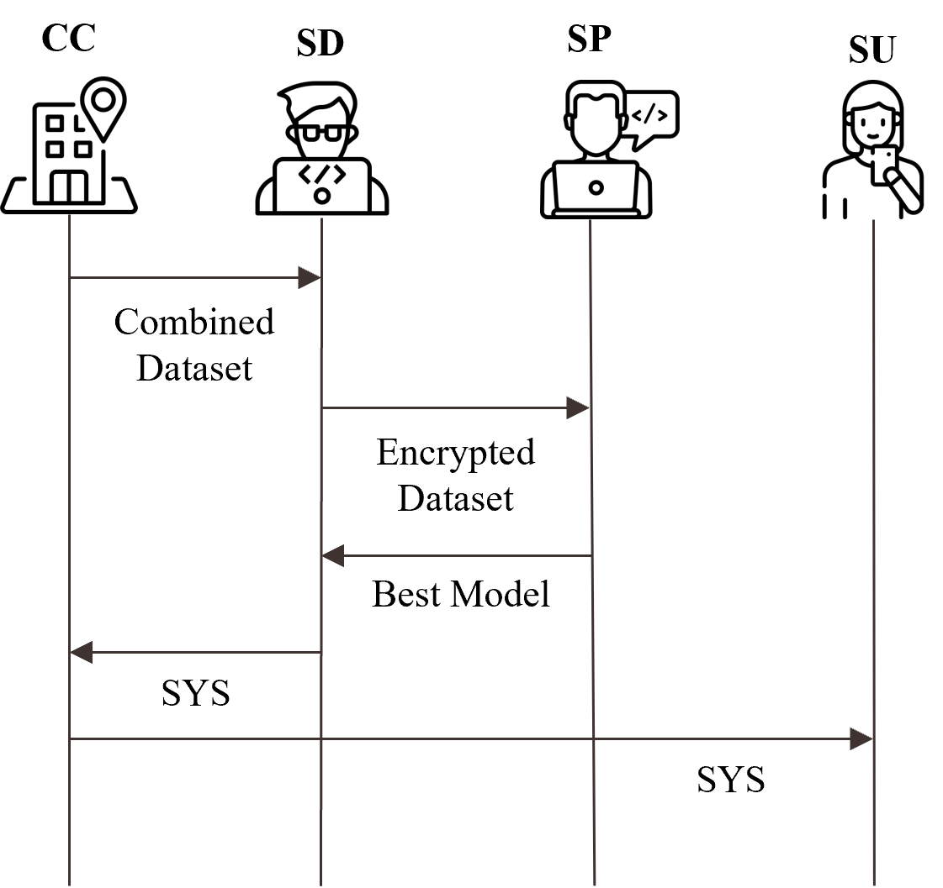
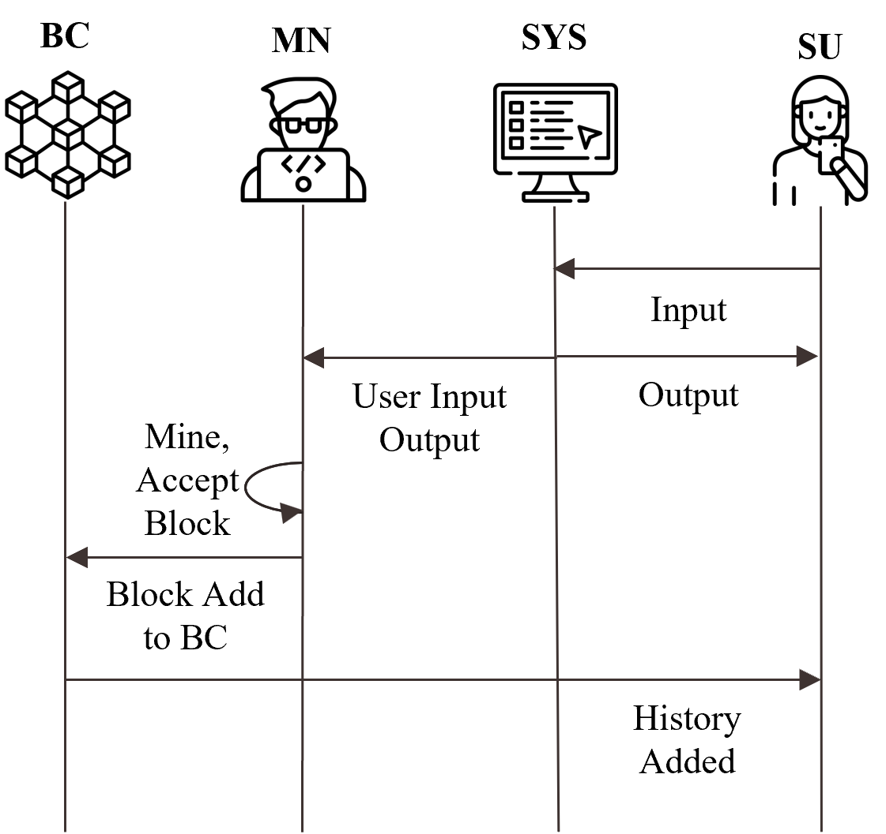
Proposed System Architecture
cont’d
Fig. 1. An overview of the Proposed System Architecture

Slide 12
Methodology
SD
CC
5
2
1
SYS
Encryption
Combined Dataset
16
Dataset 1
3
Patient Data
Keys Generation
17
6
1
Encryption
Encrypted Dataset
Dataset N
18
4
Encrypted Data
Public Keys
SP
10
11
19
Train Data
Training
Preprocessing
7
15
Preprocessing
12
Best Model
9
Trained Models
20
Train Test Split
Predicted Output
14
8
Compare Models
Scaler
10
13
Test Data
Testing
Fig. 2. System Architecture

Slide 13
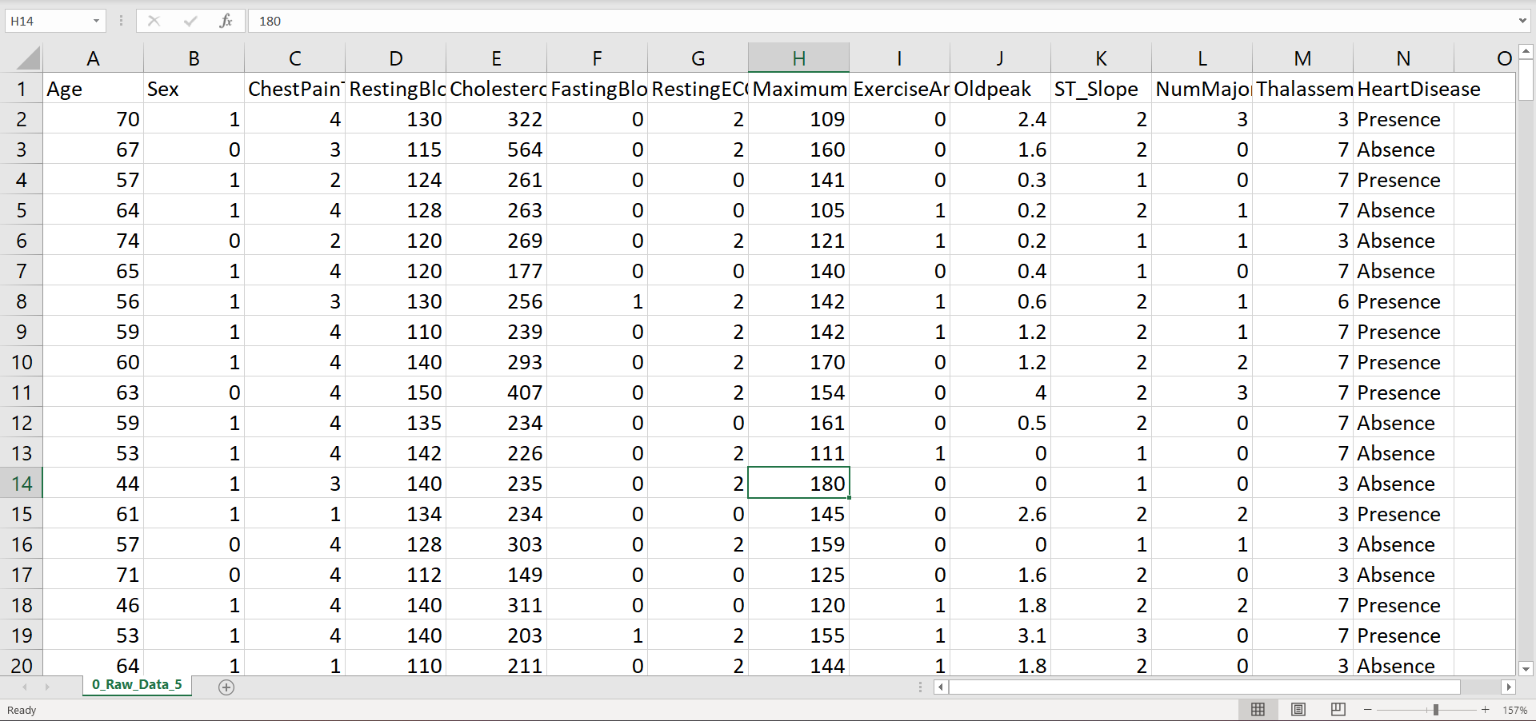
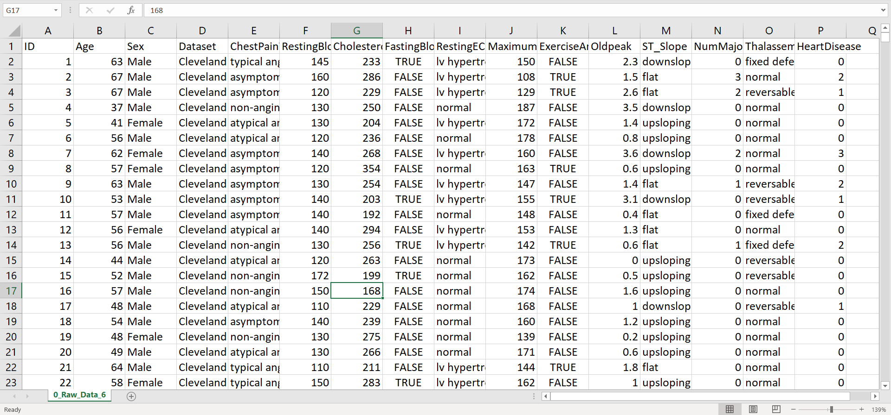
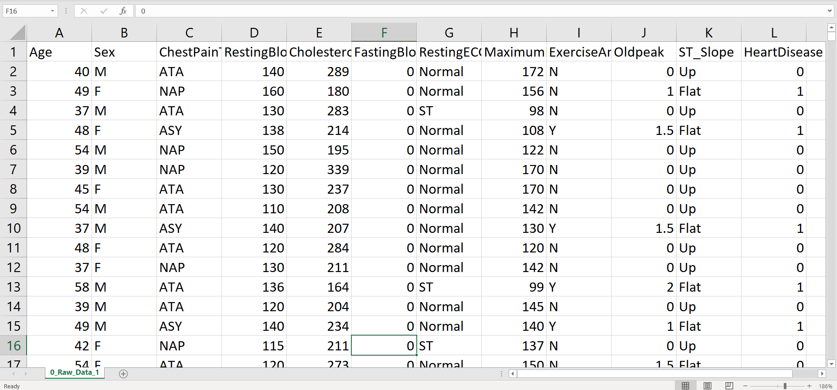
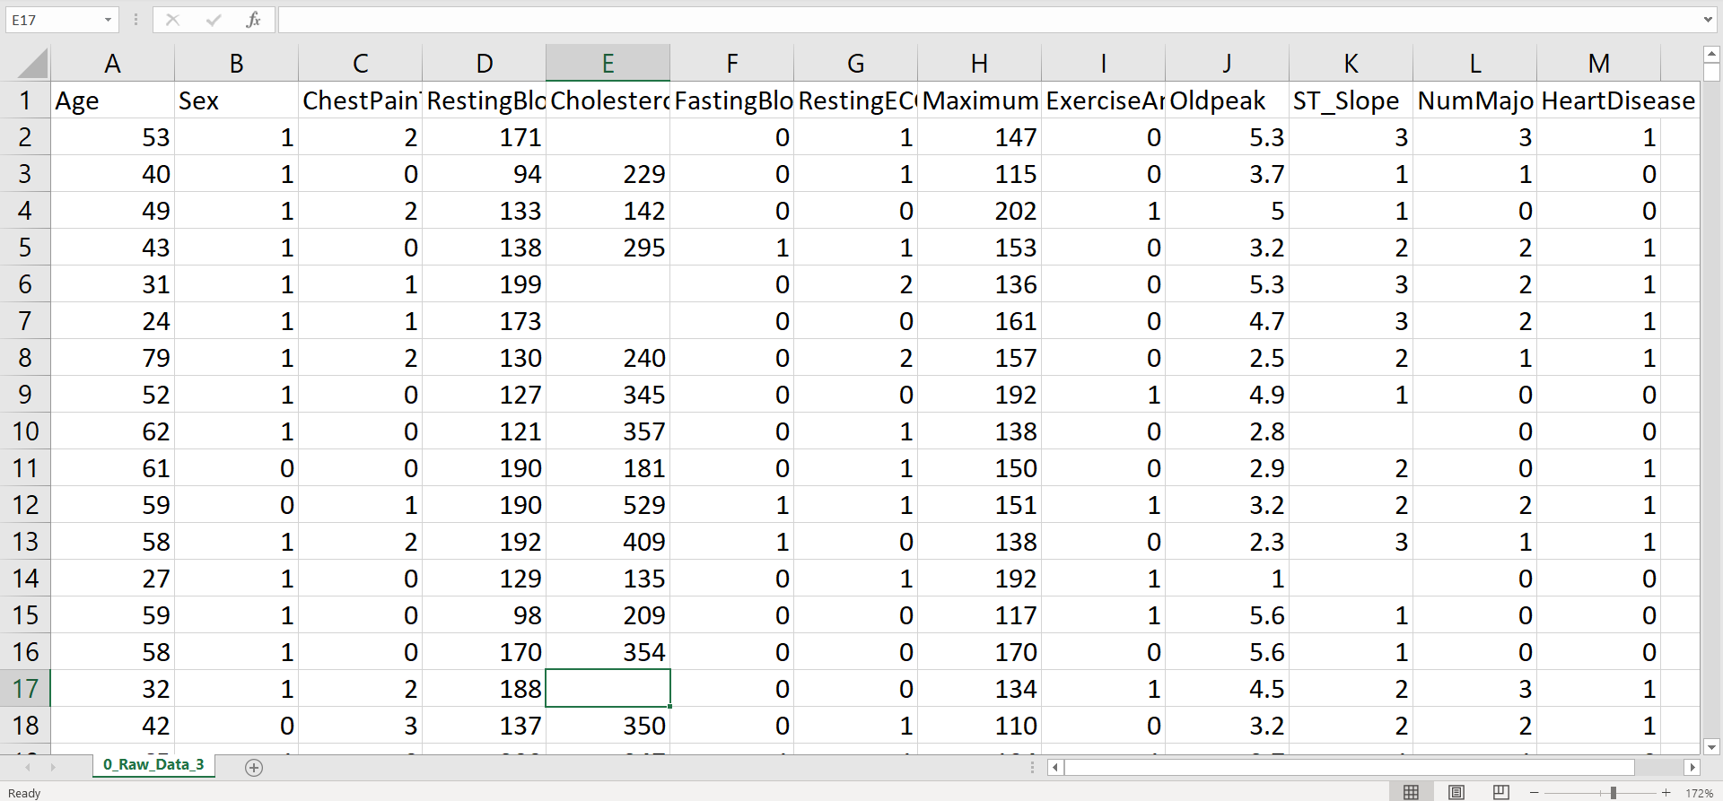
Datasets [21-26]

Slide 14
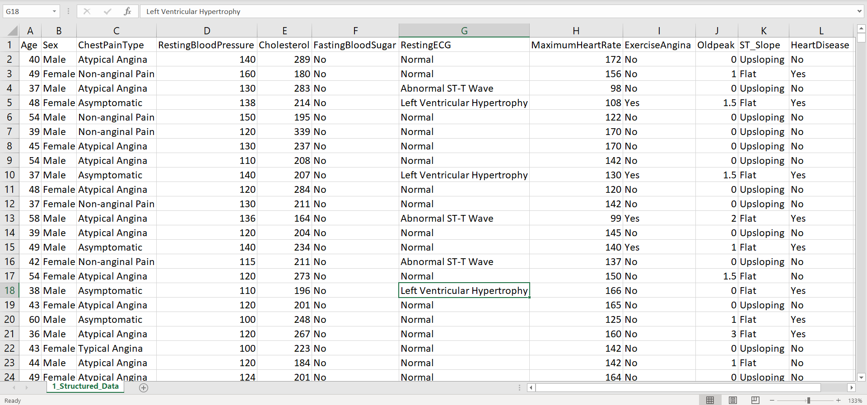
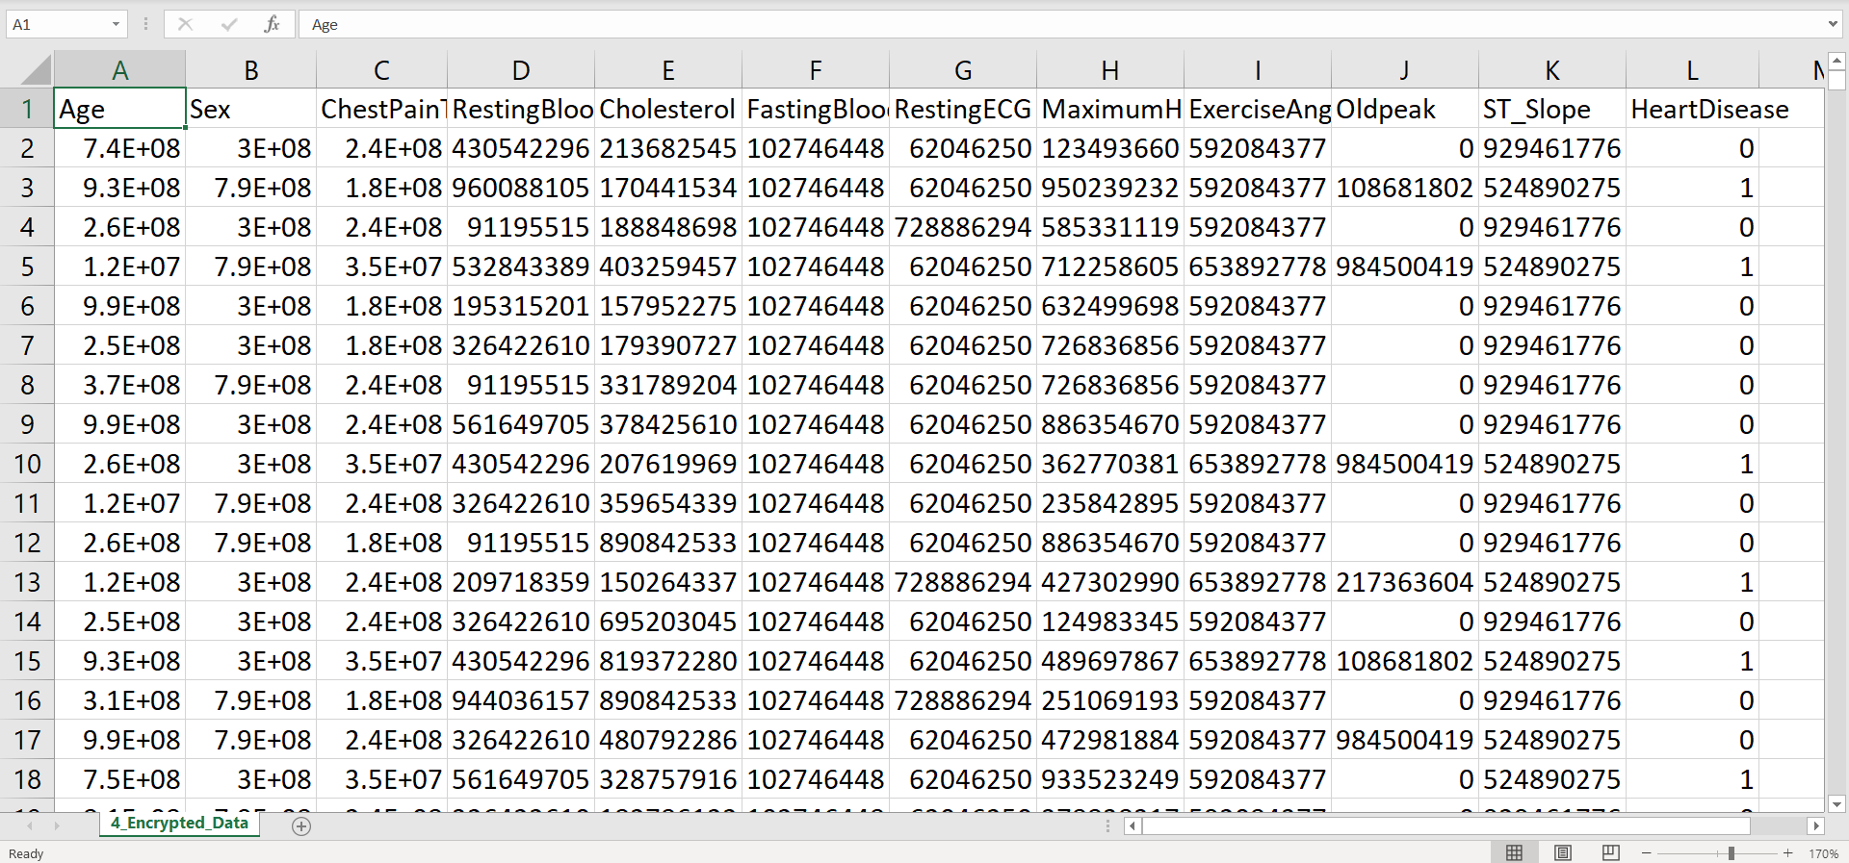
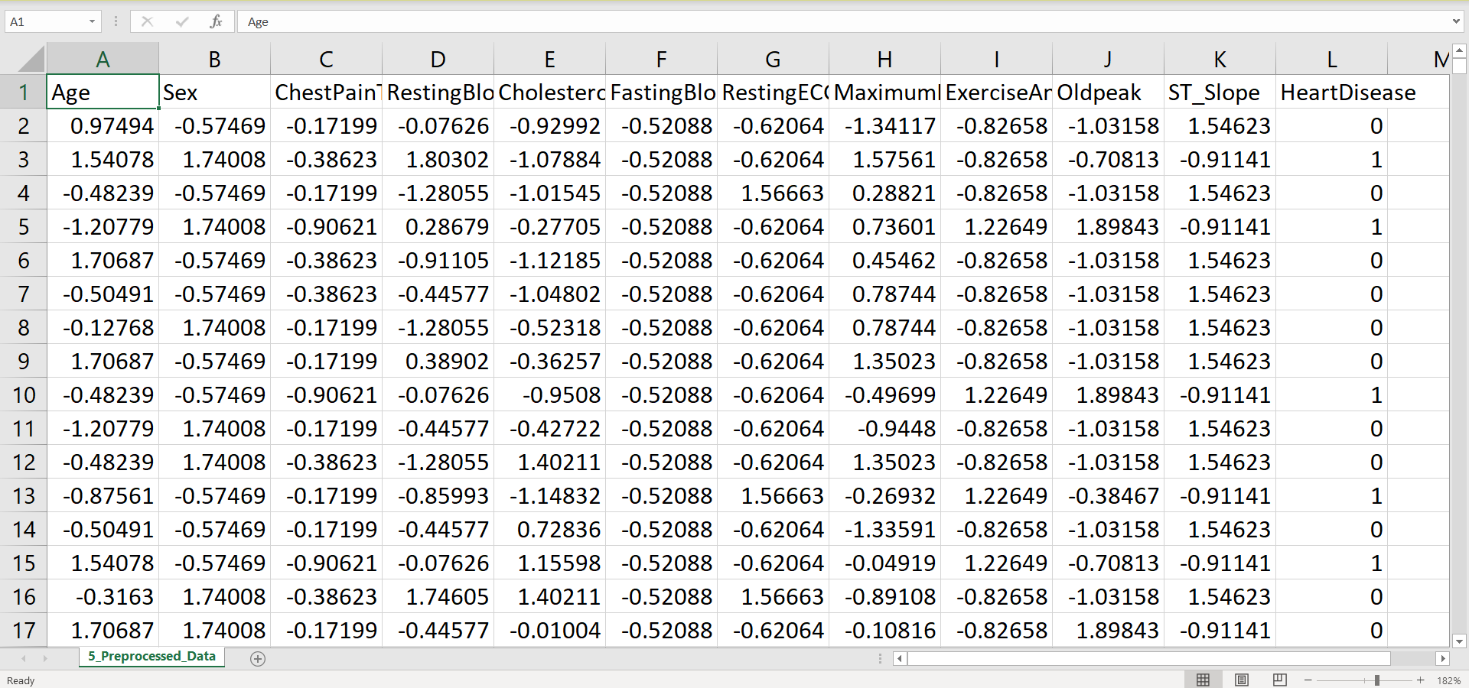
Results
Structured Data
Encrypted Data
Preprocessed Data

Slide 15
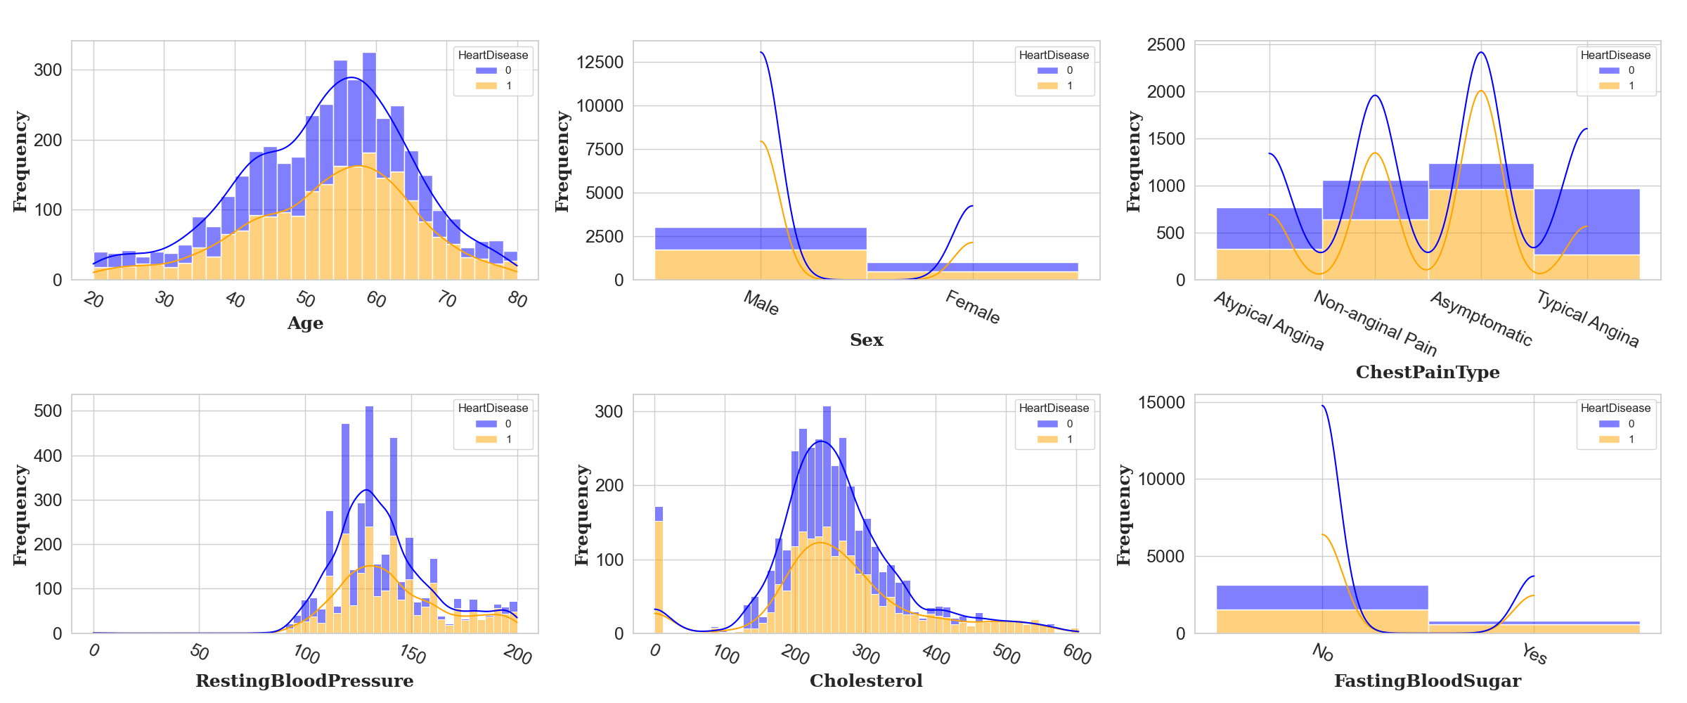
Results
cont’d
Plots showing heart disease distribution by age, sex, chest pain, blood pressure, cholesterol, and blood sugar:
Fig. 3: Distribution of Features by Heart Disease Status

Slide 16
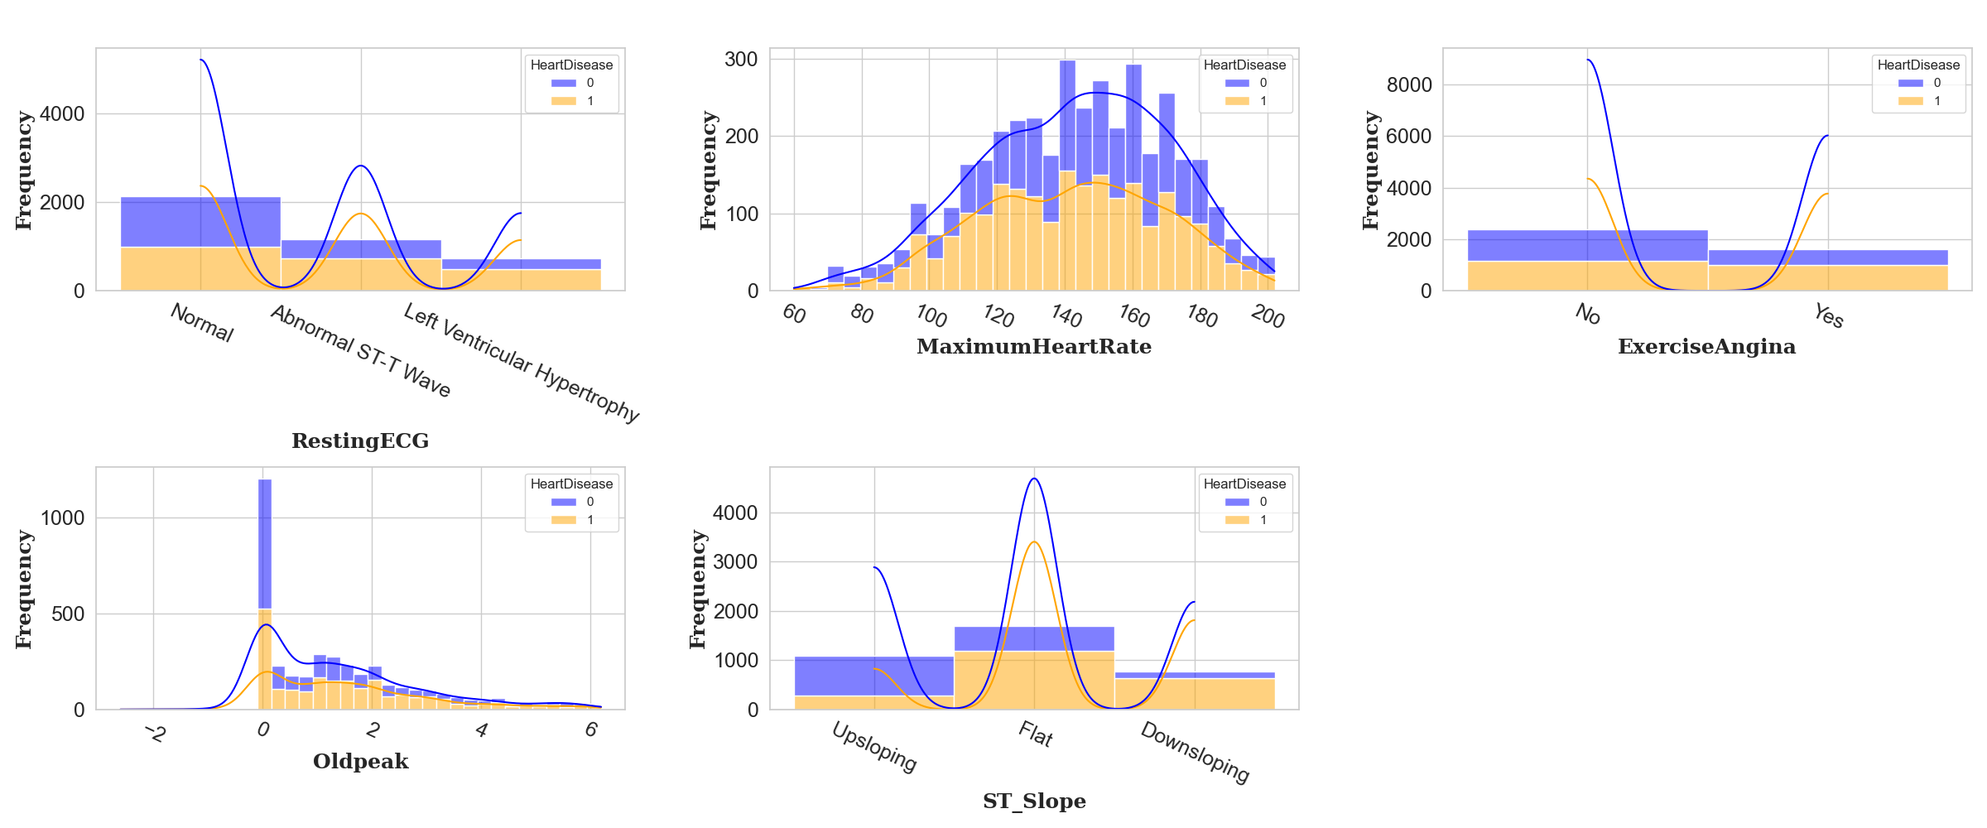
Results
cont’d
Plots showing heart disease distribution by ECG results, maximum heart rate, exercise angina, Oldpeak, and ST slope:
Fig. 3: Distribution of Features by Heart Disease Status (Contd.)

Slide 17
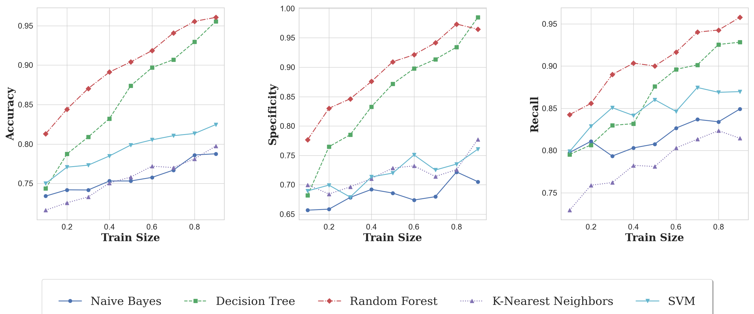
Results
cont’d
Fig. 4: Performance Metrics of Classification Algorithms

Slide 18
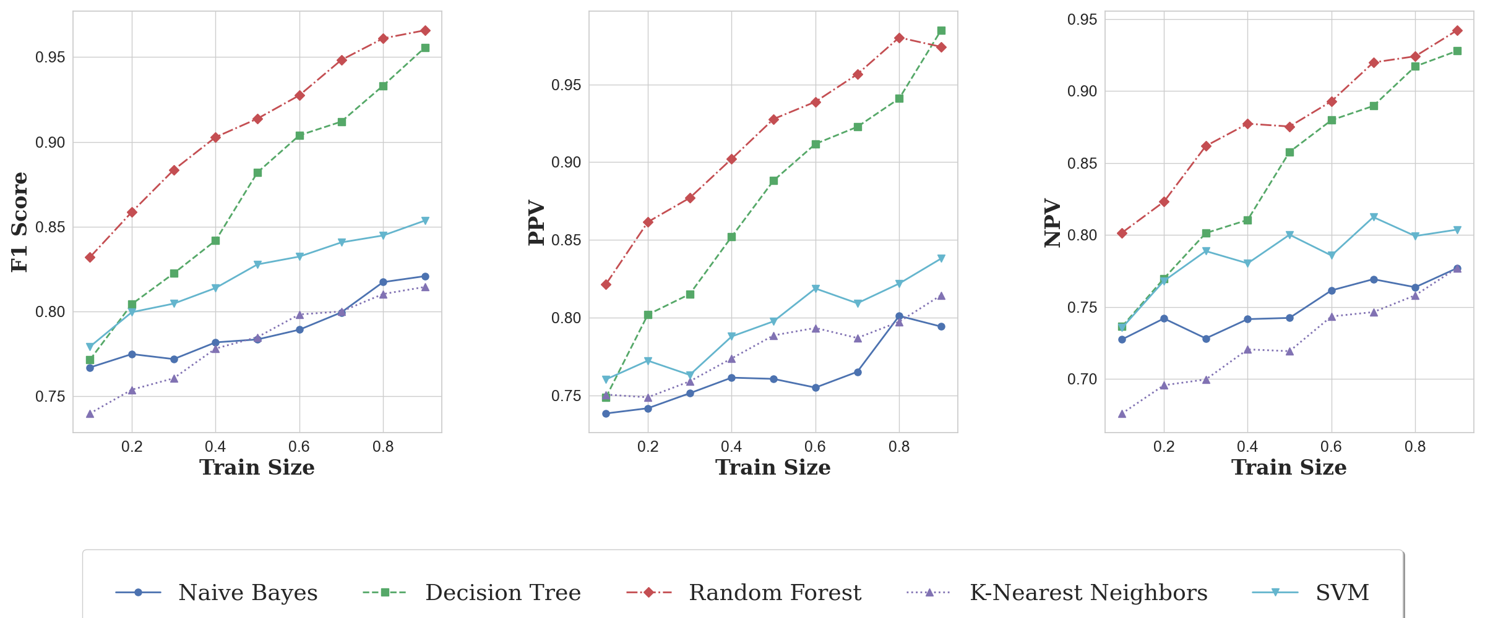
Results
cont’d
Fig. 4: Performance Metrics of Classification Algorithms (Contd.)

Slide 19
Results
cont’d
Random Forest outperforms other algorithms.
Decision Tree shows strong performance.
SVM has acceptable performance.
Naïve Bayes and K-Nearest Neighbor have limitations in predictive values.
Increasing training set size improves performance, but the rate of improvement decreases.

Slide 20
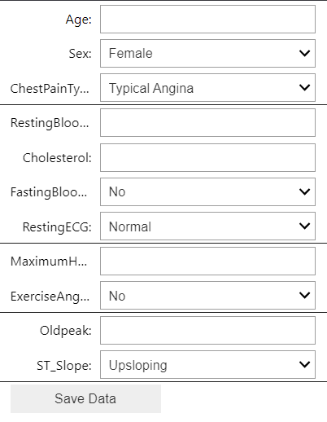
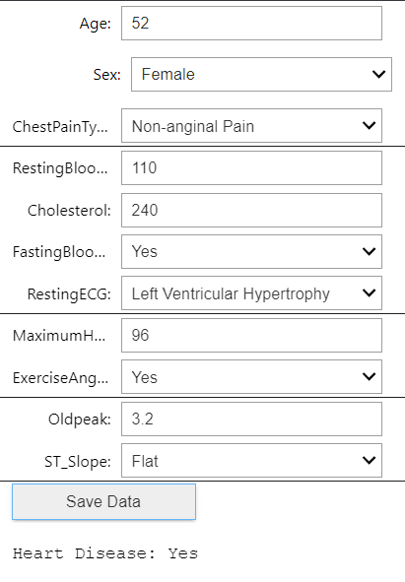
Results
cont’d
Users input their medical information and receive a prediction.
Fig. 5: User interface of a heart disease prediction system

Slide 21
Comparison
Table 3: Comparison With Other Approaches
Attribute | [7] | [8] | [9] | [12] | [15] | Proposed System
Dataset | Cleveland | Cleveland | Two public | Cleveland, Hungary, Switzerland, Long Beach V, UCI Kaggle | Cleveland, Comprehensive, CVD | Combined Kaggle Dataset
Data Quality | Missing values removed, SS, Min-Max | Missing values removal, Binary conversion | SMOTE, Splitting, Balancing | Quality implication, Standard preprocessing | Data type conversion, Outliers handling, SMOTE, Under-sampling | Standardization, Scaling, Encoding, Data cleaning, Feature selection
Feature Engineering | Relief, MRMR, LASSO | HRFLM method | Significant features | 14-attribute dataset created | Chi-Square, ANOVA, FS, FE | -

Slide 22
Comparison
cont’d
Table 3: Comparison With Other Approaches (contd.)
Attribute | [7] | [8] | [9] | [12] | [15] | Proposed System
ML Algorithms | ANN, LR, KNN, SVM, DT, NB | NB, GLM, LR, DL, DT, RF, GBT, SVM | SVM, SGD, KNN, ET, XGB, LR | LR, KNN, SVM, GBC | LR, DT, RF, KNN, NB, SVM, MLP, QMBC | NB, DT, RF, KNN, SVM
Hyperparameter Tuning | Leave-one-subject-out | - | Hyperband, SMOTE | GridSearchCV | Minimal, Basic evaluation | Optimized "random_state"
Evaluation Metrics | Accuracy, Specificity, Sensitivity, MCC | Accuracy, Sensitivity, Specificity, Precision, F-Measure | Accuracy, F1-Score, MCC | Accuracy, Precision, Recall, F1-Score | Accuracy, Sensitivity, Specificity, Precision, Recall, F1-Score, AUC | Accuracy, Recall, Specificity, Precision, F1-Score

Slide 23
Comparison
cont’d
Table 3: Comparison With Other Approaches (contd.)
Attribute | [7] | [8] | [9] | [12] | [15] | Proposed System
ML Model, Train-Test Ratio, Evaluation Metric | SVM+ Relief+ LASSO+ FCMIM+ LLBFS, Accuracy (92.37%) | HRFLM (RF+LM), 7:3, Accuracy (88.7%) | HB+ SMOTE+ ET, 3:1, F1-Score (95.78%) | XGB+ GridSearchCV, 7:3, Accuracy (99.03%) | CVD Dataset: QMBC+ Chi-Square+ PCA, 8:2. F1-Score (99.92%) | RF, 8:2, F1-Score (96.58%)
Novelty of Approach | Fast mutual information | HRFLM hybrid model | Hyperband, balancing | Near-zero prediction error, unique model | Novel QMBC, improved performance | Encryption, integrated techniques

Slide 24
Conclusion
The system securely collects, encrypts, and processes heart disease data.
Random Forest achieved top accuracy on encrypted data.
Blockchain ensures data integrity and tamper-proof storage.
F1-score was prioritized for balanced precision and recall.
The system aids both patients and healthcare providers.

Slide 25
Limitations
Public datasets may affect accuracy.
Slows processing on large data.
Limited data diversity hinders model generalization.

Slide 26
Future Works
Better techniques for missing data handling.
Enhanced model results with PCA, iForest, and deep learning.
User registration and key generation
Secure data storage with digital signatures
Blockchain-based record verification and storage
Immutable and tamper-proof medical records
Use NLP and text mining to analyze unstructured data

Slide 27
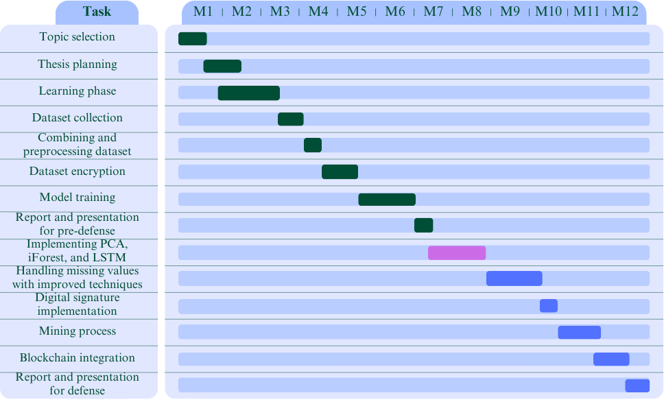
Gantt Chart
Completed
On going
Yet to be done
Figure 6: Project Timeline Overview for Thesis Work

Slide 28
Socio-Economic Impact and Sustainability
Improved access to healthcare.
Enhanced patient autonomy.
Reduced healthcare costs.
Economic benefits from healthier individuals.
Evaluate accuracy and reliability.
Ensure accessibility for all.
Analyze cost-effectiveness.

Slide 29
Financial Analyses and Budget
Table 4: Financial Analyses and Budget
Category | Item | Cost | Notes
Dataset Acquisition | Data Collection Efforts | 500 Tk | Unsuccessful hospital data collection attempts
Miscellaneous Expenses | Documentation and Printing | 600 Tk | Estimated cost for binding and printing
Total Estimated Budget |  | 1100 Tk

Slide 30
References
[7] | Li, Jian Ping, Amin Ul Haq, Salah Ud Din, Jalaluddin Khan, Asif Khan, and Abdus Saboor. "Heart disease identification method using machine learning classification in e-healthcare." IEEE access 8 (2020): 107562-107582.
[8] | Mohan, Senthilkumar, Chandrasegar Thirumalai, and Gautam Srivastava. "Effective heart disease prediction using hybrid machine learning techniques." IEEE access 7 (2019): 81542-81554.
[9] | Abdellatif, Abdallah, Hamdan Abdellatef, Jeevan Kanesan, Chee-Onn Chow, Joon Huang Chuah, and Hassan Muwafaq Gheni. "An effective heart disease detection and severity level classification model using machine learning and hyperparameter optimization methods." ieee access 10 (2022): 79974-79985.
[10] | Das, Ranjit Chandra, Madhab Chandra Das, Md Amzad Hossain, Md Ashiqur Rahman, Md Helal Hossen, and Rakibul Hasan. "Heart disease detection using ml." In 2023 IEEE 13th Annual Computing and Communication Workshop and Conference (CCWC), pp. 0983-0987. IEEE, 2023.

Slide 31
References
cont’d
[11] | Haq, Amin Ul, Jianping Li, Muhammad Hammad Memon, Muhammad Hunain Memon, Jalaluddin Khan, and Syeda Munazza Marium. "Heart disease prediction system using model of machine learning and sequential backward selection algorithm for features selection." In 2019 IEEE 5th International Conference for Convergence in Technology (I2CT), pp. 1-4. IEEE, 2019.
[12] | Ahmad, Ghulab Nabi, Hira Fatima, Shafi Ullah, and Abdelaziz Salah Saidi. "Efficient medical diagnosis of human heart diseases using machine learning techniques with and without GridSearchCV." IEEE Access 10 (2022): 80151-80173.
[15] | Kapila, Ramdas, Thirumalaisamy Ragunathan, Sumalatha Saleti, T. Jaya Lakshmi, and Mohd Wazih Ahmad. "Heart disease prediction using novel quine McCluskey binary classifier (QMBC)." IEEE Access 11 (2023): 64324-64347.
[20] | https://www.kaggle.com/datasets/abhishek14398/heart-disease-classification
[21] | https://www.kaggle.com/datasets/fedesoriano/heart-failure-prediction

Slide 32
References
cont’d
[22] | https://www.kaggle.com/datasets/jocelyndumlao/cardiovascular-disease-dataset
[23] | https://www.kaggle.com/datasets/rishidamarla/heart-disease-prediction
[24] | https://www.kaggle.com/datasets/redwankarimsony/heart-disease-data
[25] | https://www.kaggle.com/datasets/ineubytes/heart-disease-dataset
[26] | https://www.kaggle.com/datasets/johnsmith88/heart-disease-dataset

Slide 33
Thank You All… Any Question???

