Slide 1
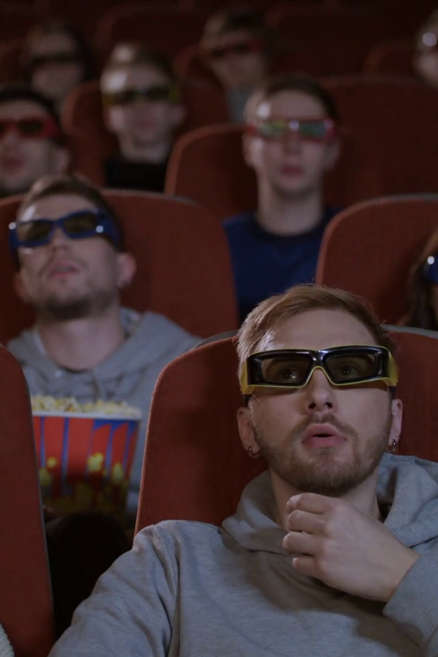
Multimodal Emotion Recognition in Response to Videos
Emotions play a crucial role in our daily communication, affecting our behavior and decision-making. In this presentation, we will explore the fascinating world of multimodal emotion recognition and its applications.
by Isratul Hasan
ID: 20301072

Slide 2
What is Multimodal Emotion Recognition?
Definition
Importance
Multimodal emotion recognition combines different information sources such as facial expressions, speech, and gestures to infer an individual's emotional state.
Understanding emotions in videos can enhance user experience, human-computer interaction, mental health assessment, and more.
Components
Challenges
Facial expressions analysis
Variability in expressions
Speech analysis
Interactions between modalities
Gesture analysis
Limited labeled data

Slide 3

Techniques and Approaches
1
Feature extraction
Extracting relevant features from each modality is crucial for accurate recognition.
2
Machine learning algorithms
Machine learning models such as Support Vector Machines, Hidden Markov Models, and Deep Neural Networks have been successfully applied in this field.
3
Fusion strategies
Combining information from different modalities using strategies such as early fusion, late fusion, or hybrid approaches can improve recognition results.

Slide 4
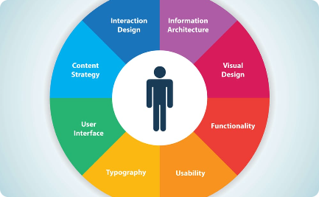


Applications of Multimodal Emotion Recognition
User experience in multimedia content
Human-computer interaction
Mental health assessment
Emotion recognition can help assess mental health conditions such as depression, anxiety, and PTSD.
Emotion recognition can enhance user experience in areas such as entertainment, e-learning, and advertising.
Emotion recognition can improve the interaction between humans and machines.

Slide 5
Challenges and Opportunities
1
Challenges
2
Opportunities
Large variability in expressions
Advances in deep learning techniques
Multimodal interactions are complex
New applications in areas such as gaming, marketing, and health
Limited labeled data
Integration with other technologies such as virtual and augmented reality

Slide 6
Future Research Directions
Social intelligence
Robustness to real-world conditions
Privacy and ethical issues
Integrating multimodal emotion recognition with social intelligence to infer group emotions, social attitudes, and personality traits.
Improving the robustness of recognition models to real-world conditions such as noise, illumination, and occlusions.
Examining the privacy and ethical implications of using emotion recognition technologies in different contexts.

Slide 7

The End
Thank you for joining us in this journey through the fascinating world of multimodal emotion recognition. We hope you enjoyed it and learned something new!

