Slide 1

A better way to gain
Alexis Joseph, Issac Kim, David Wollmer, David Fox

Slide 2
Agenda
Purpose
Other Sites
Audience
Mockup
Demo
Database Schema
Future Improvements

Slide 3
Purpose
Make it simpler for people to workout
Entice Beginners to continue working out
Make a workout site that is less overwhelming than current sites

Slide 4
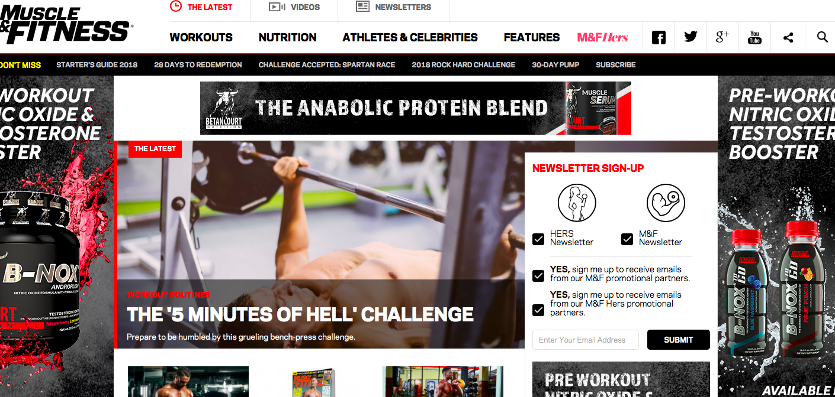
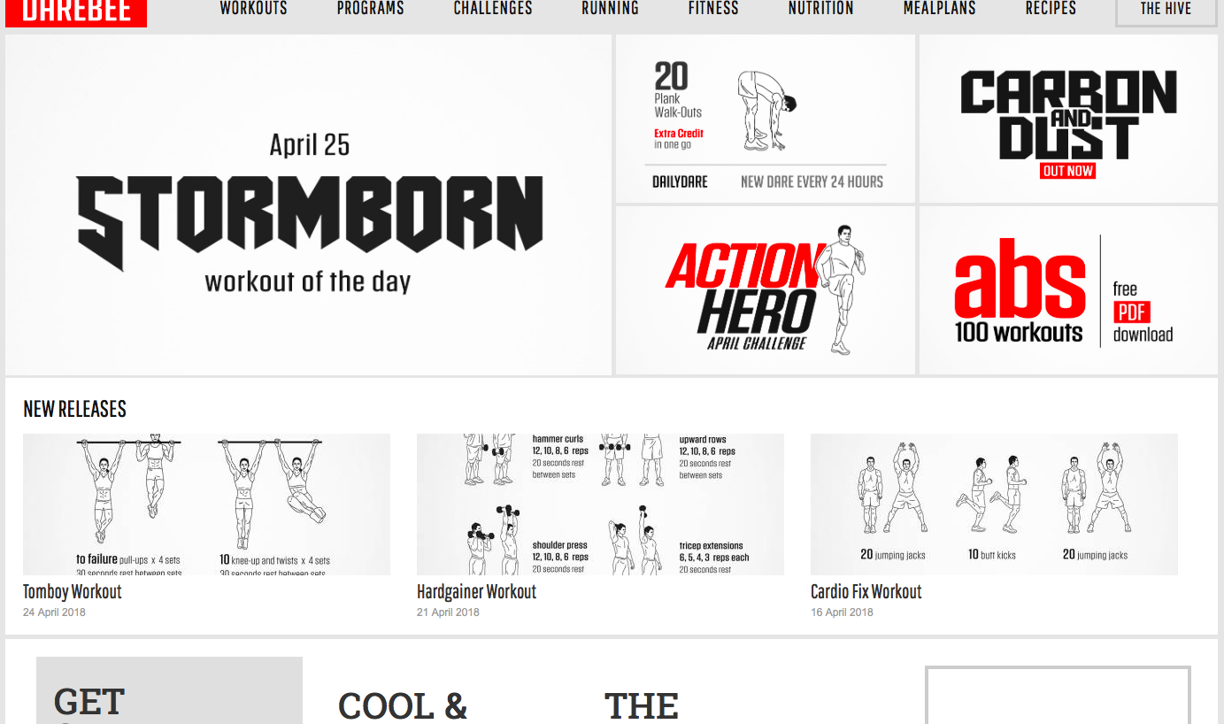
Other Sites

Slide 5
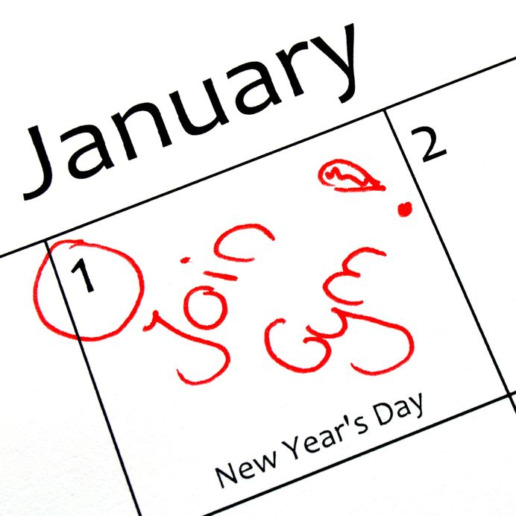
Audience
New Year Resolutioners
Beginners
Notes:
The structure of the site makes it easily accessible to beginners because of the simple layout, not overwhelming the user.

Slide 6

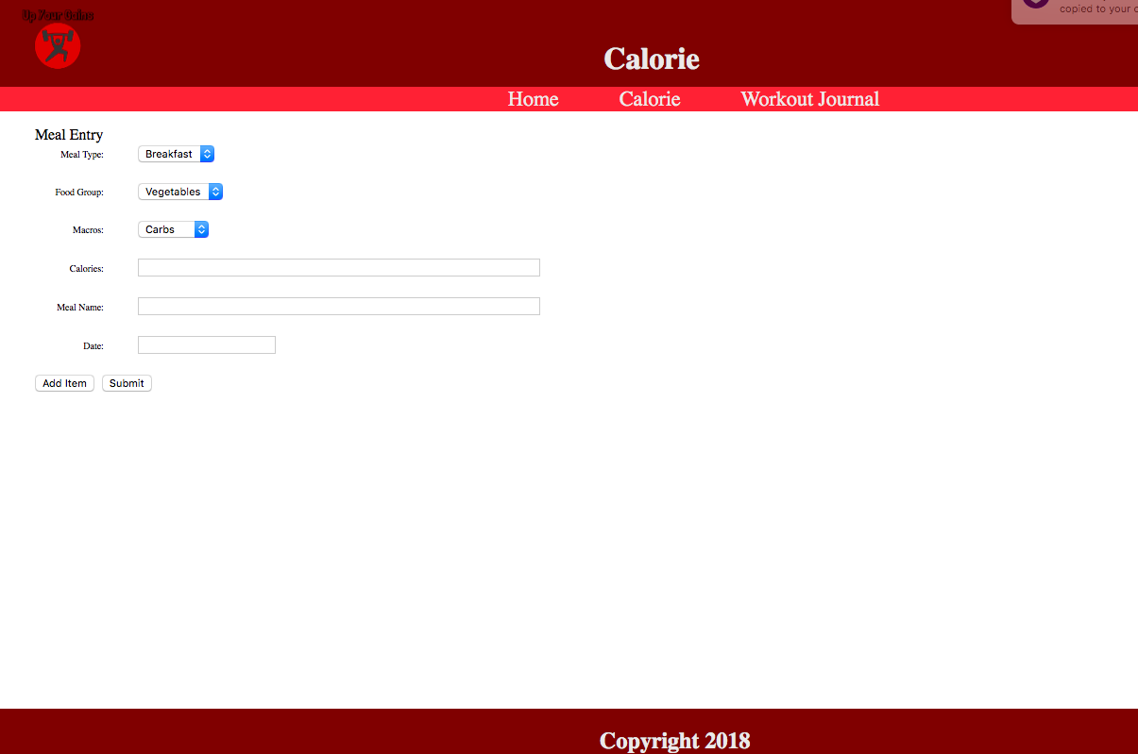
Mockup

Slide 7
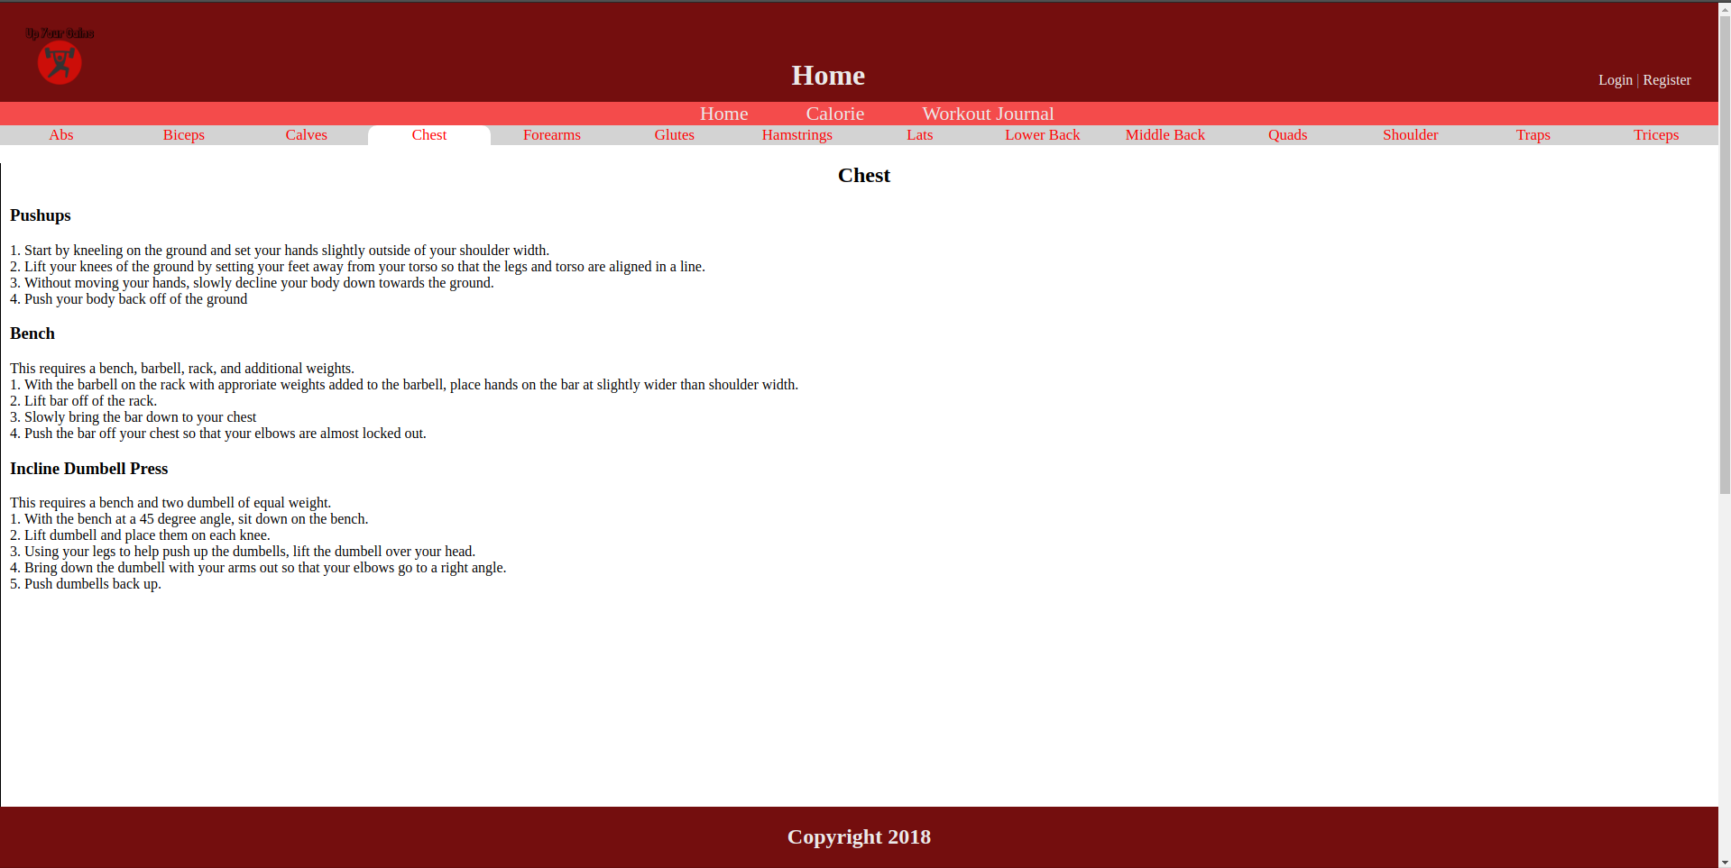
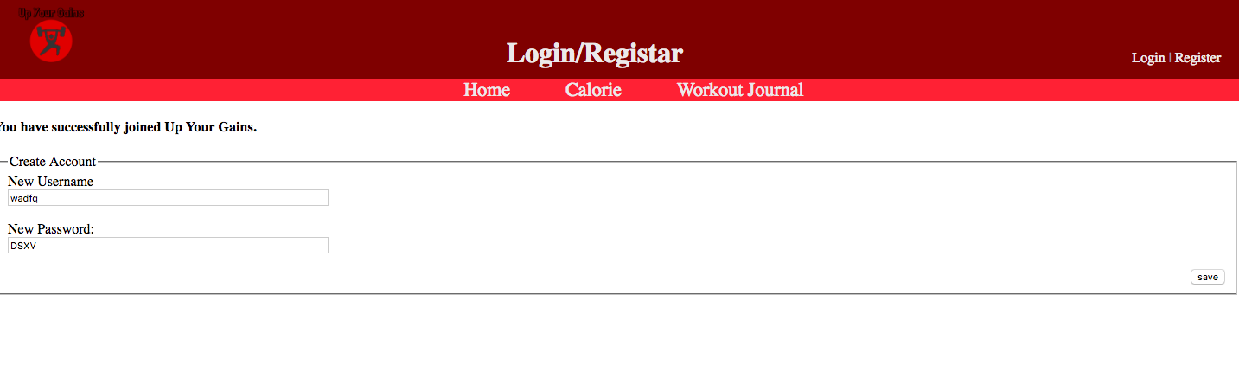
Result

Slide 8
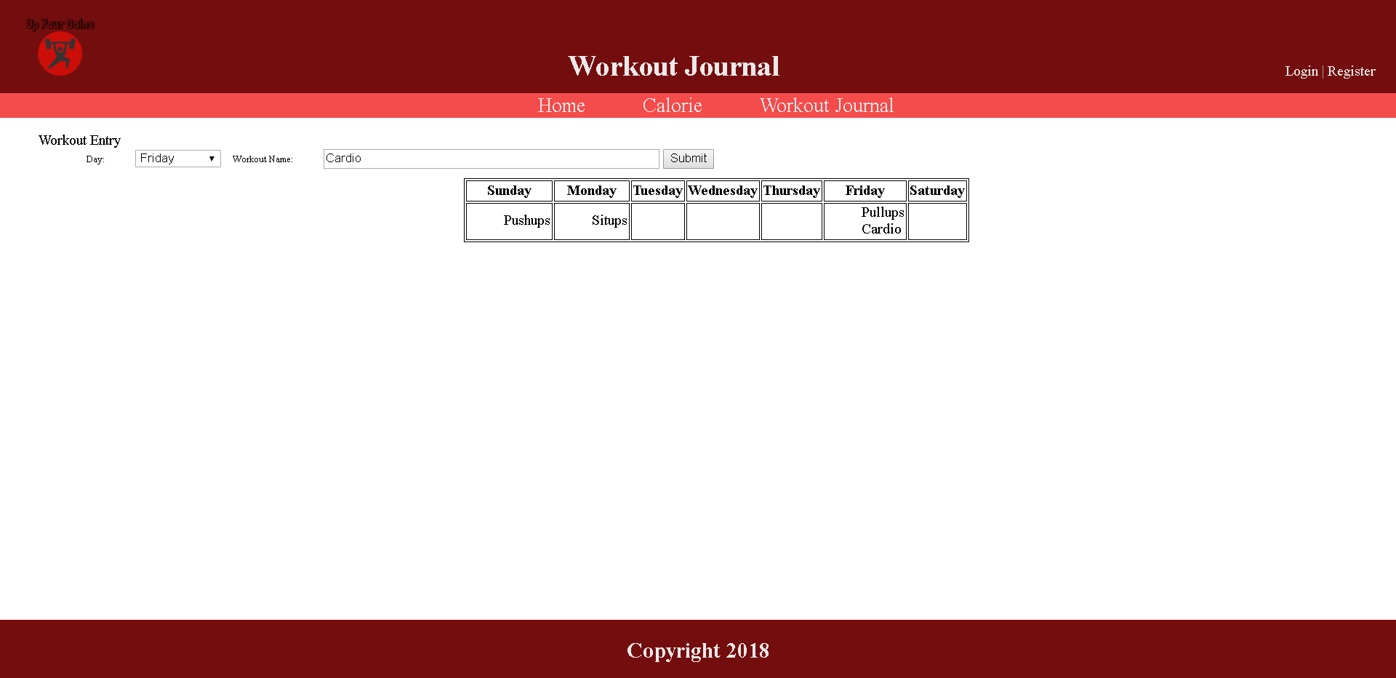
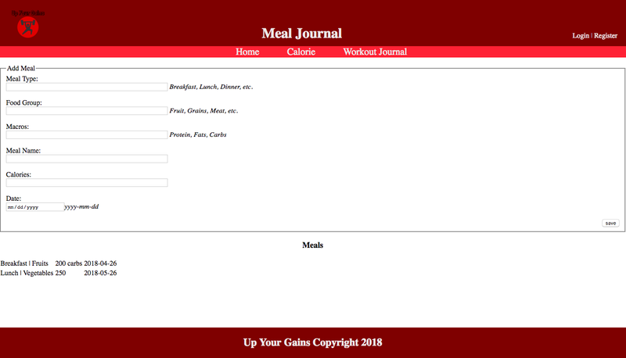
Results

Slide 9
Demo

Slide 10
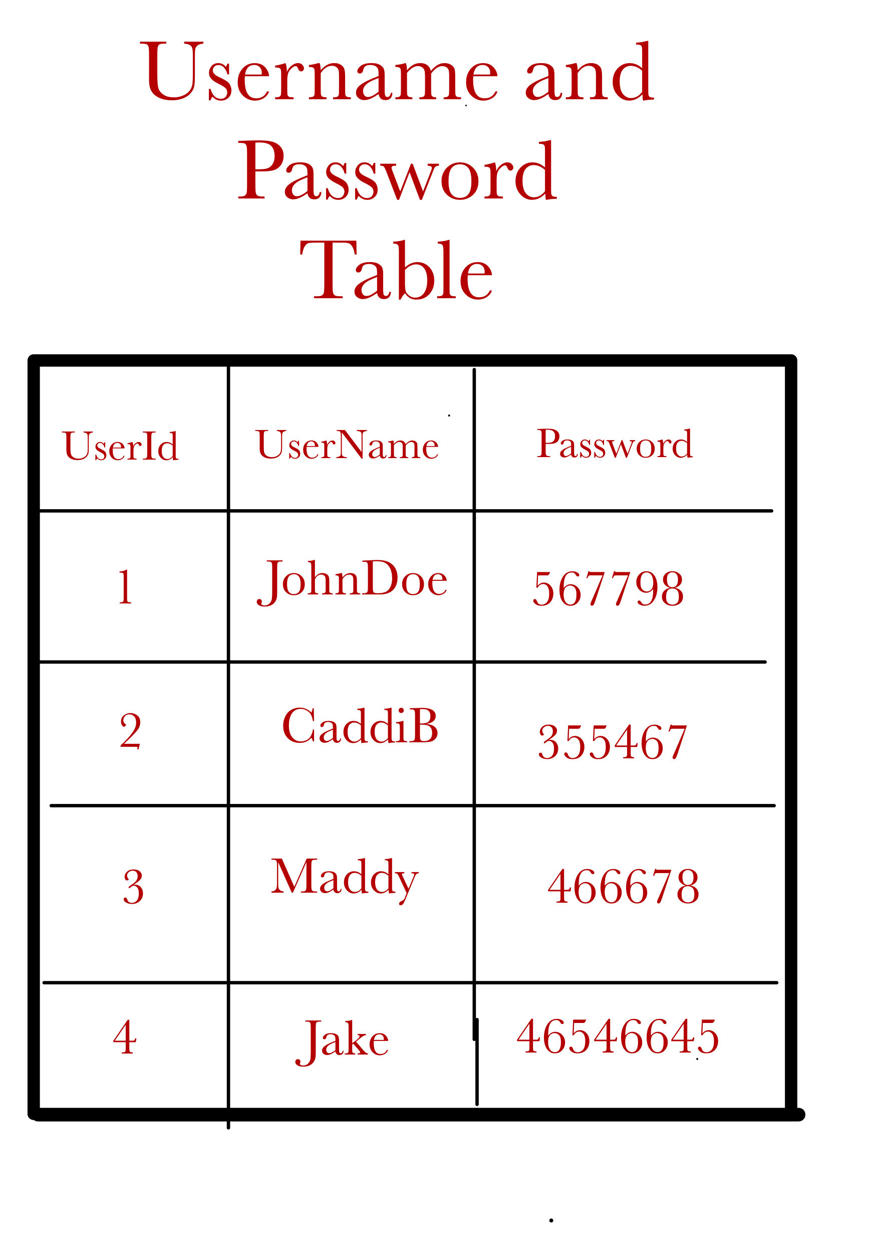
Database Schema

Slide 11
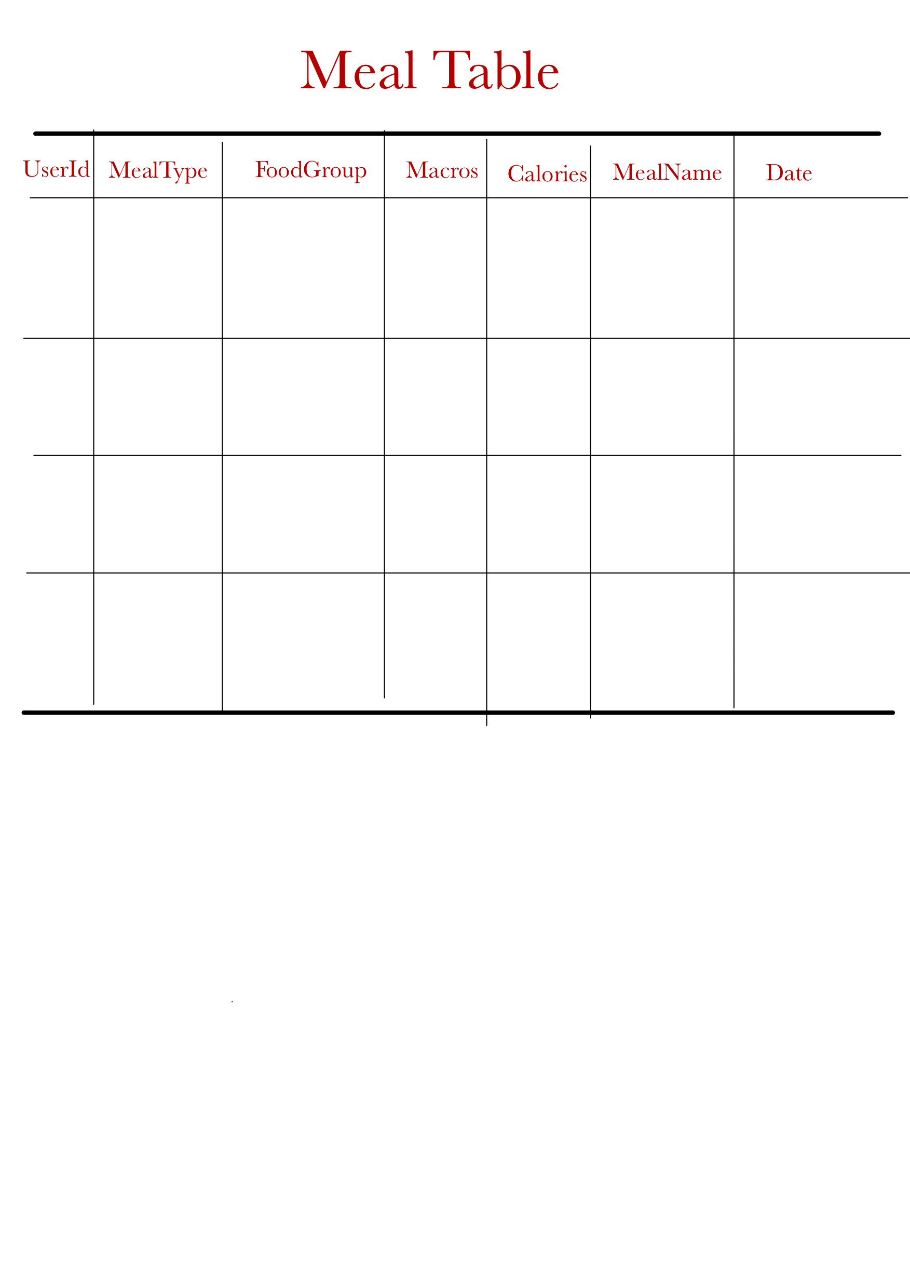
Database Schema

Slide 12
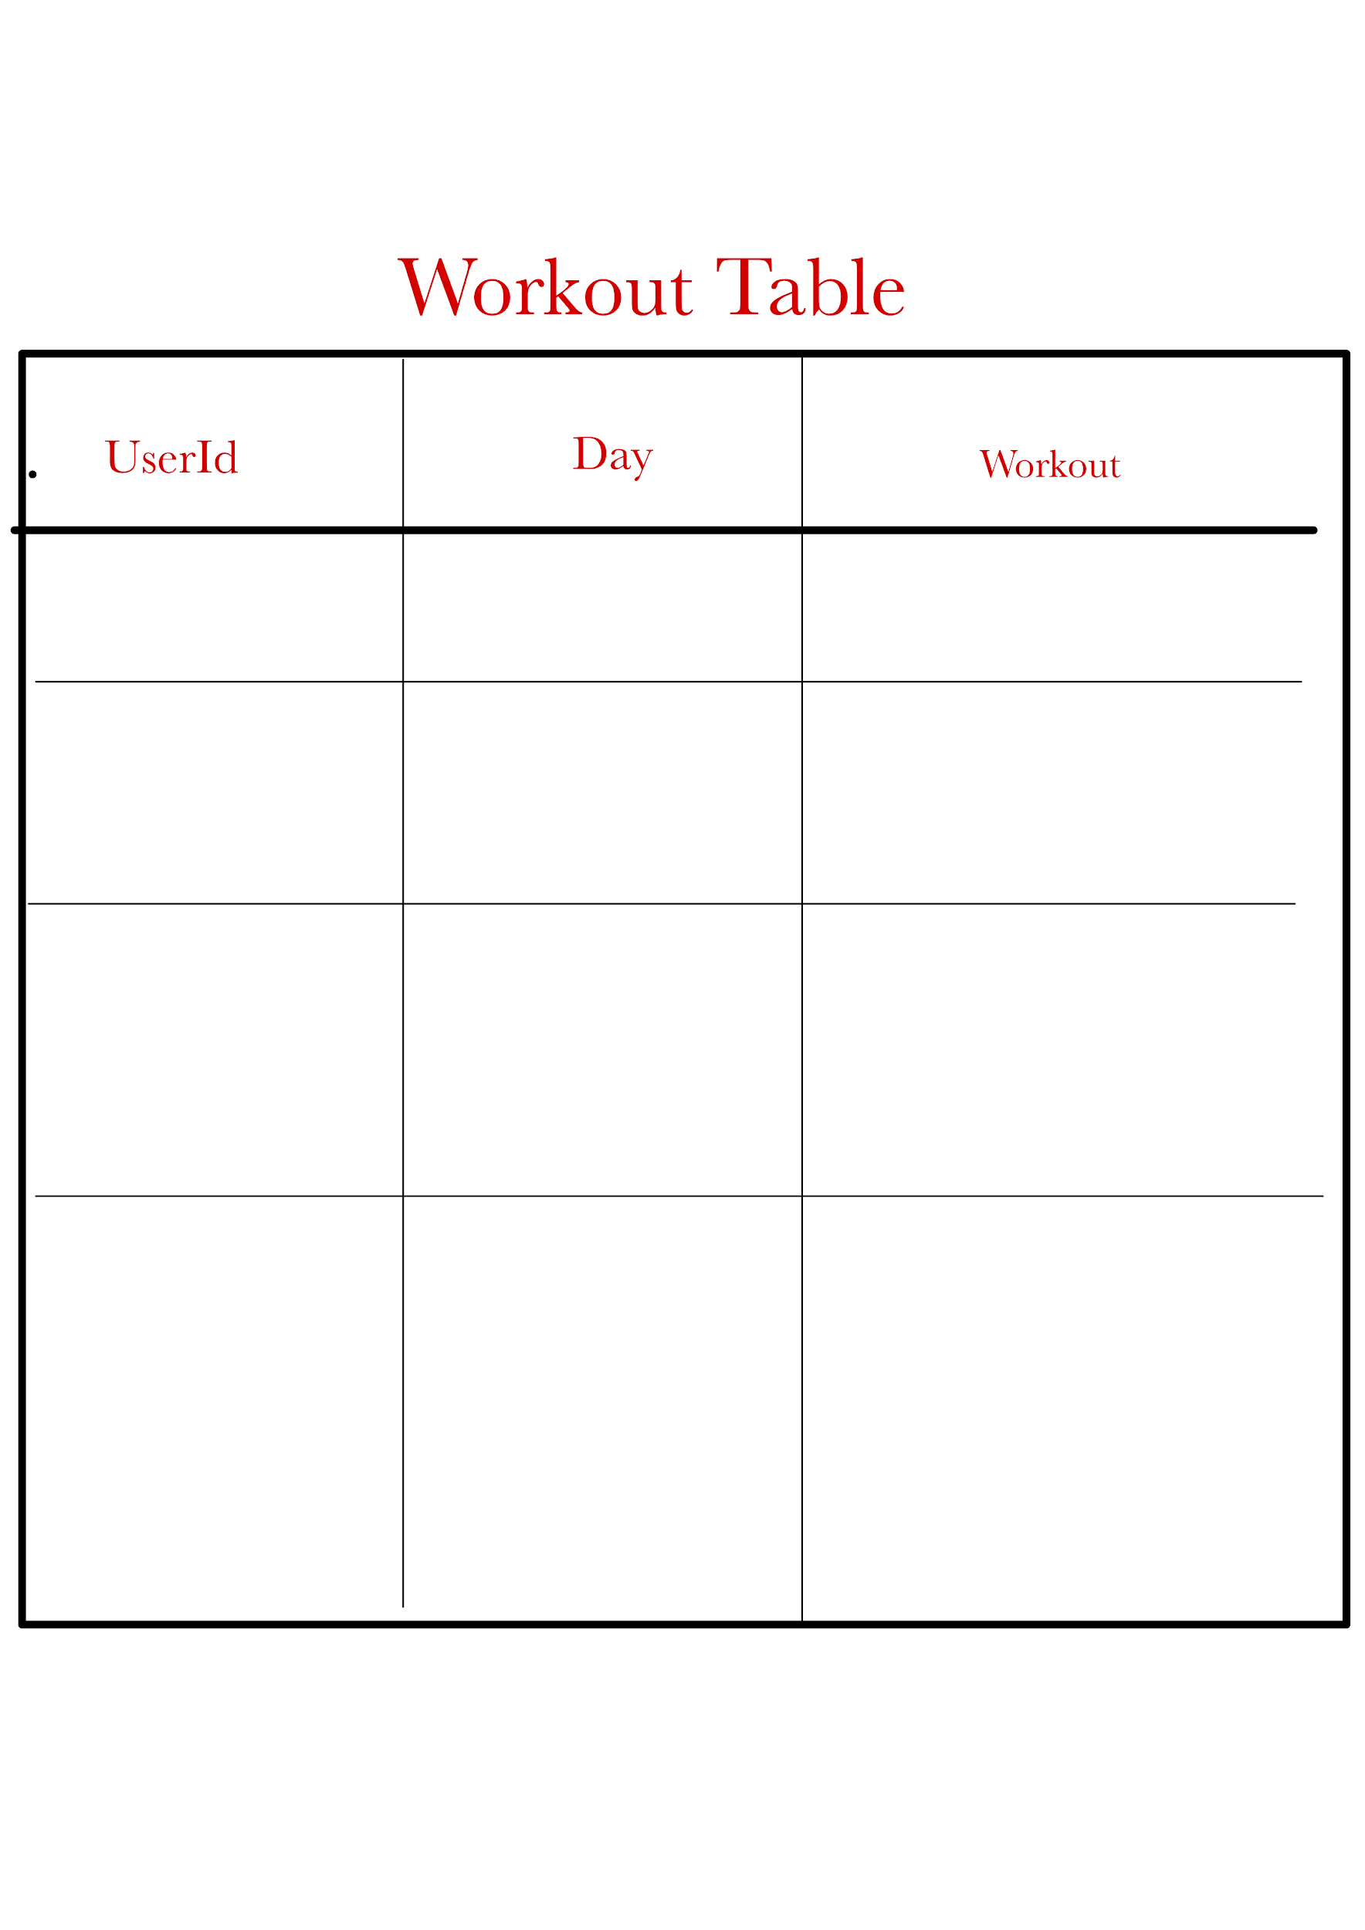
Database Schema

Slide 13
Future Improvements
Possibly add a level system (competitive aspect)
Have images or videos demonstrating the workouts
Allow workouts to be added from the home page
Fully implement the login database.

