Slide 1

“Hishgad” scratch cards analysis
Presented by: Itzhak Davidi

Slide 2

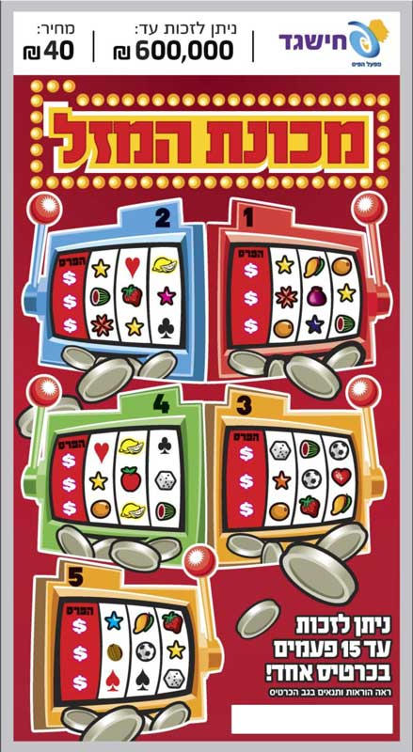

Exploration
The project is about "hishgad" scratch cards. Those scratch cards can be bought almost in every corner store in Israel and they provide a small chance to win various amounts of money.

Slide 3

What is this project about
My goal in this project is to explore and share insights from the data of scratch tickets.
Are some cards possibly better than others regardless of having the same price?
Or maybe cards that are more expensive are better? I will do my best to answer those questions in the next slides. I hope you are excited as I am to see what I’ve found out! Enough talking let's dive in.

Slide 4
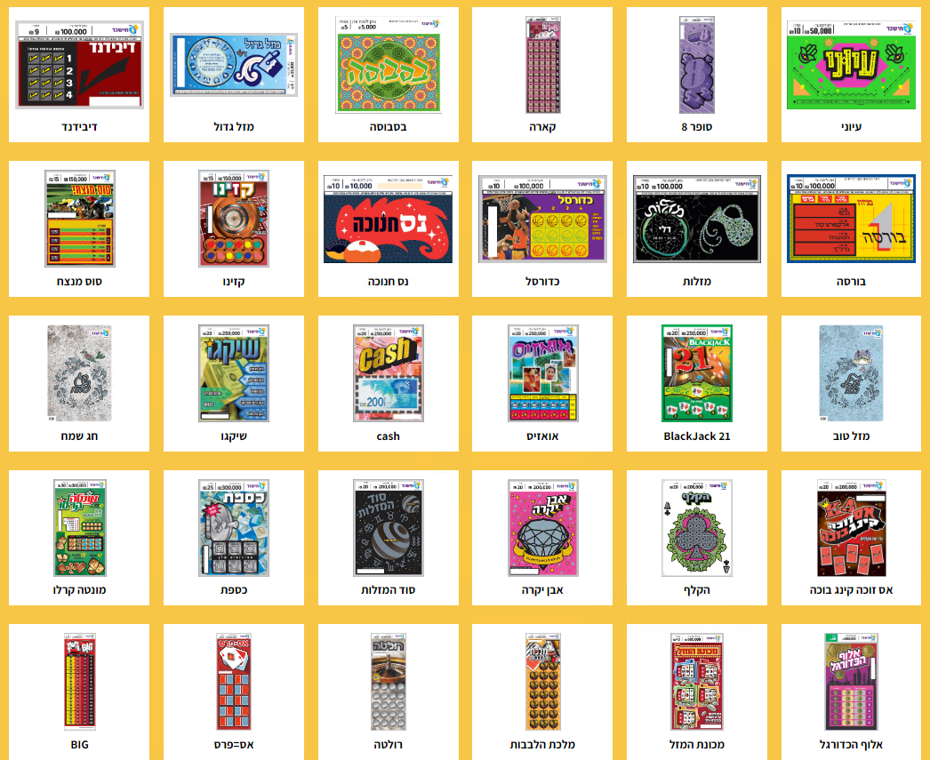
The methods
Illustration of how does the scratch card details are shown in the web:
R, Excel and VBA used to collect, manipulate and visualize the data.
The data collected by web scraping each card details such as: name, price, total number of tickets and the chance of winning.
The R scripts, csv and excel files that used in this project can be found here
The full scratch cards list can be found in this website link.
NOTE: that all the data collected at 15/02/2023. Some cards are unavailable due to changes in the amount of the cards published from time to time.

Slide 5
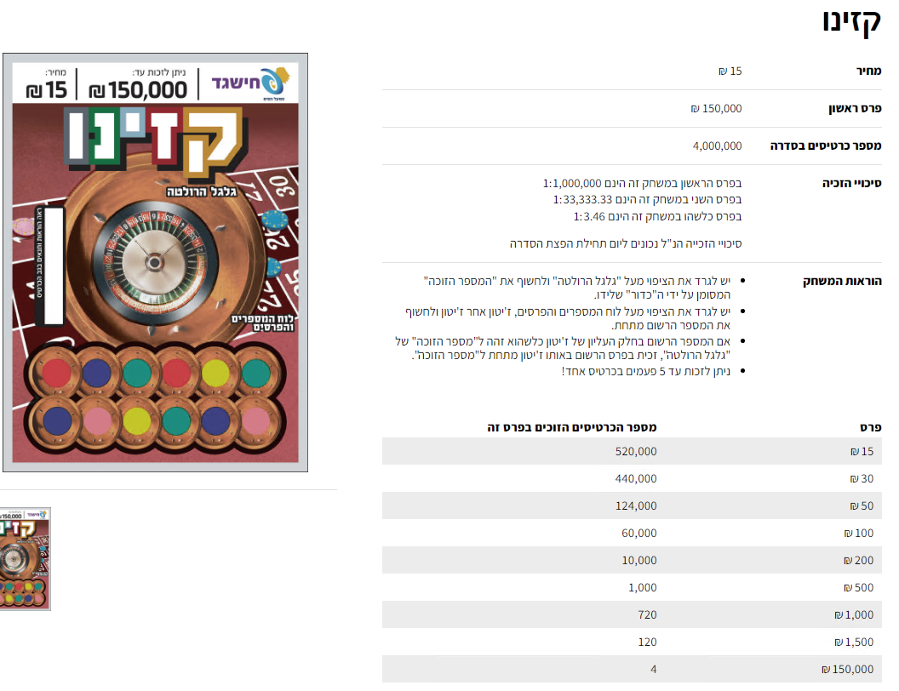
The Web page
*Please note that some information is different than what is shown on the web page because the information on the web pages changes over time
The link to the web page for this specific ticket can be found here

Slide 6
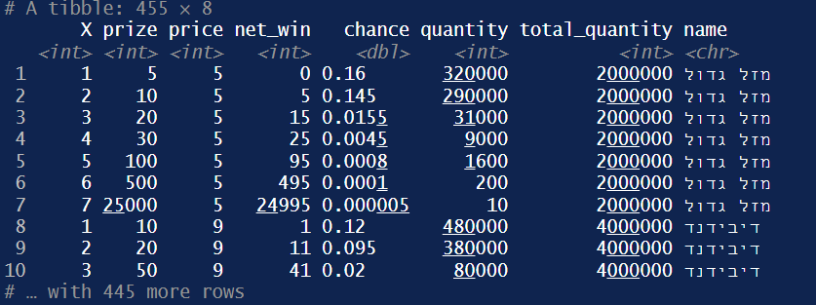
The data table
The table includes 47 scratch tickets that we will use for our analysis.
The table columns are: price, prize, chance, quantity, and total quantity
The table rows are the tickets

Slide 7
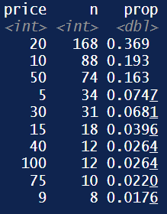
Exploratory analysis
Our data table consists 455 observations. The most common ticket price is 20 shekels and the most uncommon one is 9

Slide 8
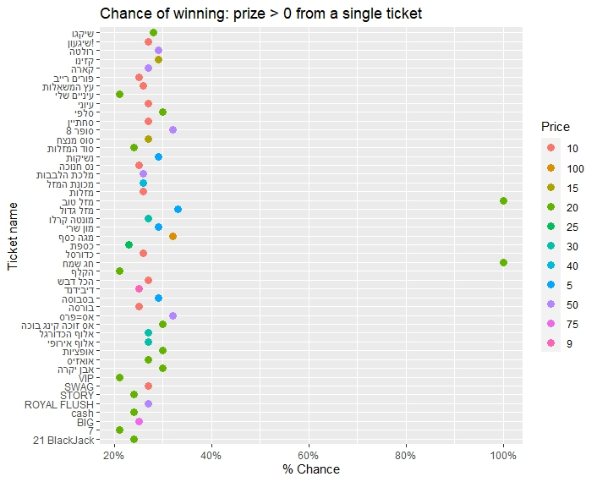
Exploratory analysis
The graph shows the chance of winning something, categorized by color = ticket price the two green dots at the right side of the graph represents two cards with 100% chance win rate.
Hurray! We have found a goldmine, don’t we? well, not really.
The graph is overwhelming at first but no worries it will be polished in the next few slides!

Slide 9

Exploratory analysis
by looking at the data table we find the two green cards we saw earlier have 80.2% chance of losing 10 shekels.
High chance of actually losing.. Interesting!

Slide 10
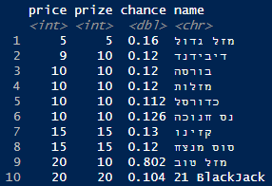
Exploratory analysis
Filtering the data to show the highest chance among all tickets reveal that most of the time we will breakeven.
The two tickets we saw earlier are exceptions.
High chance but no win..

Slide 11
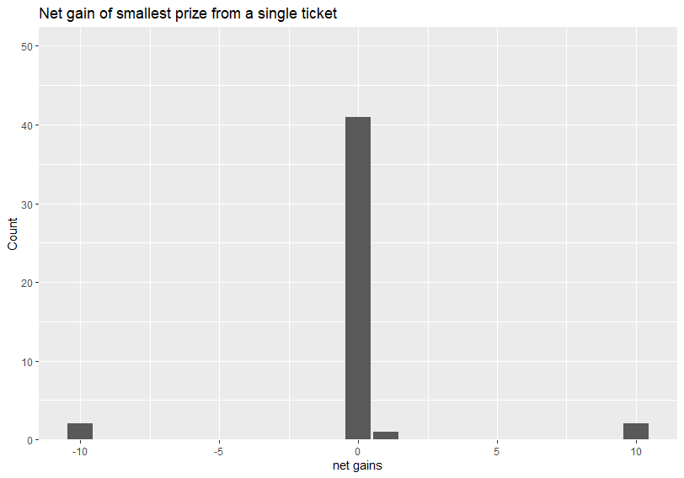
Exploratory analysis
We can see that most of the cards that have a high win chance are not profitable.
So which card has better chance to make a buck?

Slide 12
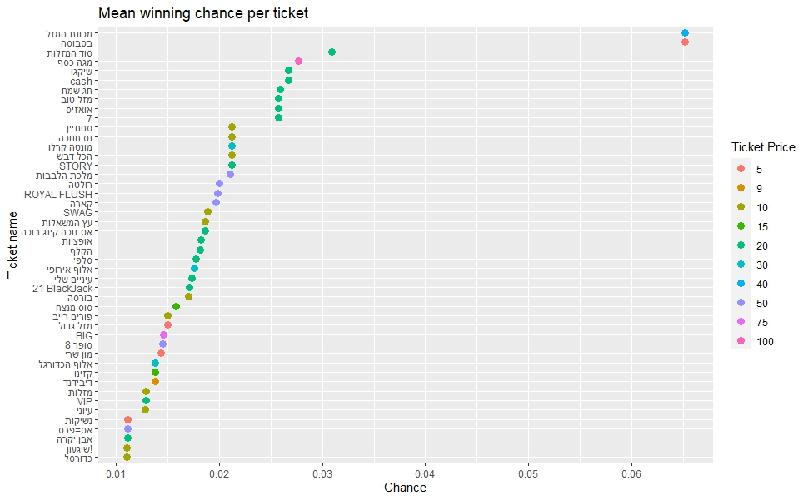
Insights
This graph represents the mean chance of ending with a positive return from all the tickets.

Slide 13
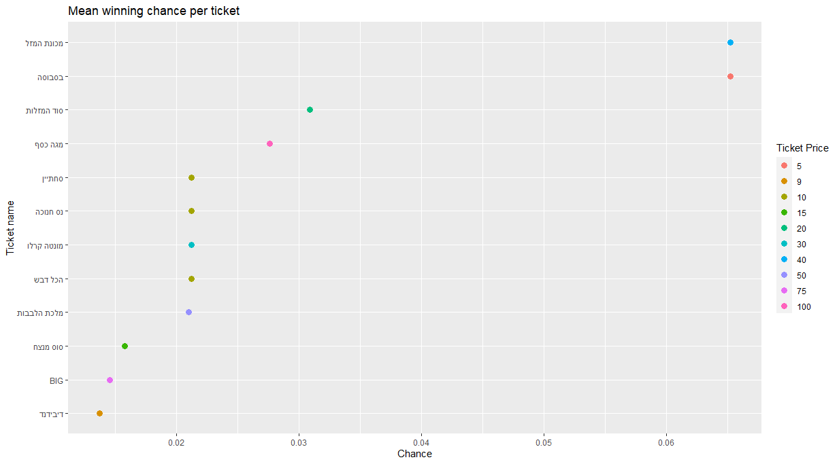
In this graph, I've made it easy for you to see the cards with the highest chances to make a profit on average among all ticker prices
Insights

Slide 14

Conclusion
We have found that cards with the same price have different chances of winning, and some of them are better options than the others on average.
Now you know the secret, So the next time you buy a scratch ticket remember which card gives you better chances and..good luck!
Thanks for watching!

