Slide 1
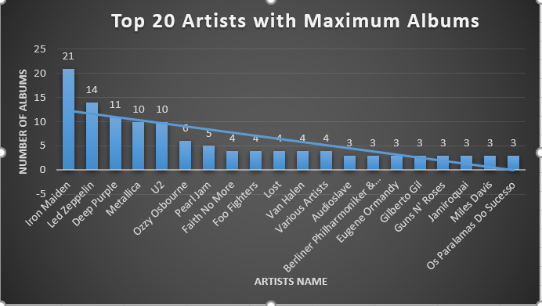

Artists with Maximum Albums
Albums are collection of tracks of an artist generally related to a specific subject. Iron Maiden is the artist with the most number of albums in the market

Slide 2
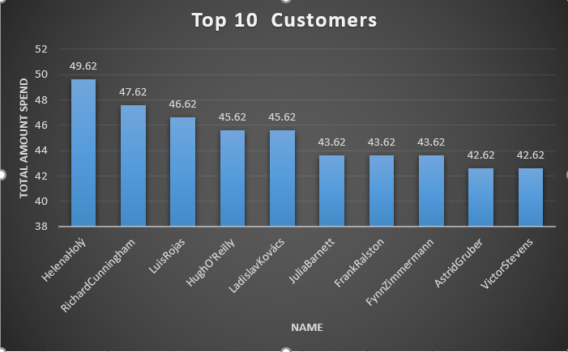
Top 10 Customers
It can be observed from the graph that Helena Holy is the biggest customer with the spending of $49.62 on tracks which also show her interest in music followed by Richard Cunningham, Luis Rojas and many more

Slide 3
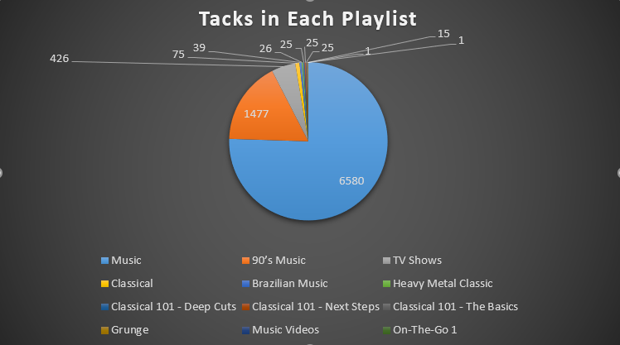
Tracks and Playlists
It is evident from the pie-chart that music playlist has the most number of tracks followed by the 90’s music playlist . Whereas there is only 1 track each in music videos and on the go 1 playlist.

Slide 4
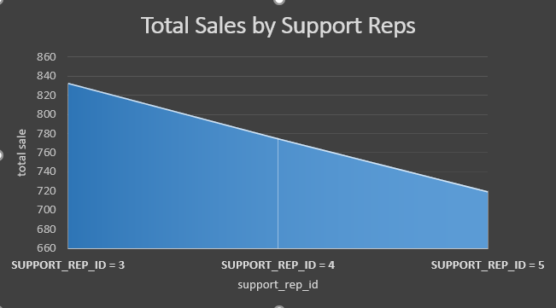
Total Sales By Support Reps
Support_rep_id 3 with the largest sales in its pocket this graph shows the sales done by each rep

