Slide 1
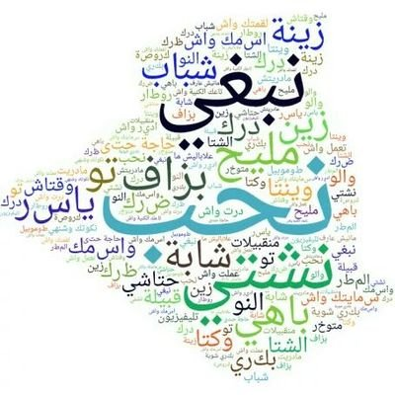


Sentiment Analysis For Low-resource
African Languages using Twitter Dataset
by Ahmed Issaoui, Massa Coulibaly, and Ahmad Mohamad

Slide 2
Introduction & Motivation
Task Description: What is sentiment classification?
Why is it important?
What are we doing new? Algerian Dialect

Slide 3
Data Description
From where did we get the data?
Some information about the data:
Low quantity (~1600)
Low quality ( وعلاه جاى مكرون)
Not balanced (54% , 25%, 21%)

Slide 4
Pre-processing
Removing @user and RT (Twitter tokens)
Tokenization
Removing stopwords
Removing punctuation
Removing numbers
Normalizing emojis
Removing empty string tokens
@user مرنكة أقسم بالله 😂😂😂تبهليل ما بعد منتصف الليل
مرنكة أقسم بالله 😂 تبهليل منتصف الليل

Slide 5
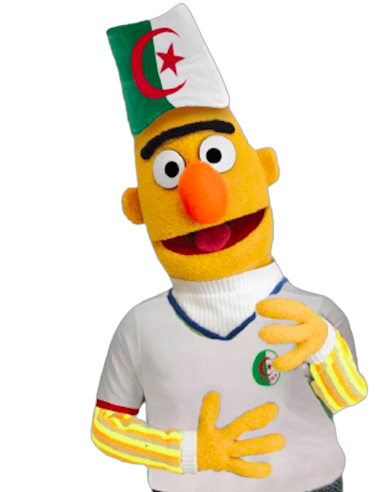
Data Augmentation
تبهليل هاذا
شكون هاذا
تبهليل شبعتونا
هاذا [MASK]
[MASK] تبهليل
DziriBERT

Slide 6
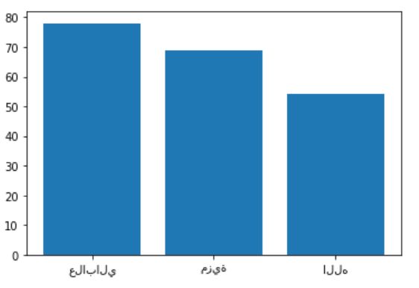
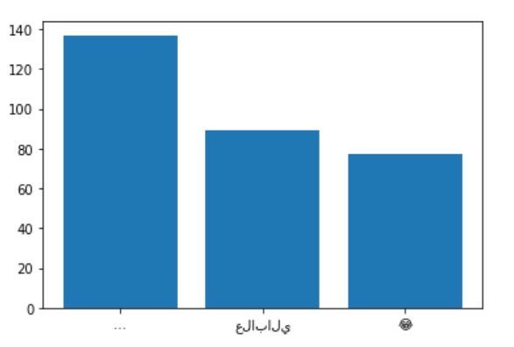
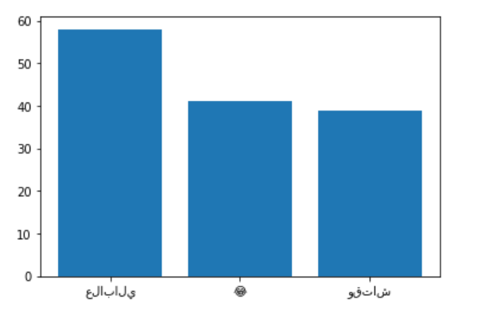
Data Analysis
Most Freq Positive Words
Most Freq Negative Words
Most Freq Neutral Words

Slide 7
Basic ML models

Slide 8
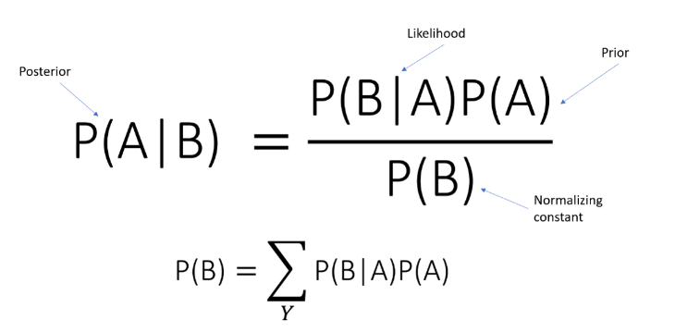
Naive Bayes
Results:
Non-Augmented: 51%
Augmented: 54%

Slide 9
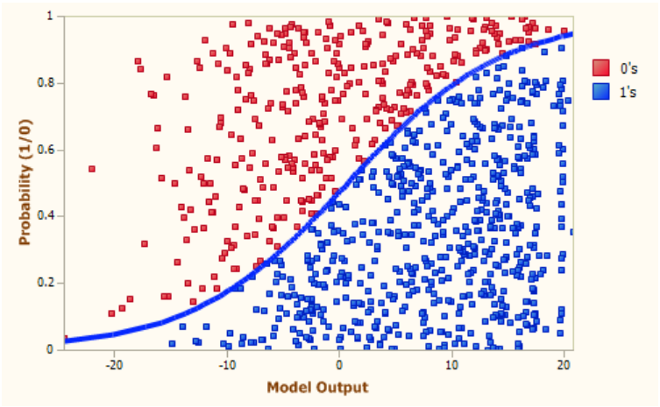
Logistic Regression
Results:
Non-Augmented: 48%

Slide 10
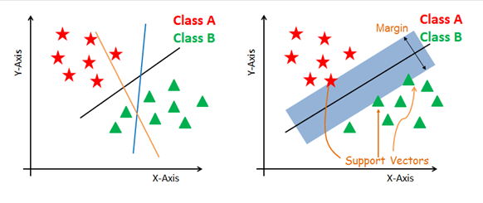
SVM
Results:
Non-Augmented: 37%
Augmented: 41%

Slide 11
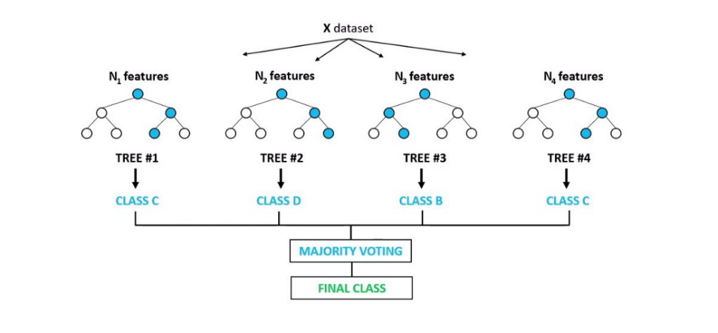
Random Forest
Results:
Non-Augmented: 46%

Slide 12
LSTM-based models: Vectorization & Padding
مرنكة أقسم بالله 😂 تبهليل منتصف الليل
[7 , 14 , 6 , 88 , 5 , 23 , 76]
[7 , 14 , 6 , 88 , 5 , 23 , 76 , 0 , 0]

Slide 13
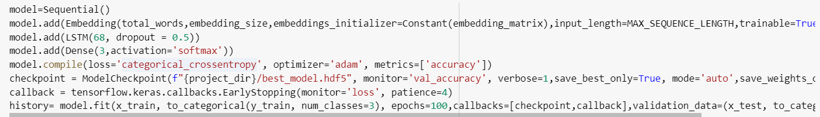
LSTM-based models: Layers

Slide 14
LSTM-based models: Results
61% accuracy
+10% improvement on baseline models

Slide 15
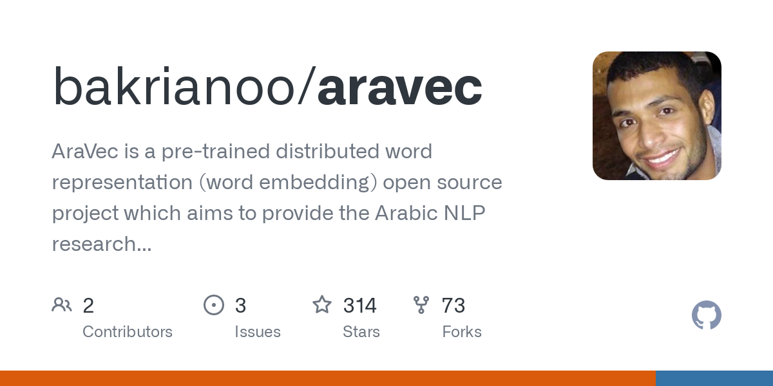
LSTM-based + Aravec

Slide 16
LSTM-based + Aravec: Results
63% accuracy
+2% improvement on the basic LSTM model

Slide 17
New approach: 2-step Classification

Slide 18
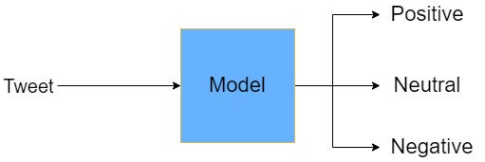

Slide 19
I`m going to uni 😭😭😡

Slide 20
I`m going to uni 😊😊😊

Slide 21
I`m going to uni

Slide 22
If there is no patterns that indicate neutrality in a sentence (neutrality itself is not detectable)
how are we (as humans) able to identify neutral sentences?

Slide 23
We do not directly identify neutrality?
We go through a 2-step classification process
How positive?
Text
Sentiment
How negative?

Slide 24
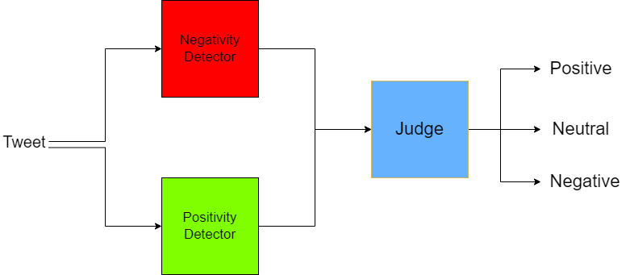

Slide 25
Results
70% accuracy
+20% improvement on baseline models
7% improvement on traditional approach (LSTM-based model)

Slide 26
Conclusion and Future Work

Slide 27
Better Stopwords
it is really hard to collect all stop words from the algerian dialect.
If we get access to these stop words then there will be more focus on the important information.

Slide 28
Better Data
To make a enhanced model, better quality and more data and will need to be collected.
The current data is very low quality and quantity but we tried to get the best accuracy possible.

Slide 29
Better Augmentation
Spend more time on making a more advanced data augmentation algorithm.
Our augmentation algorithm is very basic and needs more work if we are working with arabic dialects.

