Slide 1
Dataset
Launch Google Collab
Download the Bitcoin Metrics dataset from:
https://www.kaggle.com/datasets/ahmedoveedd/bitcoin-metrics
Bitcoin Metrics dataset is a collection of bitcoin stats from the year 2009 to 2016 containing different values and attributes.

Slide 2
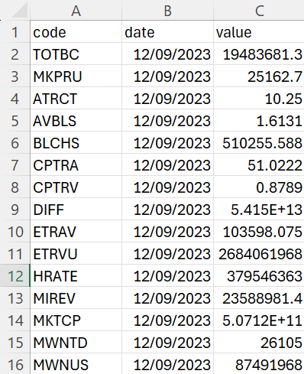
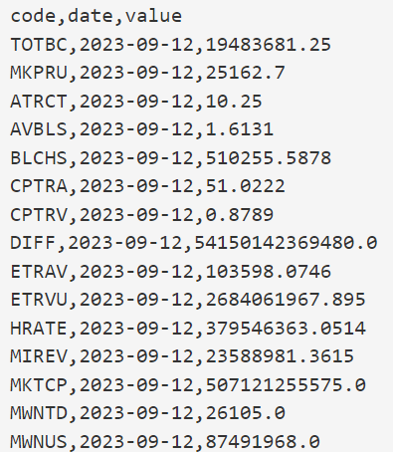
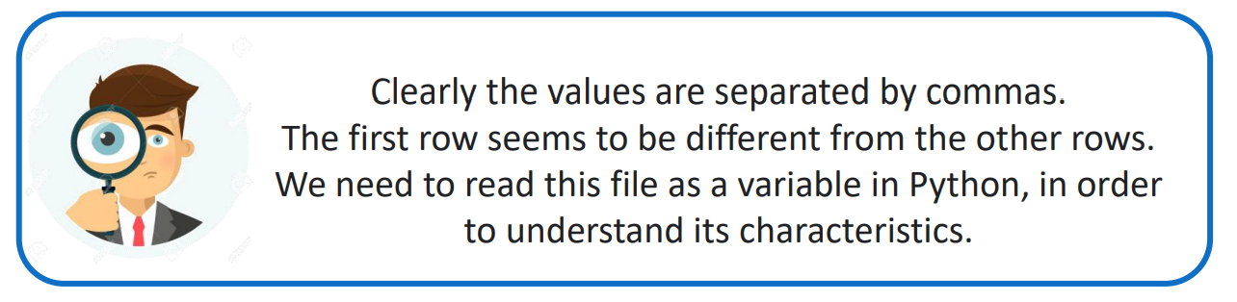
Data visualisation
Double click on the "Bitcoin_metrics.csv" file to see its content

Slide 3
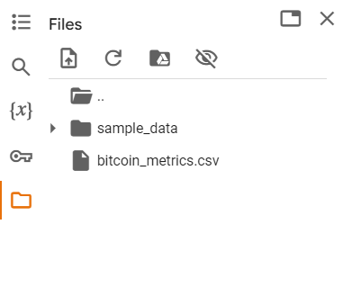

Work environment
Import your dataset into collab

Slide 4


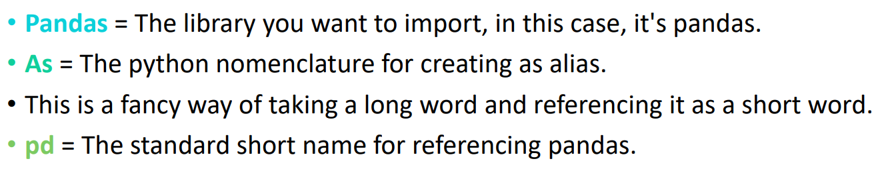
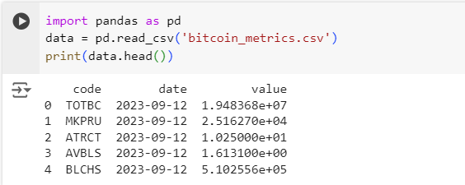
Read a dataset in a variable
Write these 3 rows in your cell:
This should be the result

Slide 5
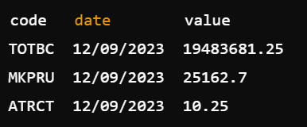

Data manipulation
Notice:
1 day (12/09/2023)
This is generally called data reshaping, this process specifically is called data pivoting; from long format to short format
Let’s try it!

Slide 6
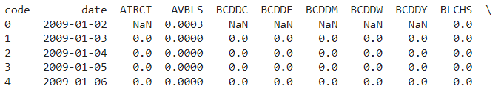

Data reshaping
Add a new cell then write this line of code:
The values with which we want to fill our new table
In case of recurrence it will only take the first occurence
What we want as the row index
What we want as columns
Now let’s print our new dataframe:
. . .

Slide 7

Data manipulation
Some codes seem to be depricated! ☹
These values are no longer supported: 'BCDDC', 'BCDDE', 'BCDDM', 'BCDDW', 'BCDDY', 'NETDF', 'TVTVR'
This is what we call missing values, there are several ways to deal with them:
Deleting the columns with missing data
Deleting the rows with missing data
Replacing the issing values the mean/median
Filling the missing values with the values from the above/next row
Data Imputing techniques like "k-Nearest Neighbors"
In our case, since we don’t really need these values, we can drop the columns:

Slide 8
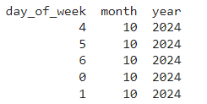
Data encoding
Our current date format is as follows: 12/09/2023
Let’s convert this object into numerical information:
In pandas, datetime refers to a powerful data type used for handling date and time-related data.
Now we can access date components:

Slide 9
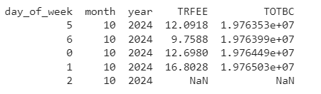
Our use case:
I want to be able to predict the TRFEE from a provided date and TOTBC values.
In this case, TOTBC + date are called features and TRFEE is our target.
We need to:
Remove the columns that we don’t need
Deal with the missing values
Normalise the values

Slide 10
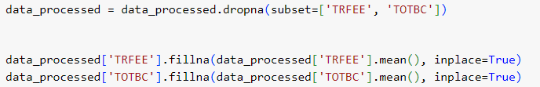
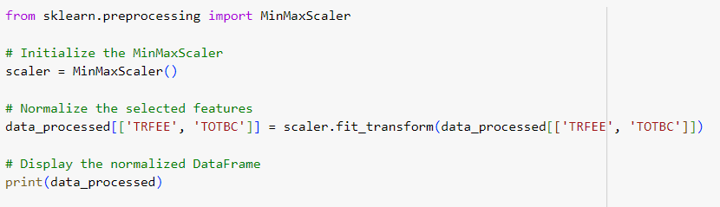
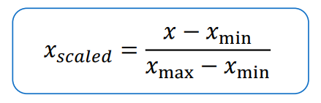
Data normalisation
We either drop the missing values or fill them

Slide 11
Show us your clean data!

