Slide 1
FLORIST · SCIEZ / LÉMAN · DEMO DAY
Pivoine & Lilas
The boutique that still sells after closing time.
Dimitri Jaille & Mattieu Mouroux · Flask, JWT, Decimal checkout, printable invoices
Pivoine & Lilas · Sciez / Léman · Dimitri Jaille & Mattieu Mouroux

Slide 2
0. IDENTITY
Team, roles, decisions
Name | Role | Owns
Dimitri Jaille | Backend lead | API, SQLAlchemy, JWT, checkout, tests, security
Mattieu Mouroux | Frontend & Demo Day | Jinja/CSS/JS, stories, deck, live demo
Communication: GitHub commits/PRs every day; 15–30 min sync before each demo.
Decisions: Mattieu on UI copy; Dimitri on money/auth. Cuts (email, geo, HT/TVA) are written as missing stories — never hidden.
Evidence: github.com/Issercio/Demo-day · branch main · ./run-tests.sh (80 tests).
Pivoine & Lilas · Sciez / Léman · Dimitri Jaille & Mattieu Mouroux

Slide 3
1. PROBLEM
Who suffers, and how we know
Problem: the Sciez shop still sold after 19:00, but the Wix site was a brochure — no cart, no pay, no catalog the florist could update.
Users: Marie (last-minute birthday), Léa (subscription), Camille the florist (atelier + vitrine).
Pain: phone orders without line items; Instagram instead of a catalog; shared demo carts; no workshop status.
Evidence: Wix observation, classroom bugs we actually fixed (empty checkout, bcrypt Marie, client prices), Interflora already takes cards after hours.
Pivoine & Lilas · Sciez / Léman · Dimitri Jaille & Mattieu Mouroux

Slide 4
2. SOLUTION
One shop, server-owned prices
Responsive Flask shop: catalog with photos, private cart, checkout, 30 % deposit, subscriptions, Mes commandes.
Florist desk: CRUD + photo upload, season/event vitrine combo, FAC invoices, prep À préparer → Remise.
Value: buy after closing time; florist sees payment and the atelier; Demo Day runs without Stripe secrets (4242).
MVP boundary: a paid photographed bouquet + a florist invoice. Not in MVP: email, geo, click-and-collect, fiscal HT/TVA.
Pivoine & Lilas · Sciez / Léman · Dimitri Jaille & Mattieu Mouroux

Slide 5
TECHNOLOGIES
Choices we can defend
Frontend
Jinja2 + vanilla JS
Custom CSS (florist pink)
localStorage cart per account
Backend / API
Flask 3 + RESTX Swagger
SQLAlchemy 2 Numeric money
JWT HS256, roles from DB
Payments / extra
Test cards or Stripe API
Photos on disk
unittest + coverage
Why not React: two people, one process, 20-minute demo. Why SQLite: classroom machines. Why Decimal: euros are not floats.
External API: Stripe PaymentIntent when keys exist. Empty keys → documented test PANs (mandatory “external service” without live charges).
Pivoine & Lilas · Sciez / Léman · Dimitri Jaille & Mattieu Mouroux

Slide 6
USER STORIES — SHIPPED
Must / Should / Could that actually run
Role | Story | Prio
Customer | Register, login, logout, JWT | Must
Customer | Browse photos, filter colour/price/name | Must
Customer | Cart isolated per account + pay (4242 / deposit) | Must
Customer | Track order on Mes commandes | Should
Customer | Subscribe Éclat Mensuel | Should
Florist | CRUD catalog + upload photo | Must
Florist | Vitrine season / theme / combo | Could
Florist | Printable FAC invoice + atelier prep | Must
Pivoine & Lilas · Sciez / Léman · Dimitri Jaille & Mattieu Mouroux

Slide 7
MISSING ON PURPOSE
Specified, not shipped — not defects
Story | Why cut | Today
Email verification / reset mail | No mail provider in class | UI pages only
Password change by customer | PUT /users is admin-only | Hash exists, no form
Click-and-collect slot | Time-box | Paid order, no window
Delivery zones | No geo table | Not modelled
Homepage CMS | Vitrine is the shop window | accueil is a template
HT + TVA invoice | CGV has no VAT regime | TTC demo FAC only
Reviews | Model leftover | API not mounted
Pivoine & Lilas · Sciez / Léman · Dimitri Jaille & Mattieu Mouroux

Slide 8
MOSCOW / MVP
If everything is Must, nothing is
Must: auth, catalog+photos, isolated cart, server checkout, admin guard, florist invoice/prep.
Should: subscriptions, 30 % deposit, Mes commandes, shop filters.
Could: vitrine combos, custom event themes, optional Stripe, print window.
Won’t: native app, chat, AI, 2FA, OAuth, email, geo, fiscal TVA.
MVP green: Marie pays for Bouquet Pivoine; Camille opens FAC-YYYY-NNNN and moves À préparer.
Pivoine & Lilas · Sciez / Léman · Dimitri Jaille & Mattieu Mouroux

Slide 9
BUGS AND LIMITATIONS
Nothing that blocks a purchase
Fixed (tests + demo)
Empty checkout after per-user carts
Marie locked out by bcrypt
Cart leaked between accounts
Checkout trusted browser prices
float money → Numeric / Decimal
Navbar covering content / profile stretch
Season picker on accueil → admin vitrine
Stolen PI on public checkout rejected
XSS tester index.html gone
Open (honest)
No email send
Reviews API unmounted
Cart in localStorage
Unused prices table
No production host / TLS in repo
JWT in localStorage (XSS residual)
No login rate-limit (CNIL gap)
Coverage diluted by leftovers
Invoices are TTC demo docs, not tax invoices
Pivoine & Lilas · Sciez / Léman · Dimitri Jaille & Mattieu Mouroux

Slide 10
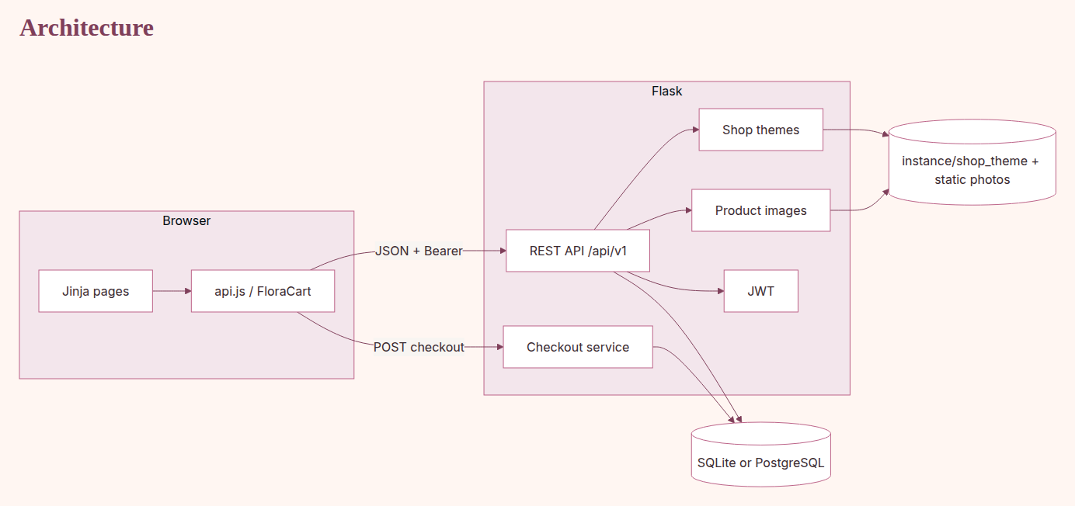
ARCHITECTURE
The browser displays. The server owns the price.
Pivoine & Lilas · Sciez / Léman · Dimitri Jaille & Mattieu Mouroux

Slide 11
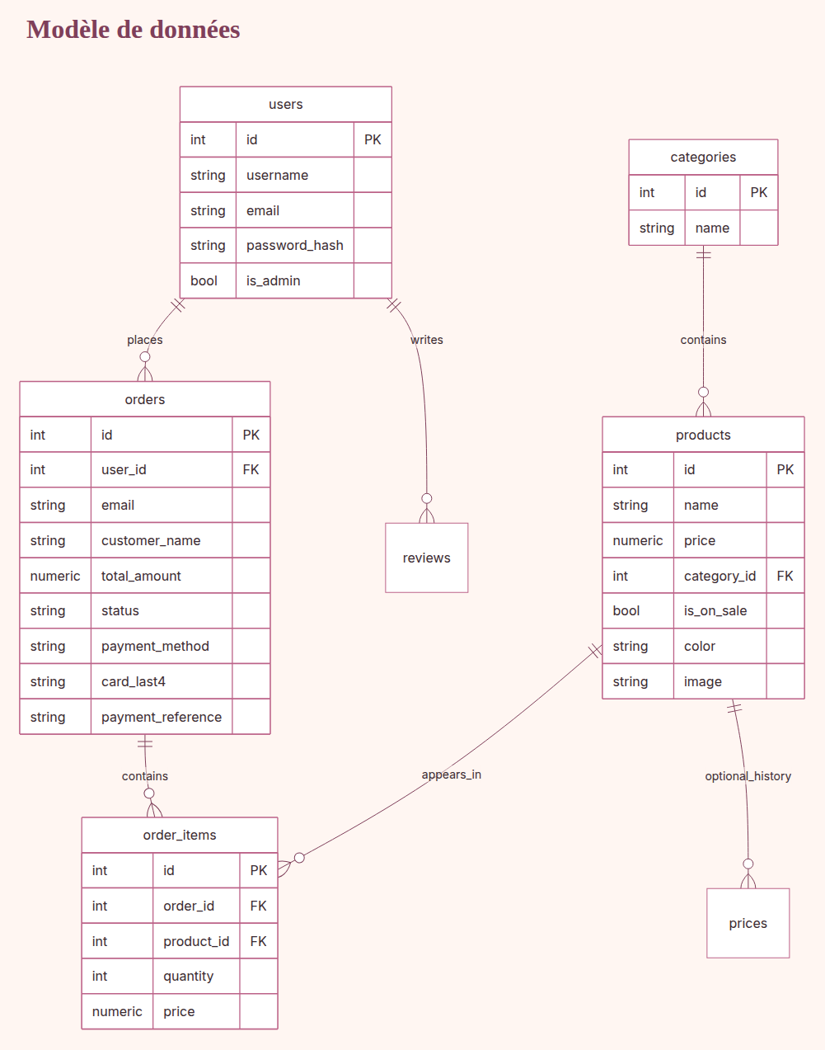
DATABASE ERD
Cardinalities, PKs, FKs, money
Pivoine & Lilas · Sciez / Léman · Dimitri Jaille & Mattieu Mouroux

Slide 12
UML
Use cases + domain classes
Actors: Guest (browse/pay as guest) · Customer (JWT, track, delete account) · Florist (CRUD, vitrine, FAC, prep).
Classes: User, Category, Product, Order, OrderItem, ShopTheme, ThemeProduct, ShopVitrine.
User 1—* Order · Category 1—* Product · Order 1—* OrderItem · Theme *—* Product.
Open live: User.check_password (Werkzeug + bcrypt, plaintext refused) and checkout_service.build_order_lines.
Pivoine & Lilas · Sciez / Léman · Dimitri Jaille & Mattieu Mouroux

Slide 13
SEQUENCE
Marie pays with 4242
1. Checkout submits email, card, items[{product_id, quantity}] — no price field trusted.
2. POST /api/v1/payments/checkout · JWT optional (logged-in email overwrites the body).
3. SQL SELECT Product.price → Decimal total → Luhn test card.
4. 4242 INSERT order paid + prep a_preparer · 0002 → 402 failed, no atelier.
5. 201 JSON without Stripe PI · UI → commandes.html#order-id · florist sees FAC.
Pivoine & Lilas · Sciez / Léman · Dimitri Jaille & Mattieu Mouroux

Slide 14
SECURITY NFR
What we implemented, what we still owe
SQLi: ORM + bound params. Hashing: PBKDF2 + bcrypt verify. Plaintext compare = false.
JWT in Bearer; is_admin from the users table; placeholder SECRET_KEY refused.
IDOR: orders owner/admin; confirm-payment owner; spoofed checkout email ignored.
XSS: escapeHtml; #rrggbb colours only. Uploads admin, type allow-list, 4 MB.
TLS: localhost HTTP for class; production must be HTTPS. No PAN. .env not in Git.
CNIL gap: no brute-force lockout, no customer password-change form, no mail verify — listed.
Pivoine & Lilas · Sciez / Léman · Dimitri Jaille & Mattieu Mouroux

Slide 15
COLLABORATION
GitHub flow, board, evidence
main = demo. Feature branch → tests → PR → merge. Commits in English, imperative.
Board columns: Backlog / In progress / Review / Done (PRs + spec cards US-01…).
Review: no secrets, story matches, responsive if UI, tests updated.
Evidence to open: GitHub history, docs/test-evidence, docs/screenshots, Swagger /api/v1.
Pivoine & Lilas · Sciez / Léman · Dimitri Jaille & Mattieu Mouroux

Slide 16
TESTING
80 tests OK — auth, money, IDOR, vitrine
unittest + Flask test_client + sqlite:// · ./run-tests.sh · coverage on app.
Covered: hashing, demo seed, admin vs Marie, uploads, checkout 4242/0002/9995, deposit, tracking, combo vitrine, forged JWT, PI rejected on checkout.
Not covered: Playwright e2e, live Stripe network, email, load.
Manual M1–M10 in docs/testing.md. Bugs we found are in the spec, with Fixed/Open.
Pivoine & Lilas · Sciez / Léman · Dimitri Jaille & Mattieu Mouroux

Slide 17
CHALLENGES
Technical and non-technical
Challenge | Kind | Resolution
Cart identity / empty checkout | Tech | FloraCart + snapshot
Mixed password hashes | Tech | Werkzeug + bcrypt; plaintext refused
No Stripe keys in class | Tech | Test cards when env empty
float euros | Tech | Decimal + Numeric(10,2)
Rebuild all of Wix | Product | Cut CMS/geo/email; keep purchase
20 minutes including demo | Org | Timed Marie story; skip decline if late
Pivoine & Lilas · Sciez / Léman · Dimitri Jaille & Mattieu Mouroux

Slide 18
NEXT & LEARNED
Operations next, not another stylesheet
Improve
Server-side cart
Click-and-collect + zones
Real email / CNIL lockout
Hosted HTTPS + recorded backup
Playwright + Postgres in CI
Optional HT/TVA if CGV completed
Learned
Never trust a browser price
Decimals for money
Legacy hashes or Marie locks
Empty Stripe must not crash
Secrets stay out of Git
A demo is a story, not a click tour
Missing stories must be listed
Each of us can explain the shared checkout
Pivoine & Lilas · Sciez / Léman · Dimitri Jaille & Mattieu Mouroux

Slide 19
LIVE DEMO
Friday 23:00 — Marie forgot her mother’s birthday
Beat | On screen | What happens
1 | Home | Boutique open online. Street shop is dark.
2 | Admin vitrine | Camille applies Printemps + Mariage. Shop follows.
3 | Shop | Marie filters, adds Bouquet Pivoine (photo).
4 | Account | marie@test.com / marie123. Cart is hers.
5 | Checkout | 4242. Server total. Payée + À préparer.
6 | Mes commandes | Detail, last4, stepper read-only.
7 | Facture | Camille: FAC, TTC lines, Imprimer, prep → Remise.
Pivoine & Lilas · Sciez / Léman · Dimitri Jaille & Mattieu Mouroux

Slide 20
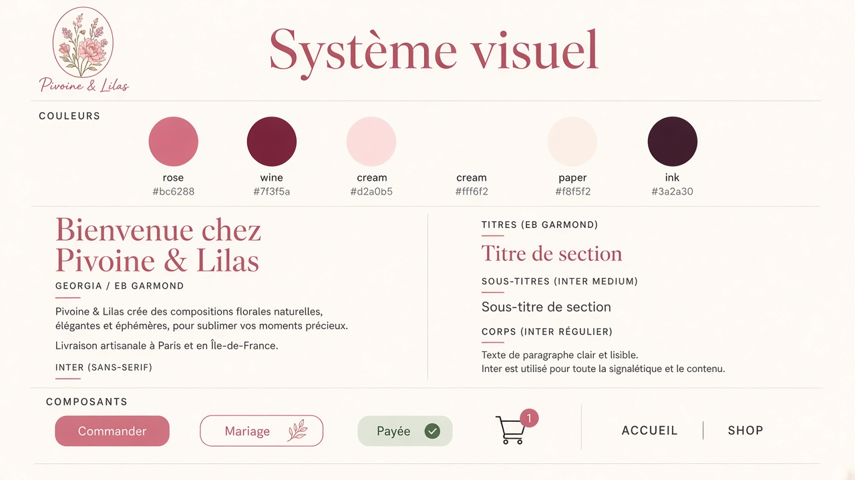
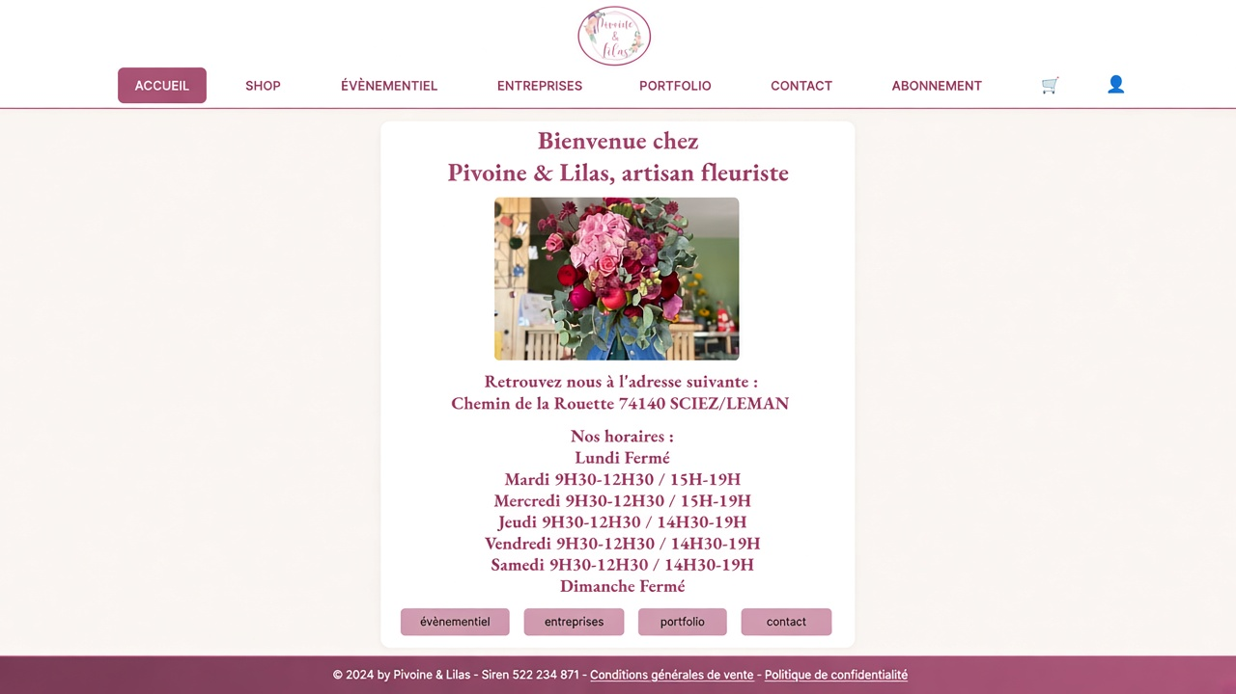
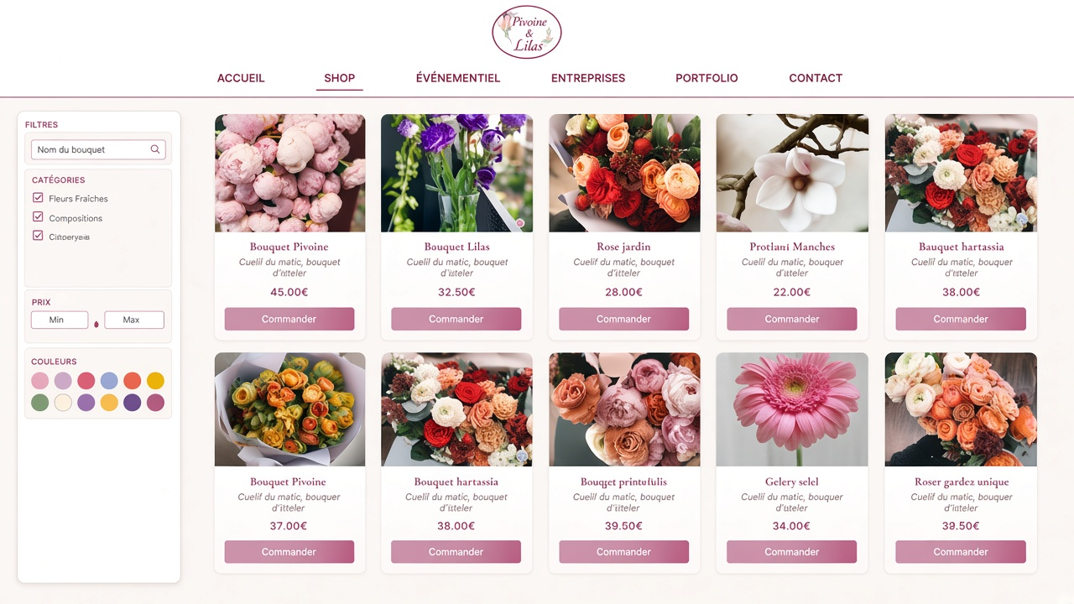
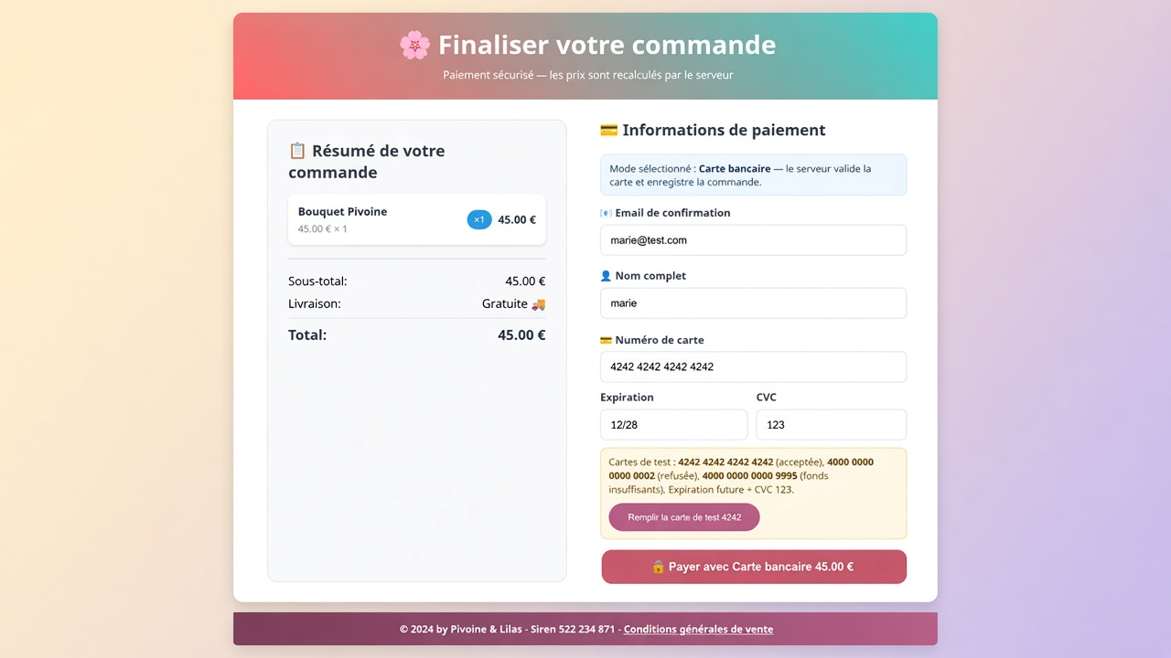
MAQUETTE
Desktop — palette, accueil, shop, paiement
Système visuel
Accueil
Shop
Paiement
Pivoine & Lilas · Sciez / Léman · Dimitri Jaille & Mattieu Mouroux

Slide 21
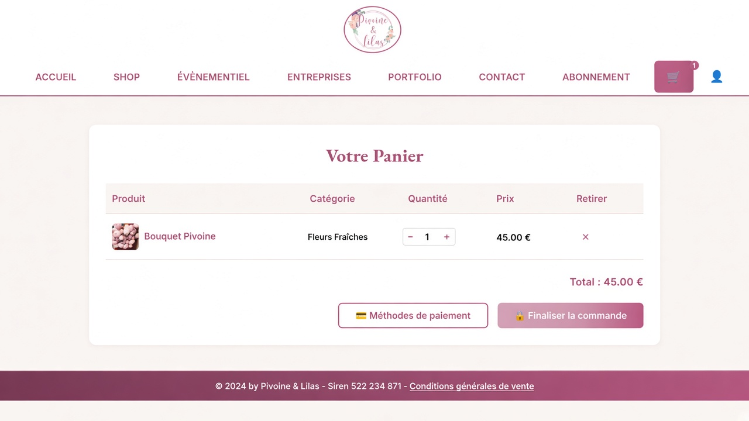
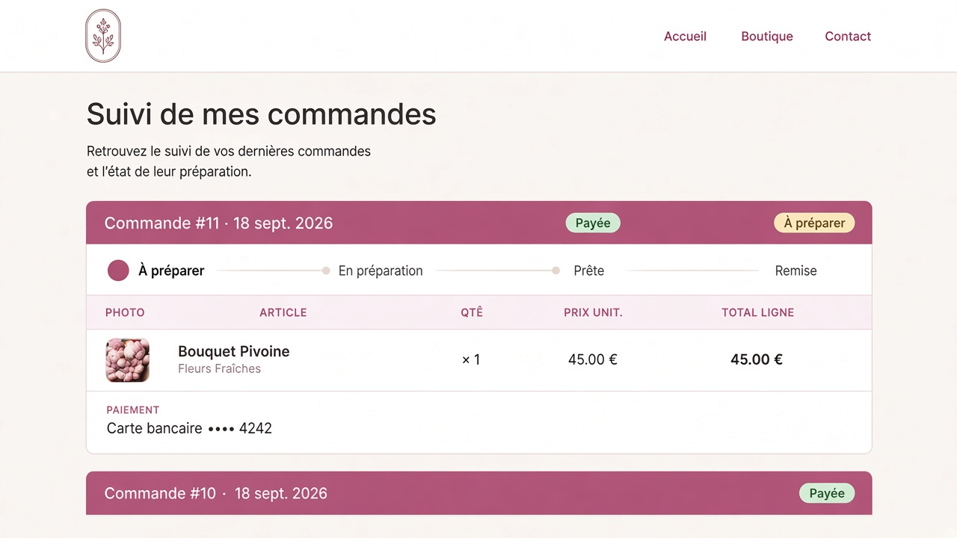
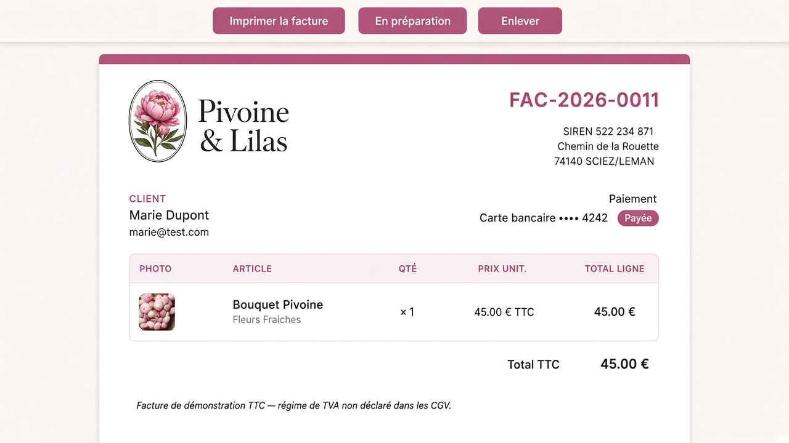
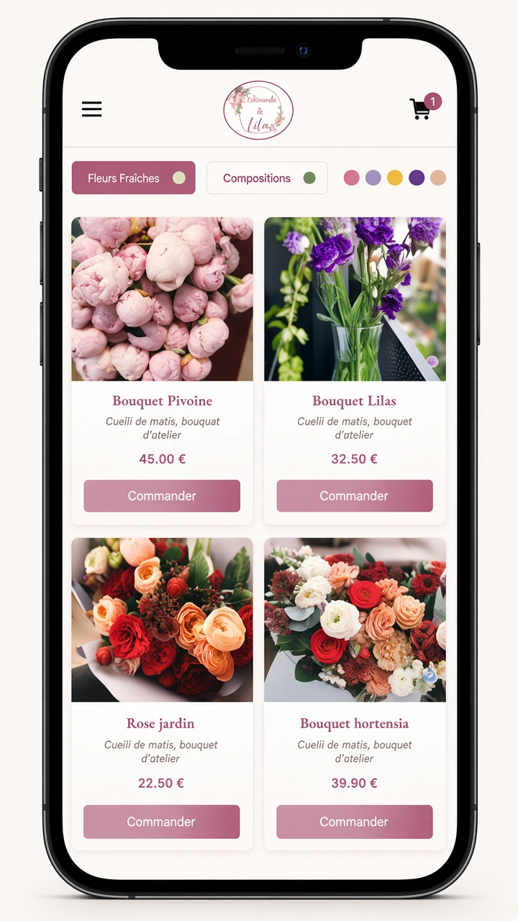
MAQUETTE
Panier, commandes, admin FAC, mobile
Panier
Mes commandes
Facture FAC
Shop mobile
Pivoine & Lilas · Sciez / Léman · Dimitri Jaille & Mattieu Mouroux

Slide 22
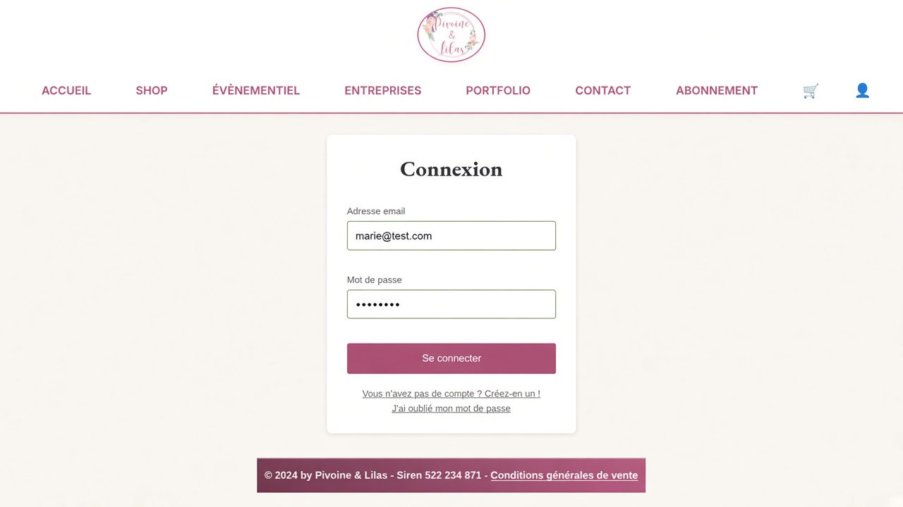
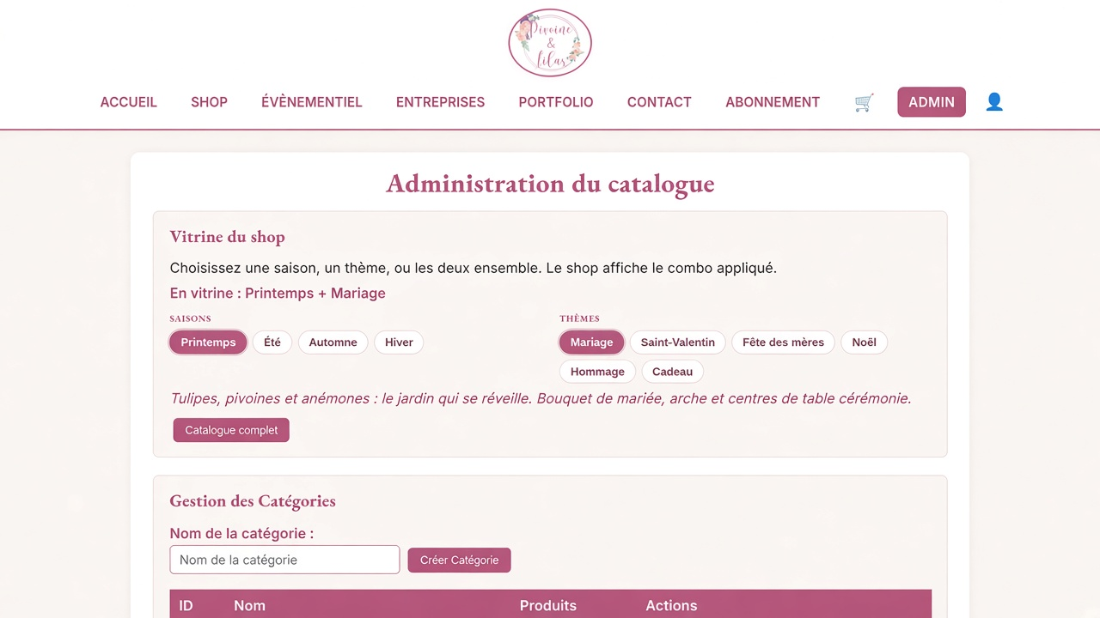

MAQUETTE
Connexion, vitrine admin, panier vide
Connexion
Vitrine admin
Panier vide mobile
Pivoine & Lilas · Sciez / Léman · Dimitri Jaille & Mattieu Mouroux

Slide 23
CONCLUSION
A florist shop that takes money and can be explained
A customer can sign in, buy a photographed bouquet, pay or leave a deposit, subscribe, and track.
The florist manages catalog, vitrine, and a printable TTC invoice — not a fake 20 % TVA.
Gaps from the original Wix spec are written down. 80 tests. Secrets stay out of Git.
Next slice: operations (delivery, email, hosting), not another visual pass.
Pivoine & Lilas · Sciez / Léman · Dimitri Jaille & Mattieu Mouroux

Slide 24
Fin. Merci.
Pivoine & Lilas — Sciez / Léman
marie@test.com / marie123 · admin@florashop.com / admin123 · 4242
Pivoine & Lilas · Sciez / Léman · Dimitri Jaille & Mattieu Mouroux

