Slide 1
Overview Presentation
Issy Middleton

Slide 2
Contents
This is an R Markdown presentation, summarising the Exploratory_Analysis project conducted by Issy Middleton for CSC8631 - Data Management & Exploratory Analysis.
Looking at the data and deciding on an area of interest
Using ProjectTemplate
Pre-processing
Syncing GitHub and using Git for Commit
Producing graphs and tables
Loading into an RMarkdown report

Slide 3
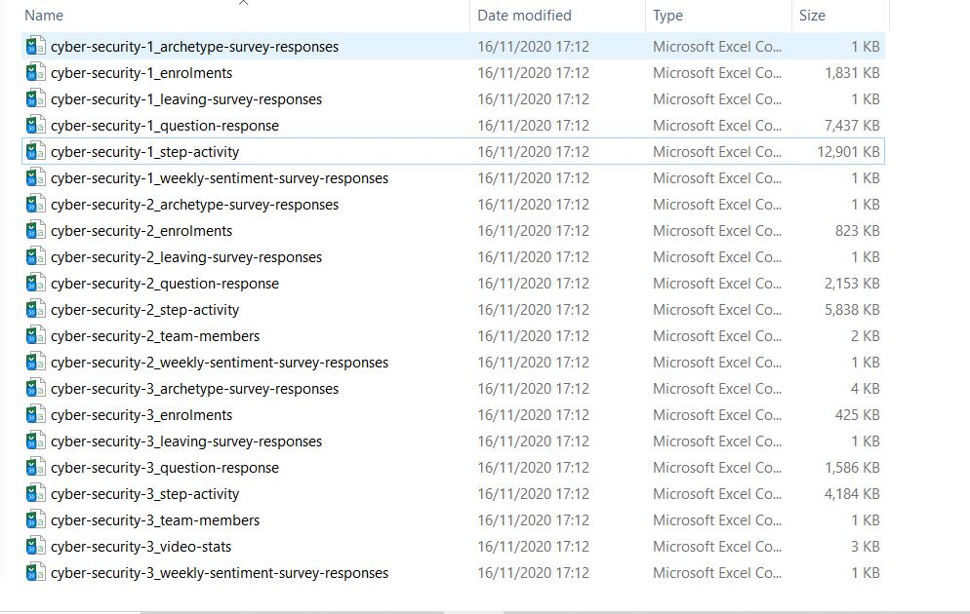
Looking at the data
Initially I reviewed the decompressed files. It was possible to determine from the file sizes that there was missing data. The files related to a course was entitled Cyber Security: Safety at Home, Online, in Life.

Slide 4
Deciding an area of interest
I loaded sample data into RStudio and started looking at the data using R commands (head, summary, glimpse). It was possible to determine the size of the tables, the types of data that had been captured and see missing items. I decided to investigate students’ willingness to share personal data at enrolment, given that the course was related to security.
## # A tibble: 1 x 4 ## learner_id enrolled_at unenrolled_at role ## <chr> <chr> <chr> <chr> ## 1 160d6600-ea0e-4568-bfa9-5d7cd5b8e~ 2016-08-10 14:28:49 U~ "" learn~

Slide 5
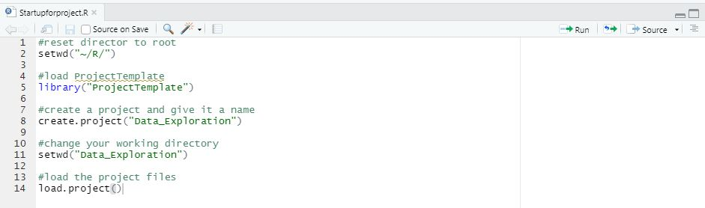
Using ProjectTemplate
To generate the necessary folders for my work, organise the files, load the R packages and data sets into memory I ran the ProjectTemplate scripts above. For more details about ProjectTemplate, see http://projecttemplate.net

Slide 6
Pre-processing

Slide 7
Syncing GitHub and using Git for Commit

Slide 8
Producing graphs and tables

Slide 9
Loading into an RMarkdown report

