Slide 1
Overview Presentation
Issy Middleton

Slide 2
Contents
This is an R Markdown presentation, summarising the Exploratory_Analysis project conducted by Issy Middleton for CSC8631 - Data Management & Exploratory Analysis.
Looking at the data
Deciding on an area of interest
Using ProjectTemplate
Version Control
Pre-processing
Producing graphs and tables
Loading into an RMarkdown report

Slide 3
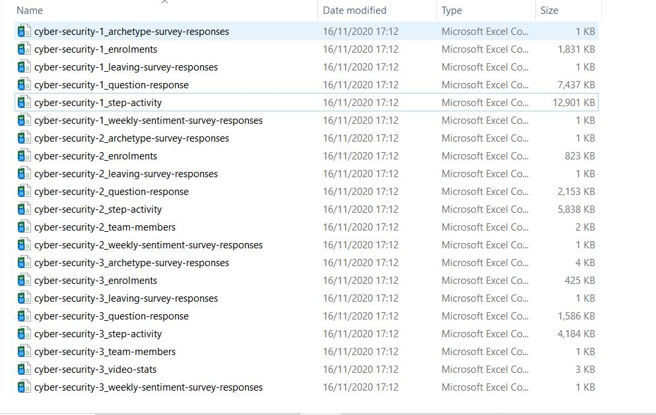
Looking at the data - names, size, file types
The files varied in size and type but were all related to a training course entitled Cyber Security: Safety at Home, Online, in Life.

Slide 4
Deciding an area of interest
I loaded sample data into RStudio and started looking at the data using R commands (head, summary, glimpse). It was possible to determine the size of the tables, the types of data that had been captured and see missing items. I decided to investigate students’ willingness to share personal data at enrolment, given that the course was related to security.
Sample row and columns:
## # A tibble: 3 x 3 ## enrolled_at unenrolled_at role ## <chr> <chr> <chr> ## 1 2016-08-10 14:28:49 UTC "" learner ## 2 2016-05-24 17:34:34 UTC "2018-10-30 20:20:51 UTC" learner ## 3 2016-05-19 00:52:38 UTC "" learner

Slide 5
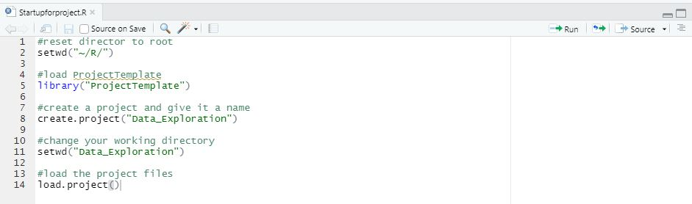
Using ProjectTemplate
To generate the necessary folders for my work, organise the files, load the R packages and data sets into memory I ran the ProjectTemplate scripts above. For more details about ProjectTemplate, see http://projecttemplate.net

Slide 6
Version control
Syncing RStudio with my GitHub account allowed me to use Git for version control, by using Commit and Push. I created an new repository on GitHub, set up the security credentials under my profile and saved the public key into my version of RStudio. I downloaded Git and linked a new .RProj file.
Git provides the functionality to control file versions and GitHub is a platform for hosting Git repositories.

Slide 7
Pre-processing
The pre-processing scripts (or data munging code) are stored in munge folder and will be executed sequentially when load.project()` is called. Numbers within filenames indicate the sequential order of the scripts. The scripts:
add columns at runtime, merge data sets and adjust data formats
remove duplicate records where learner_id is not unique, calculating course duration between first and last enrolment date
filters the data by groups of students willing to share data
categorises data
provides additional data items on duplicate records
calculates volume of shared data items
determines counts and percentages of data that it shared by student, by survey
and calculates counts and percentage of data that is not shared

Slide 8
Producing tables
In total, 35225 unique student enrolment records were assessed from seven survey files.

Slide 9
Survey No. | Date First Student Enrolled | Date Last Student Enrolled | Duration (days) | No. of Students
1 | 29 March 2016 | 07 September 2017 | 527 days | 14394
2 | 05 December 2016 | 13 July 2017 | 220 days | 6049
3 | 02 July 2017 | 26 February 2018 | 239 days | 3053
4 | 27 July 2017 | 25 January 2018 | 182 days | 3558
5 | 15 December 2017 | 09 September 2018 | 268 days | 3147
6 | 08 April 2018 | 11 August 2018 | 125 days | 2908
7 | 25 June 2018 | 01 November 2018 | 129 days | 2116

Slide 10
Students sharing data
Of students that shared data at least one detail was 3769, which equates to 10.70% of total students.

Slide 11
Survey No. | % of Students * | Ave. Items *
1 | 11.98% | 4.69
2 | 10.91% | 4.68
3 | 10.15% | 4.68
4 | 9.13% | 4.71
5 | 11.57% | 4.65
6 | 7.50% | 4.67
7 | 7.94% | 4.57

Slide 12
* where students shared at least one of the five lifestyle details
Over the seven enrolments, the percentage of students sharing data dropped from almost 12% to under 8%. However for those students that did share data the amount of details they provided stayed fairly level at around an average of 4.7 items per student, dropping very marginally in the last intake to 4.6. Where students did share at least one, 73.26% of students provide all five requested details.

Slide 13
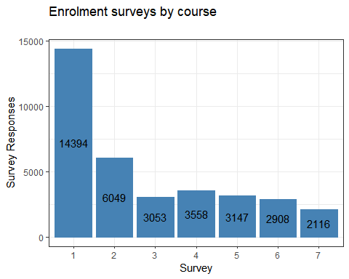
Producing graphs

Slide 14
Shared_Gender
Shared_Gender_by_Age
Shared_Gender_by_Emp_by_Survey
Shared_Gender_by_Age_by_Survey
Shared_MF_by_Age_by_Survey
Shared_MF_by_Age
Shared_Age_and_Gender_by_Year
Annual_Survey_Response
Survey_Response2
Employment_Area_Total
Employment_Area_by_Year
Employment_Status_Total
Employment_Status_by_Year
Not_Provided
Shared_Info

Slide 15
Loading into an RMarkdown report
I used the RMarkdown file to generate a report to be stored in the Reports section of the project file structure. During the generation of graphs and tables I returned to the data preparation phase frequently. Regularly, I would update the Git version control by using a Commit and Push commands.

