Slide 1
Overview Presentation
Issy Middleton

Slide 2
Contents
This is an R Markdown presentation, summarising the Exploratory_Analysis project conducted by Issy Middleton for CSC8631 - Data Management & Exploratory Analysis.
Looking at the data
Deciding on an area of interest
Using ProjectTemplate
Version Control
Pre-processing
Starting the analysis
Removing duplicates
Refining graphs
Loading into an RMarkdown report

Slide 3
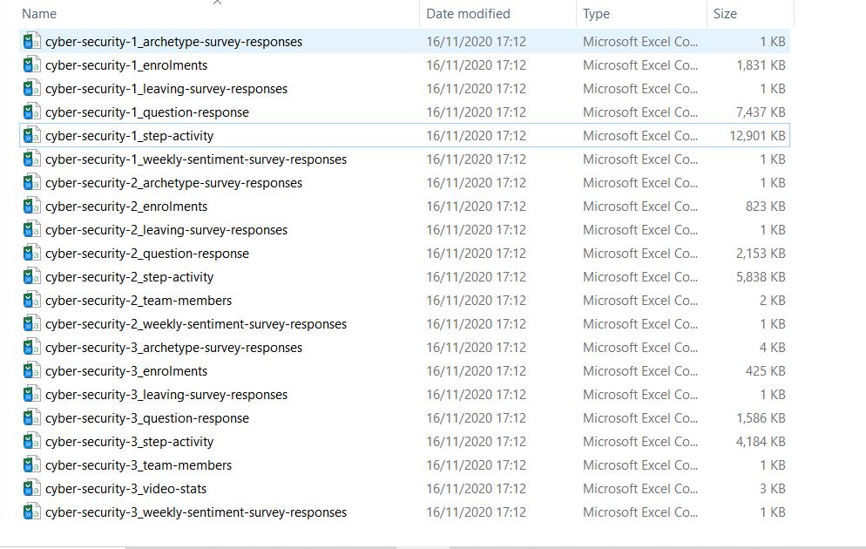
Looking at the data - names, size, types
The files varied in size and type but were all related to a training course entitled Cyber Security: Safety at Home, Online, in Life.

Slide 4
Deciding on an area of interest
I loaded sample data into RStudio and started looking at the data using R commands (head, summary, glimpse). It was possible to determine the size of the tables, the types of data that had been captured and see missing items. I decided to investigate students’ willingness to share personal data at enrolment, given that the course was related to security.
Sample row and columns:
## # A tibble: 3 x 3 ## enrolled_at unenrolled_at role ## <chr> <chr> <chr> ## 1 2016-08-10 14:28:49 UTC "" learner ## 2 2016-05-24 17:34:34 UTC "2018-10-30 20:20:51 UTC" learner ## 3 2016-05-19 00:52:38 UTC "" learner

Slide 5
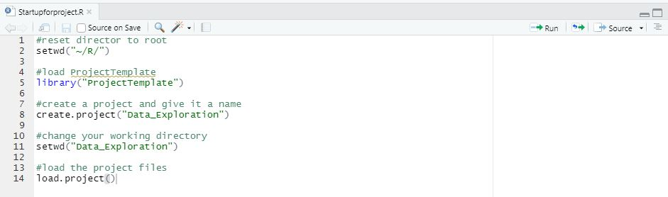
Using ProjectTemplate
To generate the necessary folders for my work, organise the files, load the R packages and data sets into memory I ran the ProjectTemplate scripts above. For more details about ProjectTemplate, see http://projecttemplate.net

Slide 6
Version control
Syncing RStudio with my GitHub account allowed me to use Git for version control, by using Commit and Push. I created an new repository on GitHub, set up the security credentials under my profile and saved the public key into my version of RStudio. I downloaded Git and linked a new .RProj file.
Git provides the functionality to control file versions and GitHub is a platform for hosting Git repositories.

Slide 7
Pre-processing
The pre-processing scripts (or data munging code) are stored in munge folder and will be executed sequentially when load.project()` is called. Numbers within filenames indicate the sequential order of the scripts. The scripts:
add columns at runtime, merge data sets and adjust data formats
remove duplicate records where learner_id is not unique, calculating course duration between first and last enrolment date
filters the data by groups of students willing to share data
categorises data
provides additional data items on duplicate records
calculates volume of shared data items
determines counts and percentages of data that it shared by student, by survey
and calculates counts and percentage of data that is not shared

Slide 8
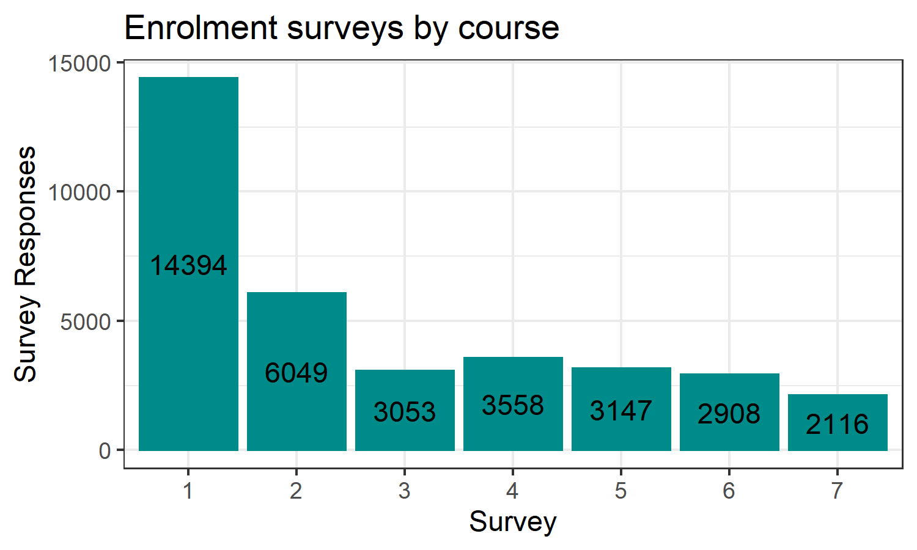
Starting the analysis
It was necessary to calculate total enrolment by course. I adjusted date format and calculated course duration.

Slide 9
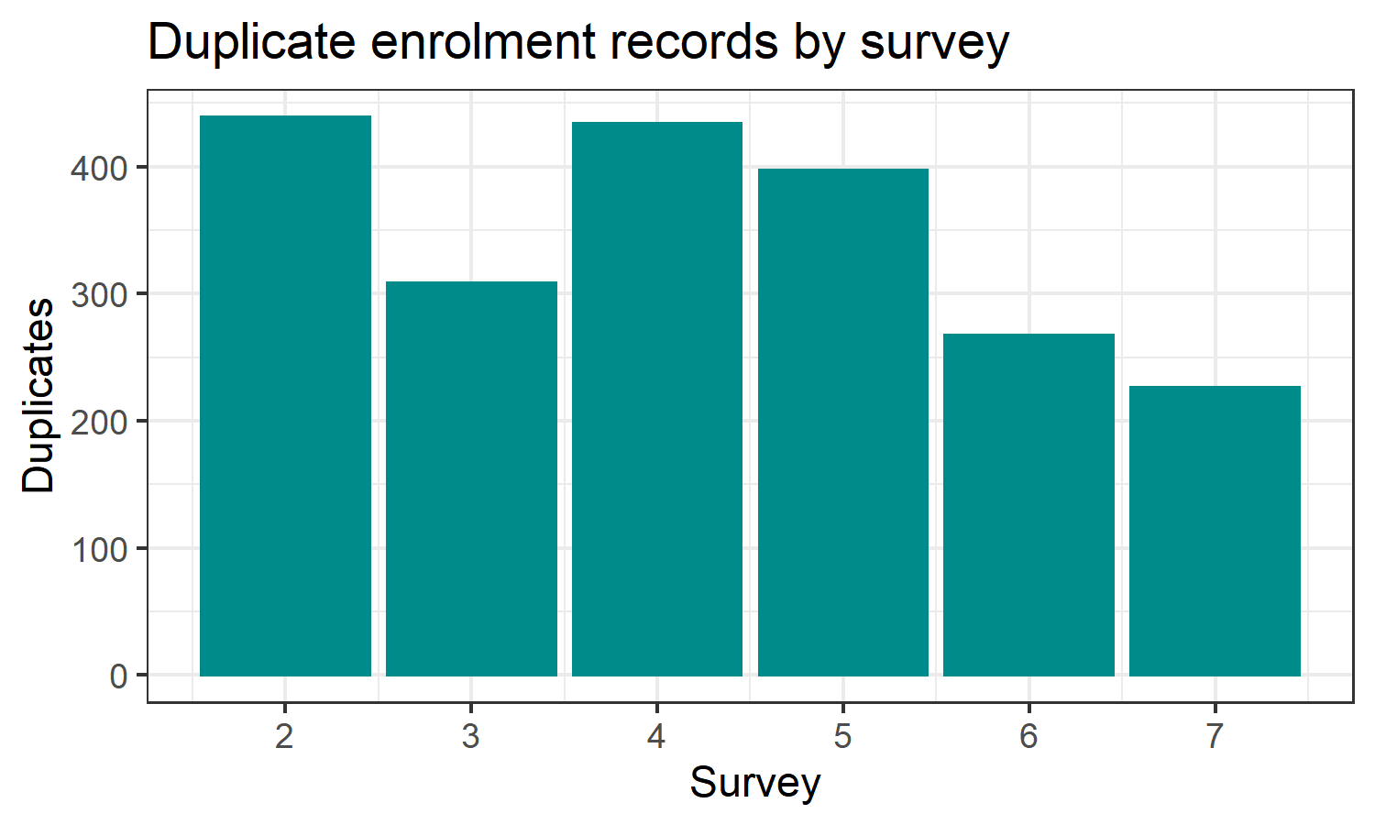
Removing duplicates
During the analysis it became necessary to identify 2071 duplicate records, leaving 35225 unique records, removing 5.55%.

Slide 10
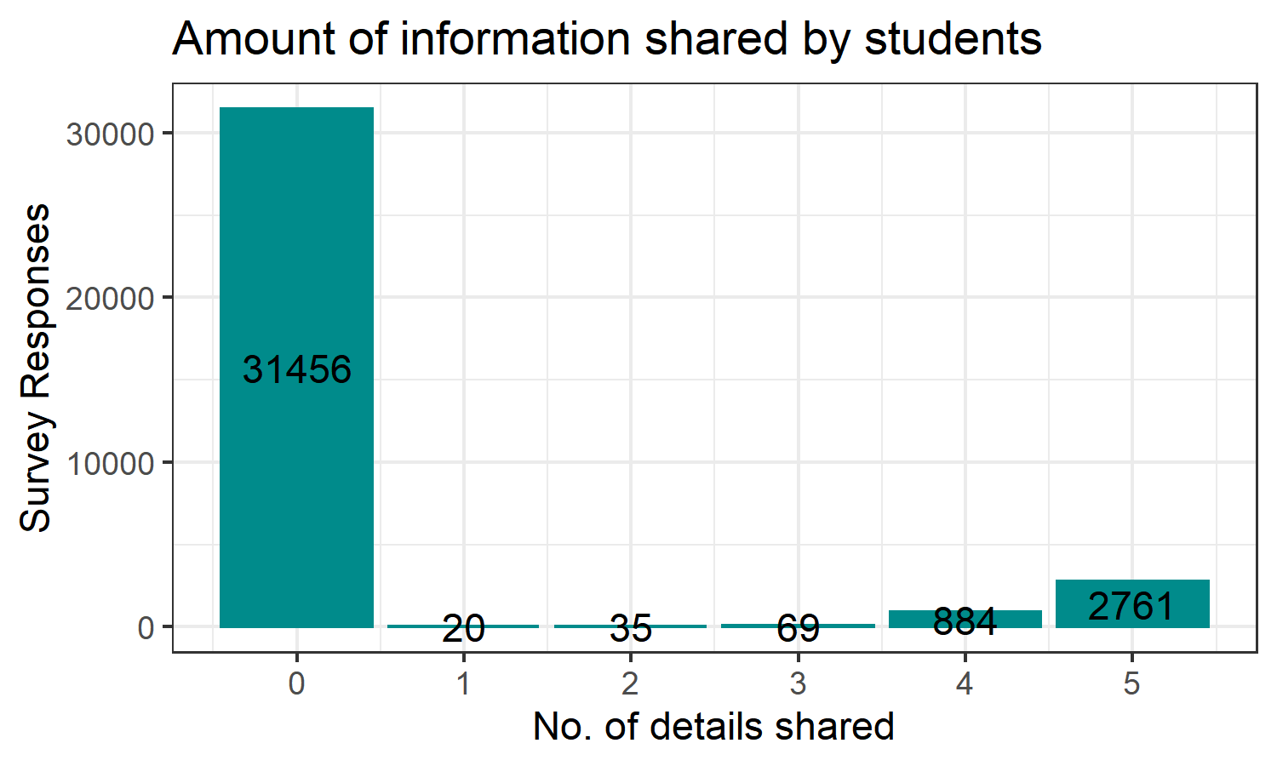
Attitudes to sharing
3769 shared at least one detail (gender, age range, employment status, employment area, highest education level), which equates to 10.60% of total students.

Slide 11
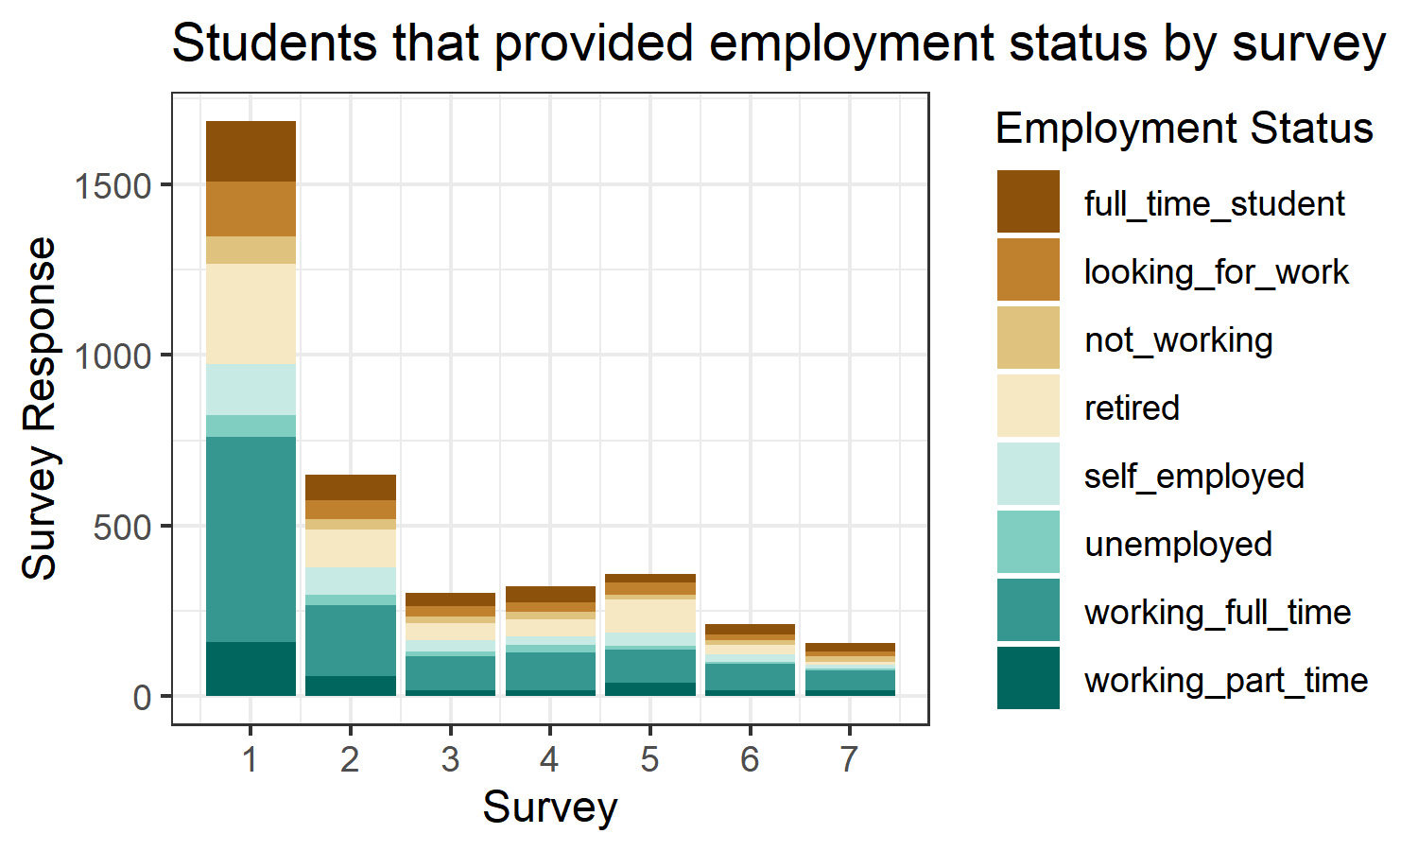
Common findings
Over the seven courses, students sharing data dropped consistently across all categories, from almost 12% to under 8%.

Slide 12
# Test Table

Slide 13
Survey No. | Date First Student Enrolled | Date Last Student Enrolled | Duration (days) | No. of Students
1 | 29 March 2016 | 07 September 2017 | 527 days | 14394
2 | 05 December 2016 | 13 July 2017 | 220 days | 6049
3 | 02 July 2017 | 26 February 2018 | 239 days | 3053
4 | 27 July 2017 | 25 January 2018 | 182 days | 3558
5 | 15 December 2017 | 09 September 2018 | 268 days | 3147
6 | 08 April 2018 | 11 August 2018 | 125 days | 2908
7 | 25 June 2018 | 01 November 2018 | 129 days | 2116

Slide 14
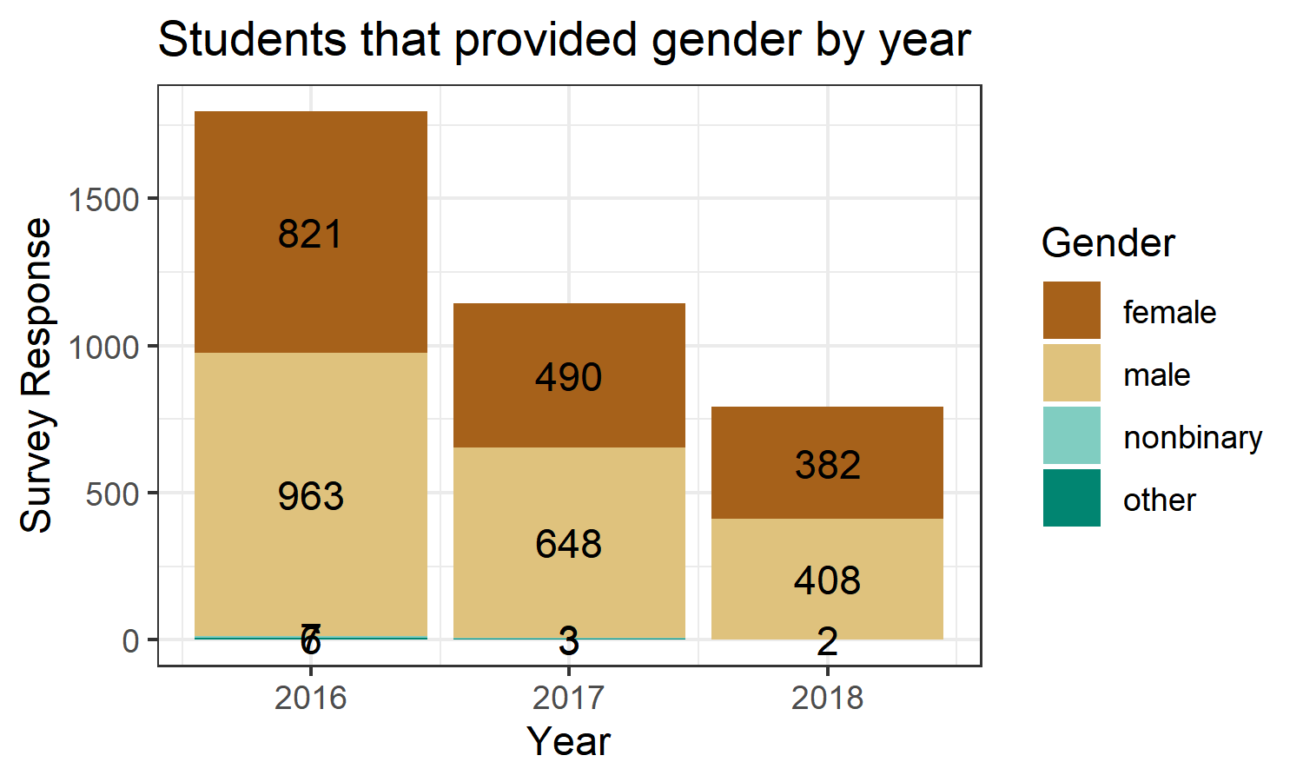
Key Findings
However for those students that did share data the amount of details they provided stayed fairly level at around an average of 4.7 items per student, dropping very marginally in the last intake to 4.6. Where students did share at least one, 73.26% of students provide all five requested details.

Slide 15
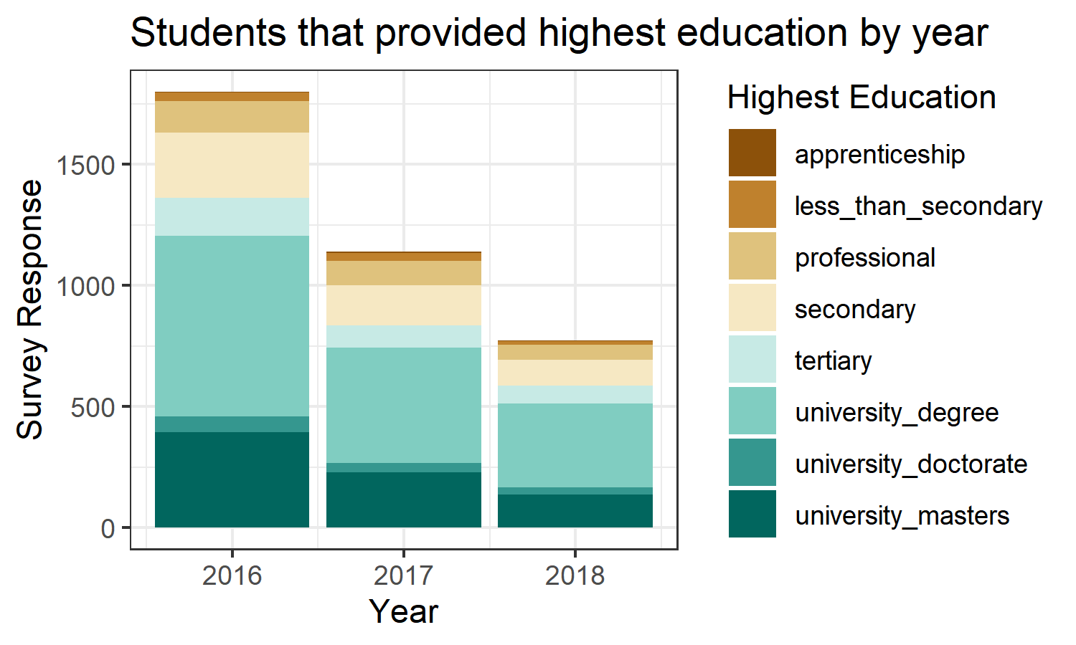
Refining graphs
Students willing to share data dropped over time.

Slide 16
Loading into an RMarkdown report
I used the RMarkdown file to generate a report to be stored in the Reports section of the project file structure. During the generation of graphs and tables I returned to the data preparation phase frequently. Regularly, I would update the Git version control by using a Commit and Push commands.

