Slide 1
Overview Presentation
Issy Middleton

Slide 2
Contents
This is an R Markdown presentation, summarising the Exploratory_Analysis project conducted by Issy Middleton for CSC8631 - Data Management & Exploratory Analysis.
Looking at the data and deciding on an area of interest
Starting the analysis
Using ProjectTemplate
Pre-processing
Syncing GitHub and using Git for Commit
Producing graphs and tables
Loading into an RMarkdown report

Slide 3
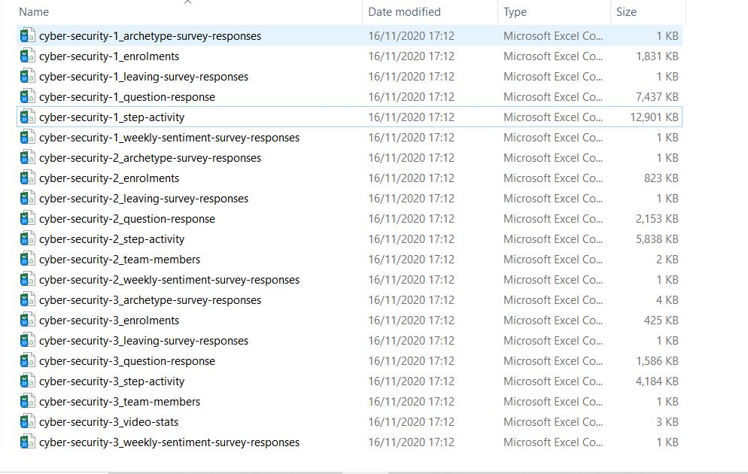
Looking at the data
Initially I reviewed the decompressed files. It was possible to determine from the file sizes that there was missing data. The files related to a course was entitled Cyber Security: Safety at Home, Online, in Life.

Slide 4
Still looking at the data
I loaded sample data into RStudio and started looking at the data using R commands. It was possible to determine the size of the tables, the types of data that had been captured and see missing items. It was possible to determine the types of data that had been captured and see missing items.
glimpse(cyber.security.1_enrolments)
## Rows: 14,394 ## Columns: 15 ## $ learner_id <chr> "160d6600-ea0e-4568-bfa9-5d7cd5b8e61b", "4d... ## $ enrolled_at <chr> "2016-08-10 14:28:49 UTC", "2016-05-24 17:3... ## $ unenrolled_at <chr> "", "2018-10-30 20:20:51 UTC", "", "", "", ... ## $ role <chr> "learner", "learner", "learner", "learner",... ## $ fully_participated_at <chr> "", "", "2016-09-22 16:56:03 UTC", "", "", ... ## $ purchased_statement_at <chr> "", "", "", "", "", "", "", "", "", "", "",... ## $ gender <chr> "Unknown", "male", "Unknown", "Unknown", "U... ## $ country <chr> "Unknown", "PE", "Unknown", "Unknown", "Unk... ## $ age_range <chr> "Unknown", "46-55", "Unknown", "Unknown", "... ## $ highest_education_level <chr> "Unknown", "university_degree", "Unknown", ... ## $ employment_status <chr> "Unknown", "working_part_time", "Unknown", ... ## $ employment_area <chr> "Unknown", "teaching_and_education", "Unkno... ## $ detected_country <chr> "GB", "PE", "NG", "UG", "IM", "NO", "GB", "... ## $ survey <dbl> 1, 1, 1, 1, 1, 1, 1, 1, 1, 1, 1, 1, 1, 1, 1... ## $ year <chr> "2016", "2016", "2016", "2016", "2016", "20...

