Slide 1
Overview Presentation
Issy Middleton, CSC8631 - Data Management & Exploratory Analysis

Slide 2
Contents
Data Understanding
Looking at the data
Deciding on an area of interest
Setting up
ProjectTemplate and Version Control
Data Preparation & Modeling
Pre-processing script development
Developing the analysis
Removing duplicates
Modeling & Evaluation
Refining graphs
Adding to pre-processing
Deployment
Loading into an RMarkdown report

Slide 3
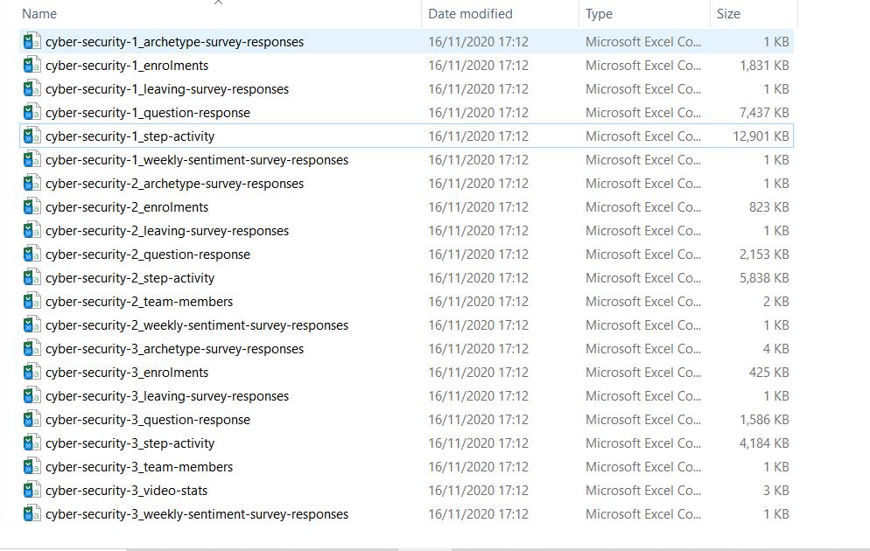
Looking at the data - names, size, types
It was possible to learn about the data by looking at the files and gain some early understanding. The files related to a Cyber security course.

Slide 4
Deciding on an area of interest
By loading a few data files into RStudio and using R commands (head, summary, glimpse) it was possible to determine the size of the tables, the types of data that had been captured and see missing items.
The enrolment files contained details of gender, employment and age so I decided to investigate students’ willingness to share personal data at enrolment, given that the course was related to security.
Sample row and columns:
## # A tibble: 3 x 2 ## unenrolled_at role ## <chr> <chr> ## 1 "" learner ## 2 "2018-10-30 20:20:51 UTC" learner ## 3 "" learner

Slide 5
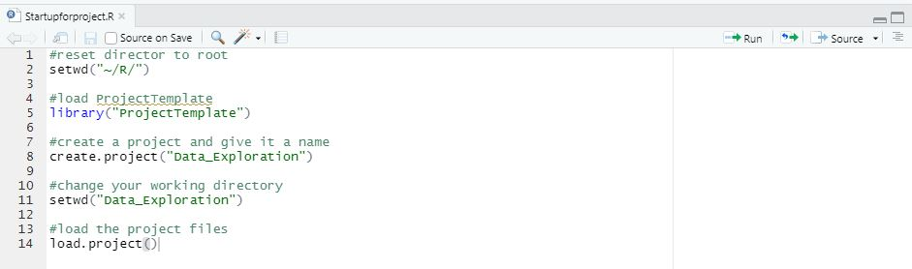
Setting up - ProjectTemplate and Git
To generate the necessary folders for my work, organise the files, load the R packages and data sets into memory I ran the ProjectTemplate scripts above. Syncing RStudio with my GitHub account allowed me to use Git for version control, by using Commit and Push.

Slide 6
Data Preparation - initial
The pre-processing scripts (or data munging code) are stored in munge folder and will be executed sequentially when load.project()` is called.
Numbers within filenames indicate the sequential order of the scripts.
The initial scripts were:
adding columns at runtime, merging data sets, adjusting data formats
filtering the data by groups of students willing to share data
categorising data

Slide 7
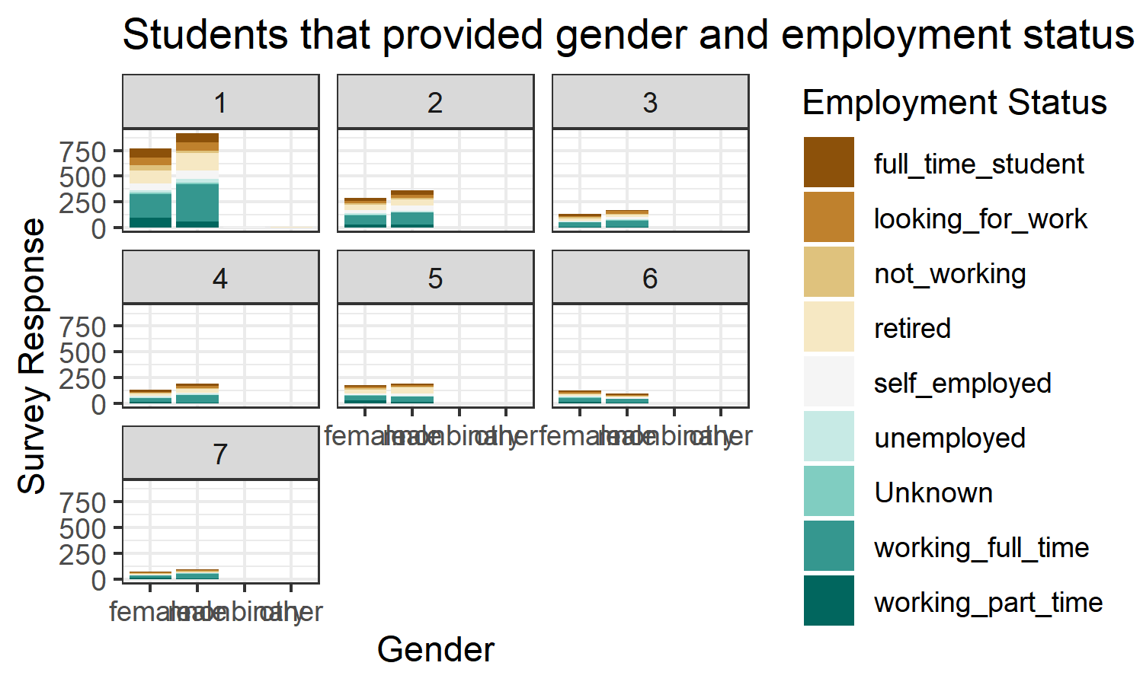
Initial Modeling - quick charts
It was possible to produce lots of graphs really quickly with ggplot2 but work on formatting and colour was needed.

Slide 8
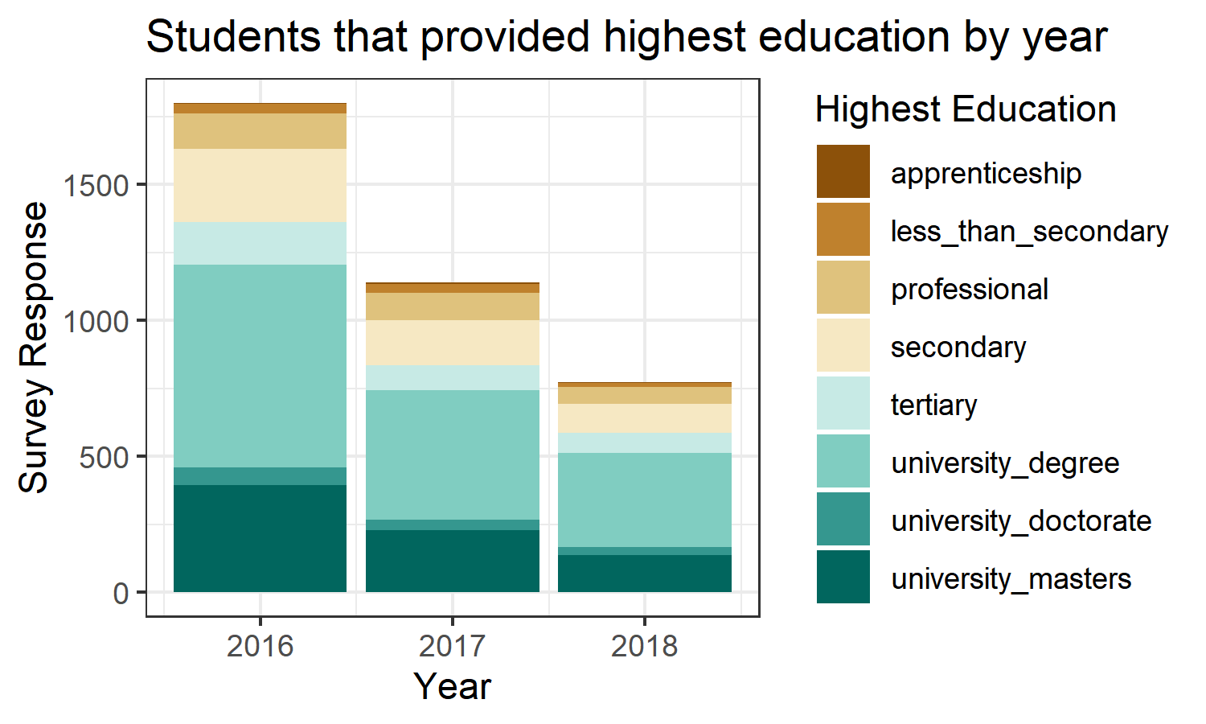
Identifying more data processing
Students willing to share data dropped over time. To provide context, it was necessary to return to calculating total enrolment by course.I adjusted date format, removed duplicate records and calculated course duration.

Slide 9
Course details
Survey No. | Date First Student Enrolled | Date Last Student Enrolled | Duration (days) | No. of Students
1 | 29 March 2016 | 07 September 2017 | 527 days | 14394
2 | 05 December 2016 | 13 July 2017 | 220 days | 6049
3 | 02 July 2017 | 26 February 2018 | 239 days | 3053
4 | 27 July 2017 | 25 January 2018 | 182 days | 3558
5 | 15 December 2017 | 09 September 2018 | 268 days | 3147
6 | 08 April 2018 | 11 August 2018 | 125 days | 2908
7 | 25 June 2018 | 01 November 2018 | 129 days | 2116

Slide 10
Data Preparation - continuing
The later scripts included:
calculating volume of shared data items
determining counts and percentages of data that it shared by student, by survey
calculating counts and percentage of data that is not shared

Slide 11
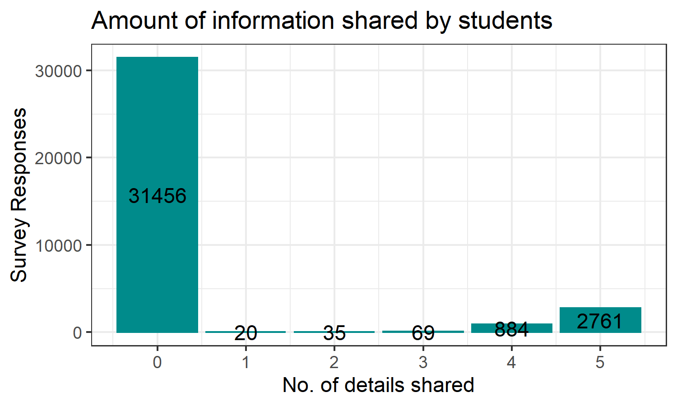
Modeling - attitudes to sharing
3769 shared at least one detail (gender, age range, employment status, employment area, highest education level).

Slide 12
Modelling - tables
Survey No. | % of Students | Ave. Items
1 | 11.98% | 4.69
2 | 10.91% | 4.68
3 | 10.15% | 4.68
4 | 9.13% | 4.71
5 | 11.57% | 4.65
6 | 7.50% | 4.67
7 | 7.94% | 4.57

Slide 13
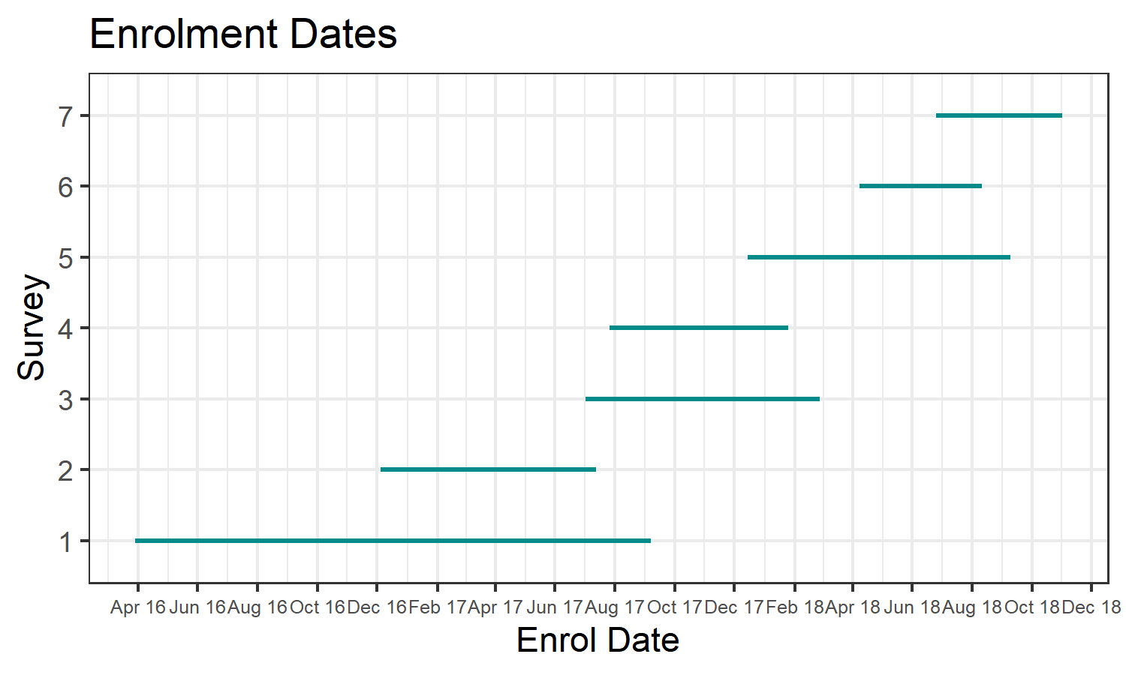
Evaluation - enrolments
Enrolments overlapped but the gaps in students providing information could indicate settings were changed.

Slide 14
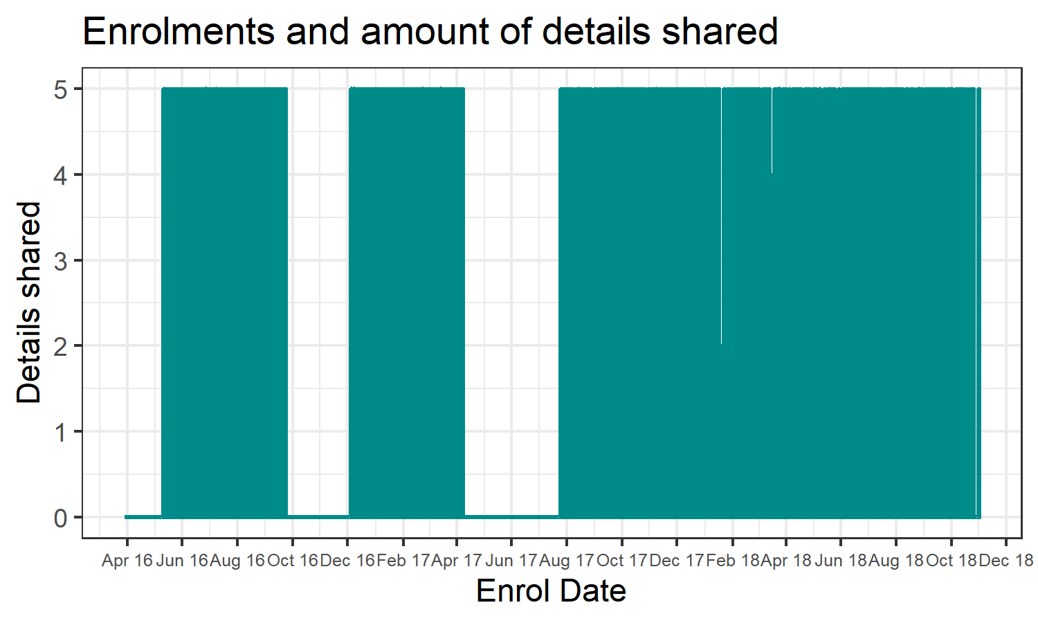
Evalation - details shared
It is possible that the survey settings were changed, either to encourage students to provide information or that these fields were mandatory.

Slide 15
Deployment - creating a report
I used the RMarkdown file to generate a report to be stored in the Reports section of the project file structure. During the generation of graphs and tables I returned to the data preparation phase frequently. Regularly, I would update the Git version control by using a Commit and Push commands.
I spent a far amount of time ‘mopping up’ and making sure code had comments for explanation of the steps and the reasons. Also I added to the README documents and checked contents of all the ProjectTemplate folders.

