Slide 1
Backtracking
Md. Rezaul Karim
CSEDU

Slide 2
Features of Backtracking
Backtracking is more intelligent variation of brute force approach
The principal idea is to construct solutions one component at a time and evaluate such partially constructed candidates as follows.
If a partially constructed solution can be developed further without violating the problem’s constraints, it is done by taking the first remaining legitimate option for the next component
If there is no legitimate option for the next component, no alternatives for any remaining component need to be considered.
In this case, the algorithm backtracks to replace the last component of the partially constructed solution with its next option.

Slide 3
State-SpaceTree
It is convenient to implement this kind of processing by constructing a tree of choices being made, called the state-space tree.
Its root represents an initial state before the search for a solution begins.
The nodes of the first level in the tree represent the choices made for the first component of a solution, the nodes of the second level represent the choices for the second component, and so on.
A node in a state-space tree is said to be promising if it corresponds to a partially constructed solution that may still lead to a complete solution; otherwise, it is called nonpromising
Leaves represent either nonpromising dead ends or complete solutions found by the algorithm

Slide 4
State-SpaceTree
A state-space tree for a backtracking algorithm is constructed in the manner of depth first search.
If the current node is promising, its child is generated by adding the first remaining legitimate option for the next component of a solution, and the processing moves to this child
If the current node turns out to be nonpromising, the algorithm backtracks to the node’s parent to consider the next possible option for its last component; if there is no such option, it backtracks one more level up the tree, and so on
Finally, if the algorithm reaches a complete solution to the problem, it either stops (if just one solution is required) or continues searching for other possible solutions

Slide 5
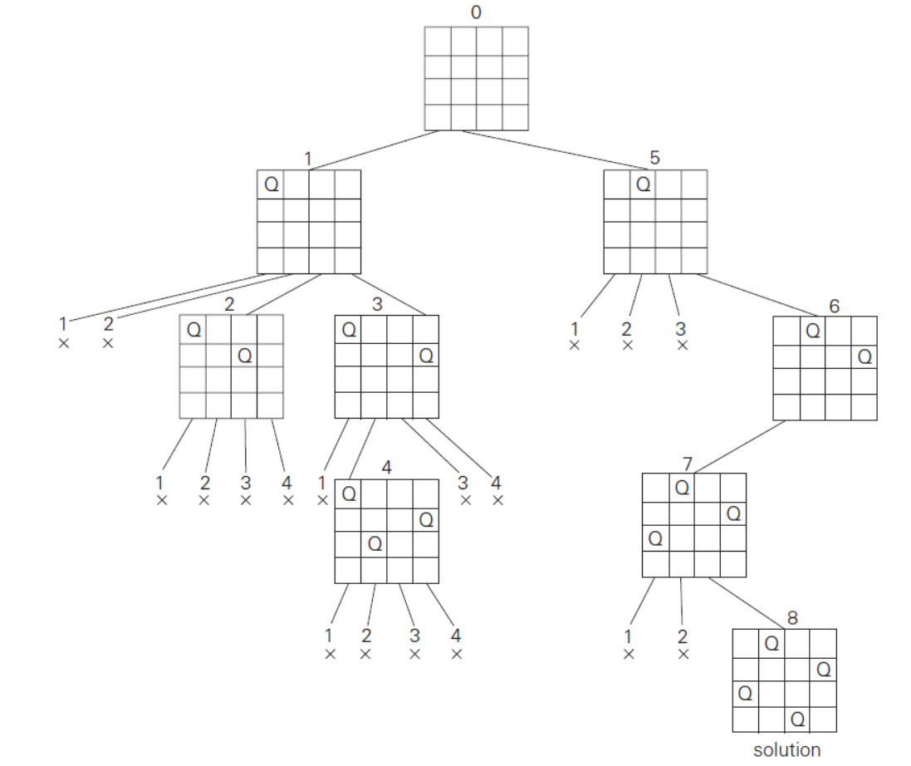
Four-Queens Problem

Slide 6
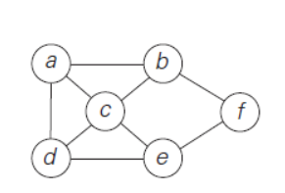
Hamiltonian Circuit

Slide 7
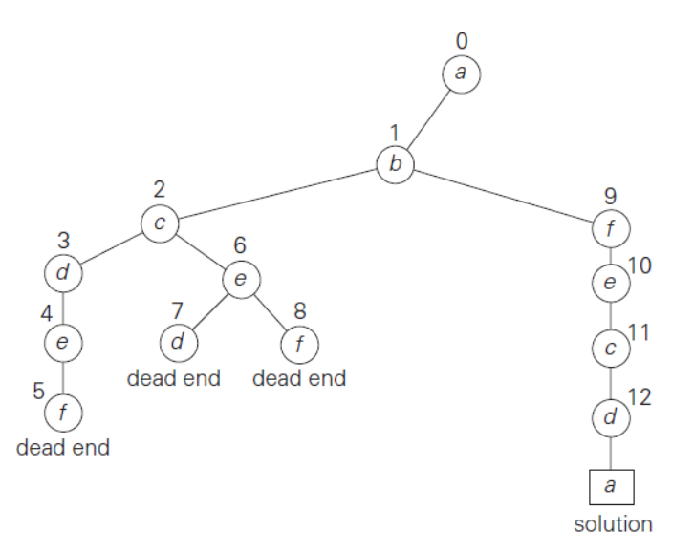

Slide 8
Branch and Bound
Deals with optimization problem
A feasible solution is a point in the problem’s search space that satisfies all the problem’s constraints (e.g., a Hamiltonian circuit in the traveling salesman problem or a subset of items whose total weight does not exceed the knapsack’s capacity in the knapsack problem),
An optimal solution is a feasible solution with the best value of the objective function (e.g., the shortest Hamiltonian circuit or the most valuable subset of items that fit the knapsack).

Slide 9
Branch and bound
Additional two item
A way to provide, for every node of a state-space tree, a bound on the best value of the objective function on any solution that can be obtained by adding further components to the partially constructed solution represented by the node
The value of the best solution seen so far
If this information is available, we can compare a node’s bound value with the value of the best solution seen so far.
If the bound value is not better than the value of the best solution seen so far—i.e., not smaller for a minimization problem and not larger for a maximization problem—the node is nonpromising and can be terminated (some people say the branch is “pruned”)

Slide 10
Indeed, no solution obtained from it can yield a better solution than the one already available. This is the principal idea of the branch-and-bound technique.
we terminate a search path at the current node in a state-space tree of a branch-and-bound algorithm for any one of the following three reasons:
The value of the node’s bound is not better than the value of the best solution seen so far.
The node represents no feasible solutions because the constraints of the problem are already violated.
The subset of feasible solutions represented by the node consists of a single point (and hence no further choices can be made)—in this case, we compare the value of the objective function for this feasible solution with that of the best solution seen so far and update the latter with the former if the new solution is better.

