Slide 1
UMass Lowell Computer Science Prof. Karen Daniels
Computational Geometry
Overview from Cormen, et al.
Chapter 33

Slide 2
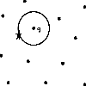
Overview
Line Segment Intersection
Convex Hull Algorithms
Nearest Neighbors/Closest Points

Slide 3
Line Segment Intersections (2D)
Intersection of 2 Line Segments
Intersection of > 2Line Segments

Slide 4
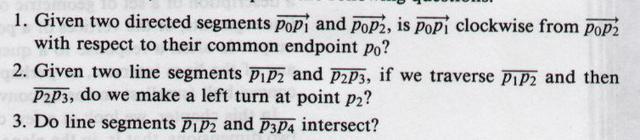
Cross-Product-Based Geometric Primitives
Some fundamental geometric questions:
source: 91.503 textbook Cormen et al.
p₂
p₃
p₃
p₂
p₁
p₂
p₄
p₀
p₁
p₁
(1)
(2)
(3)

Slide 5
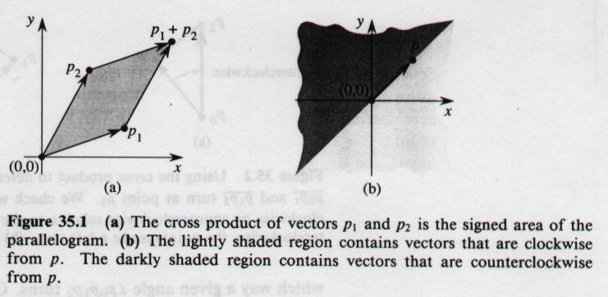
Cross-Product-Based Geometric Primitives: (1)
p₂
33.1
p₁
p₀
(1)
Advantage: less sensitive to accumulated round-off error
source: 91.503 textbook Cormen et al.

Slide 6
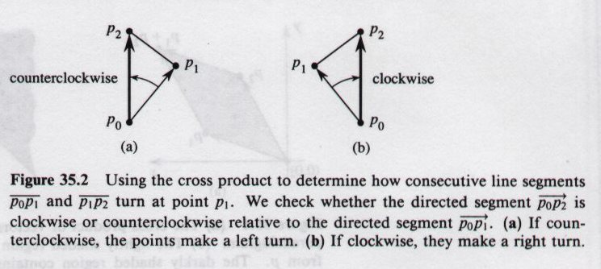
Cross-Product-Based Geometric Primitives: (2)
p₂
p₁
33.2
p₀
(2)
source: 91.503 textbook Cormen et al.

Slide 7
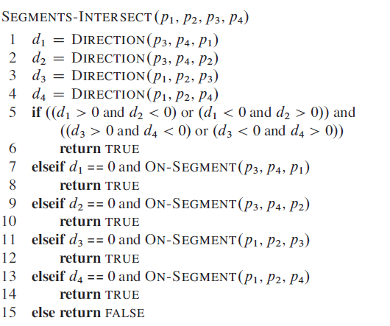
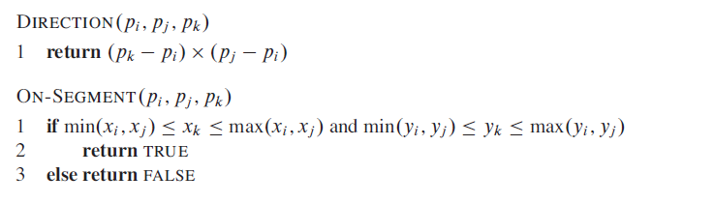
Intersection of 2 Line Segments
p3 and p4 on opposite sides of p1p2
source: 91.503 textbook Cormen et al.

Slide 8
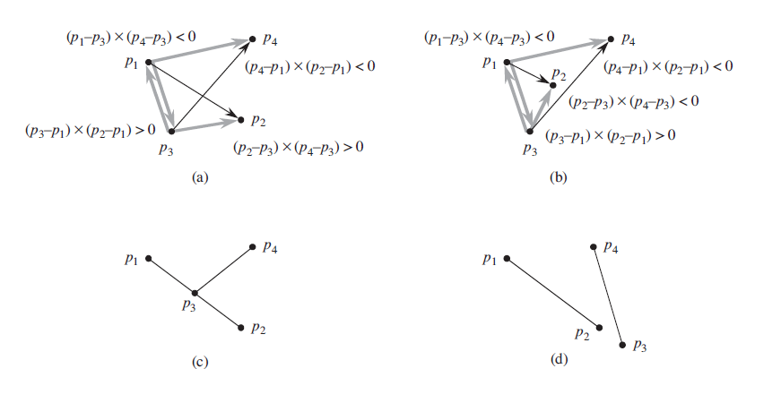
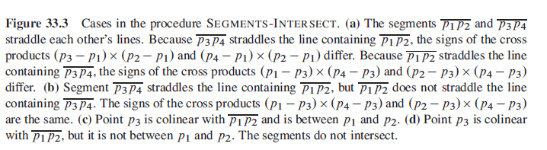
Intersection of 2 Line Segments
p3 and p4 on opposite sides of p1p2
source: 91.503 textbook Cormen et al.

Slide 9
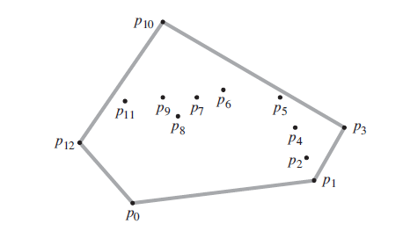
Convex Hull
source: O’Rourke, Computational Geometry in C
The convex hull of a set Q of points, denoted by CH (Q) is the smallest convex polygon P for which each point in Q is either on the boundary of P or in its interior.

Slide 10
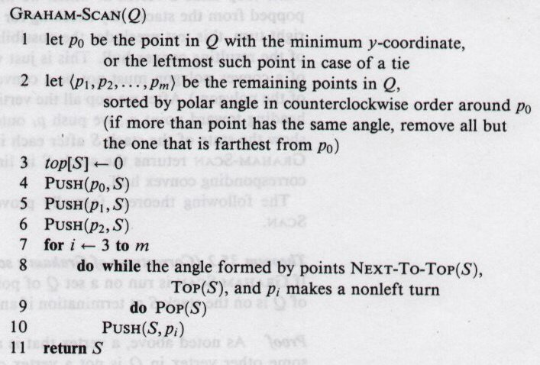
Graham Scan
source: 91.503 textbook Cormen et al.

Slide 11
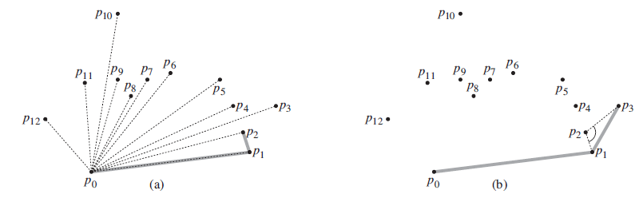
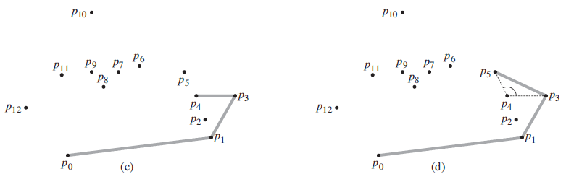
Graham Scan
source: 91.503 textbook Cormen et al.

Slide 12
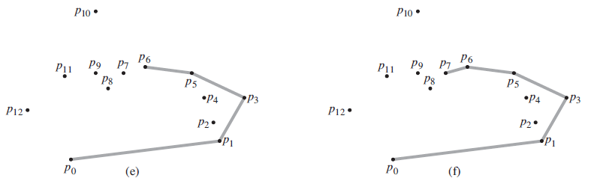
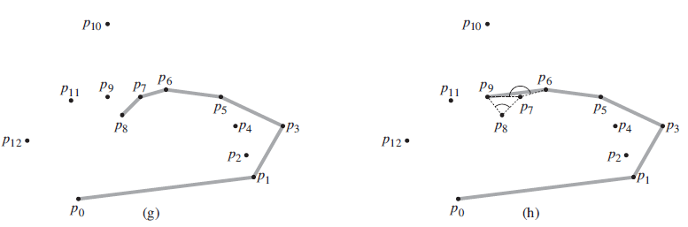
Graham Scan
source: 91.503 textbook Cormen et al.

Slide 13
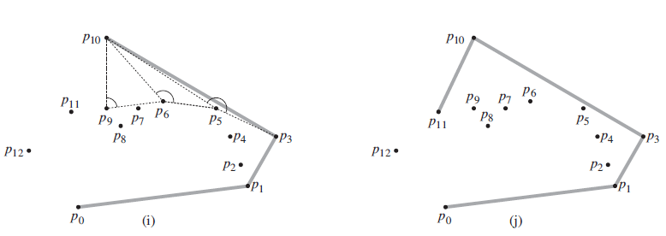
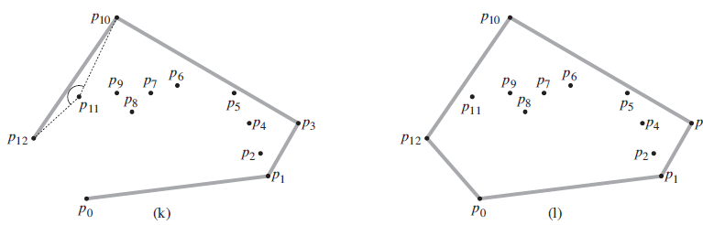
Graham Scan
source: 91.503 textbook Cormen et al.

Slide 14
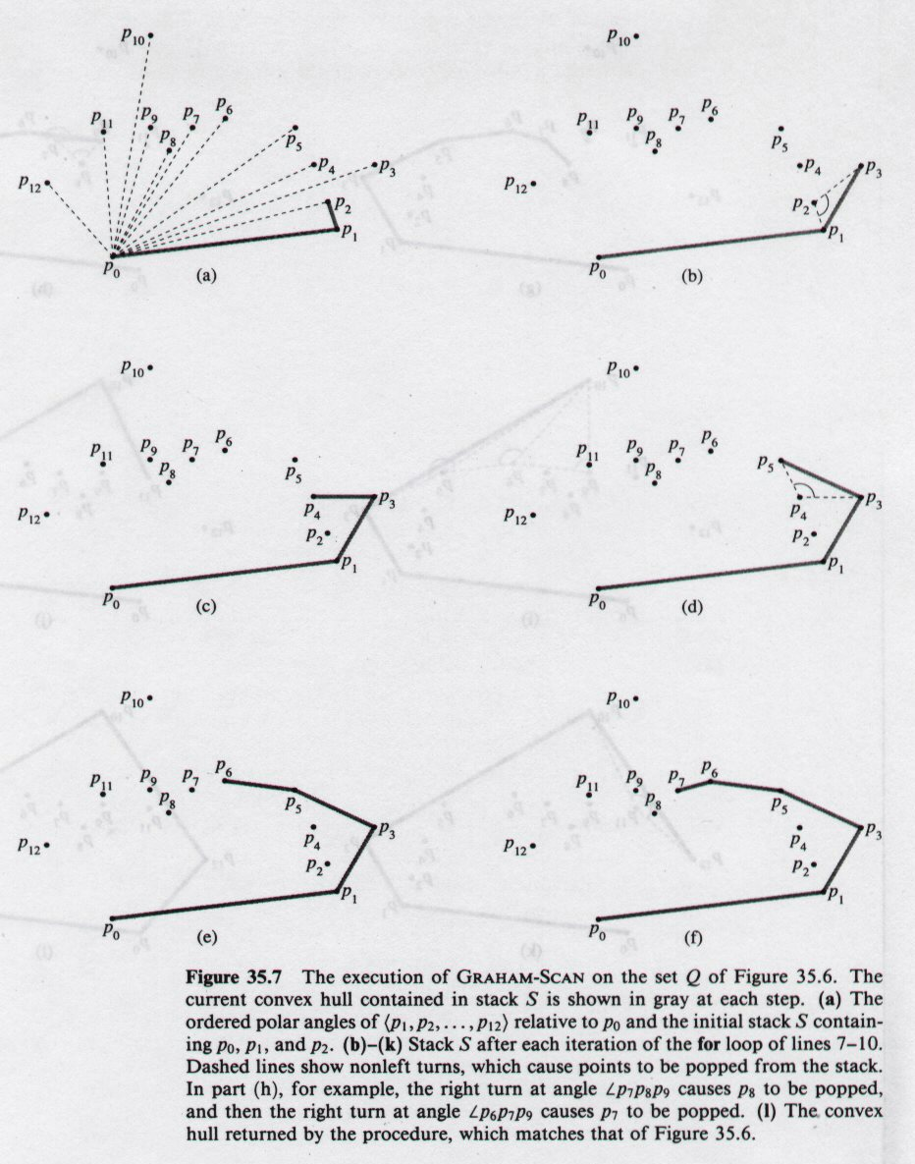
Graham Scan
33.7
source: 91.503 textbook Cormen et al.

Slide 15
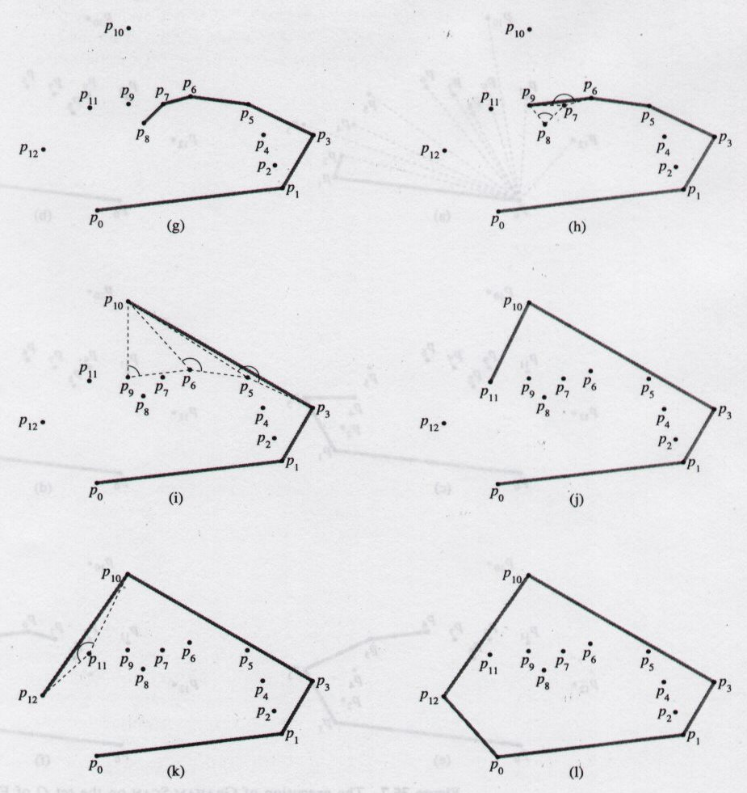
Graham Scan
33.7
source: 91.503 textbook Cormen et al.

Slide 16
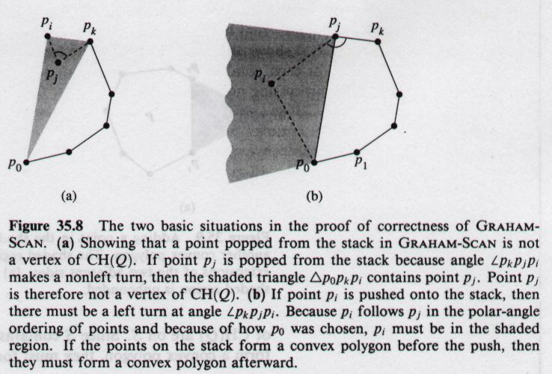
Graham Scan
source: 91.503 textbook Cormen et al.

Slide 17
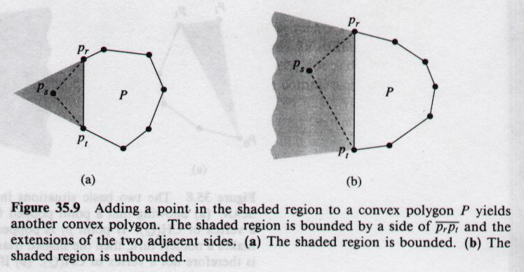
Graham Scan
source: 91.503 textbook Cormen et al.

