Slide 1
Football League Management
Welcome to a system management project

Slide 2
By
Isteak Ahammed Shupto
Roll: 1909006
Dept. of ECE, KUET

Slide 3
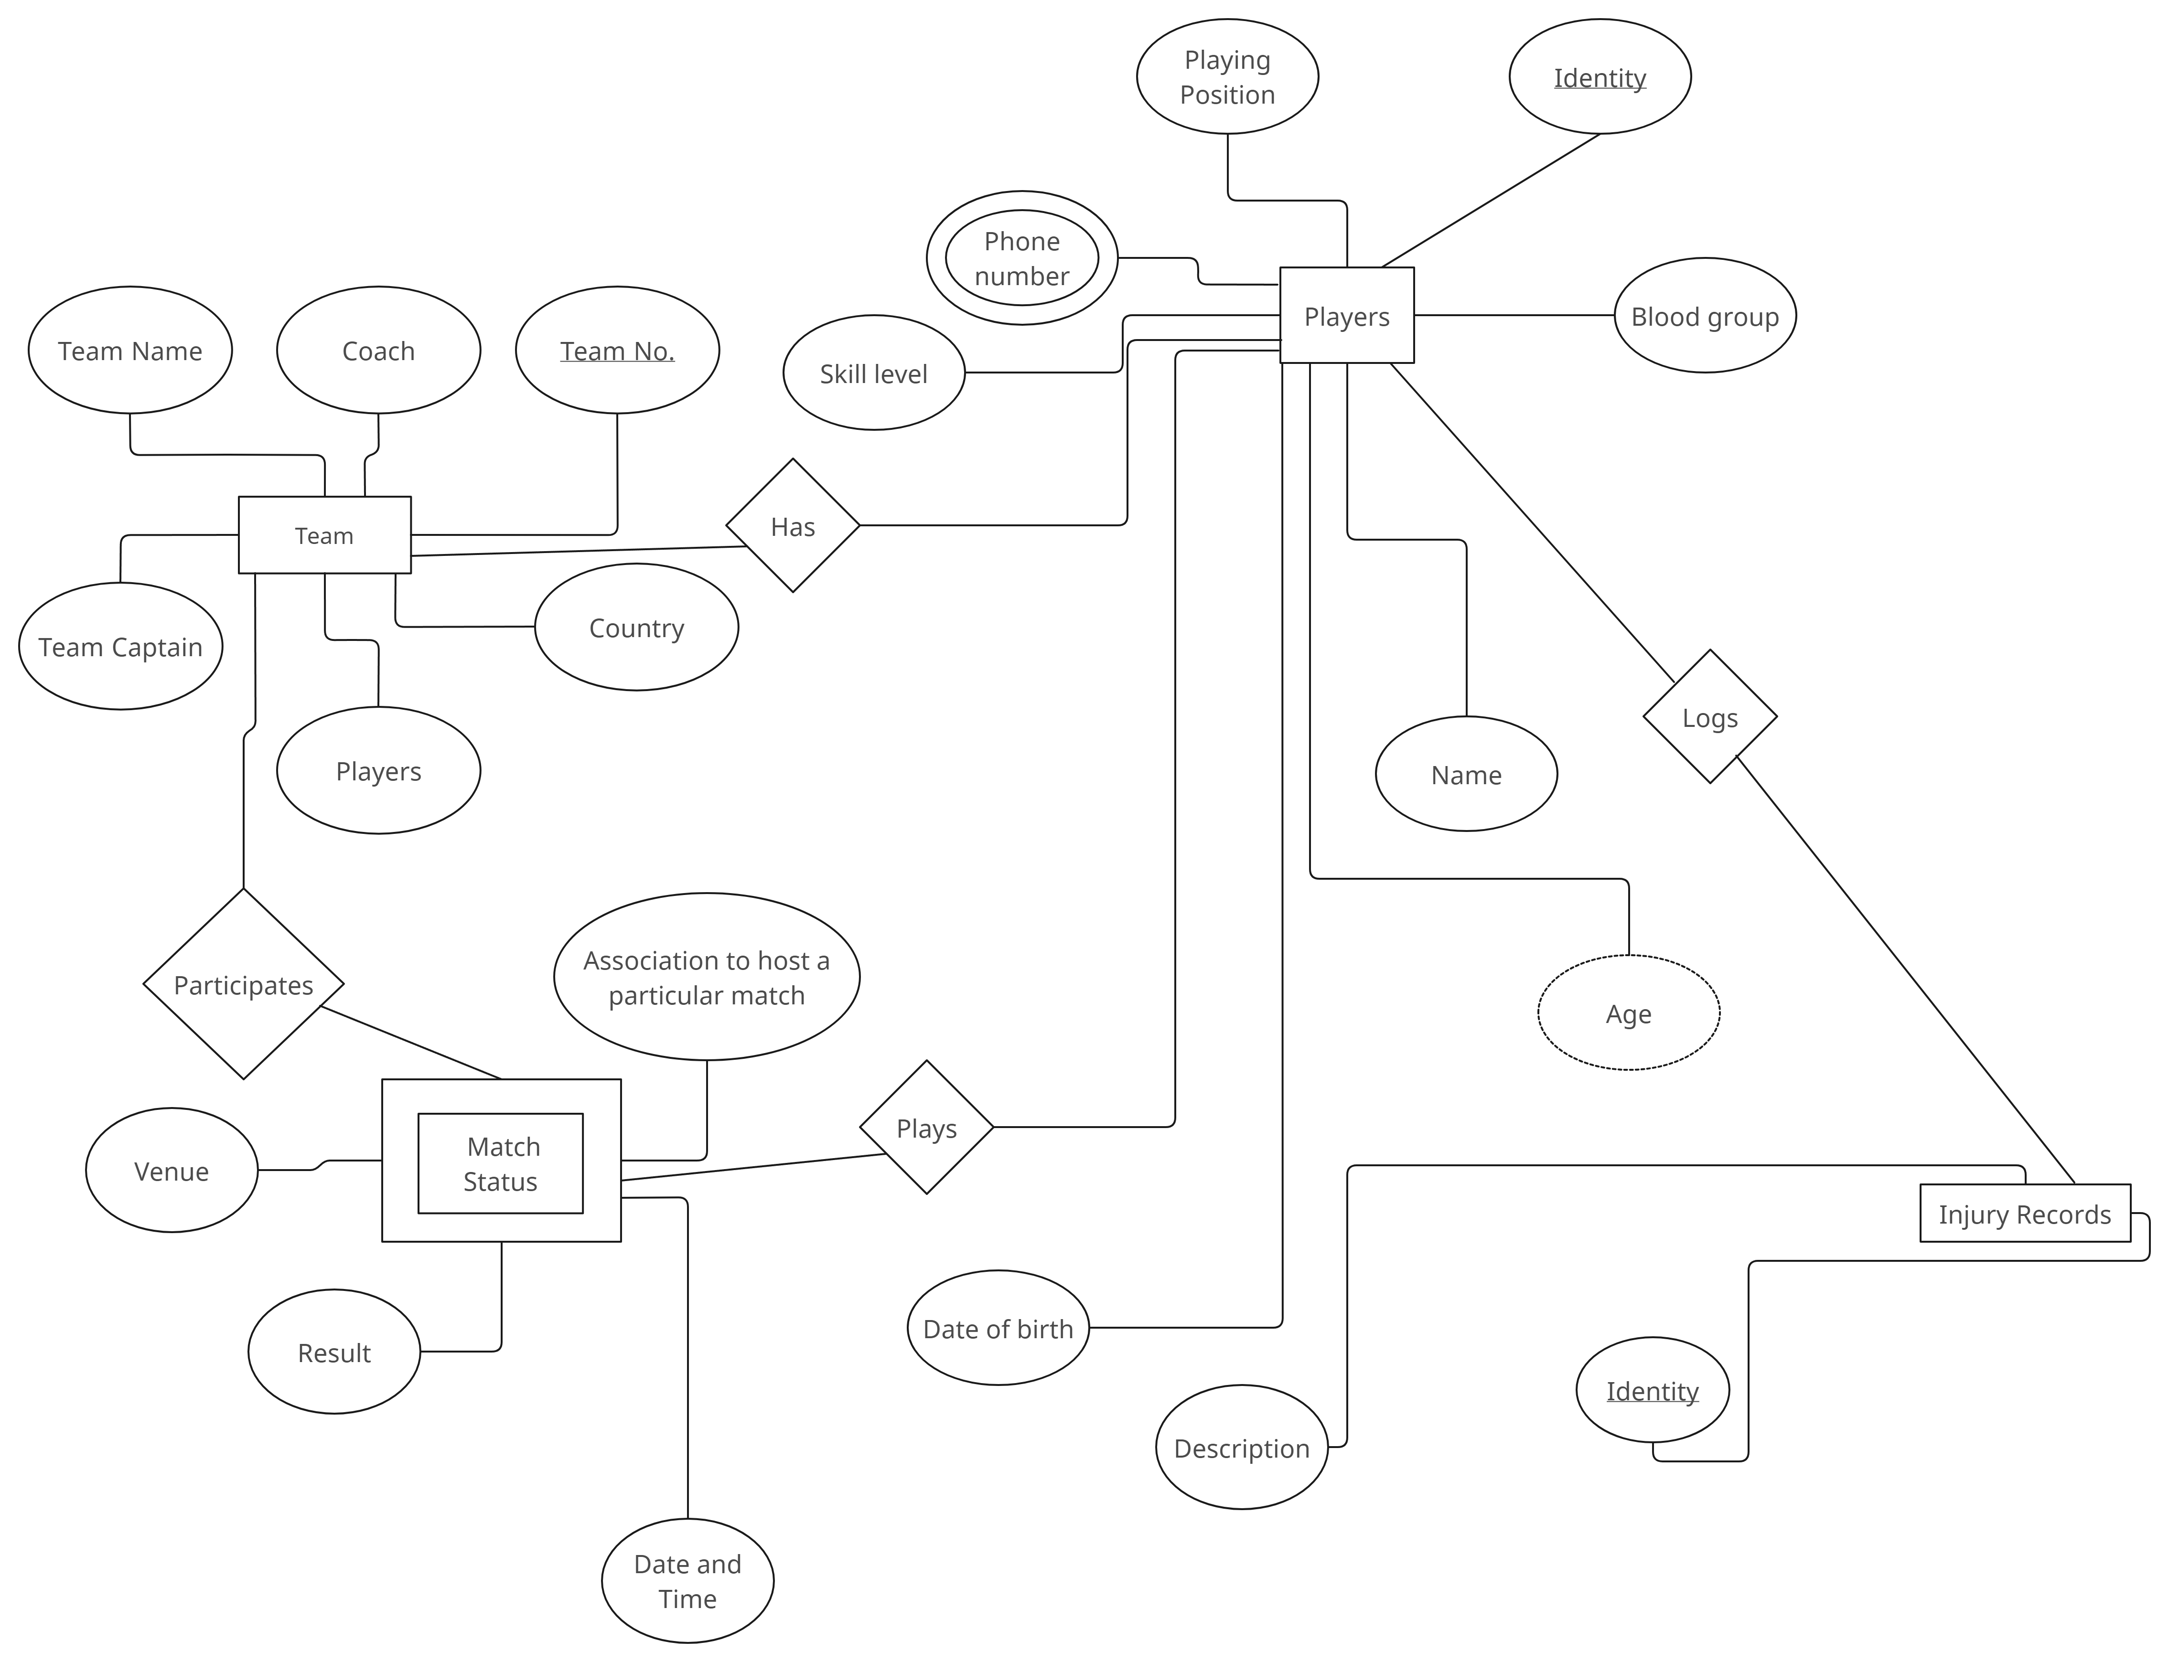
ER DIAGRAM

Slide 4
Tables
01
02
03
Four Tables
Players
Match Status
04
05
Match Status
Injury records

Slide 5
Relationship Sets
01
02
03
Four sets
Participates
Logs
04
05
Plays
Has

Slide 6
Loggedin accounts
 | User | Password
Account1 | system | shupto
Account2 | PROJECT | project

Slide 7
The Tables
01
Manipulating tables with raw datas

Slide 8
Team
 | Name | Coach | Country | players | Captain
1 | FC Barcelona | Xavi | Spain | 25 | Sergio
2 | Real Madrid | Carlo | Spain | 25 | Benzema
3 | Bayern Mun. | Julian | Germany | 25 | Robert
4 | Man City | Pep | England | 25 | Kevin

Slide 9
Players
 | Name | Age | Team no. | Playing position | Blood group
1 | Lionel Messi | 35 | 1 | Forward | A+
2 | Vini Jr. | 21 | 2 | Forward | O-
3 | Erling Haaland | 20 | 4 | Striker | B+
4 | De Bruyne | 33 | 4 | Midfielder | A-

Slide 10
Injury Records
 | Description | Date of injury | Player identity
1 | Hamstring injury | 2023-11-10 | 1
2 | Ankle injury | 2023-11-09 | 2
3 | Knee injury | 2023-11-08 | 2

Slide 11
Match status
 | Association | Venue | Result | Team no. | Player id.
1 | UCL | Camp Nou | 0 - 3 | 1 | 1
2 | La Liga | Barnabéu | 4 - 0 | 2 | 2
3 | Bundesliga | Allianz | 5 - 3 | 3 | -
4 | EPL | Etihad | 0 - 0 | 4 | 4

Slide 12
The Examples
02
Doing queries with the raw table datas

Slide 13
The Query 101
SQL> SELECT players.ID, players.NAME, injury_records.DATE_OF_INJURY, injury_records.DESCRIPTION
2. FROM players
3. INNER JOIN injury_records ON players.ID=injury_records.ID;

Slide 14
The Query 102
SQL> SELECT players.ID, players.NAME, teams.COACH, teams.TEAM_NAME
2. FROM players
3. INNER JOIN teams ON players.TEAM_NO=teams.TEAM_NO;

Slide 15
Thank You
1. We have successfully created tables and manipulated them with raw datas.
2. Got our required output for each table searching in SQL language.

