Slide 1
Prediction Seed Germination Using Machine Learning Models
Performance Comparison

Slide 2
Information of Dataset
Experiments are conducted on the Hyperspectral dataset only.
Explain more about the dataset

Slide 3
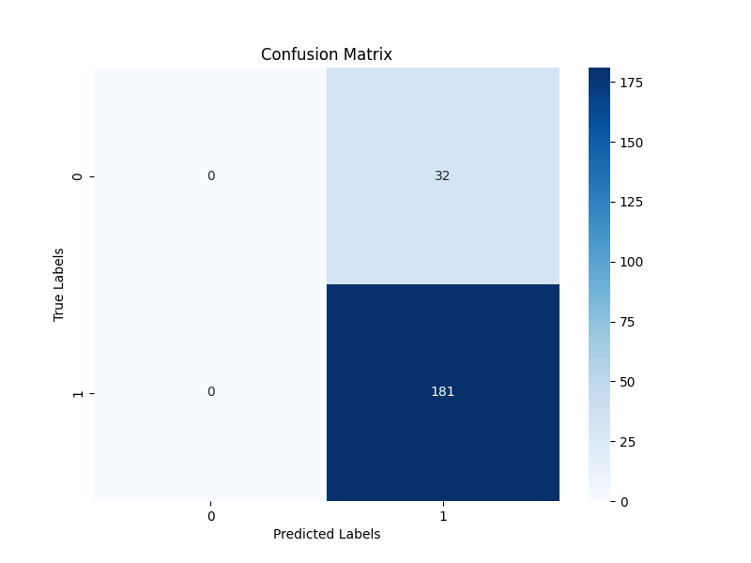
Logistic Regression
Accuracy | 85%
Precision | 85%
Recall | 1.0
F1-Score | 0.9188
Dataset
Data Pre-processing
Split Dataset
Confusion Matrix
Accuracy
Precision
Recall
F1-Score
Logistic Regression
Model Prediction
Performance Evaluation

Slide 4

Random Forest
Accuracy | 84%
Precision | 85%
Recall | 0.9834
F1-Score | 0.9105
Dataset
Data Pre-processing
Split Dataset
Confusion Matrix
Accuracy
Precision
Recall
F1-Score
Random Forest
Model Prediction
Performance Evaluation

Slide 5

Support Vector Machine (SVM)
Accuracy | 85%
Precision | 85%
Recall | 1.0
F1-Score | 0.9188
Dataset
Data Pre-processing
Split Dataset
Confusion Matrix
Accuracy
Precision
Recall
F1-Score
SVM
Model Prediction
Performance Evaluation

Slide 6
Partial Least Squares Discriminant Analysis
Accuracy | 85%
Precision | 85%
Recall | 1.0
F1-Score | 0.9188
Dataset
Data Pre-processing
Split Dataset
Confusion Matrix
Accuracy
Precision
Recall
F1-Score
PLS-DA
Model Prediction
Performance Evaluation

Slide 7

XGBoost
Accuracy | 80%
Precision | 84%
Recall | 0.9503
F1-Score | 0.8935
Dataset
Data Pre-processing
Split Dataset
Confusion Matrix
Accuracy
Precision
Recall
F1-Score
XGBoost
Model Prediction
Performance Evaluation

Slide 8

LightGBM
Accuracy | 81%
Precision | 84%
Recall | 0.9558
F1-Score | 0.8964
Dataset
Data Pre-processing
Split Dataset
Confusion Matrix
Accuracy
Precision
Recall
F1-Score
LightGBM
Model Prediction
Performance Evaluation

Slide 9

Feed Forward Network (FFN)
Labels | 0 | 1
Accuracy | 85%
Precision | 0.67 | 0.85
Recall | 0.06 | 0.99
F1-Score | 0.11 | 0.92
Dataset
Data Pre-processing
Split Dataset
Confusion Matrix
Accuracy
Precision
Recall
F1-Score
FFN
Model Prediction
Performance Evaluation

