Slide 1
Crop pest recognition based on a modified capsule
Author: Shanwer Zhang, Rongzhi jing & Xiaoli Shi

Slide 2
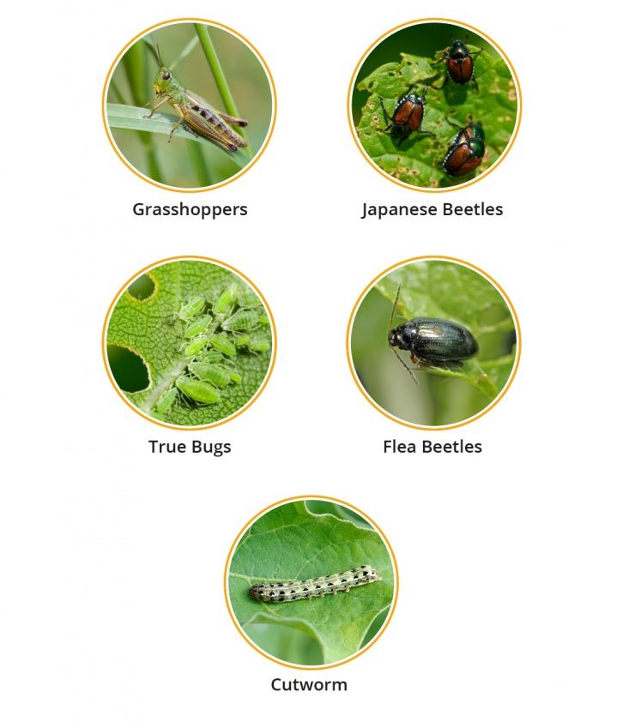
Introduction
Background:
Crop pests impact yield and quality
Conventional methods causes environmental pollution.
Challenges:
Complexities in pest identification in the field
Variability in shapes,color,size and background.

Slide 3
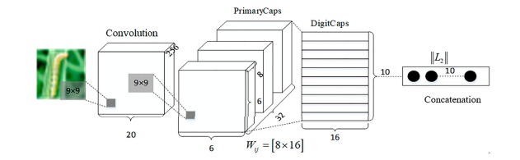
Proposed Method- MCapsNet
Components:
Modified Capsule Network (MCapsNet)
Integration of Capsule Networks and Attention Mechanism
LeakyReLU Activation for Improved Convergence
Objective:
Effective Classification of various field crop insects and protect crops from these harmful insects.

Slide 4
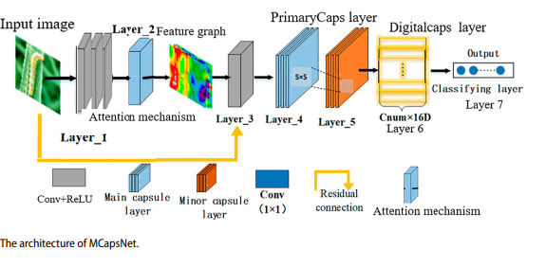
MCapsNet Architecture
Components
Convolutional Layers
Attention Mechanism
LeakyReLU Activation
Capsule Layers
Training Approach
Two-stage training process
Adaptive learning rate using the Ada Algorithm.

Slide 5
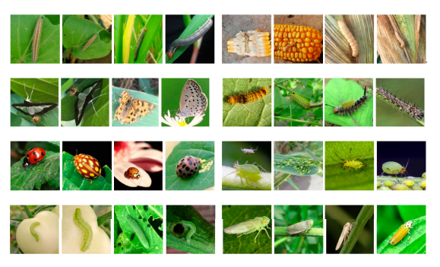
Experiments and Results
Dataset
Images of eight common crop pest
Collection from a natural field environment
Environmental effects

Slide 6
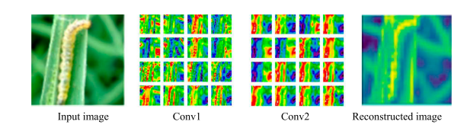
Conclusion
MCapNet Effectiveness in crop pest recognition
Practical Application in agriculture for pest control

Slide 7
Q&A
Thank You !

